Slide 1
IoT based Healthcare Monitoring System using Wireless Body Area Networks
Moossa Hussain
115CS0017
CSE Dept.
Under the guidance of
Dr. Judhistir Mahapatro

Slide 2
Objective
Analysis of RPL (Routing protocol for low power and lossy networks) with low power consumption in Body Area Networks, as it reduces the routing inconsistencies and is able to self- repair the network.
.

Slide 3
Wireless Body Area Network (WBAN)
Body Area Network is formally defined by IEEE 802.15 as [1], “A communication standard optimized for low power devices and operation on, in or around the human body (but not limited to humans) to serve a variety of applications including medical, consumer electronics / personal entertainment and other”.
The problem of WBAN related to routing is Network Topology, Path-loss, Energy Efficiency and reliability. In implanted sensor nodes, the power generated by the node’s circuitry and antenna could cause damage to the tissues. Therefore, in designing a routing protocol for WBANs, it is important to reduce the power.

Slide 4
Real time implementation of implanted sensor node needs the low power consuming protocol.
Routing Protocol for Low Power and Lossy Networks (RPL) is a routing protocol specifically designed for Low power and Lossy Networks (LLN) compliant with the 6LoWPAN protocol.
Goals are to minimize memory requirement, low complexity in routing, data forwarding mechanisms, reduce routing signals, use compact routing algorithm and efficiently discover links and peers.

Slide 5
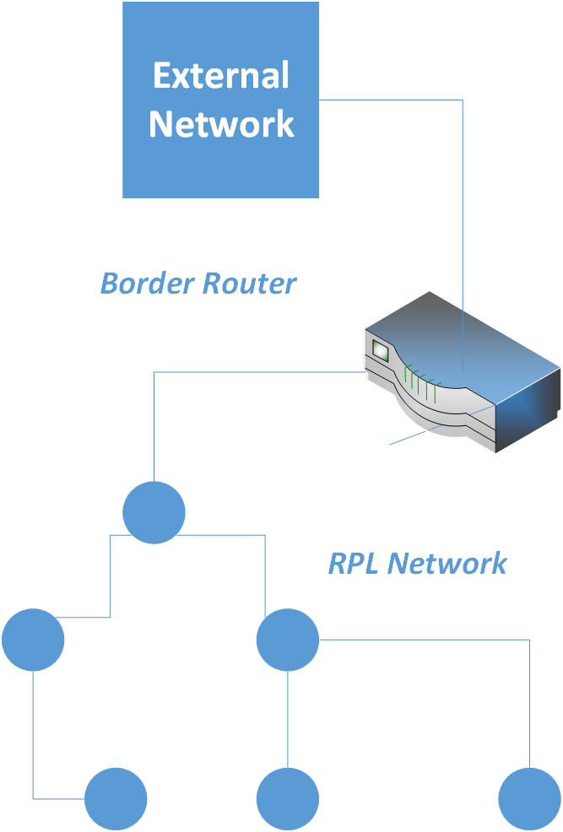
Fig: RPL network Architecture

Slide 6
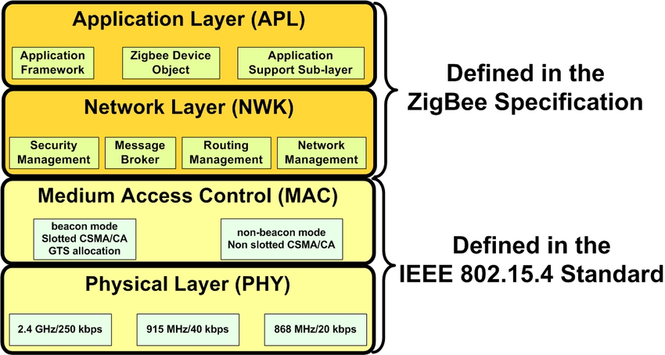
FIG: Zigbee Architecture

Slide 7
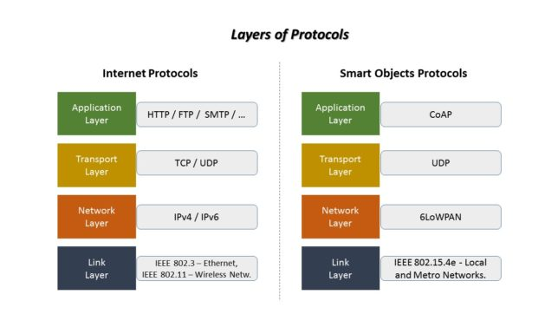

Slide 8
6LoWPAN
IPv6 over low power WPAN (6lowPAN) protocols are suitable technology that can be adapted in wireless sensor network.
The deployment of IPv6 provides a huge address space, which is suitable to address large wireless sensor networks. The outside world that will be interconnecting with 6lowPAN is the IPv6 network where no translational address table is required.
6LoWPAN provides a means of carrying packet data in the form of IPv6 over IEEE 802.15.4 and other networks. It provides end-to-end IPv6 and as such it is able to provide direct connectivity to a huge variety of networks including direct connectivity to the Internet.

Slide 9
RPL Design
RPL is specifically designed for large scale devices. The devices communicating over the networks are made for low power constraints .The goals of RPL are to
Maintain less memory.
Routing Complexities are removed.
Lessen the energy consumption.
Link discovery is done efficiently.
Less Power Consumption

Slide 10
RPL Network
The main functionality of this protocol is to help each node in finding its neighbour nodes and route to their neighbour nodes.
In network topology, there are two types of nodes: Coordinator Node which is referred as RPL Server, and Non-Storing Node which is referred as RPL Client.
RPL Server decides the path, which is termed as Destination Oriented Directed Acyclic Graph (DODAG)

Slide 11
Modified RPL
The Modified Routing Protocol for Low-Power and Lossy Networks builds a Destination Oriented Directed Acyclic Graph (DODAG) using the Objective Function (OF).
The objective functions optimize or constrain the routing metrics that are used to form the routes and hence help in choosing the best route.
The objective function calculates best route based on the network scenario such as traffic density, node distance.

Slide 12
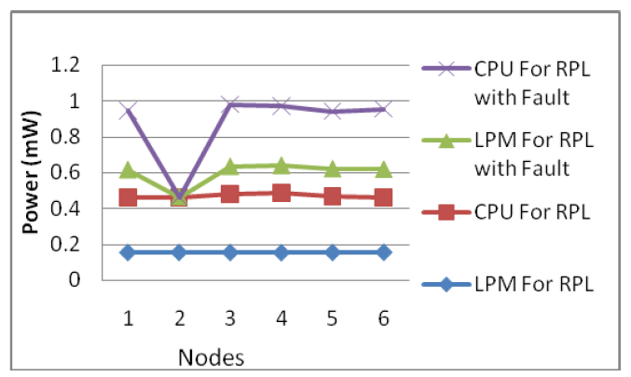
Result
Perfomance Evaluation of LPM and CPU modes of RPL and Faulty node.

Slide 13
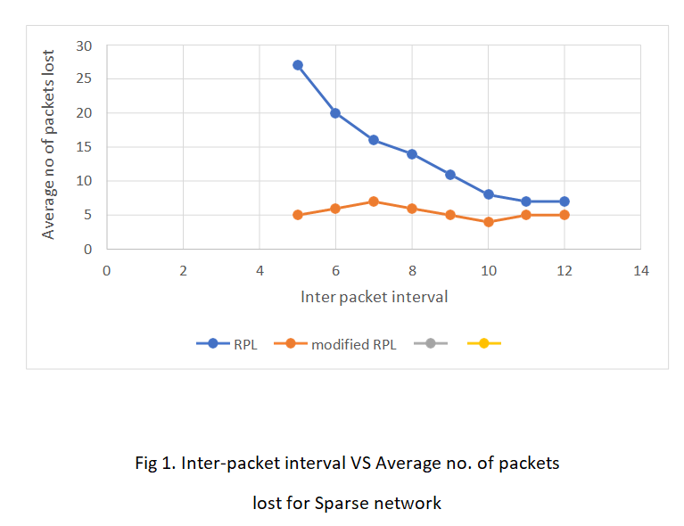
RPL And Modified RPL

Slide 14
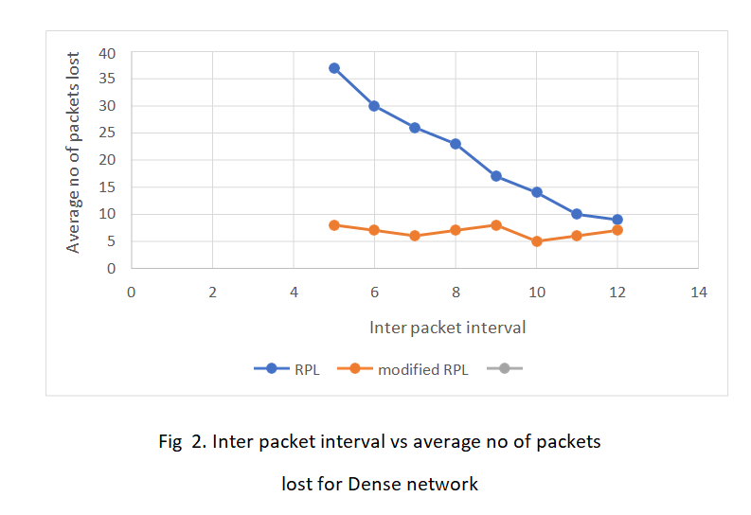

Slide 15
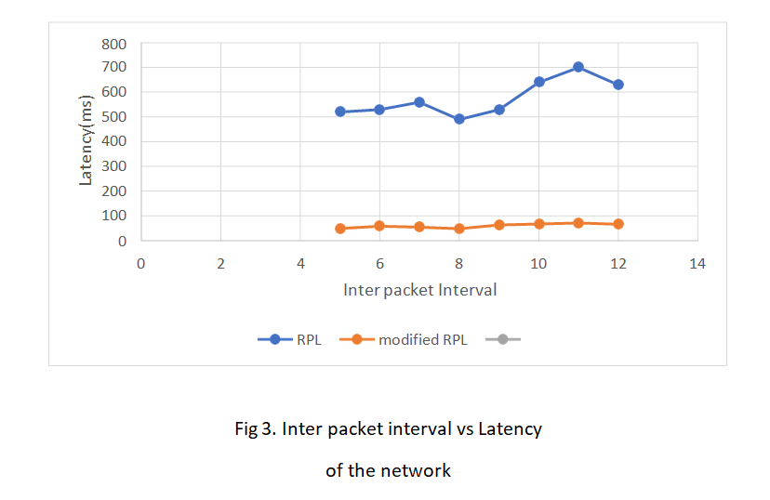

Slide 16
Conclusion
From the simulations, we can observe that modified RPL is stable throughout the simulation time with very less deviations in performance both in sparse and dense network topologies. The number of packets dropped are very less in this modified RPL and so is the latency.

Slide 17
Tools used :
Contiki Operating system
It is an open source operating system for the Internet of Things. It connects tiny low-cost, low-power microcontrollers to the Internet. It is a powerful toolbox for building complex wireless systems.
It is a mini version of unix system.
Cooja Network simulator
Cooja is the Contiki network simulator. It allows large and small networks of Contiki motes to be simulated.
COOJA Network simulator is used to demonstrate the working of motes and RPL in real time simulation.

Slide 18
References
[1] S. Movassaghi,M. Abolhasan,J. Lipman,D. Smith and A. Jamalipour,
”Wireless Body Area Networks: A Survey” in IEEE Communications
Surveys & Tutorials, vol. 16, no. 3,pp. 1658-1686, Third Quarter 2014.
[2]S. Ullah, H. Higgins, B. Braem, B. Latre, C. Blondia, I. Moerman, S. Saleem, Z. Rahman, K. S. Kwak, "A Comprehensive Survey of Wireless Body Area Networks: On PHY MAC and Network Layers Solutions", Journal of Medical Systems IN PRESS.
[3] Tang, Q.; Tummala, N.; Gupta, S.K.; Schwiebert, L. TARA: Thermal-aware Routing Algorithm for Implanted Sensor Networks. In Distributed Computing in Sensor Systems; Springer: BerlinHeidelberg, Germany, 2005
[4]Z. Shelby, "Constrained Application Protocol (CoAP)", IETF Internet draft, Oct. 2011

Slide 19
THANK YOU !

