Slide 1
Telcom Churn Data Mining Assignment
Submitted by GROUP- 246:
Veldur Samantaka Rajkiran, 2020sc04476
Venkatesh S, 2020sc04331
Sumeet Singhal, 2020sc04376

Slide 2
Problem Statement
Problem Statement:
TalkTel is a leading Telecommunication organization. Who’s current concern is people who are leaving the service for a competitor(Churn).
Calculate the following three metrics:
Average revenue per user
Customer Churn
Subscriber growth rate
Telecom Churn Assignment by Group-246
<number>

Slide 3
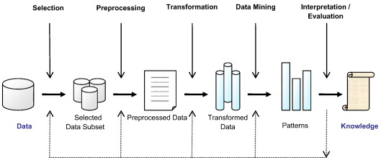
Learning Objectives
Exploratory data analysis
Preprocess the data
Model selection
Train & Test the model
Model performance evaluation
Suggest Model improvements
Telecom Churn Assignment by Group-246
<number>

Slide 4

Data Understanding
The dataset used in this project has 7043 observations with 16 attributes
The class Churn is binomial with labels ‘No’ (~73% of the total data) and ‘Yes’ (~27% of the total data).
Among the other 15 attributes, 5 attributes are categorical, 3 are numeric 6 are binomial and one variable represents unique customer IDs
Contract attribute represents the billing cycle of TalkTel’s customers. Month-to-Month(Monthly payment cycle), Two Year(Bi-annual billing cycle) and One Year(Annual billing cycle)
PaymentMethod attribut represents the mode of payment. There are basically 4 types of payments used by TalkTel customers: Electronic Check, Mailed Check, Bank Transfer(Automatic), Credit Card(Automatic)
InternetService attribute contains type of Internet connection subscribed by the TalkTel customers, DSL, Fiber Optics and ‘No’ which stands for No internet service
StreamingService attribute contains whether the user has subscribed to Streaming service. Values: Yes, No, No internet service
MultipleLines attribute contains the information whether the customer has multiple phone lines. Values: Yes, No, No Phone Lines
Telecom Churn Assignment by Group-246
<number>

Slide 5
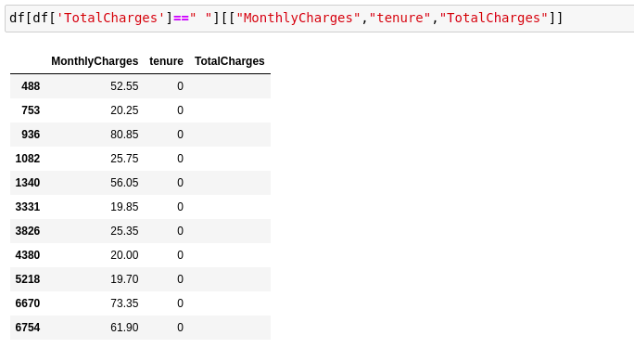
Data Pre-processing
The column “TotalCharges” was string type instead of Float
This was because this column contained empty string(“ “) .
The reason being TotalCharges = MonthlyCharges*Tenure
Where there were empty string(“ “) noticed that Tenure was 0
Hence, deleted these values
Then used pandas function get_dummies() to one-hot encode the categorical attributes
Telecom Churn Assignment by Group-246
<number>

Slide 6
Data Exploration or Mining
Month-to-Month Contract, Fiber Optic Internet Service, Electronic check payment method, Monthly charges, Paperless billing, No Dependents, Senior Citizens, No Partners, Streaming service and Multiple lines are positively correlated
Where as, tenure, two year contract, no internet service, total charges, no paperless billing, one year contract, having dependents, having partners are all negatively correlated
Telecom Churn Assignment by Group-246
<number>

Slide 7
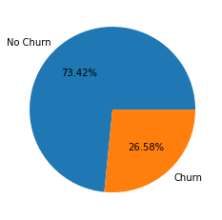
Data Exploration or Mining
We notice that about 73% of the customers are loyal and 27% of customers churn
Telecom Churn Assignment by Group-246
<number>

Slide 8
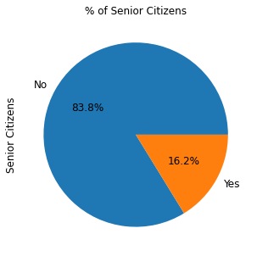
Data Exploration or Mining
We see only ~16% of TalkTel customers are senior citizens so most of TalkTel customers are young
Telecom Churn Assignment by Group-246
<number>

Slide 9
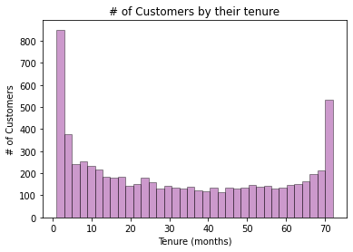
Data Exploration or Mining
From the below plot we notice that more customers left the service within a month and quiet some people have stayed back for ~72 months, these customers are loyal to TalkTel.
<number>

Slide 10
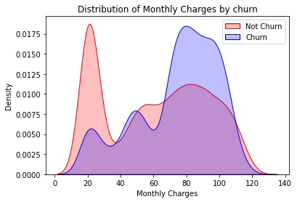
Data Exploration or Mining
From the below plot we can see that Higher % of customers churn when the monthly charges are high
<number>

Slide 11
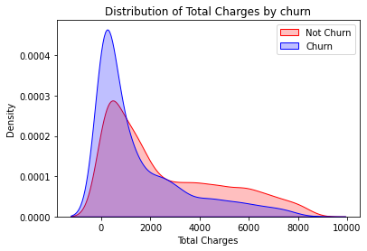
Data Exploration or Mining
There is higher churn when the total charges are lower
<number>

Slide 12
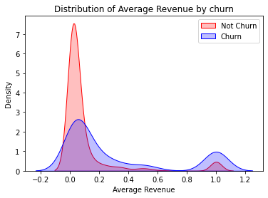
Data Exploration or Mining
We notice that the Average revenue generated by not churn customers is thrice that of customers who churn
<number>

Slide 13
Data Training and Testing Patterns
The data is split into Training and Test set in the following hold pattern
Training data - 80%
Test data - 20%
Telecom Churn Assignment by Group-246
<number>
Notes:
<number>

Slide 14
Model Prediction & Accuracy
Logistic Regression: 0.808
Gradient Boosting Machine: 0.808
Telecom Churn Assignment by Group-246
<number>

Slide 15
Scope of Improvements (Test data, Training patterns & missing value handling)
Improvements in results can be observed & if the data set can compile as:
Presence of more meaningful data, instead of missed-out or junk information (like “ “) might have improved the model accuracy.
Telecom Churn Assignment by Group-246
<number>

