Slide 1
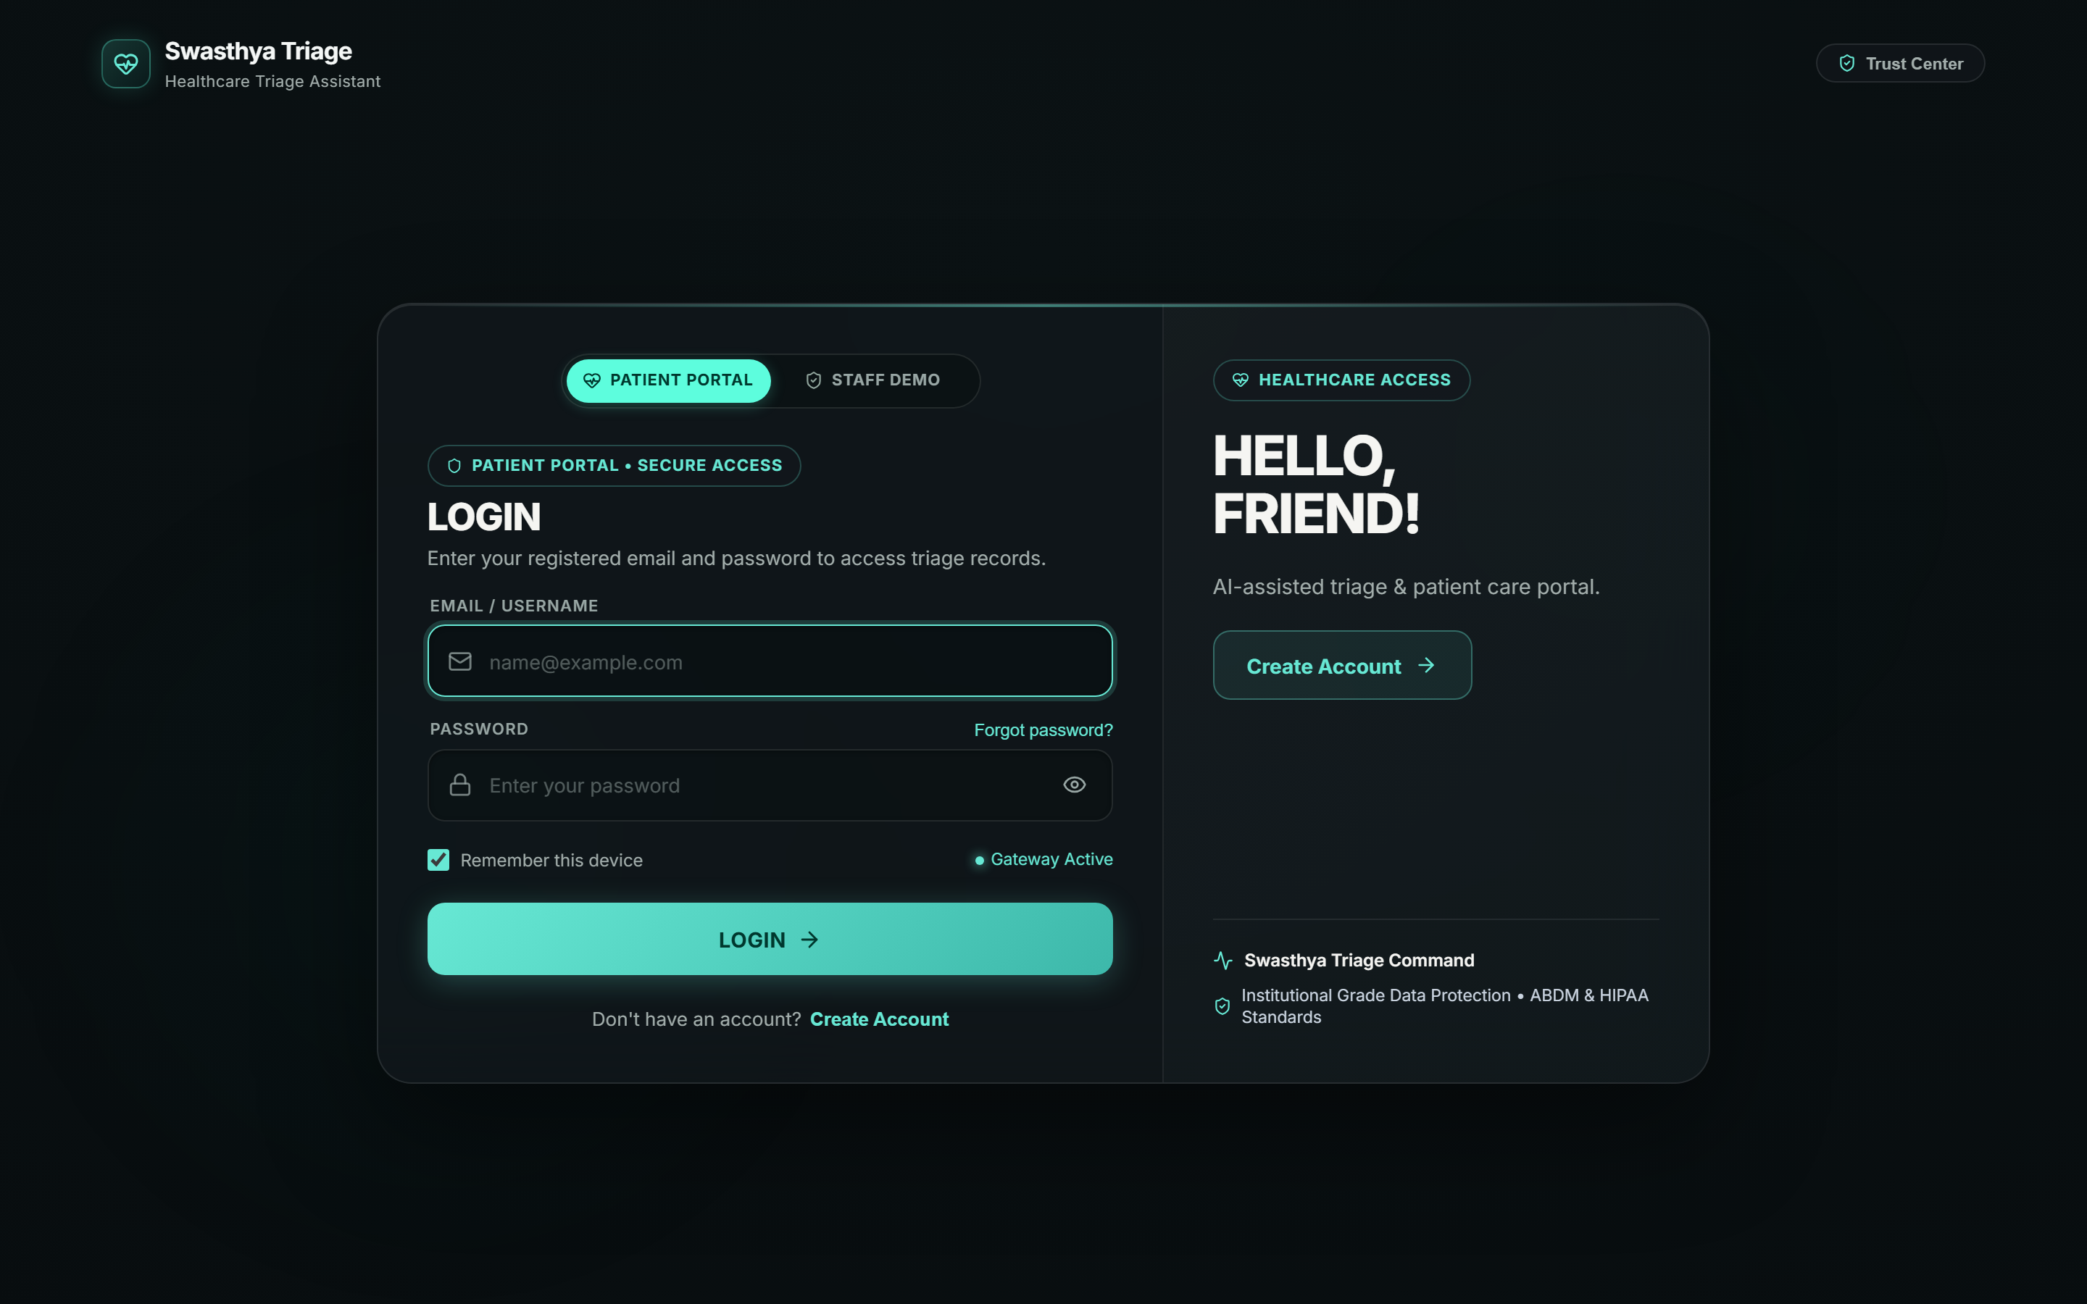
CLINICAL DECISION SUPPORT & MULTIMODAL TRIAGE
SWASTHYA TRIAGE
Clinician-Supervised Multimodal Patient Intake & Safe Triage Assistance
Problem Statement: [ADD LATER]
Problem Statement ID: [ADD LATER]
Team Name: [ADD LATER]
Domain: [ADD LATER]
Tagline: [ADD LATER]
System Architecture: FastAPI + Python + React 19 + AI Safety Pipeline
LIVE PLATFORM • PATIENT & CLINICAL AUTHENTICATION
TECH STACK: React 19 • TypeScript • FastAPI • Python 3.12 • SQLite / PostgreSQL • ReportLab PDF

Slide 2
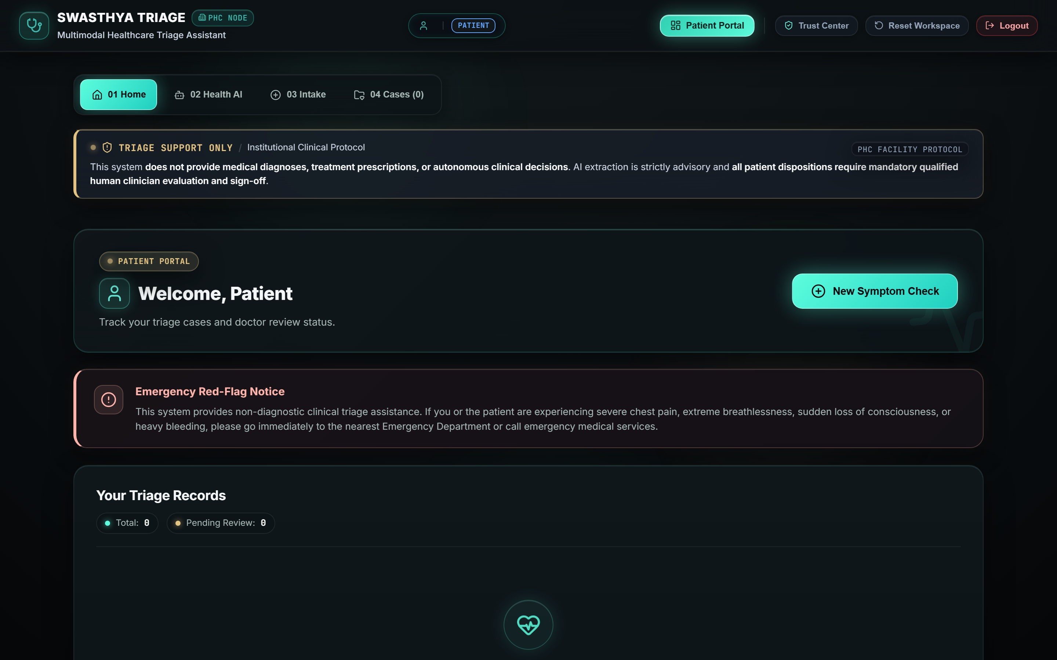
PROBLEM & MOTIVATION
02 / 10
The Problem: Unstructured Triage & Information Overload
1. Unstructured Patient Complaints
Patients present symptoms in colloquial, disorganized narratives across text, speech, and paper reports where critical red-flags are easily obscured.
2. Delayed Urgency Prioritization
Emergency and outpatient queues struggle to rapidly distinguish routine complaints from time-sensitive emergencies prior to formal bedside assessment.
3. Need for Clinician-Supervised AI
Generic chatbots hallucinate and provide unsupervised advice. Clinical environments require non-diagnostic AI with mandatory physician oversight.
TRADITIONAL WORKFLOW:
Patient → Unstructured Info → Manual Interpretation → Delayed Prioritization
SWASTHYA TRIAGE APPROACH:
Patient → Structured Multimodal Intake → AI Safety & Triage → Human Clinical Review

Slide 3
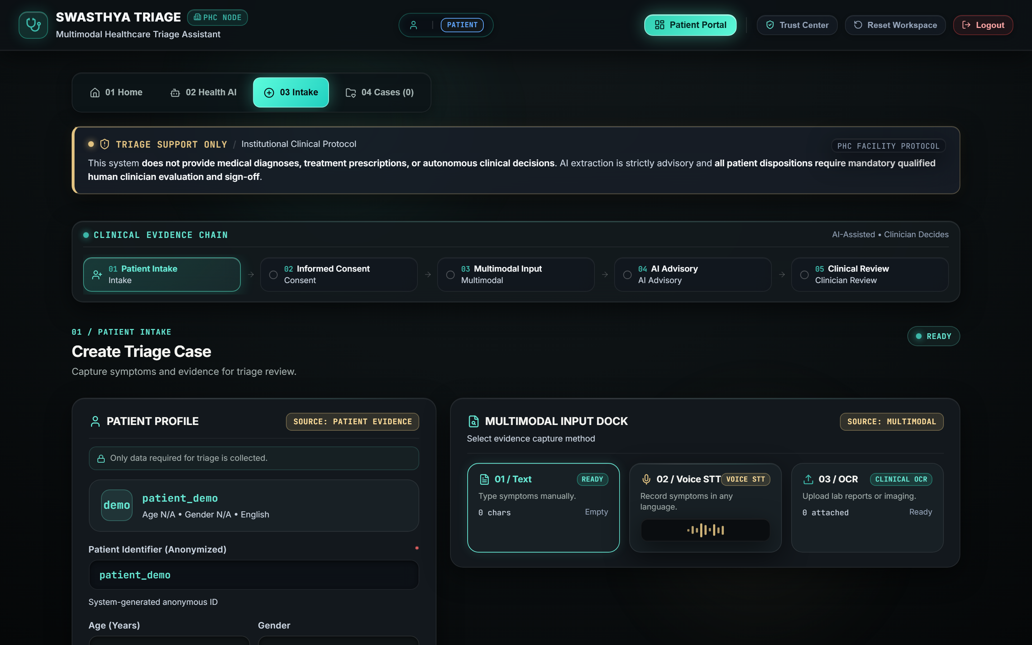
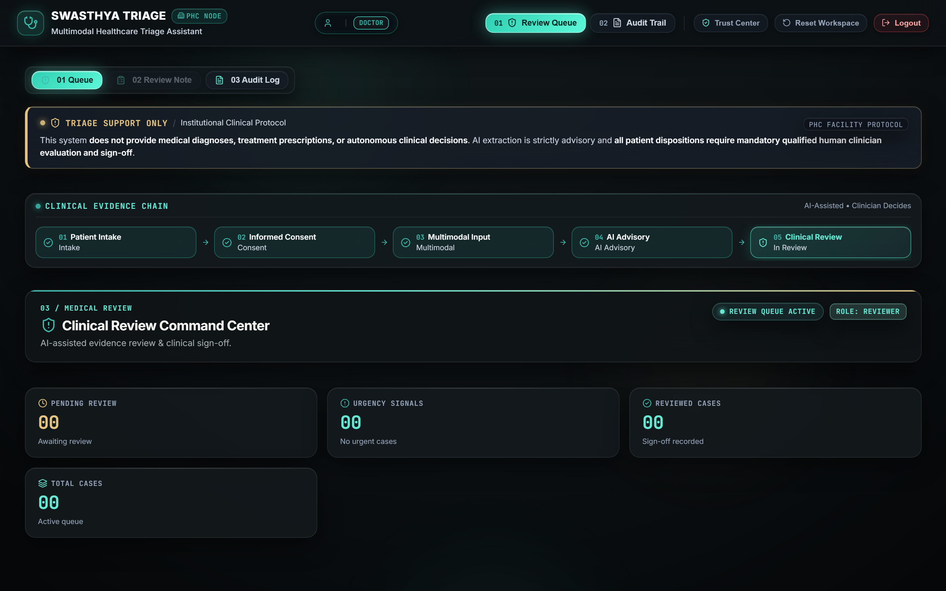
OUR SOLUTION
03 / 10
Introducing Swasthya Triage: 6-Stage Clinical Handoff
CORE PRINCIPLE: "AI assists the workflow. Clinicians make the final decision."
01. Patient Intake
Multimodal input via Text, Voice, or Lab OCR
02. Health AI
Symptom extraction & red-flag evaluation
03. Priority Triage
Urgency signal calculation with evidence
04. Nurse Queue
Prioritized triaging & bedside vitals
05. Reviewer MD
Clinical confirmation, notes, or override
06. Referral & Audit
Instant PDF generation & audit trail
Implemented Core Capabilities:
✔ Patient Self-Intake & JWT Authentication
✔ Conversational Health AI with Safety Guardrails
✔ Deterministic Urgency Rules (Cardiorespiratory, etc.)
✔ Role-Based Access Control (Patient, Nurse, Doctor, Admin)
✔ Nurse Bedside Vitals (Temp, BP, SpO2, Heart Rate)
✔ Doctor Review & Direct Override Protocol
✔ Referral Generation with ReportLab PDF Engine

Slide 4
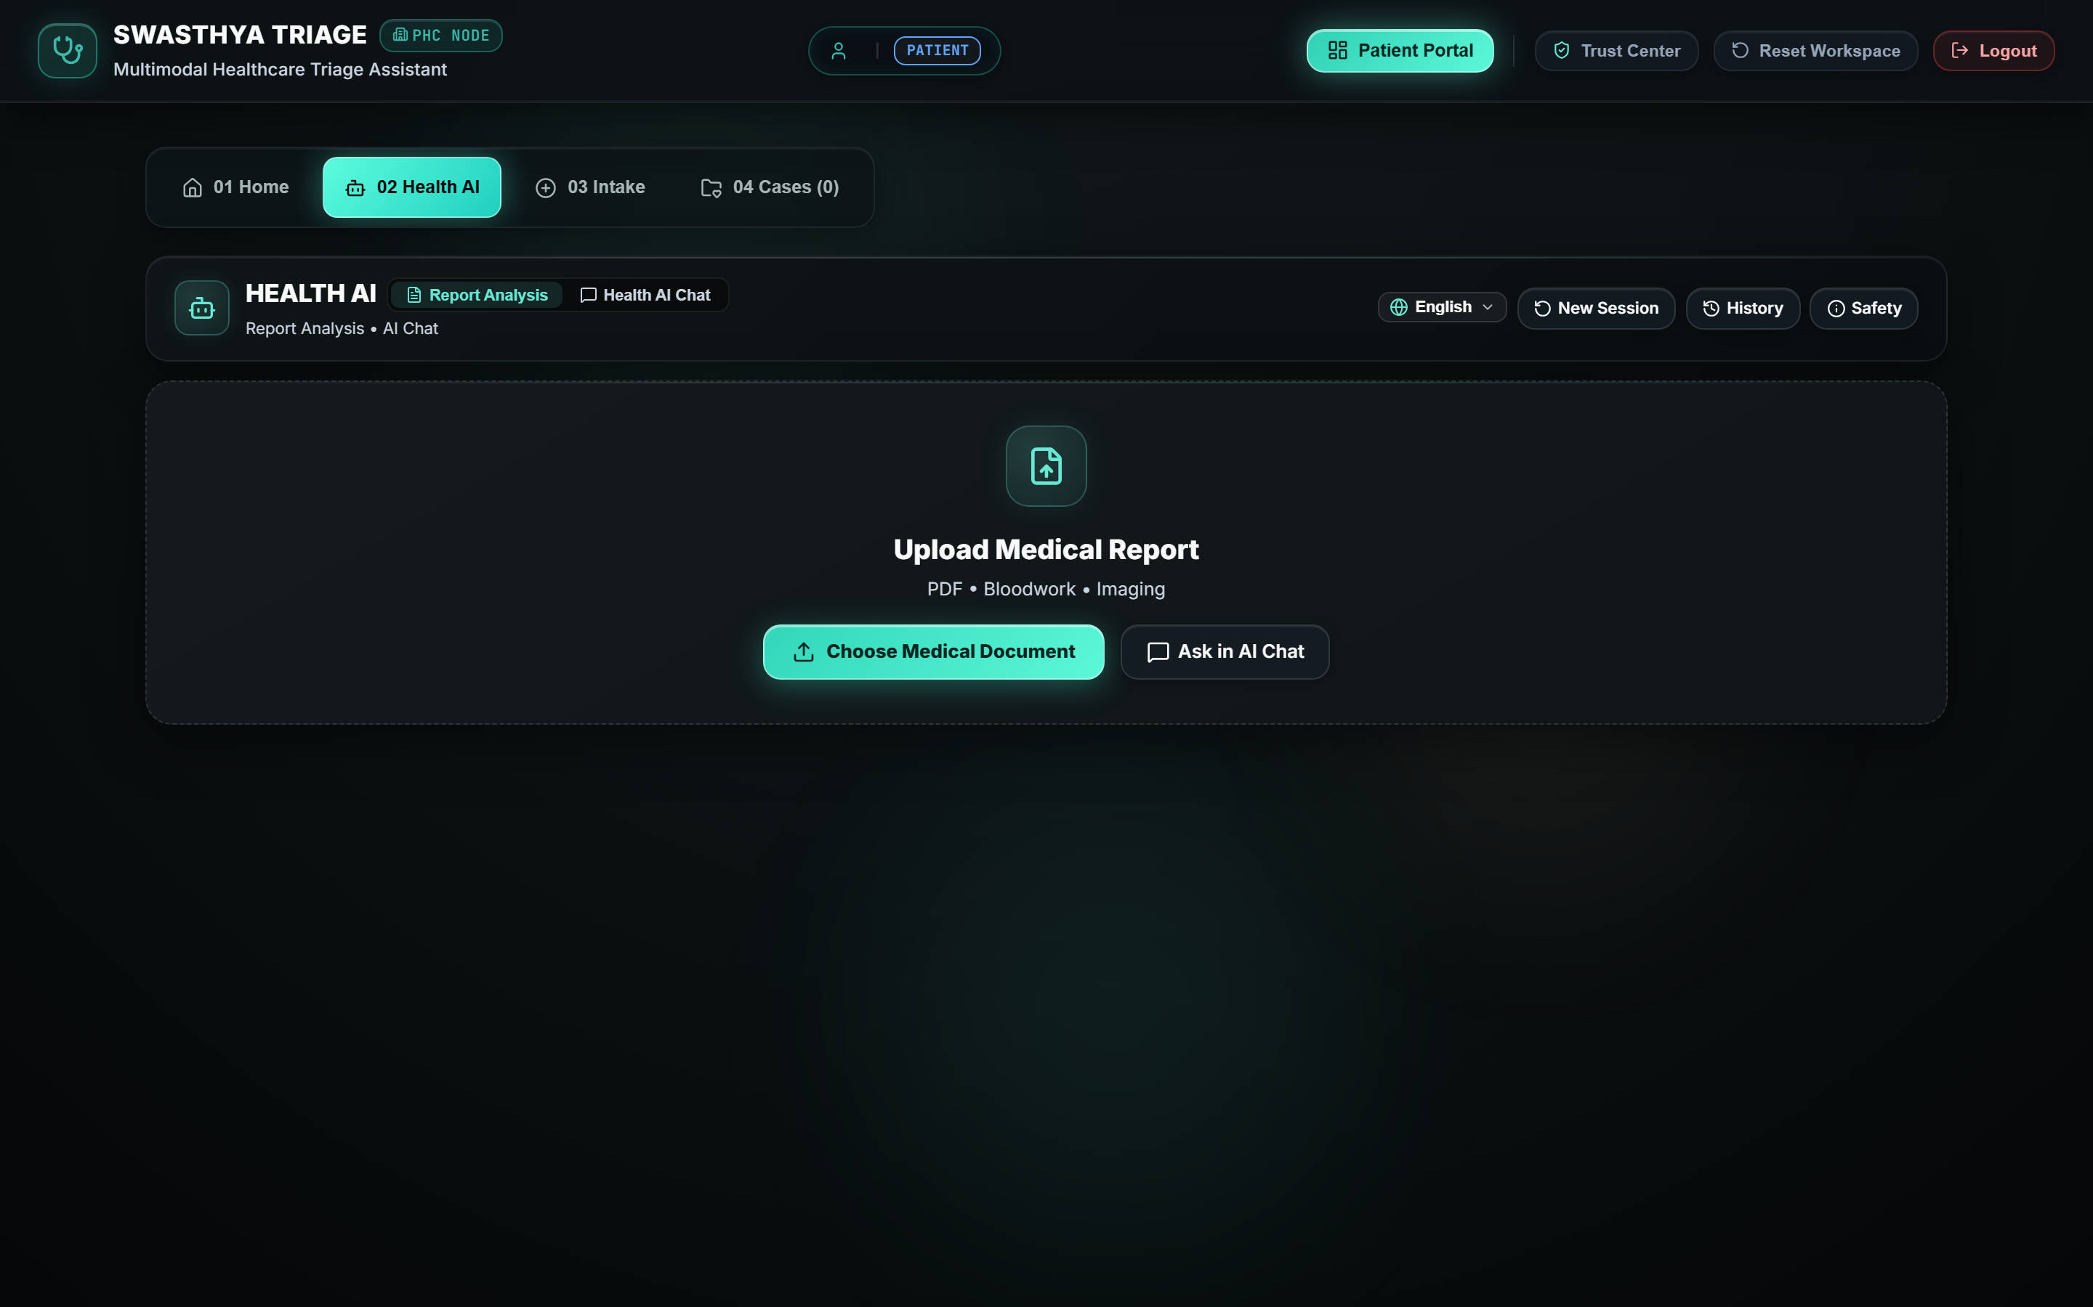
AI & SAFETY ENGINE
04 / 10
Health AI — From Patient Input to Safe Assistance
1. Multimodal Patient Input
Accepts natural language text, voice recording, or uploaded lab reports.
2. Clinical Structuring
Extracts Chief Complaint, Symptoms, Timeline, and Medical History.
3. Safety & Red-Flag Rules
Evaluates deterministic emergency rules (e.g. Cardiorespiratory distress).
4. Triage Prioritization
Computes Urgency Level (Emergency, Urgent, Routine) with evidence citations.
5. Guardrailed Non-Diagnostic Output
Delivers structured summary with mandatory clinician review protocol.
🛡️ NON-DIAGNOSTIC SAFETY GUARANTEE:
"The AI identifies urgency signals and structures information. It does not independently diagnose conditions or prescribe medications."

Slide 5
MULTIMODAL INTAKE
05 / 10
Multimodal & Multilingual Health AI: Unified Context
1. TEXT INTAKE
Natural language text in English/Hindi with timeline & symptom capture.
2. VOICE ASSIST
Speech-to-text audio recording for elderly and accessibility-first patients.
3. MEDICAL OCR
Lab report & prescription upload with OCR extraction of vitals/findings.
4. CLINICAL IMAGES
Visual symptom attachment analyzed alongside patient clinical history.
Text + Voice + Reports + Images ──▶ Input Processing ──▶ Unified Clinical Context ──▶ AI Safety Pipeline ──▶ Patient Response
Supported Multilingual Coverage:
• Core Verified Languages: English, Hindi, Odia
• Multilingual Pipeline Ready: Bengali, Telugu, Tamil, Kannada, Malayalam, Marathi, Gujarati, Punjabi
• Features: Mixed-language intake & automatic language detection
💬 "Language changes — clinical safety does not."

Slide 6
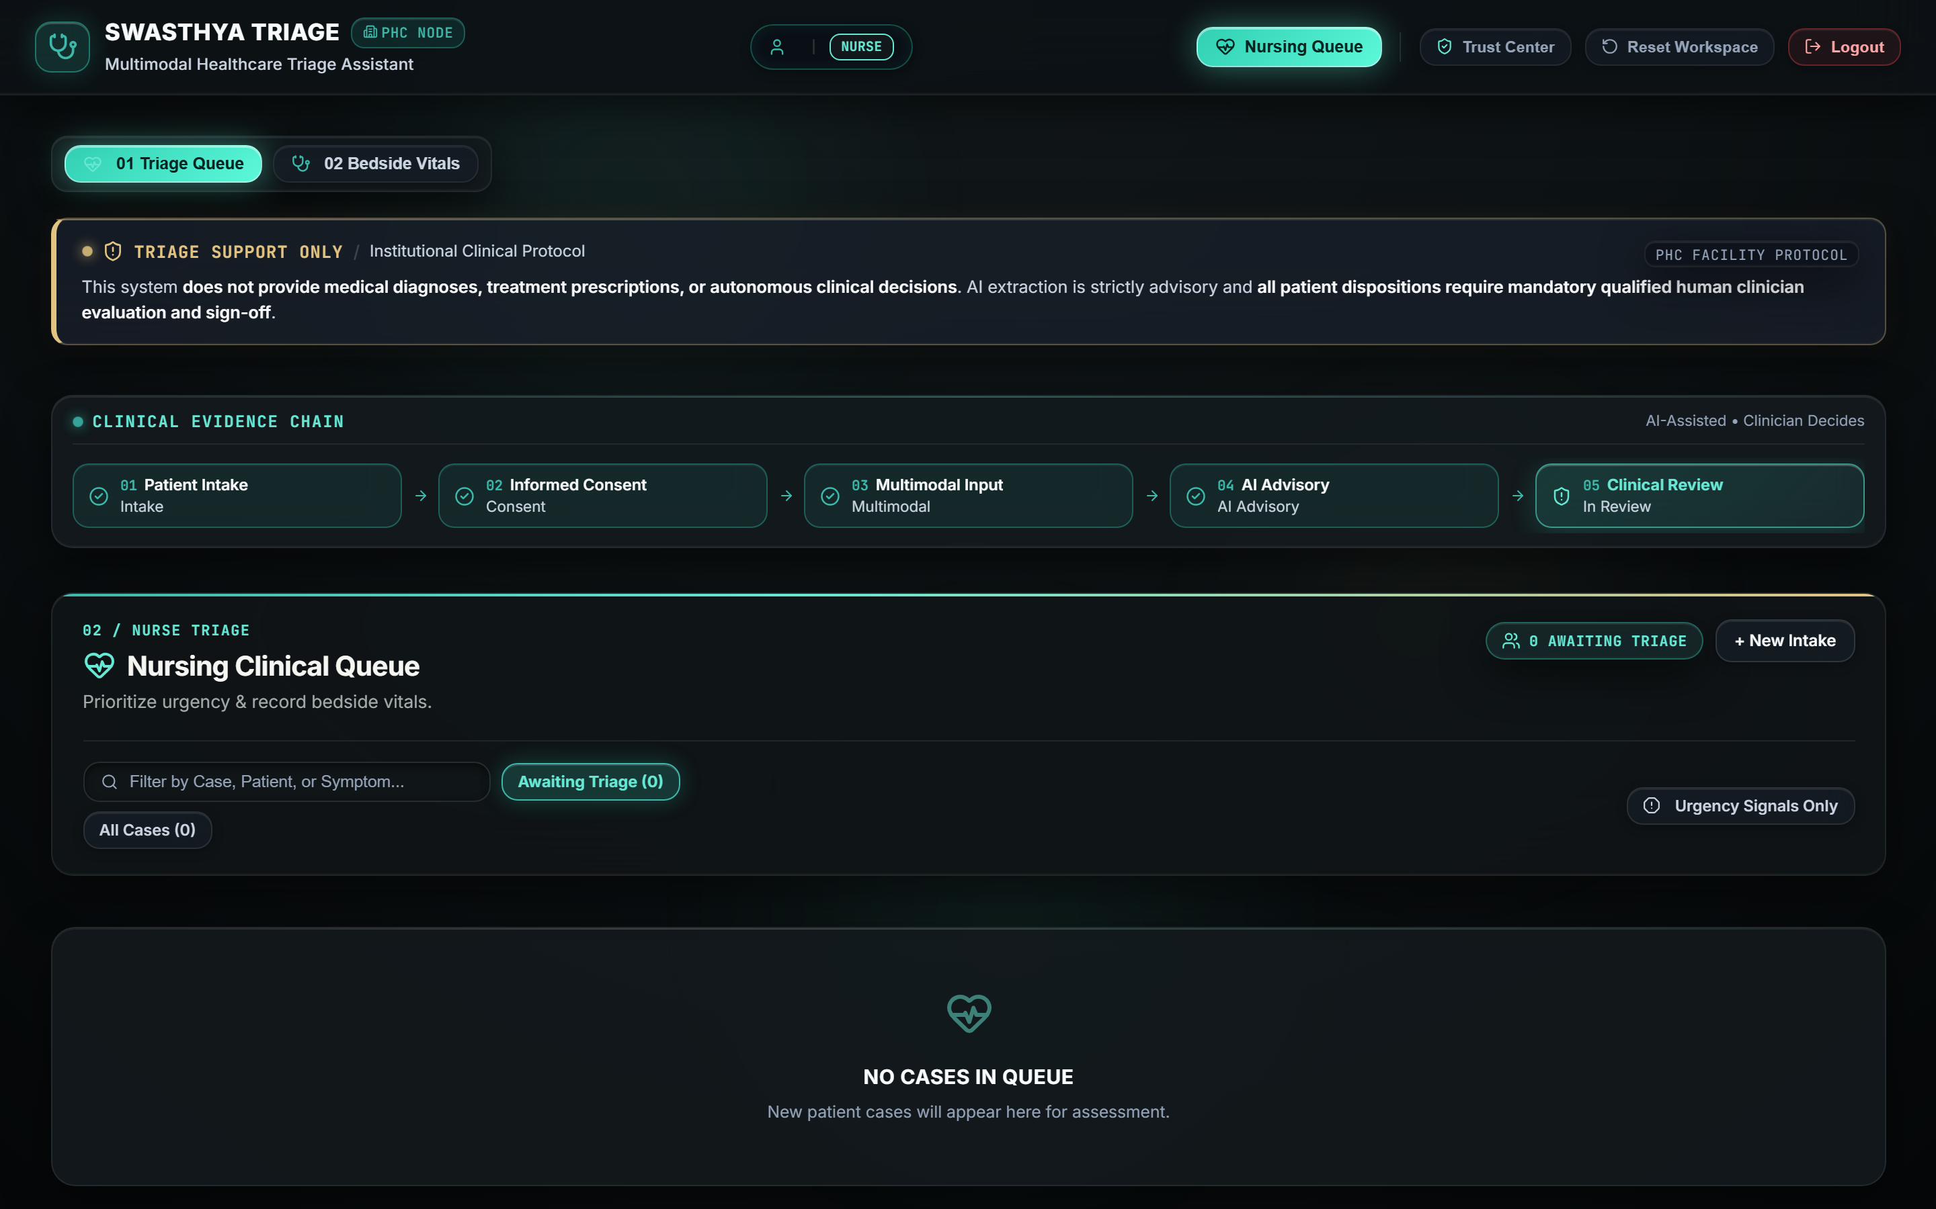
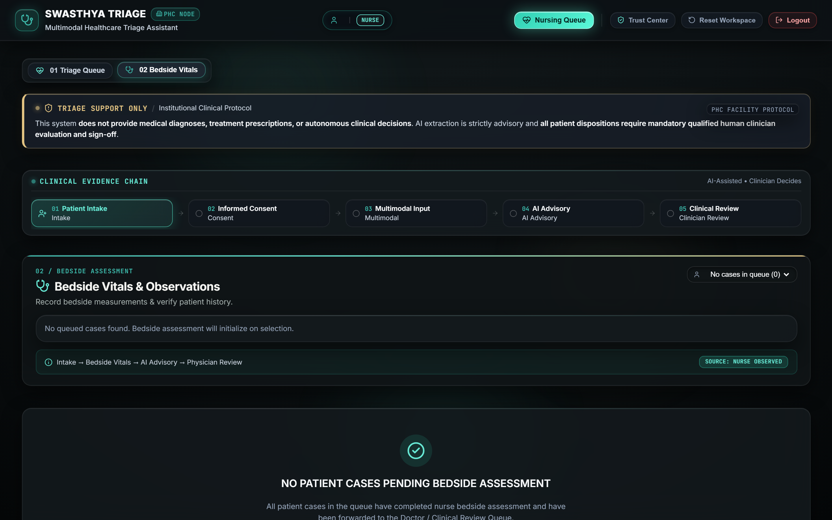
CLINICAL WORKFLOW & RBAC
06 / 10
From Patient Intake to Hospital Clinical Workflow
PATIENT INTAKE
Submits multimodal symptoms & history via secure portal.
AI-ASSISTED TRIAGE
Extracts timeline, matches red-flag rules, computes urgency level.
NURSE QUEUE & BEDSIDE
Nurse reviews prioritized list and records live vitals (BP, SpO2).
MEDICAL REVIEWER (MD)
Physician evaluates evidence, confirms triage, or executes override.
REFERRAL & CARE PATH
Generates institutional referral PDF or schedules direct consult.
AI ROLE: Assists • Structures • Flags • Summarizes
CLINICIAN ROLE: Reviews • Overrides • Prescribes • Decides

Slide 7
TECHNICAL ARCHITECTURE
07 / 10
System Architecture: Robust Full-Stack Engineering
1. FRONTEND LAYER
React 19 + TypeScript + Vite
• Portals: Role-based routing for Patient, Nurse, Doctor, Admin
• UI Design: Glassmorphic clinical command tokens & scroll reveals
• Live Views: Real-time prioritized triage queue & bedside entry
2. BACKEND API
FastAPI + Python 3.12 (Async)
• Endpoints: RESTful APIs with strict Pydantic schema validation
• Security: JWT token authentication (HS256) & BCrypt hashing
• PDF Output: Binary ReportLab referral letter generation
3. AI & SAFETY ENGINE
Provider Abstraction Layer
• LLM Core: Structured extraction of symptoms & timeline
• Safety Rules: Hardcoded deterministic emergency red-flag engine
• Fallback: Zero-cloud offline deterministic fallback pipeline
4. DATABASE & AUDIT
SQLite / PostgreSQL Ready
• ORM Layer: Async SQLAlchemy with full relational model
• Clinical Store: Persistent cases, consents, reviews, and vitals
• Audit Trail: Immutable audit log ensuring total provenance
COMPLETE SYSTEM DATA FLOW:
Patient / Staff Browser ──▶ React Frontend ──▶ FastAPI Endpoints ──▶ AI Safety Pipeline ──▶ SQLite / PostgreSQL ──▶ Immutable Audit Trail

Slide 8
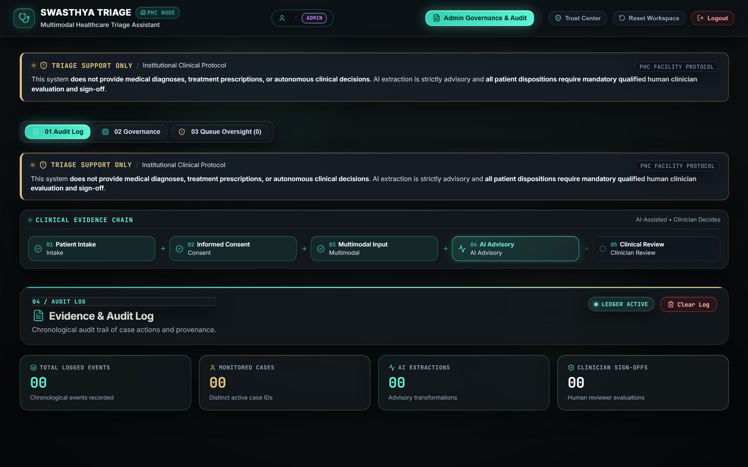
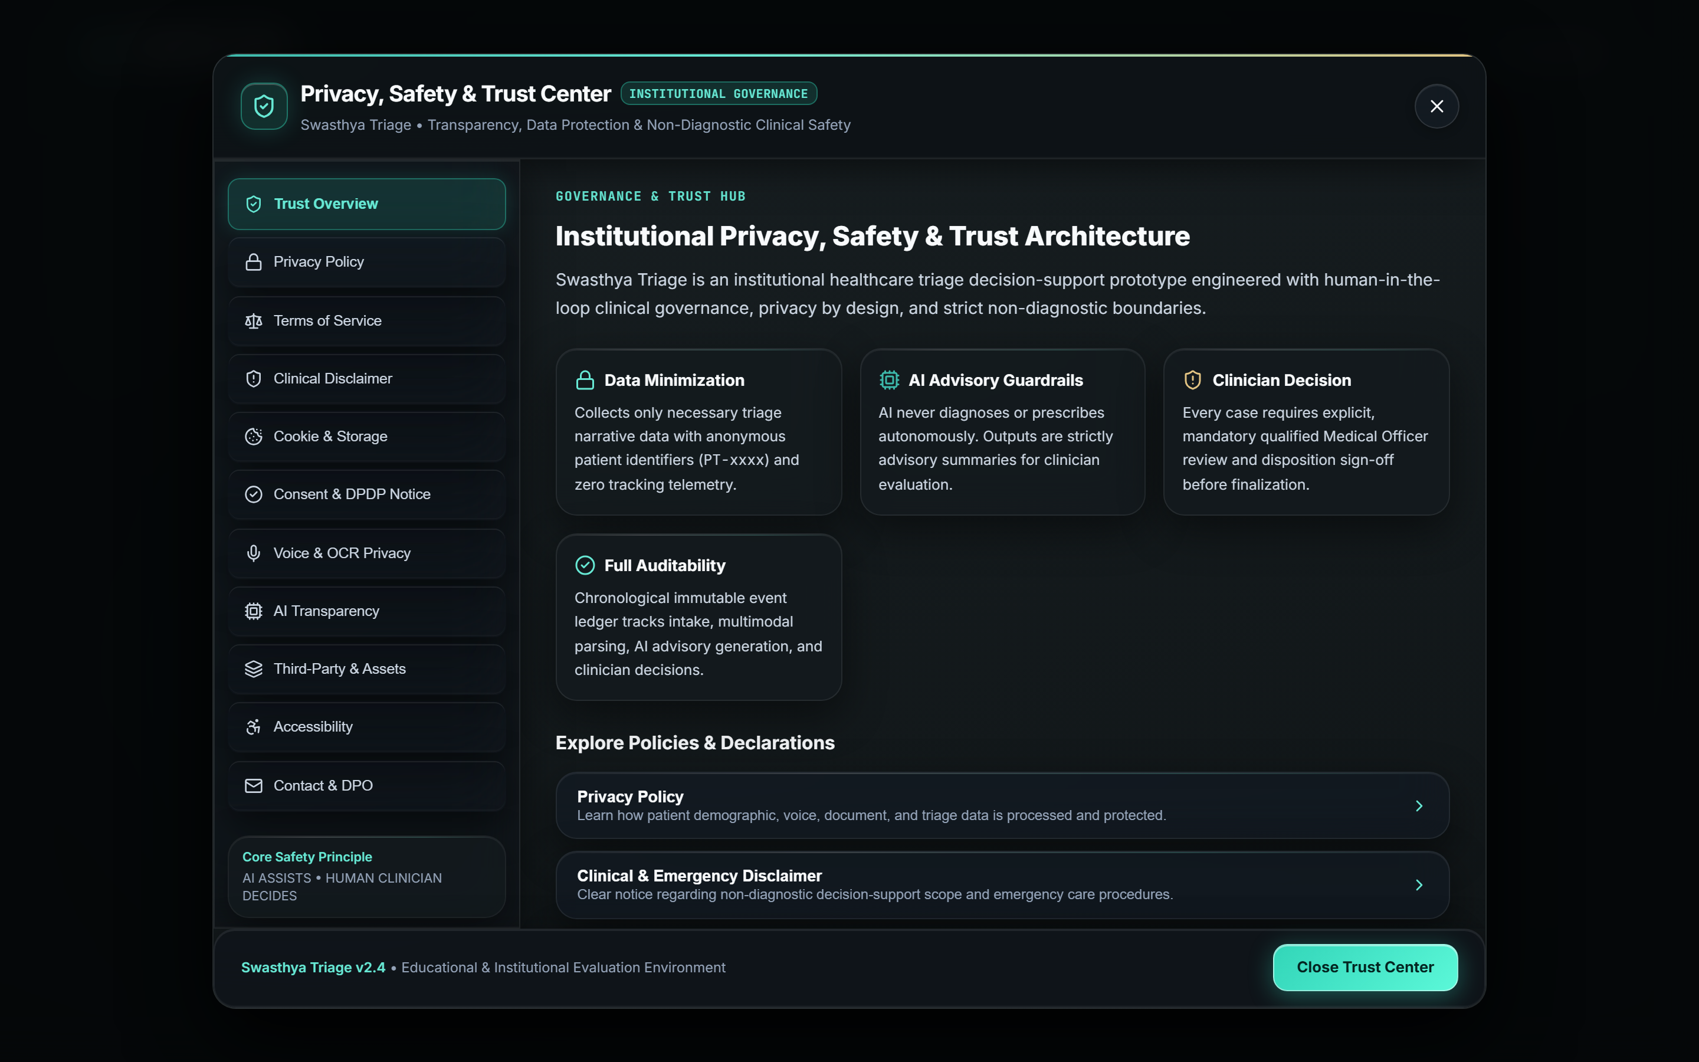
SAFETY & GOVERNANCE
08 / 10
Safety by Design: Human Oversight & Provenance
1. Clinician Supervision & Override
Physicians retain complete clinical authority to confirm, modify, or override AI triage suggestions with mandatory clinical rationale notes.
2. Deterministic Red-Flag Rules
Hardcoded medical safety rules immediately intercept acute cardiorespiratory and critical red flags, bypassing generic conversational delays.
3. Role-Based Access & Auditability
Strict JWT-based RBAC partitions Patient self-intake from Nurse and Doctor workflows. All events are recorded in an immutable audit trail.
CORE SAFETY PRINCIPLE:
"AI recommendations remain advisory; clinical decisions remain with qualified healthcare professionals."

Slide 9
IMPACT & ROADMAP
09 / 10
Validation, Expected Impact & Project Roadmap
SECTION 1 — EXPECTED IMPACT
✔ Faster Patient Structuring: Rapidly organizes unstructured complaints into clinical timelines.
✔ Early Red-Flag Detection: Prioritizes cardiorespiratory emergencies before triage bottlenecks.
✔ Multimodal Flexibility: Accommodates text, voice, and medical lab reports.
✔ Seamless Clinical Handoff: Smooth data flow across Patient, Nurse, and Doctor.
✔ Complete Traceability: Full audit history with clinician sign-off.
SECTION 2 — REAL VALIDATION
Reported Automated Test Results:
• 32: Health AI functional & safety scenarios
• 192: Backend-connected executions
• 192 Passed: 0 Failures recorded in test runner
• 13 / 13: E2E verification phases passed
• 3,448 B: Binary ReportLab referral PDF generated
SECTION 3 — FUTURE ROADMAP
➔ Wider Multilingual Coverage: Expanded regional Indian dialect models.
➔ Hospital EHR / ABDM Integration: FHIR-compliant health records sync.
➔ Multi-Center Clinical Validation: Hospital pilot trials across departments.
➔ Offline Low-Connectivity Sync: Edge SQLite replication for rural PHCs.
➔ Wearable Vitals Streaming: Continuous IoT telemetry ingestion.

Slide 10
THANK YOU
Questions & Demonstration
PROJECT: SWASTHYA TRIAGE
Team Name: [ADD]
Problem Statement ID: [ADD]
Live Website / QR Code: [ADD LATER]
Technology Stack: FastAPI + Python + React 19 + SQLite
Swasthya Triage Highlights:
★ 100% Real Working Full-Stack Healthcare System
★ Multimodal Intake (Text, Voice, Medical Reports OCR)
★ Strictly Non-Diagnostic Clinician-Supervised AI
★ Dedicated Workflows for Patient, Nurse, and Doctor
★ 192/192 Backend Automated Safety Tests Passed

