Slide 1
?

Slide 2

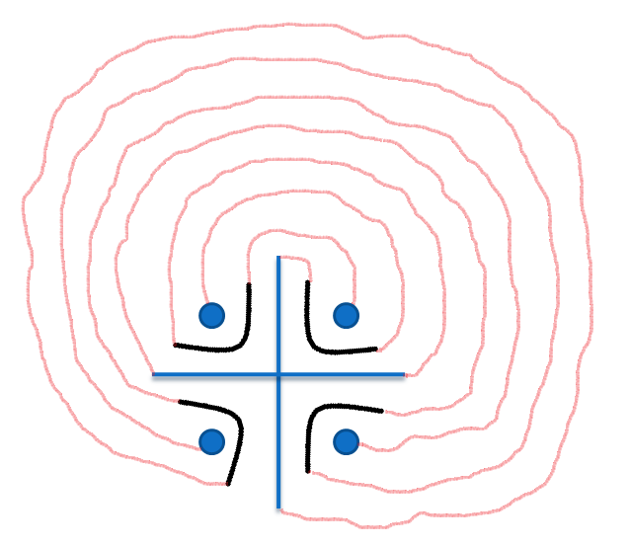

CHAKRAVYUH
3
2
1
4
7
6
5
X

Slide 3
AAJ KA ABHIMANYU

Slide 4
AAJ KA ABHIMANYU
BRAIN CRACKERS
STAGE –I =>
STAGE –II => BLIND BASKET BALL
STAGE –III =>
FINAL DESTINATION

Slide 5
BRAIN CRACKERS
REASONING QUESTIONS : - (based on)
NUMBERS (mental ability & logical)
ALPHABETS (series & logical)
SYMBOLS (series & logical)

Slide 6
BLIND BASKET BALL
BLIND PLAYERS
1
2
3
4
5
PATH
BALL
SHOOTER
BASKETS

Slide 7

FINAL DESTINATION
5PLAYERS
START
MATERIALS :-
2 BRIDGES
2 BRICKS
2 BAMBOOS
DEATH RIVER
REST HOUSE
WILD
AREA
DANGER LAND
WILD
AREA
FINAL
DESTINATION

Slide 8
WINNERS
WILL BE THE
AAJ KA ABHIMANYU

Slide 9
THANK ~ YOU

