Slide 1
?

Slide 2
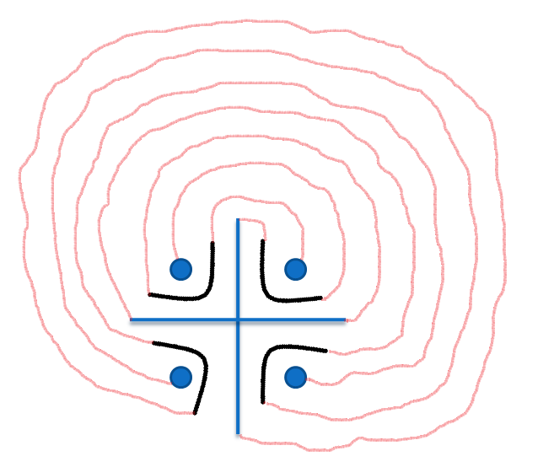

LIFE IS “CHAKRAVYUH”
3
2
1
1. FIRST AID
2. JOB
3. TRAFFIC RULES
4. HOUSE FIRE
5. DISEASES
6. EARTHQUAKE
7. TERRORISM
4
7
6
5
X

Slide 3
AAJ KA ABHIMANYU

Slide 4
AAJ KA ABHIMANYU
STAGE –I =>
STAGE –II => PRACTICE DRILLS
STAGE –III =>
BASIC WORKSHOPS
FINAL DESTINATION

Slide 5
BASIC WORKSHOPS
1. FIRST AID
2. JOB
3. TRAFFIC RULES
4. HOUSE FIRE
5. DISEASES
6. EARTHQUAKE
7. TERRORISM

Slide 6
PRACTICE DRILLS
TRAINERS
TEAMS
TIME
EXECUTION
EQUIPMENTS
PLACES
PERFORMERS

Slide 7
FINAL DESTINATION
START
1
2
3
1. FIRST AID
2. JOB
3. TRAFFIC RULES
4. HOUSE FIRE
5. DISEASES
6. EARTHQUAKE
7. TERRORISM
FINAL
DESTINATION
4
7
6
5

Slide 8
WINNERS
WILL BE THE
AAJ KA ABHIMANYU

Slide 9
THANK ~ YOU

