Slide 1
?

Slide 2

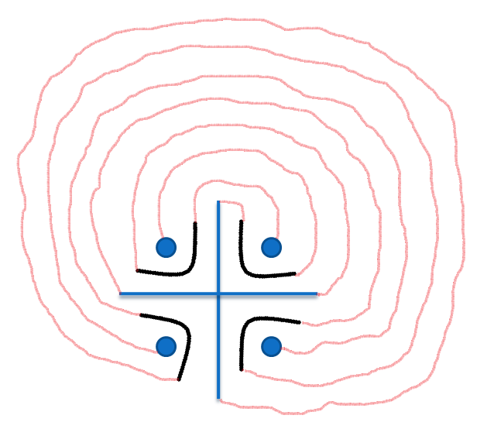

STUDY IS “CHAKRAVYUH”
ACADEMICS
SPORTS
CULTURAL
LOGICAL
SITUATIONAL
BEHAVIOURAL
QUICK DECISION
SCHOOL
3
2
1
4
7
6
5
X

Slide 3
AAJ KA
A
B
H
I
M
A
N
Y
U
1
2
3

Slide 4
AAJ KA ABHIMANYU
SUBJECTIVE G.K.
Wat – SRT – PPDT
Relay race
(Needle + thread)

Slide 5
SUBJECTIVE G.K.
Social Science
Science
Maths
Languages (Hindi+English+Sanskrit)

Slide 6
Wat – SRT – PPDT
Word Association Test
Number of Questions=60
Situation Reaction Test
Number of Questions=60
Picture Perception Discussion Test
10 GREY+WHITE “PICTURES”
1 BLANK “PICTURE”
DISCUSSION TEST per CANDIDATE one minute

Slide 7
Relay race
(special)
Few Players with threads
Few Players with Needle s
(joining them)
Few Players with certain letters
Few Players with remaining letters
(combining them)

Slide 8
Learning Outcomes:
S
K
I
L
L
S
ACADEMICS
SPORTS
CULTURAL
LOGICAL
SITUATIONAL
BEHAVIOURAL
QUICK DECISION

Slide 9
WINNERS
WILL BE THE
AAJ KA ABHIMANYU

Slide 10
THANK ~ YOU

