Slide 1

Project Title -Seasonal Agriculture Performance Analysis
[Student Name-Rajkumar
College Name- United University]
AICTE STU ID : STU6a2e48bc951021781418172
Program: VOIS × AICTE
2026–2027

Slide 2

PROBLEM STATEMENT
Agricultural performance changes significantly with seasonal conditions.
Different seasons affect:
Rainfall and water availability
Temperature and humidity
Soil moisture
Irrigation and water usage
Crop yield and production
Cost, revenue and profit
Disease and pest risk
Problem
There is a need to analyze agricultural data across Kharif, Rabi and Zaid seasons to identify meaningful patterns, variations and relationships.

Slide 3
Project Description:-
Dataset: 4,000 records | 28 attributes
Analysis includes:
Crops & geographical regions
Environmental conditions
Irrigation & resource usage
Yield & production
Cost, revenue & profit
Disease/Pest risk
Workflow: Cleaning → EDA → Seasonal Analysis → Statistical Analysis → Visualization → Insights → Recommendations

Slide 4

WHO ARE THE END USERS?
The analysis can be useful for:
Farmers
Select suitable crops and seasons
Improve resource utilization
Agricultural Departments
Seasonal agricultural planning
Regional performance monitoring
Data Analysts & Researchers
Study agricultural trends
Analyze relationships between variables
Agribusiness Organizations
Understand production and profitability
Improve resource allocation
Agricultural Planners
Support evidence-based decisions

Slide 5

Technology Used
Technology Used
Programming: Python
Libraries:
Pandas
NumPy
Matplotlib
SciPy
Platform: Jupyter Notebook / Google Colab
Techniques:
Descriptive Statistics
GroupBy Analysis
Correlation
IQR Outlier Detection
ANOVA
Data Visualization

Slide 6
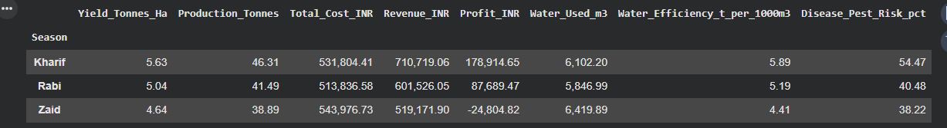
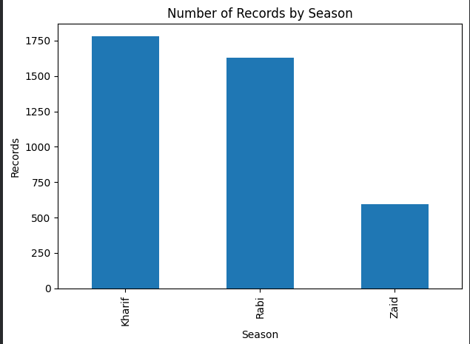
RESULTS
Seasonal Distribution
Observation
Kharif contains the largest number of records.
Rabi has the second-largest representation.
Zaid has considerably fewer observations.
Visualization
📊 Insert: Bar chart — Number of Records by Season

Slide 7
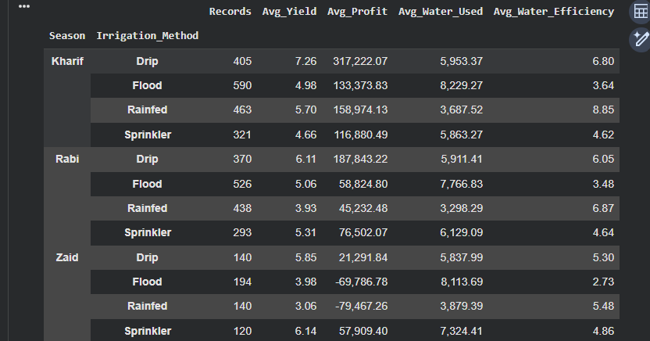
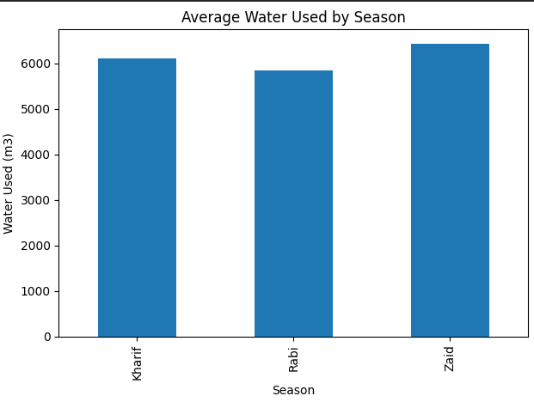
RESULTS
Irrigation Method & Seasonal Performance
Efficient irrigation selection can improve water utilization, yield and profitability, particularly under different seasonal conditions.

Slide 8
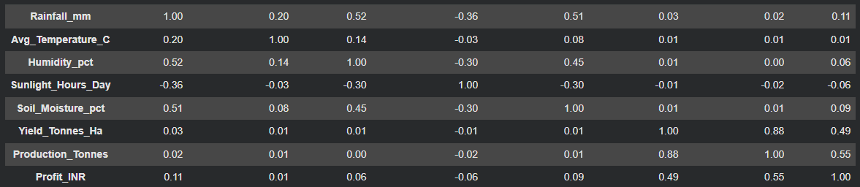
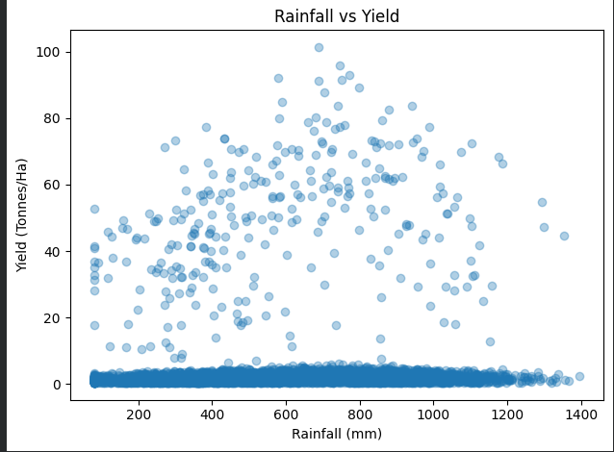
RESULTS
Environmental Conditions vs Agricultural Outcomes
Yield ↔ Production = 0.88 → Strong positive relationship; higher yield is associated with higher production.
Production ↔ Profit = 0.55 → Moderate positive relationship between production and profit.
Yield ↔ Profit = 0.49 → Moderate positive relationship between yield and profitability.
Rainfall ↔ Humidity = 0.52 → Moderate positive relationship.
Rainfall ↔ Soil Moisture = 0.51 → Moderate positive relationship.
Temperature ↔ Yield = 0.01 → Almost no linear relationship in this dataset

Slide 9
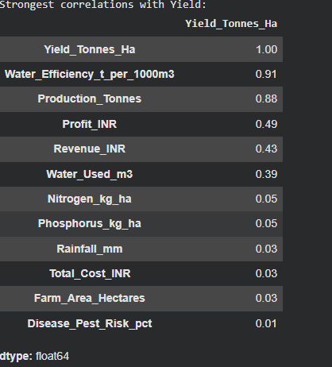
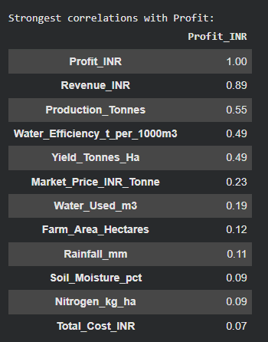
RESULTS
Correlation Analysis: Yield & Profit
Strongest correlations with Yield:
💧 Water Efficiency → 0.91
🌾 Production → 0.88
💰 Profit → 0.49
💵 Revenue → 0.43
💦 Water Used → 0.39
Strongest correlations with Profit:
💵 Revenue → 0.89
🌾 Production → 0.55
💧 Water Efficiency → 0.49
🌾 Yield → 0.49
📈 Market Price → 0.23

Slide 10
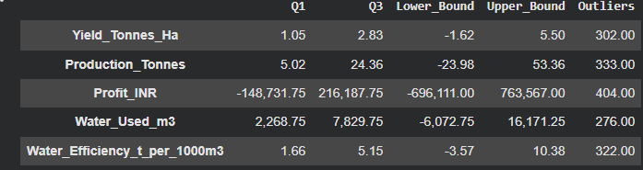
RESULTS
Outlier Analysis
Key Findings
Profit has the highest number of outliers .
Production has 333 unusual observations.
Water Efficiency has 322 outliers.
Outliers indicate significant variation in agricultural performance.
These observations may represent unusual farms, crops, regions, or seasonal conditions.
Conclusion
Outlier analysis helps identify exceptional or unusual agricultural records that require further investigation before drawing conclusions.

Slide 11
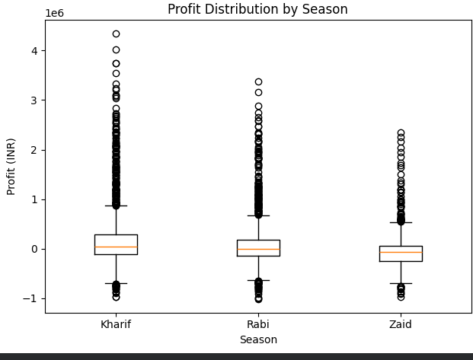
RESULTS
Profit Distribution by Season
Profit Distribution Analysis
The boxplot compares the distribution of Profit (INR) across Kharif, Rabi and Zaid seasons.
Key Findings
Kharif has the highest overall profit distribution.
Rabi shows moderate profitability compared with Kharif.
Zaid has the lowest profit distribution and a lower median.
All three seasons contain several outliers, including both unusually high profits and losses.
Kharif shows the widest range of extreme profit values
Conclusion-
Kharif demonstrates stronger and more variable profitability, while Zaid shows weaker profitability with more negative outcomes.

Slide 12
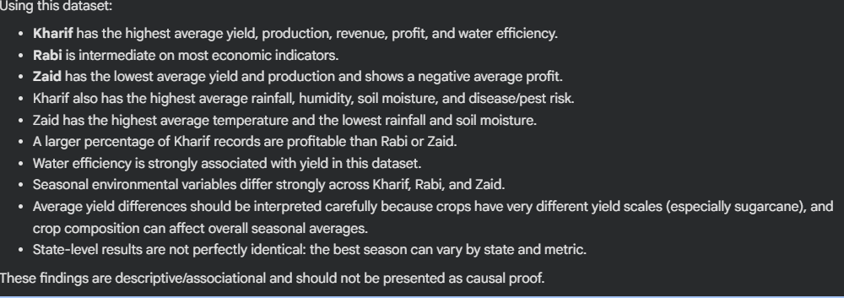
RESULTS
Evidence-Based Conclusions

Slide 13
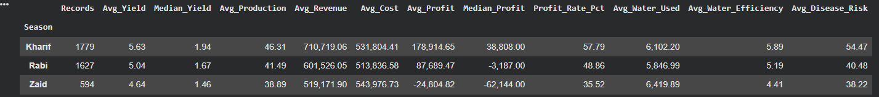
RESULTS
final seasonal summary
Kharif yields the highest revenue and average profit despite facing the highest disease/pest risk.
Rabi maintains reasonable production levels, but median profit drops below zero (-3,187.00 INR), showing high performance variance across farms.
Zaid operates at an average loss (-24,804.82 INR) driven by higher average costs relative to lower revenue, as well as the lowest water efficiency.

Slide 14
Future scope
Future Enhancements
The project can be extended with:
Machine Learning-based Yield Prediction
Profit Prediction
Weather-based Agricultural Forecasting
Crop Recommendation System
Satellite & Remote Sensing Data
Real-time Weather Data Integration
Smart Irrigation Recommendation
Regional Risk Prediction
Interactive Streamlit Dashboard
AI-based Agricultural Recommendations
Long-Term Goal
Develop an intelligent agricultural decision-support system using AI + Data Analytics + Real-Time Data.

Slide 15
GitHub Link
PROJECT GITHUB REPOSITORY
https://github.com/Rajkumar-git1/Seasonal-Agriculture-Performance-Analysis

Slide 16

VOIS Course completion certificate - Course name- Data Visualization

Slide 17
Thank you !
.
.
Seasonal Agriculture Performance Analysis
Presented by: Rajkumar
VOIS × AICTE

