Slide 1
INDUSTRIAL HUMAN RESOURCE GEO – VISUALIZATION
PREDICTIVE ANALYSIS AND GEO-VISUALIZATION OF HUMAN RESOURCE DATA

Slide 2
INTRO
Problem Statement :
"In India, the industrial classification of the workforce is crucial to
understand labor distribution across sectors“.
"Current data on main and marginal workers is outdated and may
not reflect the current state of the workforce“.
"The aim of this study is to provide accurate data for policy making
and employment planning“.

Slide 3
OBJECTIVE
Objective :
“Update industrial classification of main and marginal
workers based on sex and section, division, and class”.
Significance:
“Accurate data on workforce classification
helps in making informed policy decisions and employment
planning“.

Slide 4
TOOLS
Technologies and Tools:
Python as the programming language.
Streamlit for web application.
Pandas for data manipulation.
Matplotlib and Folium for data visualization.

Slide 5
APPROACH
Project Workflow :
Data Loading: Use of Pandas to load human resource data from CSV.
Preprocessing: Clean and preprocess data, including splitting column.
Data Exploration: Explore data using St for user-friendly interaction.
Geo-Visualization: Utilize Folium to create an interactive map for human resource distribution.

Slide 6
EDA - EXPLORATORY DATA ANALYSIS
Key Findings:
Total no of state & district workers(Main & Marginal).
Distribution of workers in rural, main and urban areas.
Male female ratios among workers.
Visualization of marginal workers in rural and urban areas.

Slide 7
NLP ANALYSIS
Main workers Marginal workers different and Rural and Urban workers.
Various NICName sectors.

Slide 8
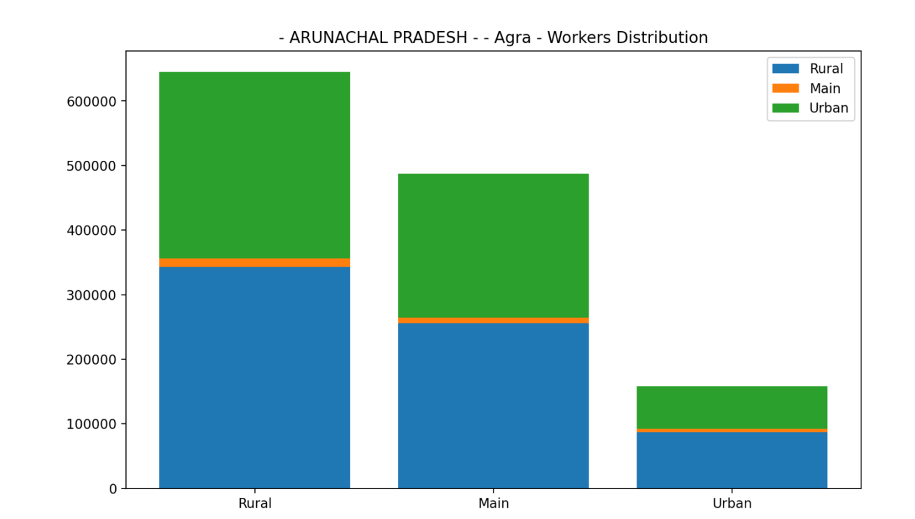

Slide 9
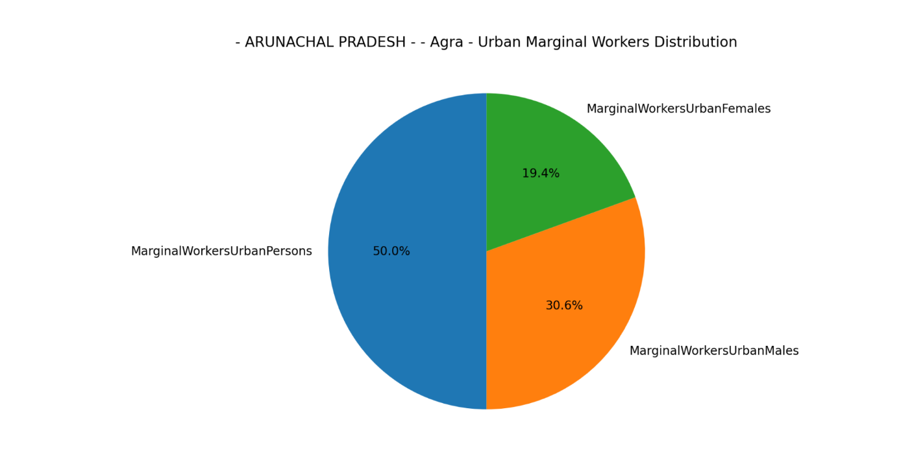

Slide 10
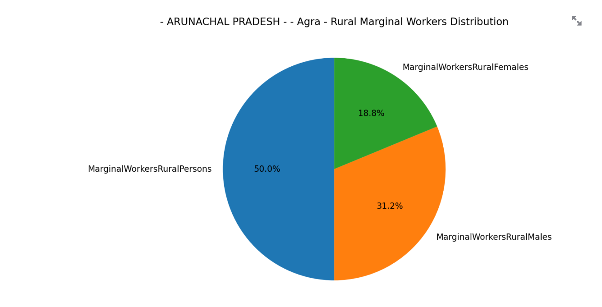

Slide 11
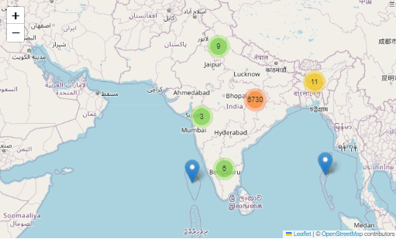

Slide 12


