Slide 1
CRM Sales Pipeline: Where Winnable Revenue Leaks
Prepared by Rajkumar Vijayan
Client: MavenTech · Analysis of 8,800 sales opportunities
August 2026

Slide 2
MavenTech can recover at least $237K in won revenue from sales coaching alone
• Situation: MavenTech's sales team wins 63.2% of closed deals and $10.0M in revenue, but has no visibility into where value is lost.
• Complication: A diagnosis of 8,800 opportunities reveals two recoverable gaps.
• Findings: a 15-point win-rate spread across agents, and $4.9M in losses concentrated in three products.
• Recommendation: coaching below-median agents to the team average alone represents at least $237K in recoverable revenue, within one quarter.

Slide 3
MavenTech's new CRM tracks deals but leaves leadership blind to where they're won or lost
• A new CRM system captures every opportunity, but the data has no visibility outside the platform.
• Leadership cannot see which agents, products, or stages drive won vs. lost revenue.
• Question: where is the team losing winnable revenue, and what is it worth to fix?

Slide 4
We traced 8,800 opportunities end-to-end, from raw CRM extract to validated findings
• Data: 8,800 B2B deals across four linked tables (opportunities, agents, accounts, products).
• Method: cleaned and validated in Python, diagnosed the funnel, cross-checked every figure in Tableau.
• Examined three levers: agent consistency, lost-deal concentration, and discount leakage.

Slide 5
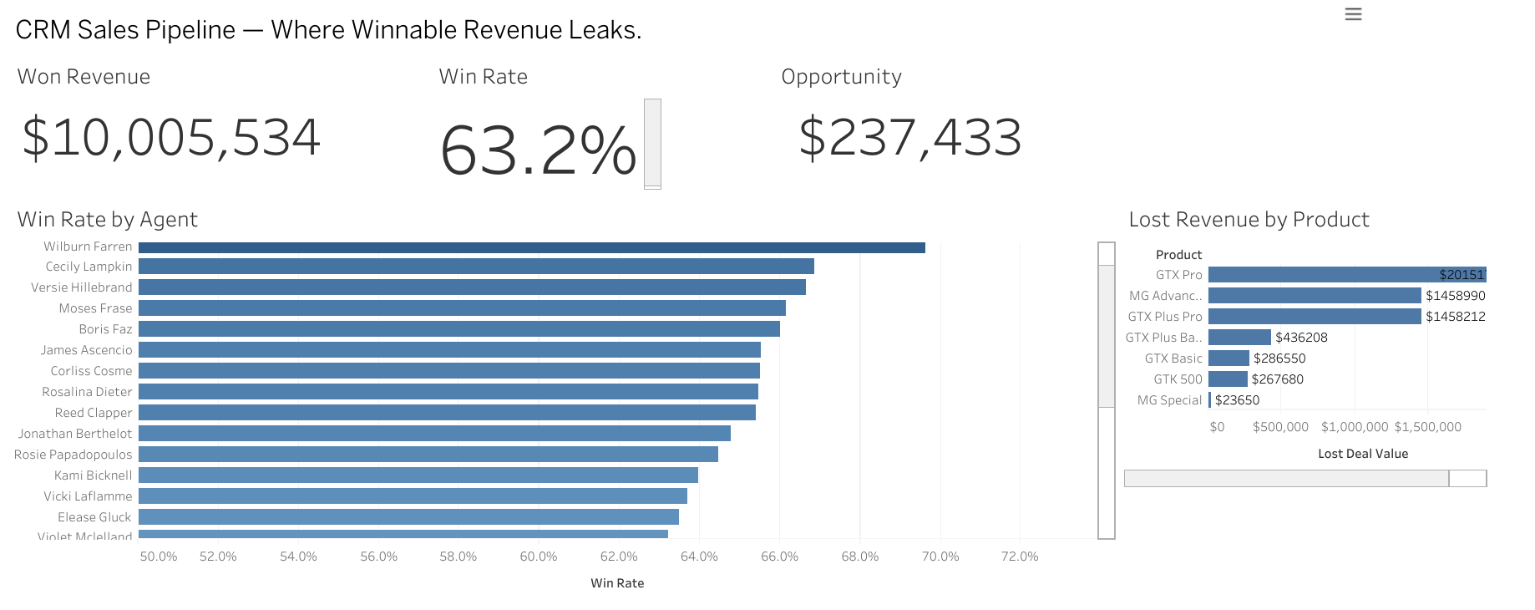
One view of the whole pipeline: win rate, revenue, and where deals are lost
Live, interactive dashboard published on Tableau Public.

Slide 6
The team wins 63% of deals — but individual win rates swing 15 points
• Median agent win rate is 63.6%, but rates range from 55% to 70% across the team.
• The spread holds on the same products and accounts — so it reflects execution, not territory.
• That gap is coachable, which makes it the most actionable lever.

Slide 7
Lifting below-median agents to the team average is worth at least $237K
• Counting only agents below median, lifted only to the median (a deliberately conservative floor).
• That yields 101 additional wins at an average deal value of $2,361.
• Estimated upside: $237,433 — a 2.4% lift on current won revenue.
• This is the floor: lifting to top-quartile performance would recover materially more.

Slide 8
Three products drive ~$4.9M of lost revenue — and GTX Pro loses the most per deal
• GTX Pro ($2.0M), MG Advanced ($1.46M), and GTX Plus Pro ($1.46M) account for most losses.
• GTX Pro loses fewer deals than MG Advanced but costs more per loss — it is higher-value.
• Prioritising GTX Pro win-back therefore returns more per deal recovered.

Slide 9
A single CRM naming inconsistency was hiding the #1 lost-revenue product
• The CRM stored the same product as both 'GTXPro' and 'GTX Pro', silently breaking table joins.
• This undercounted GTX Pro's losses until the naming was standardised.
• Fixing one data-quality issue changed which product looked worst — a process gap worth closing.

Slide 10
Three targeted actions capture the opportunity
• Coach bottom-quartile agents toward the median team's playbook and cadence.
• Prioritise GTX Pro win-back, given its high revenue-per-lost-deal.
• Enforce consistent product naming in the CRM to keep reporting reliable.

Slide 11
At least $237K is recoverable from coaching alone, measurable within one quarter
• Track win rate by agent monthly and close the gap to the team median.
• Run a targeted GTX Pro loss review to recover high-value deals.
• Upside beyond $237K: lifting above median, plus the product-loss lever, both add to the total.

