Slide 1


Analysis on IPL 2022 data set
This Photo by Unknown author is licensed under CC BY-NC.
Done by:-
Lakshmi Rani Pudi - LP07823N
Deekshitha Duddola - DD63441N
Raj Kumar Nelluri – RN88648N

Slide 2
Contents
Abstract
Introduction
Dataset
Data Preprocessing
Literature Review
Methodology
Results
Conclusion
References
GitHub Repository for code

Slide 3
Abstract
The Indian Premier League (IPL) is one of the most watched cricket events in the world, and both its viewership and its finances have significantly increased over the past few years. The Indian Premier League (IPL), which debuted in 2008 and is currently the most well-known T20 league worldwide, is played in India. Cricket is a tremendously fluid sport that evolves with each ball.
People enjoy and watch cricket the most, and the Twenty20 format in particular since no one can predict the winner until the final ball of the final over. India’s most popular and frequently played sport, with the largest fan following, is cricket.
In our Analysis we have used pandas, matplotlib and ploty libraries for data reading, data analysis and data visualization.

Slide 4
Introduction
In India, cricket has long been compared to a religion. It’s considered to be more than just a game. The cricketers are worshipped and revered as divinities. Cricket’s Twenty20 for-mat made history.
The history of the Indian Premier League is fascinating. Lalit Modi, former vice president of the Board of Cricket Control in India (BCCI), had the idea for the Indian Premier League before anything else.
Its design is modeled around European club football, most specifically the English Premier League. IPL was launched as a counterpunch to Zee Group’s rebellious Indian Cricket League (ICL). An incredible development in cricket history isthe DLF Indian Premier League.

Slide 5
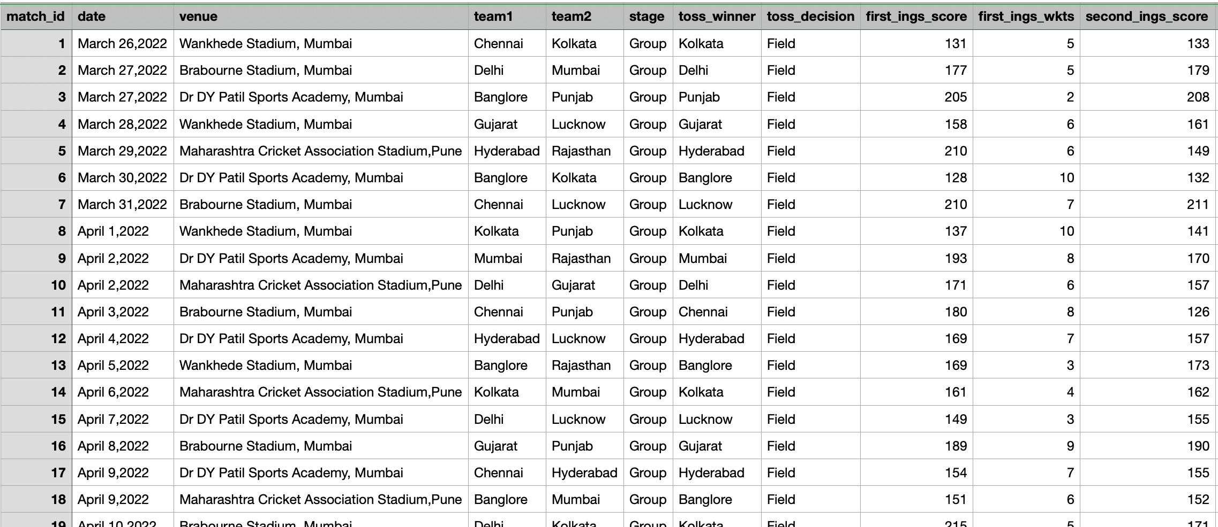
Dataset
Source of dataset: IPL 2022-Dataset from Kaggle (Link)
Snap Shorts of Dataset

Slide 6
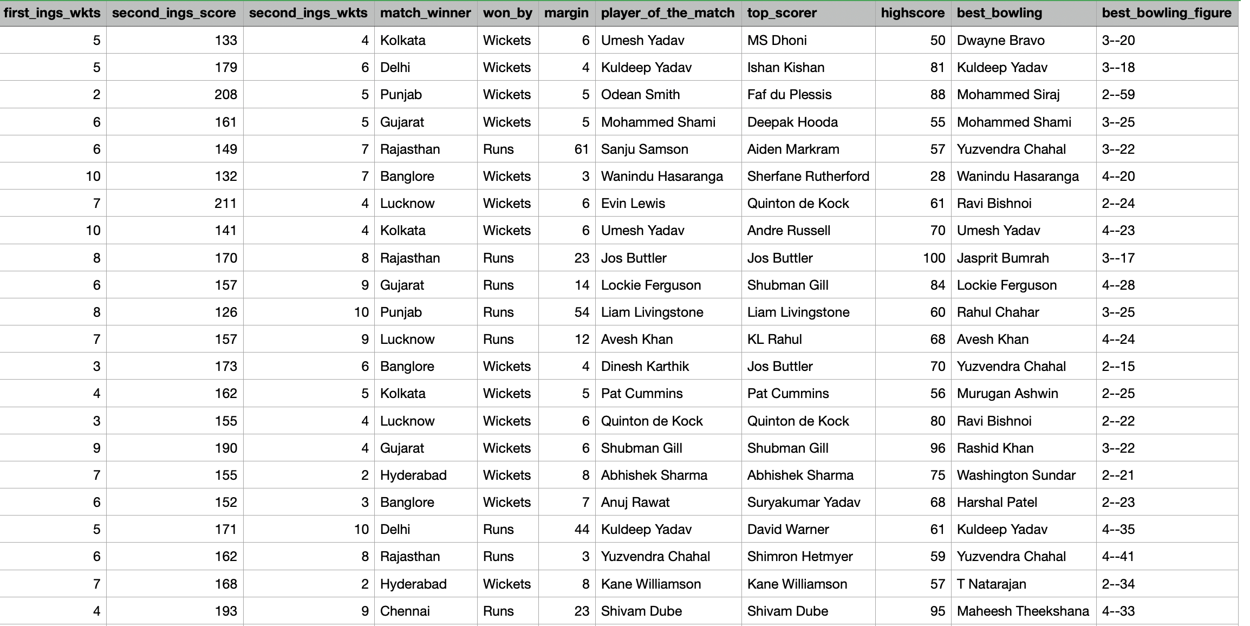

Slide 7
Literature Review
Exploratory Data Analysis of Indian Premier League: An Empirical Study :- This paper highlights the evolution of analytics in sports, beginning with baseball and extending to cricket, where technology and data analytics have significantly influenced the game. It covers various aspects, including predictive modeling using machine learning, the impact of technology in cricket, and the application of analytics in improving player selection and team strategies. This comprehensive analysis underscores the transformative role of data analytics in sports, particularly in cricket, offering a detailed examination of how analytical tools and methodologies can enhance understanding and performance in the IPL.
IPL Data Analysis and Visualization for Team Selection and Profit Strategy :- This paper employs data science and machine learning to assess IPL data from 2008 to 2020. It utilizes Python libraries such as Numpy, Pandas, Matplotlib, and Seaborn for data preprocessing, analysis, and visualization. The objective is to predict team scores and winning probabilities, assisting team trainers and owners in making informed decisions during player auctions for optimal team performance and profitability. This approach highlights the potential of analytical tools in enhancing strategic decisions in sports management.
A Structured Analysis on IPL 2022 matches by approaching various Data Visualization and Analytics :- The report "A Structured Analysis on IPL 2022 matches by approaching various Data Visualization and Analytics" delves into the IPL 2022 season, using Python for data analysis to guide franchise decisions in player auctions. It offers a comprehensive examination of player performances and team statistics through graphs and tables, aiming to identify standout players for strategic recruitment. This analytical approach provides franchises with crucial insights for forming competitive teams.

Slide 8
Literature Review
IPL Data Analysis and Visualization for Team Selection and Profit Strategy:- The "IPL Data Analysis and Visualization for Team Selection and Profit Strategy" paper focuses on leveraging data science and machine learning to dissect vast volumes of IPL player data, aiming to assist franchises in making informed decisions during player auctions. Utilizing Python libraries such as Pandas, NumPy, Matplotlib, and Seaborn, the study presents an in-depth analysis from 2008 to 2020, crafting models to predict team scores and win probabilities. This analytical approach not only aids in enhancing team compositions for optimal performance but also in strategizing for financial gains, highlighting the significant impact of data-driven decisions in sports management.
IPL Data Analysis and Visualization Using Microsoft Power BI Tool:- The paper titled "IPL Data Analysis and Visualization Using Microsoft Power BI Tool" focuses on employing Power BI for analyzing and visualizing IPL match data from 2008 to 2022. It emphasizes the utilization of Python libraries within Power BI to preprocess data, analyze it, and ultimately create predictive models and interactive dashboards that forecast team scores and win probabilities. By leveraging machine learning models, particularly the Random Forest algorithm, which achieved a 93.27% accuracy score, this study presents a novel approach to sports analytics, enhancing decision-making processes with a significant emphasis on data-driven insights.
Popularity Measuring and Prediction Mining of IPL Team Using Machine Learning:- The study "Popularity Measuring and Prediction Mining of IPL Team Using Machine Learning" analyzes Twitter data to evaluate and predict IPL teams' popularity. Leveraging machine learning algorithms such as Multinomial Naïve Bayes, Logistic Regression, and Random Forest, the research categorizes sentiments from tweets into positive, negative, and neutral towards IPL 2020 teams. It demonstrates how machine learning can effectively gauge and foresee fan reactions, providing insights into team popularity based on social media engagement.

Slide 9
Data Preprocessing
data.head() – This will return first 5 rows of the dataset.
data.shape – This will return Dimensions of dataset.
data.info() – This will return info of the dataset.
data.isnull().sum() – This will return counting missing values in the dataset.
data[‘team1’].value_counts() – This will return number of matches played by team1.
data[‘team2’].value_counts() – This will return number of matches played by team2.
data[‘team1’].value_counts() + data[‘team2’].value_counts() - This will return number of matches played by each team. Here we have got NaN values.

Slide 10
Data Preprocessing
total_matches_played = data[‘team1’].value_counts().add(data[‘team2’]).value_counts() , fill_value-0).astype(int) – This will handle the NaN values.
total_won= data['match_winner'].value_counts() total_won – This will return total matches won by each team.
win_percentage = ((total_won / total_matches_played) * 100).sort_values(ascending=False).astype(int) win_percentage – This will return win percentage for each team.
team_performance = pd.DataFrame({ 'Total Matches Played': total_matches_played, 'Total Matches Won': total_won, 'Win Percentage (%)': win_percentage}).sort_values(by='Win Percentage (%)', ascending=False) – Creating DataFrame for total matches , total matches won, win percentage in descending order.

Slide 11
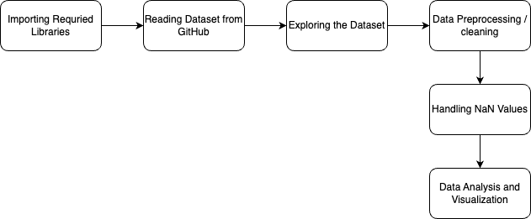
Architecture

Slide 12
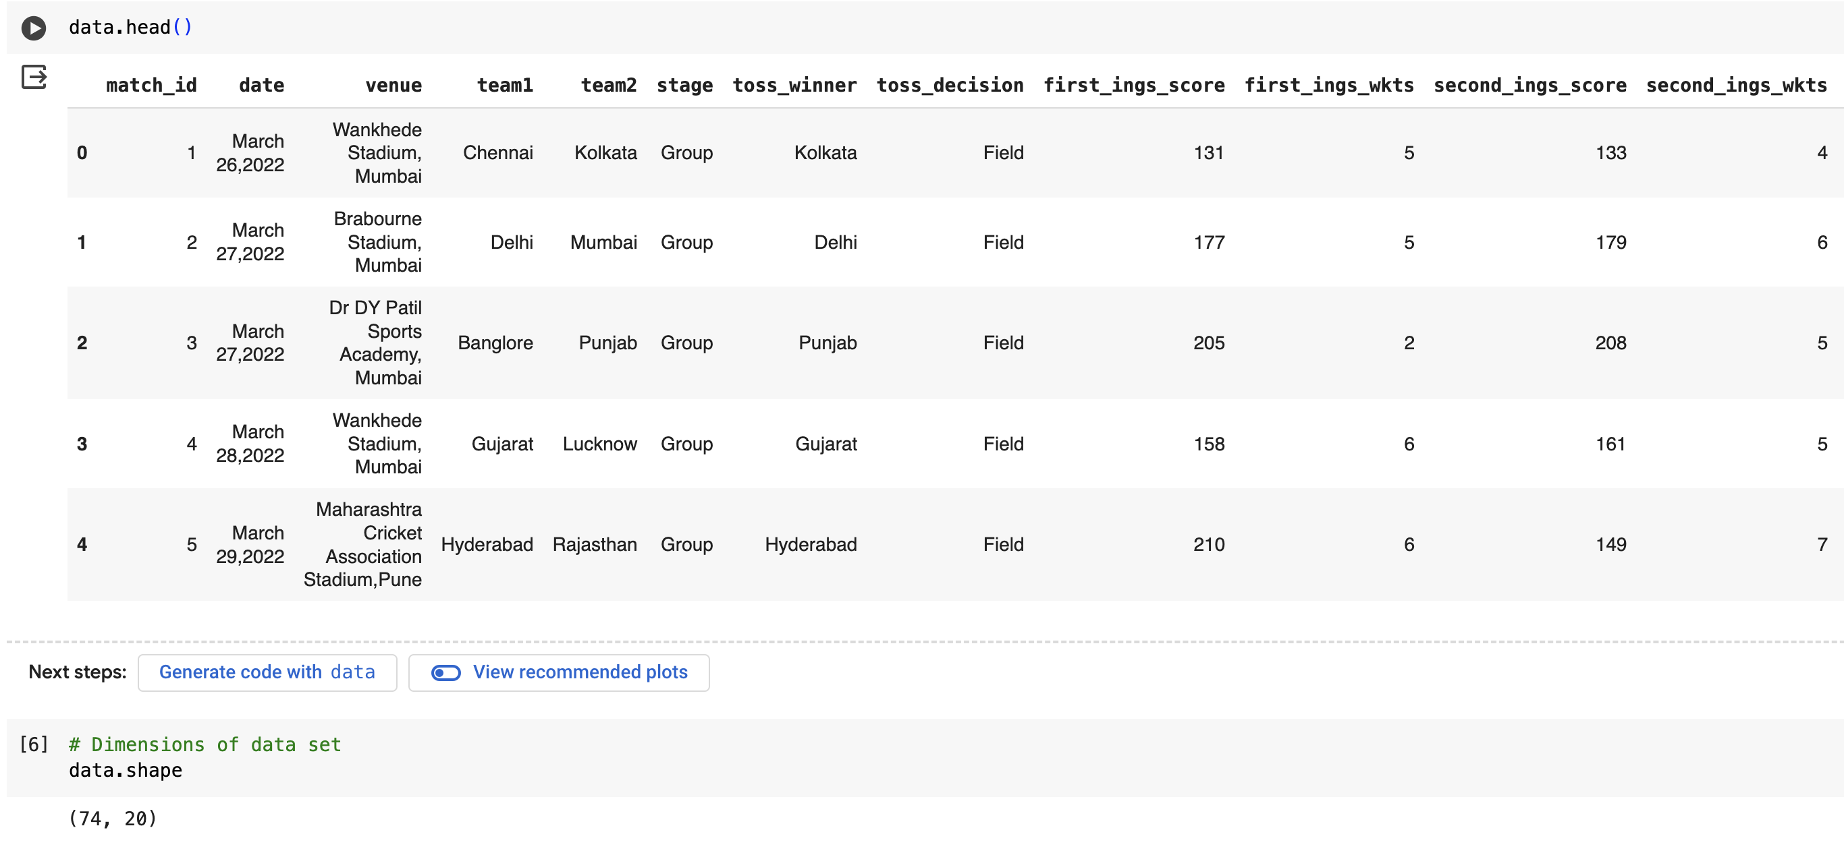
Results

Slide 13
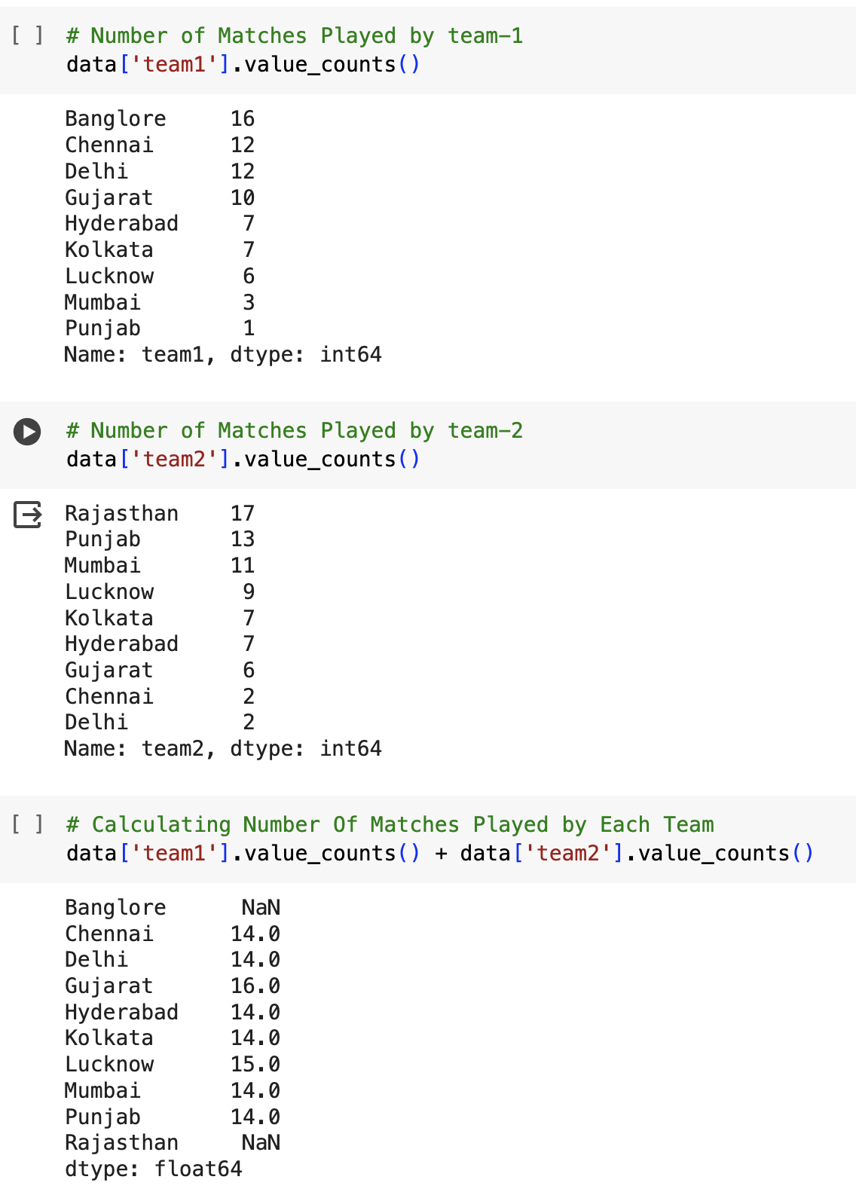
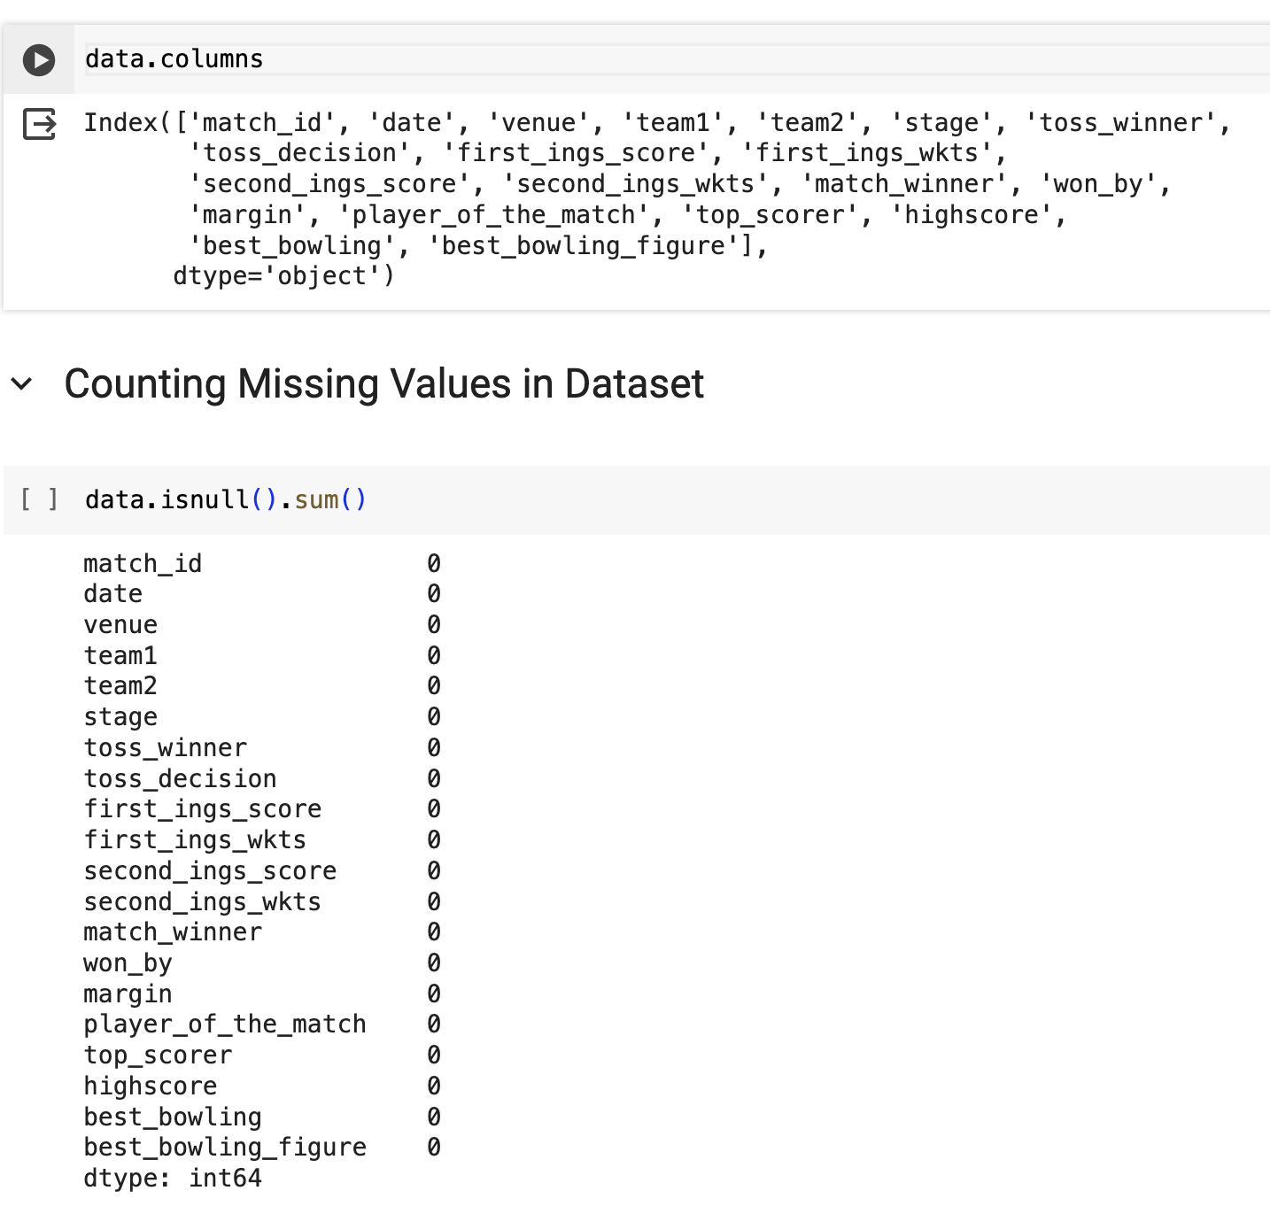
Results

Slide 14
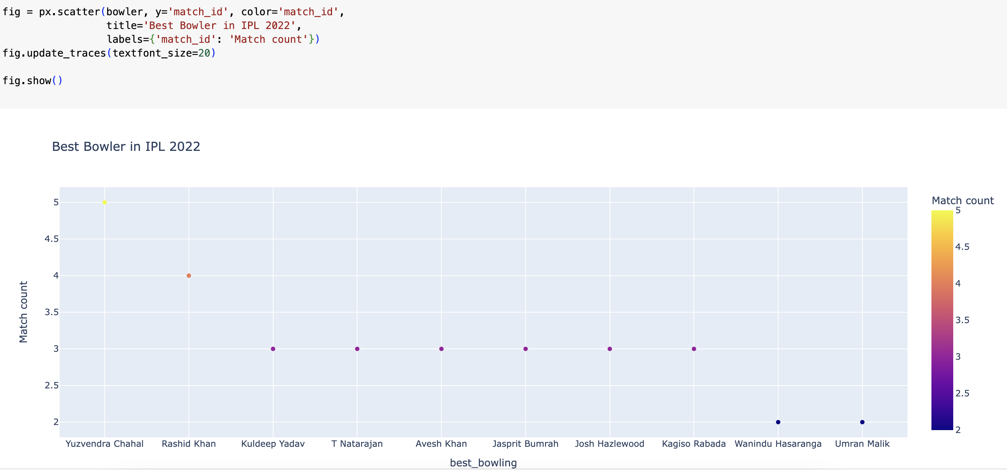
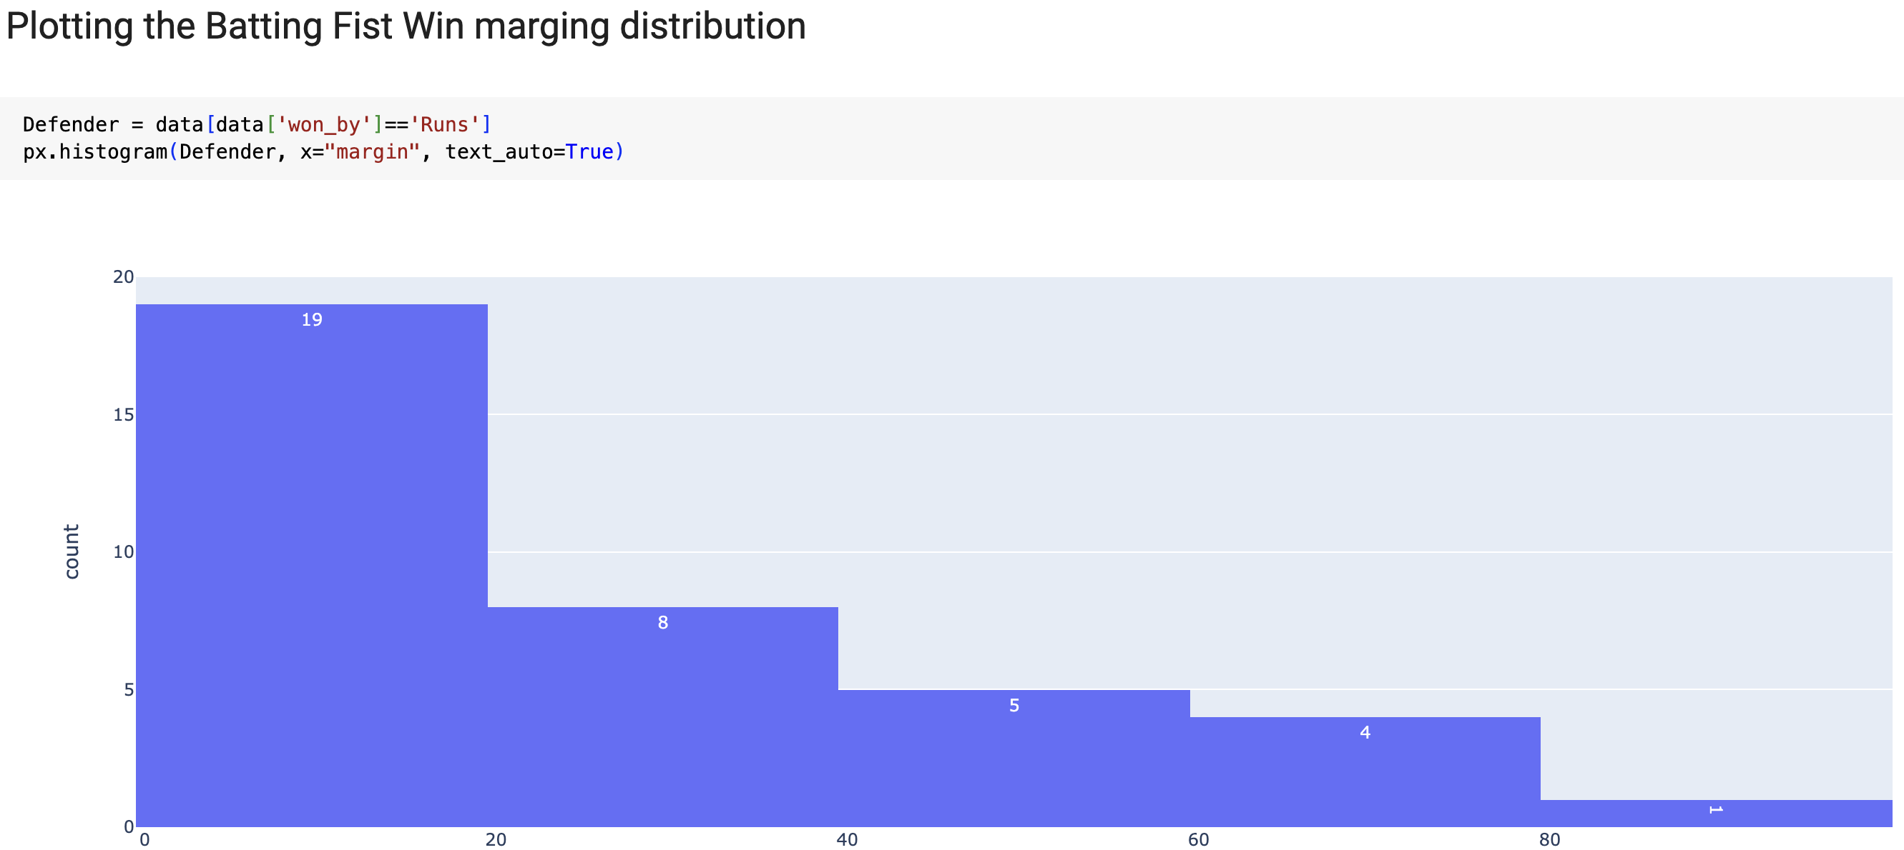
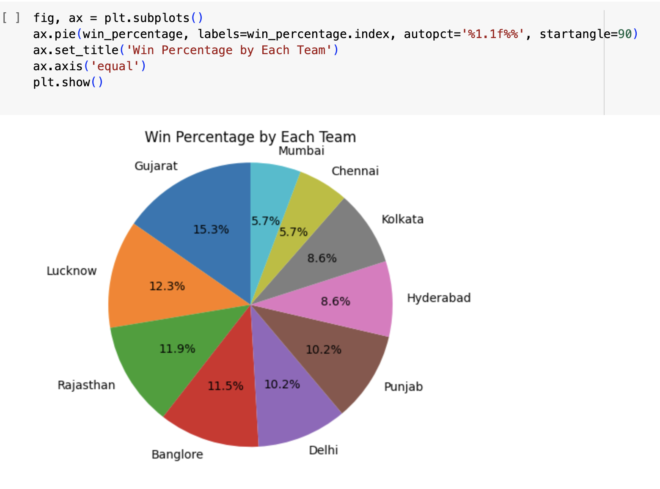
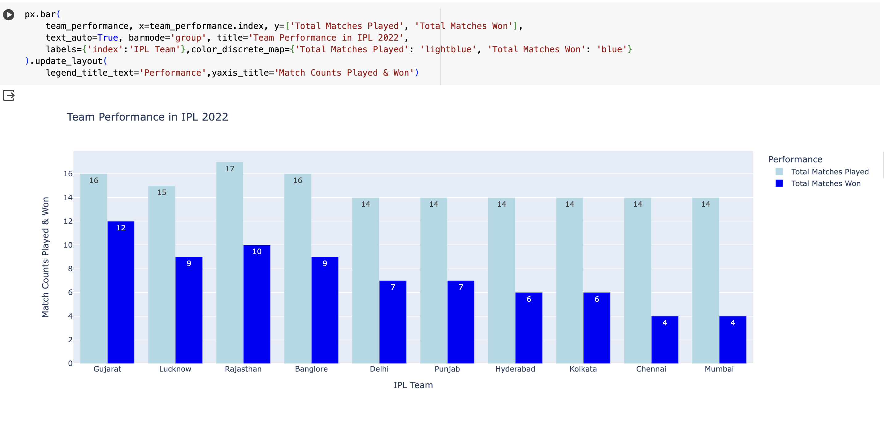

Slide 15
Conclusion
In today’s sports world with the aid of analysis, we can determine the player’s strengths and weaknesses which will in turn help to improve both individual player performance and team performance. This will aid in optimum decision-making. Working on player and team performance and predicting future performance is beneficial for all types of games. Other T20 leagues around the world, like the PSL, LPL, CPL, BBL, T20 Blast, BPL, and World League CLT20, benefit from the following methodology. Data Analytics have thus taken sports analytics to greater heights and thus selection of players in the teams and selection teams have become easy and accurate. Analyzing performance of individual players and teams over time have made accurate predictions over time possible.

Slide 16
References
[1] Baboota, Rahul, and Harleen Kaur. "Predictive analysis and modelling football results using machine learning approach for English Premier League." International Journal of Forecasting 35.2 (2019): 741-755.
[2] Saranya, G., Aravind Swaminathan, R. Surendran, and Leema Nelson. "Ipl data analysis and visualization for team selection and profit strategy." In 2023 7th International Conference on Computing Methodologies and Communication (ICCMC), pp. 592-598. IEEE, 2023.
[3] Birunda, S. Selva, P. Nagaraj, B. Jency A. Jebamani, B. Revathi, and V. Muneeswaran. "A Structured Analysis on IPL 2022 matches by approaching various Data Visualization and Analytics." In 2023 International Conference on Computer Communication and Informatics (ICCCI), pp. 1-9. IEEE, 2023.
[4] Saranya, G., Aravind Swaminathan, R. Surendran, and Leema Nelson. "Ipl data analysis and visualization for team selection and profit strategy." In 2023 7th International Conference on Computing Methodologies and Communication (ICCMC), pp. 592-598. IEEE, 2023.
[5] Jaipurkar, Manasvi, Neha Ragit, Chetana Tambuskar, and Pranay Deepak Saraf. "IPL Data Analysis and Visualization Using Microsoft Power BI Tool." In 2023 14th International Conference on Computing Communication and Networking Technologies (ICCCNT), pp. 1-6. IEEE, 2023.
[6] Kumar, Yogesh, Harendra Sharma, and Ritu Pal. "Popularity Measuring and Prediction Mining of IPL Team Using Machine Learning." In 2021 9th International Conference on Reliability, Infocom Technologies and Optimization (Trends and Future Directions)(ICRITO), pp. 1-5. IEEE, 2021.

Slide 17
GitHub Repository for Code
Click on this (link) for access code, dataset and other files.

Slide 18


