Slide 1

Mutual Fund Analytics Platform
Bluestock Fintech --Capstone Project
Internship Duration: 7-Day Capstone Project
Technology Stack: Python | Pandas | SQLite | Power BI | Data Analytics
Prepared By: Ampolu Raj Kumar
ID: BFDA51250

Slide 2
Project Objectives:
✔ Build ETL Pipeline
✔ Design SQLite Database
✔ Perform EDA
✔ Calculate Performance Metrics
✔ Develop Power BI Dashboard
✔ Implement Risk Analytics
✔ Build Fund Recommendation System
Problem Statement:
Investors often face challenges in:
Comparing mutual fund performance
Understanding risk-adjusted returns
Tracking portfolio diversification
Analyzing investor behavior
Monitoring industry growth trends

Slide 3
Data Sources
Datasets Used
Dataset | Purpose
Fund Master | Scheme Information
NAV History | Daily NAV Tracking
AUM Dataset | Asset Management Analysis
SIP Dataset | Monthly SIP Trends
Category Inflows | Investor Preferences
Folio Count | Industry Growth
Scheme Performance | Fund Returns
Transactions | Investor Behavior
Portfolio Holdings | Sector Allocation
Benchmark Data | Nifty Comparison
Total Datasets
10 Mutual Fund Industry Datasets

Slide 4
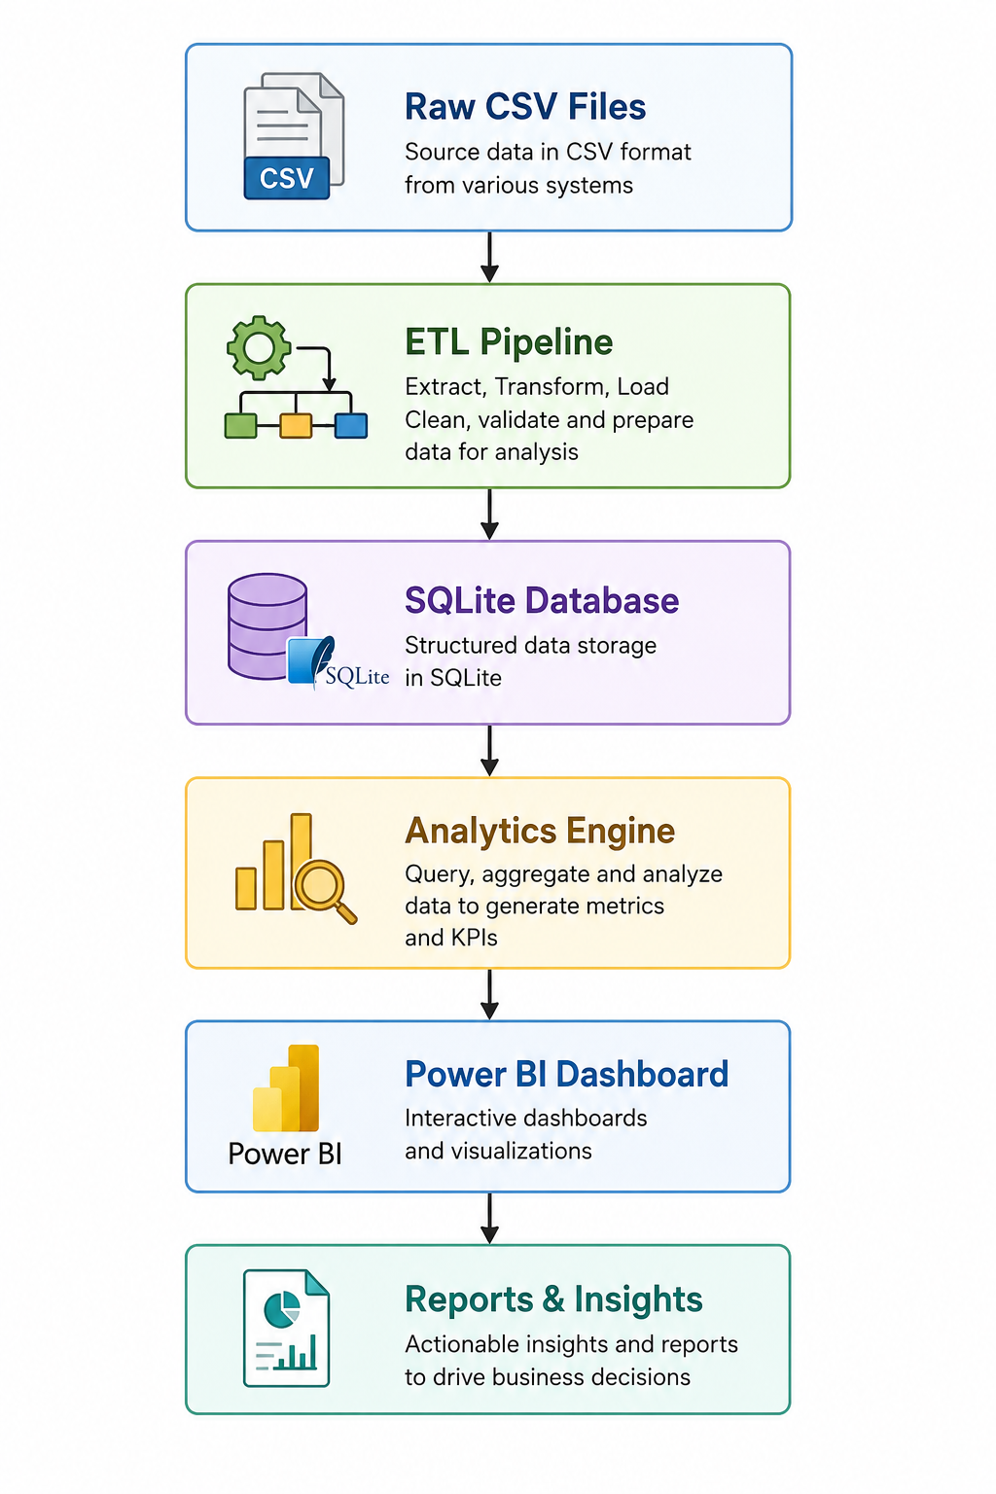
System Architecture:
Layers
Data Layer
ETL Layer
Database Layer
Analytics Layer
Visualization Layer

Slide 5
EDA Highlights – Industry Trends
Major Observations
✔ Strong NAV growth observed during 2023
✔ SBI Mutual Fund maintained highest AUM
✔ SIP inflows increased consistently
✔ Equity funds attracted highest investments
Exploratory Data Analysis
Key Visualizations
NAV Trend Analysis
AUM Growth Analysis
SIP Inflow Trends
Category Inflow Analysis

Slide 6
EDA Highlights – Investor Analytics
Investor Behavior Analysis
Key Insights
✔ 26–35 age group contributed highest investments
✔ T30 cities dominated transactions
✔ UPI emerged as preferred payment mode
✔ Industry folios doubled between 2022 and 2025
Analysis Performed
Age Group Distribution
Gender Analysis
Geographic Distribution
Transaction Analysis

Slide 7
Performance Metrics
Fund Performance Analytics
Metrics Calculated
CAGR
Sharpe Ratio
Sortino Ratio
Alpha
Beta
Maximum Drawdown
Purpose
Evaluate:
Returns
Risk
Benchmark Outperformance
Portfolio Stability

Slide 8
Advanced Risk Analytics
Risk Management Metrics
Implemented Analytics
✔ Historical VaR (95%)
✔ Conditional VaR (CVaR)
✔ Rolling Sharpe Ratio
✔ Sector HHI Concentration
✔ SIP Continuity Analysis
✔ Investor Cohort Analysis
Outcome
Improved understanding of:
Downside Risk
Diversification
Investor Retention

Slide 9
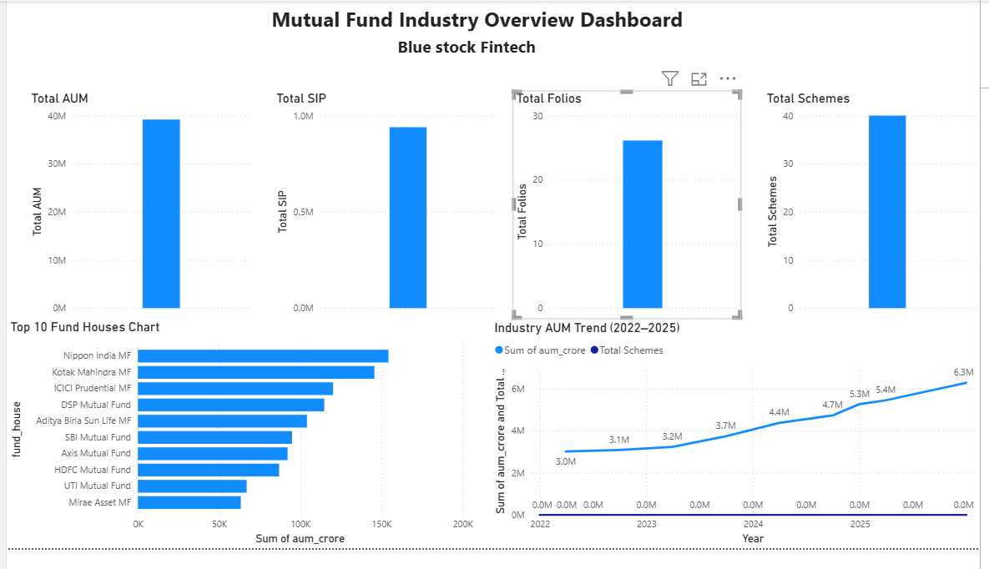
Dashboard Overview:
Power BI Dashboard – Industry Overview
Features
Total AUM KPI
Total SIP KPI
Total Folios KPI
Scheme Count KPI
Industry Growth Trends
Benefits
Provides industry-wide insights at a glance.

Slide 10
Investor Analytics & Fund Performance
Features
FeaturesFund Comparison
Return vs Risk Analysis
State-wise Investments
Transaction Breakdown
SIP Trend Monitoring
Interactive Components
✔ Filters
✔ Slicers
✔ Drill-down Analysis

Slide 11
Key Findings:
Major Project Insights
Industry Insights
✔ SBI Mutual Fund leads in AUM
✔ Equity funds dominate investments
✔ SIP inflows reached ₹31,002 Cr in Dec 2025
Investor Insights
✔ 26–35 age group invests most
✔ T30 cities contribute majority investments
Performance Insights
✔ High Sharpe Ratio funds deliver better risk-adjusted returns
✔ Diversified portfolios exhibit lower concentration risk

Slide 12
Conclusion
Project Summary
The Mutual Fund Analytics Platform successfully integrated:
✔ Data Engineering
✔ Financial Analytics
✔ Risk Analytics
✔ Dashboard Visualization
✔ Investment Recommendation Logic
Technologies Used
Python • Pandas • SQLite • Power BI • NumPy • Matplotlib

Slide 13
Thank You

