Slide 1
Final Project
RAJKUMAR M
2021503039
Department of Computer Technology,
Madras Institute of Technology, Anna University
NM ID :07166CA0EE506D199F6453875749C0B0

Slide 2
PROJECT TITLE
STUDENT PERFORMANCE AND DIFFICULTY PREDICTION

Slide 3


AGENDA
Welcome to our journey through Student Performance and difficulty prediction. We begin with an Introduction, outlining the Problem Statement and Project Overview.
Transitioning to our Solution, we explore the predictive modeling approach, discussing methodologies and algorithms.
In the Model Building section, we uncover various architectures and optimization techniques used to train our models.
Compare various models and find the suitable model for student performance prediction.
Finally, we deploy the model that helps to educator, teacher and parents for finding risk of students.
3/21/2024 Annual Review

Slide 4

PROBLEM STATEMENT
Develop a predictive model that can accurately classify whether a student will pass their final exam or not, based on various input features including demographic information, academic history, socioeconomic status, and behavioral factors such as alcohol consumption or family problems.
By leveraging machine learning techniques, we aim to provide educators and parents with insights to intervene and support students before they reach the exam stage, thereby improving overall academic performance and student success.

Slide 5

PROJECT OVERVIEW
Develop a robust classification model to predict student exam success, employing machine learning algorithms such as K-Nearest Neighbors (KNN), Random forest, Support Vector Machine (SVM), Logistic regression and gradient boosting
Evaluate and compare the performance of different classifiers to determine the most accurate model while avoiding overfitting and under fitting through the implementation of appropriate techniques such as cross-validation and hyper parameter tuning.
Identify the most influential factors affecting student performance by analysing feature importance and correlation analysis within the dataset.
Provide actionable insights for educators and parents to intervene proactively and address underlying issues that may hinder students' academic success, such as family problems or behavioral patterns like alcohol consumption.

Slide 6

WHO ARE THE END USERS?
Educators:
Teachers can utilize the model to identify students who are at risk of failing their final exams. By having access to early predictions based on various factors, educators can implement targeted interventions, such as providing additional tutoring, personalized support, or counseling, to help struggling students improve their academic performance before it's too late. This proactive approach can lead to better student engagement, retention, and overall success in the classroom
Parents:
With insights from the predictive model, parents can gain a deeper understanding of their child's academic strengths and weaknesses. This knowledge enables parents to provide appropriate support at home, such as creating a conducive study environment, offering encouragement, or seeking external assistance if needed. By being informed about potential challenges their child may face, parents can actively collaborate with educators to address underlying issues and foster a positive learning experience for their child.

Slide 7
WHO ARE THE END USERS?
School Administrators:
Administrators are responsible for overseeing the overall functioning of the school and ensuring student success. By leveraging the predictive model, school administrators can identify trends and patterns in student performance across different demographic groups, academic cohorts, or behavioral factors. This information can inform resource allocation decisions, curriculum adjustments, and the development of targeted intervention programs tailored to the specific needs of students. Administrators can also use the model outputs to track the effectiveness of various initiatives aimed at improving student outcomes and make data-driven decisions to drive continuous improvement in the school environment.

Slide 8

YOUR SOLUTION AND ITS VALUE PROPOSITION
Solution:
Our solution employs machine learning algorithms, K-Nearest Neighbors (KNN), Random forest, Support Vector Machine (SVM), Logistic regression and gradient boosting to analyze student’s details and predict their performance and difficulties. Compare these all models and we deploy the suitable model and optimize them.
Value Proposition:
Accuracy: High accuracy rates ensure reliable predictions of student’s performance.
Efficiency: Automated assessment helps to teacher for better understanding of students.
Early Detection: In education, it means spotting students at risk of academic or behavioral challenges. Utilizing data analytics and assessment tools enables targeted support, fostering better outcomes and resource allocation.

Slide 9

THE WOW IN YOUR SOLUTION
Our solution excels in employing Student with exceptional accuracy and efficiency. Here's why it stands out:
Considering Everything that Matters: Instead of just looking at grades, we're looking at a lot of different things like where students come from, how they've done in the past, and even things like family issues or drinking habits. This gives us a fuller picture of what might affect how well students do in school.
Comparing Different Ways of Predicting: Instead of just using one way to guess how well students will do, we're trying out four different methods to see which one works best. It's like trying different tools to see which one helps us build the best house.
Models: logistic regression, Random forest, KNN, SVM, and gradient boosting.
Improvement: Using cross validation technique, reduce the over fitting and eventually increase the accuracy.

Slide 10
MODELLING
Data Preparation:
Utilize a comprehensive dataset Student details with performance labels.
Perform data preprocessing, including handling missing values, scaling features, and splitting data into training and validation sets.
Model Architecture:
Construct a predictive model using machine learning algorithms such as K-Nearest Neighbors (KNN), Random forest, Support Vector Machine (SVM), Logistic regression and Gradient boosting.
Implement ensemble methods to combine the strengths of multiple models and improve predictive performance.
Training and Evaluation:
Compile each model with appropriate hyperparameters, optimizer, and loss function.
Train the models on the training data and evaluate their performance using metrics like accuracy, precision, recall, and F1-score.
Fine-tune the models using techniques like grid search or randomized search to optimize performance further.

Slide 11
MODELLING( Cont…)
Predictive System Development:
Develop a robust system for predicting Student Performance based on input student details.
Implement preprocessing steps to handle incoming data and prepare it for prediction.
Deploy the predictive system to enable real-time monitoring of Student Performance and helps to make them better.
Technology Used:
Scikit-learn for implementing machine learning algorithms and model evaluation.
NumPy and pandas for data manipulation and handling.
Matplotlib and Seaborn for data visualization and result interpretation.

Slide 12
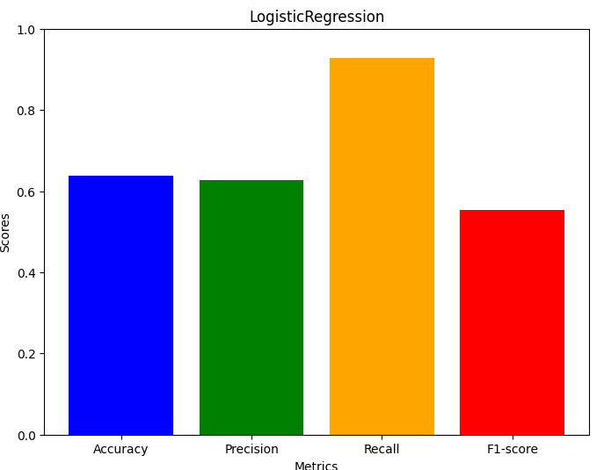
RESULTS

Slide 13
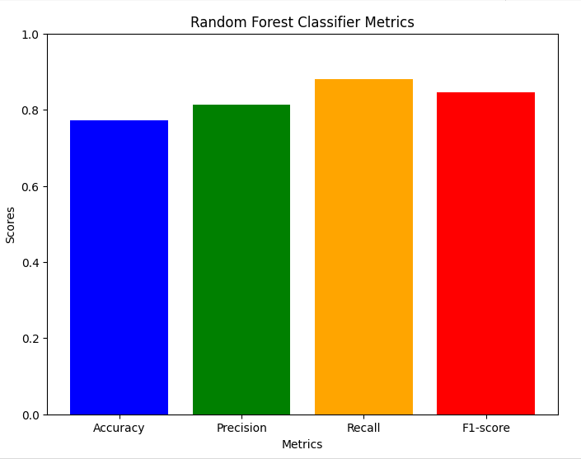
RESULTS (Cont…)

Slide 14
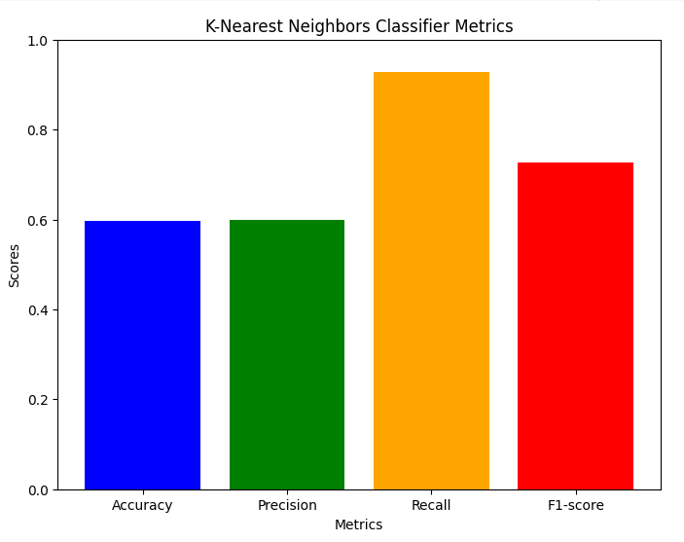
RESULTS (Cont…)

Slide 15
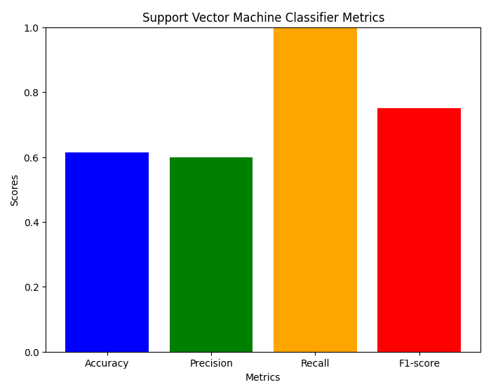
RESULTS (Cont…)

Slide 16
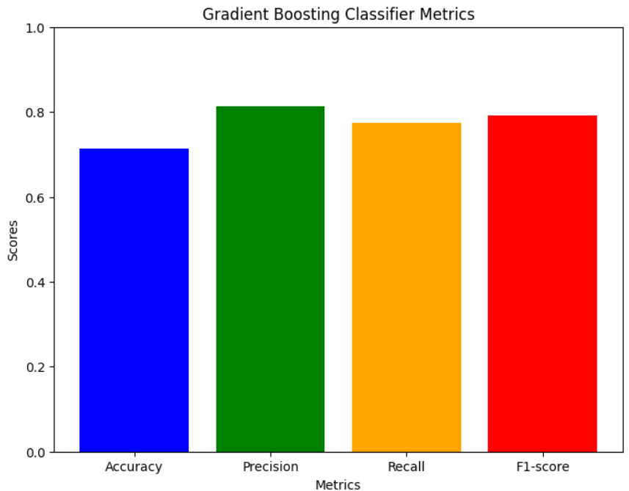
RESULTS (Cont…)

Slide 17
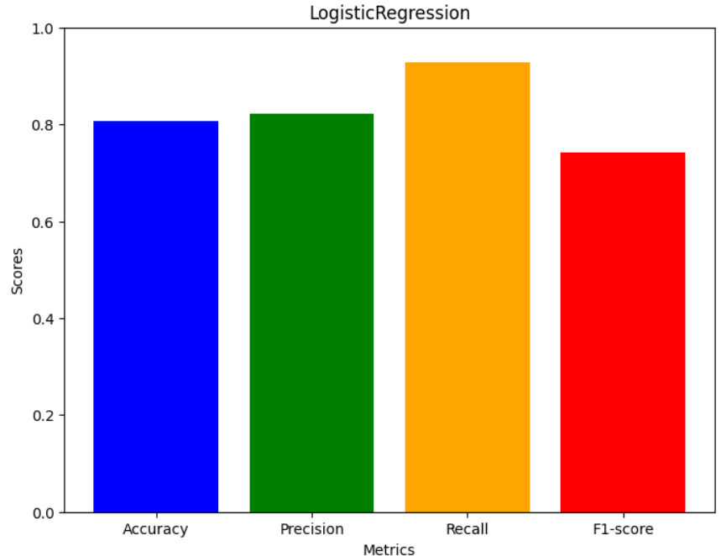
RESULTS (Cont…)
OPTIMISED MODEL

Slide 18
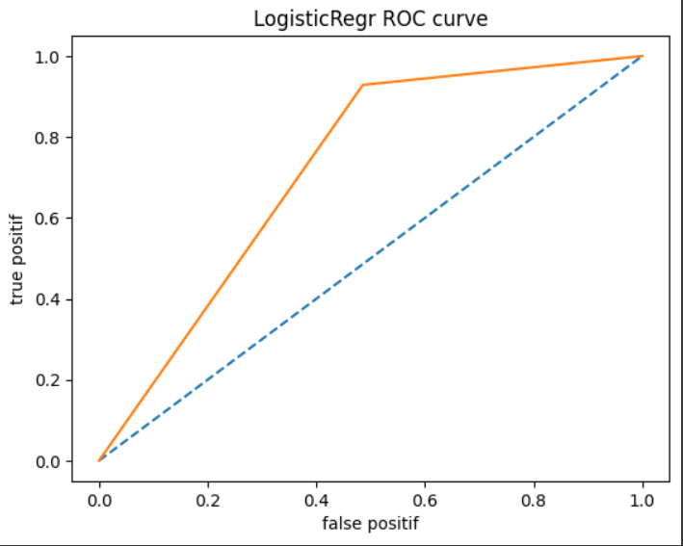
RESULTS (Cont…)
OPTIMISED MODEL

Slide 19
THANK YOU

