Slide 1
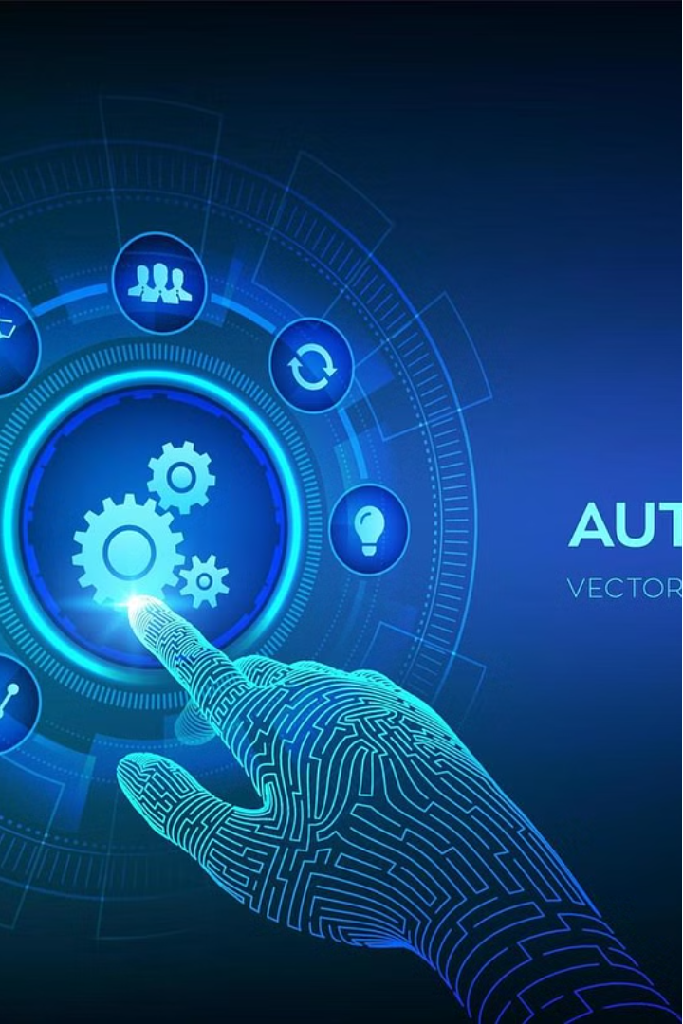
Digital Placement Platform (DPP)
Automation Transformation: Accelerating Quality Assurance
by Rajkumar Rajamani

Slide 2
Unlocking the Power of Automation
Establishing a Robust Automation Framework
1
Our team developed a customized automation framework from scratch, adopting a Cucumber BDD (Behavior-Driven Development) style.
This approach allowed us to document requirements in the form of user-friendly feature files, ensuring a seamless transition from QA to user acceptance testing.
2
Integrating API and UI Functionalities
By combining API and UI automation, we were able to achieve a comprehensive testing coverage, addressing both the backend (API) and frontend components of the application.
This holistic approach proved to be a game-changer, as it allowed us to identify and resolve issues more efficiently.
Enhancing Reporting and User Experience
3
To provide a more user-friendly and informative reporting experience, we developed a custom HTML report that goes beyond the traditional pass/fail status.
This report includes features such as known/deferred failures, screenshot capture, and detailed validation information, all presented in a visually appealing manner with intuitive pie charts and statistics.

Slide 3

Unlocking Efficiency through Parallel Execution
1
Regression Suite Optimization
2
Significant Time and Cost Savings
Our regression test suite consists of 380 cases, which previously took 8-9 hours to complete. By implementing parallel execution, we were able to reduce the execution time by 60%, from 8-9 hours to 3-4 hours.
The reduction in regression execution time has resulted in a remarkable 81 hours of manual effort saved. Considering an hourly rate of $31, this translates to a substantial cost savings for the project approximately up to $2,511.
3
Increased Productivity and Efficiency
By leveraging the power of parallel execution, our team has been able to streamline the QA process, ensuring faster feedback loops and enabling the development team to address issues more promptly.

Slide 4
Overcoming Intermittent Failures
Current Challenge: Intermittent Failures
Strategies for Improvement
Future Goals
Despite the significant benefits of our automation efforts, we are still faced with the challenge of intermittent failures during regression runs, with approximately 10% of the tests affected.
To address this issue, we plan to investigate the root causes of these intermittent failures and implement targeted improvements to our automation framework. This may include enhancing test stability, improving error handling, and incorporating more robust wait conditions.
Our ultimate goal is to further reduce the failure percentage, ensuring a more reliable and stable automation suite. This will not only improve the overall quality of our application but also instill greater confidence in our testing processes.

Slide 5
Integrating Automation into CI/CD
Seamless Integration
Faster Feedback Loops
Increased Confidence
To streamline our QA processes and ensure rapid feedback, we plan to integrate our automation suite into a CI/CD (Continuous Integration, Continuous Deployment) pipeline. This will enable us to automatically trigger regression tests with every code commit, providing immediate visibility into the impact of changes.
By integrating automation into the CI/CD pipeline, we can establish faster feedback loops, allowing developers to address issues more quickly and efficiently. This will ultimately lead to improved product quality and a more agile development cycle.
Automating the regression suite within the CI/CD pipeline will give us greater confidence in our ability to maintain the stability and reliability of our application, even as new features are introduced, and the codebase evolves.

Slide 6
The Road Ahead: Embracing the Automation Future
Reduced Execution Time for Regression
Increased Productivity
Improved Quality
Cost Savings
From 8-9 hours to 3-4 hours
81 hours of manual effort saved
Consistent and reliable test results
$2,511 saved (81 hours x $31/hour)
As we look to the future, our automation journey will continue to evolve, driven by our commitment to innovation and our desire to push the boundaries of what's possible. By embracing the power of automation, we are laying the foundation for a more efficient, agile, and quality-driven software development process, ultimately delivering exceptional value to our stakeholders.

