Slide 1
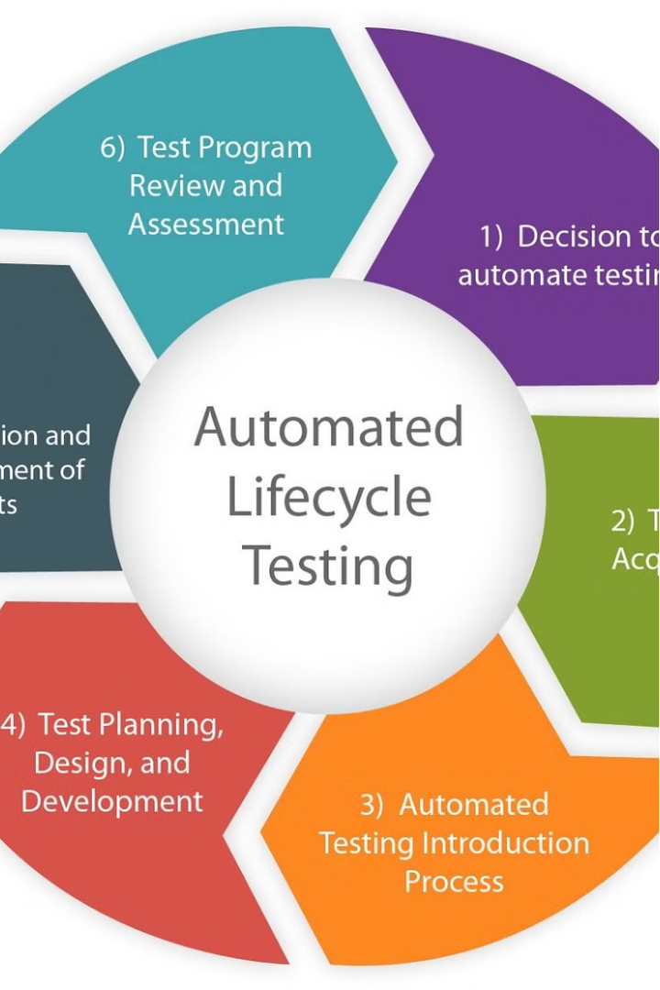



Transforming QA with Automation
Discover how our team overcame limited test coverage and siloed testing to build a comprehensive test automation framework, seamlessly integrating API and UI testing for enhanced quality assurance.
by Rajkumar Rajamani

Slide 2
Before: Fragmented Testing
Insufficient Test Coverage
Vendor Challenges
Lack of Automation Framework
The previous vendor was unable to automate both API and UI testing together, resulting in a fragmented approach.
The QA team struggled with limited test coverage, leaving critical functionality untested.
Without a robust test automation framework, the team relied on manual testing, compromising efficiency and agility.

Slide 3
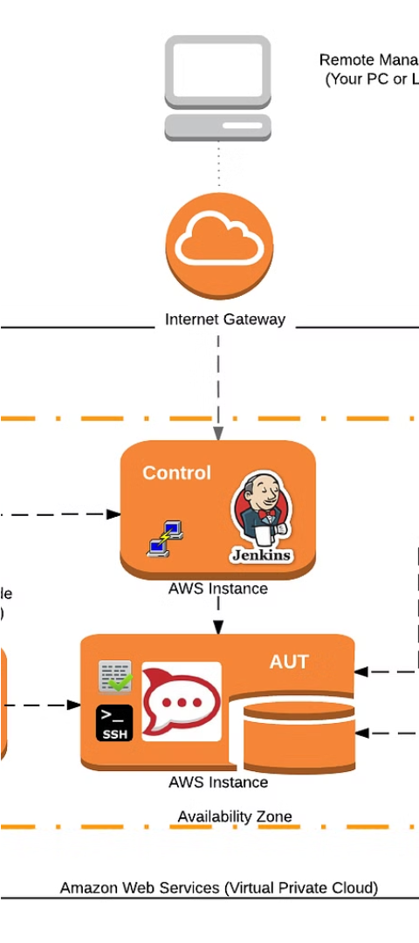
After: Unified Automation Framework
1
Comprehensive Test Coverage
Implemented a Cucumber BDD-style automation framework to ensure thorough testing of both API and UI components.
2
Seamless Integration
Automated API and UI testing within a single test case, providing end-to-end validation and greater efficiency.
3
Improved Quality Assurance
The new automation framework enabled the QA team to identify and address issues earlier in the development cycle.

