Slide 1

CONTROL SYSTEMS (5EC4-03) V-Sem(ECE)

Slide 2
Course Outcomes
CO1: Characterize a system mathematically and find its steady state behaviour
CO2: Analyze stability of a system using different tests
CO3: Design various controllers
CO4: Solve linear, non-linear and optimal complex control problems
CO5: Designing state model for a given system of equations

Slide 3
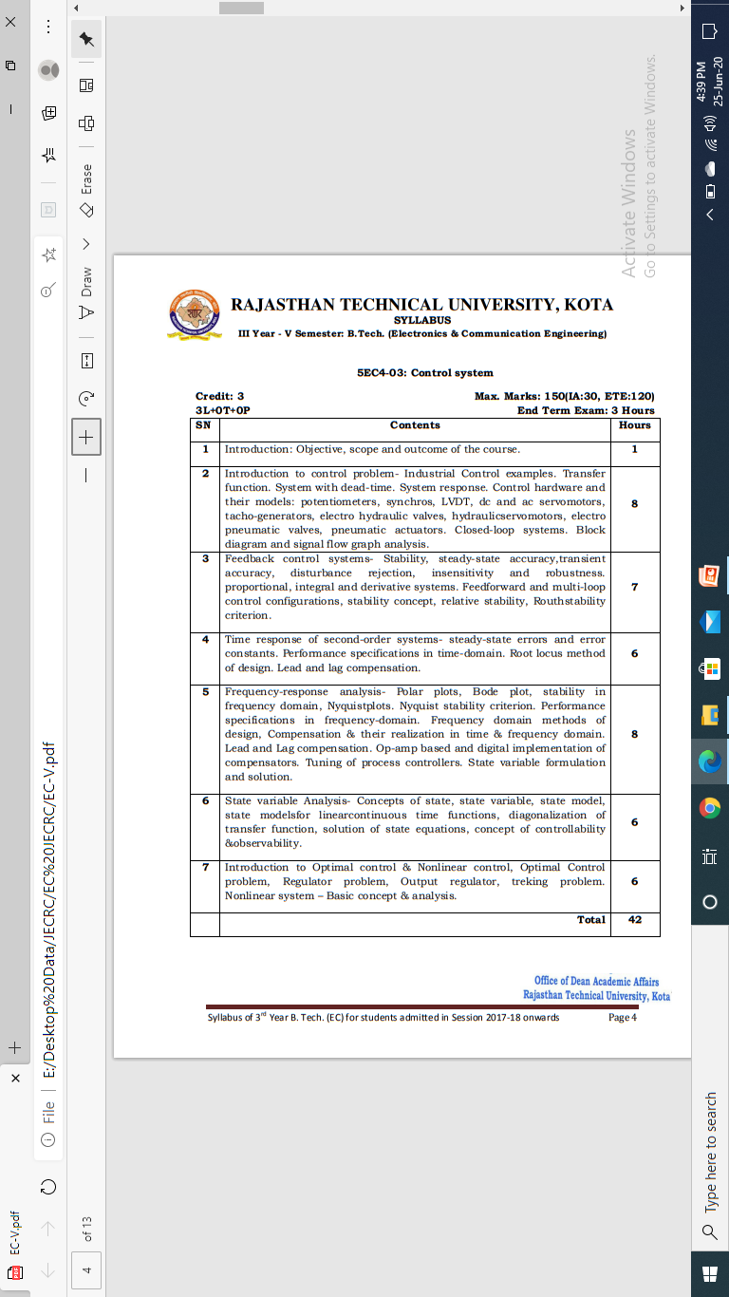
Syllabus

Slide 4
Unit-V
State Variable Analysis

Slide 5
Basic Concepts of State Space Model
The following basic terminology involved in this chapter.
It is very important to discuss here the differences between the conventional theory of control system and modern theory of control system.
1. The conventional control theory is completely based on the frequency domain approach while the modern control system theory is based on time domain approach.
2. In the conventional theory of control system we have linear and time invariant single input single output (SISO) systems only but with the help of theory of modern control system we can easily do the analysis of even non linear and time variant multiple inputs multiple outputs (MIMO) systems also.

Slide 6
In the modern theory of control system the stability analysis and time response analysis can be done by both graphical and analytically method very easily.
Now state space analysis of control system is based on the modern theory which is applicable to all types of systems like single input single output systems, multiple inputs and multiple outputs systems, linear and non linear systems, time varying and time invariant systems. Let us consider few basic terms related to state space analysis of modern theory of control systems.

Slide 7
State in State Space Analysis
It is a group of variables, which summarizes the history of the system in order to predict the future values (outputs).
It refers to smallest set of variables whose knowledge at t = t0 together with the knowledge of input for t ≥ t0 gives the complete knowledge of the behavior of the system at any time t ≥ t0.
A state of a system is the current value of internal elements of the system, that change separately (but not completely unrelated) to the output of the system. In essence, the state of a system is an explicit account of the values of the internal system components.

Slide 8
Here are some examples:
Consider an electric circuit with both an input and an output terminal. This circuit may contain any number of inductors and capacitors. The state variables may represent the magnetic and electric fields of the inductors and capacitors, respectively.
Consider a spring-mass-dashpot system. The state variables may represent the compression of the spring, or the acceleration at the dashpot.
Consider a chemical reaction where certain reagents are poured into a mixing container, and the output is the amount of the chemical product produced over time. The state variables may represent the amounts of un-reacted chemicals in the container, or other properties such as the quantity of thermal energy in the container (that can serve to facilitate the reaction).

Slide 9
State Variables in State Space analysis
The number of the state variables required is equal to the number of the storage elements present in the system.
It refers to the smallest set of variables which help us to determine the state of the dynamic system. State variables are defined by x1(t), x2(t)……..Xn(t).

Slide 10
When modeling a system using a state-space equation, we first need to define three vectors:
Input variables
A SISO (Single Input Single Output) system will only have a single input value, but a MIMO system may have multiple inputs. We need to define all the inputs to the system, and we need to arrange them into a vector.
Output variables
This is the system output value, and in the case of MIMO systems, we may have several. Output variables should be independent of one another, and only dependent on a linear combination of the input vector and the state vector.

Slide 11
State Variables
The state variables represent values from inside the system, that can change over time. In an electric circuit, for instance, the node voltages or the mesh currents can be state variables. In a mechanical system, the forces applied by springs, gravity, and dashpots can be state variables.
We denote the input variables with u, the output variables with y, and the state variables with x. In essence, we have the following relationship:
y=f(x,u)
Where f(x, u) is our system. Also, the state variables can change with respect to the current state and the system input:
x'=g(x,u)
Where x' is the rate of change of the state variables.

Slide 12
State Vector
It is a vector, which contains the state variables as elements.
In the earlier chapters, we have discussed two mathematical models of the control systems. Those are the differential equation model and the transfer function model. The state space model can be obtained from any one of these two mathematical models. Let us now discuss these two methods one by one.

Slide 13
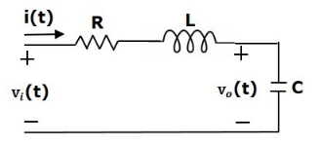
State Space Model from Differential Equation
Consider the following series of the RLC circuit. It is having an input voltage, vi(t) and the current flowing through the circuit is i(t)
There are two storage elements (inductor and capacitor) in this circuit. So, the number of the state variables is equal to two and these state variables are the current flowing through the inductor, i(t) and the voltage across capacitor, vc(t).

Slide 14
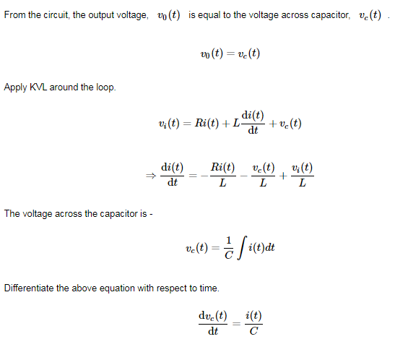

Slide 15
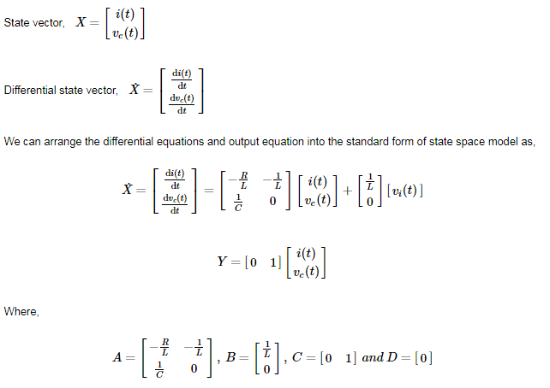

Slide 16
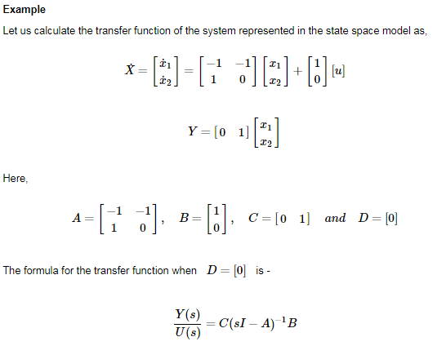

Slide 17
