Slide 1
Inheritance, Sub Classing, Package
Prof. Adarsh Ashok Assistant Professor
Faculty of Information Technology and Computer Science

Slide 2
Content
Inheritance Concepts
Defining sub classes
method overriding,
using super keyword,
Variable shadowing,
Method and variable binding,
Using final keyword,
Abstract classes and interfaces.
Object class,
Packages - Creating package
CLASSPATH environment variable
Access specifiers, Access Control / visibility.

Slide 3
Learning Outcomes
Understand the Concept of Inheritance
Define and Implement Subclasses
Apply Method Overriding
Use the super Keyword Effectively
Understand Variable Shadowing
Differentiate Between Method and Variable Binding
Use the final Keyword Appropriately
Implement Abstract Classes and Interfaces
Utilize the Object Class Methods
Create and Use Packages in Java
Set and Use the CLASSPATH Environment Variable
Understand and Apply Access Specifiers
Prof.Adarsh Ashok

Slide 4
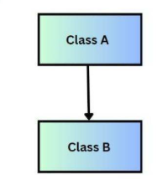
What is Inheritance?
Inheritance is a mechanism in Java by which one class (subclass/child class) can acquire(takes) the properties and behaviors (fields and methods) of another class (superclass/parent class).
Class A is the superclass
Class B is the subclass
Prof.Adarsh Ashok

Slide 5
WHY INHERITANCE
It promotes code reuse.
Establishes a parent-child relationship between classes.
Helps implement polymorphism and method overriding.
Prof.Adarsh Ashok

Slide 6
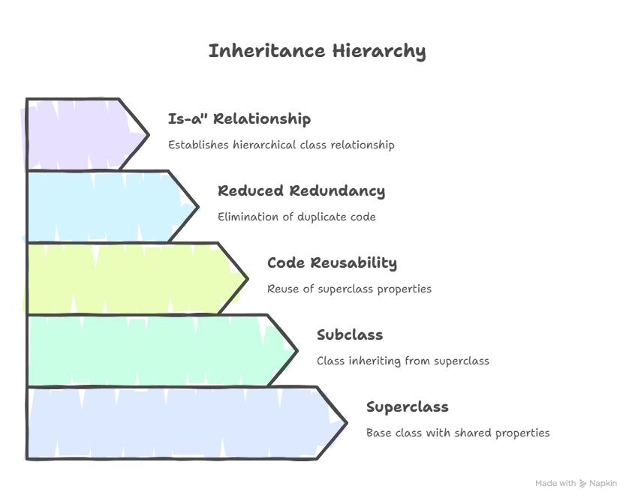
Prof.Adarsh Ashok

Slide 7
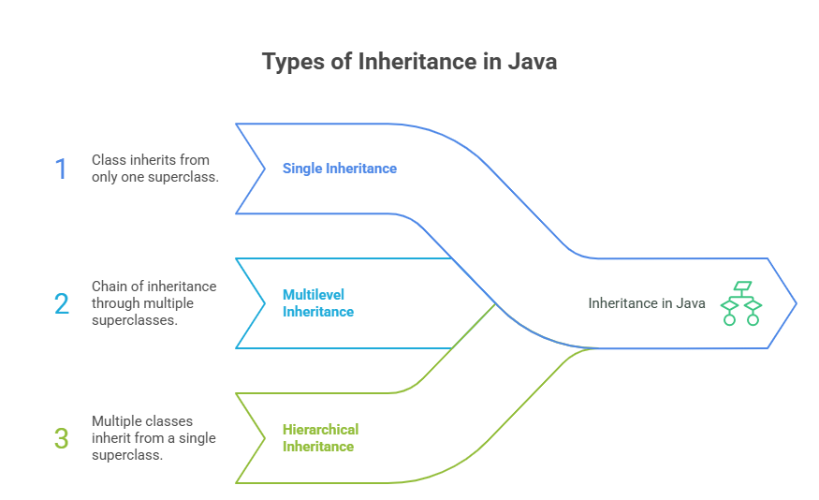
Multiple inheritance is achieved by Interface
Prof.Adarsh Ashok

Slide 8
Terminology
Superclass (Parent Class) | The class whose members are inherited.
Subclass (Child Class) | The class that inherits from the superclass.
extends keyword | Used to inherit a class.
super keyword | Refers to the superclass constructor or method.
Prof.Adarsh Ashok

Slide 9
extends keyword is used to perform inheritance.
The subclass inherits:
All non-private fields
All non-private methods
Private members of the superclass are not accessible directly in the subclass.
Java does not support multiple inheritance through classes to avoid ambiguity (like the Diamond Problem), but interfaces can be used for that.
Prof.Adarsh Ashok

Slide 10
SYNTAX:
class Parent {
}
class Child extends Parent {
}
public class Main {
public static void main(String[] args) {
}
}
Prof.Adarsh Ashok

Slide 11
Example :
class Parent {
void showMessage() {
System.out.println("Message from Parent");
}
}
class Child extends Parent {
void display() {
System.out.println("Message from Child");
}
}
public class Main {
public static void main(String[] args) {
Child c = new Child();
c.showMessage(); // inherited method
c.display(); // child method
}
}
Parent class
Child class
Main class
Prof.Adarsh Ashok

Slide 12
What is Single Inheritance?
Single Inheritance is a type of inheritance in which a subclass (child class) inherits the properties and behaviors (methods and variables) of exactly one superclass (parent class).
In simple terms, one child class extends one parent class.
Prof.Adarsh Ashok

Slide 13
Example:
class Employee {
void work() {
System.out.println("Employee works");
}
}
class Manager extends Employee {
void manage() {
System.out.println("Manager manages the team");
}
}
public class Main {
public static void main(String[] args) {
Manager m = new Manager();
m.work(); // Inherited from Employee
m.manage(); // Defined in Manager
}
}
Prof.Adarsh Ashok

Slide 14
Why Use Single Inheritance?
Code Reusability: Common methods in the parent class don't need to be rewritten in child classes.
Hierarchy Representation: Real-world relationships like Student extends Person, Manager extends Employee.
Improves maintainability: Changes in parent class affect all child classes (if inherited properly).
Prof.Adarsh Ashok

Slide 15
Limitations of Single Inheritance:
Can inherit from only one superclass.
Cannot access private data of the superclass.
For complex inheritance needs, Java provides interface-based multiple inheritance.
Prof.Adarsh Ashok

Slide 16
Multilevel Inheritance
A class inherits from a subclass, which in turn inherits from another superclass.
Multilevel Inheritance is a type of inheritance in Java where a class is derived from another class, which is also derived from another class.
In this form of inheritance,
A chain of inheritance is created where each class inherits from a class above it in the hierarchy.
In simple terms, it means class A → class B → class C, where:
class B inherits from class A
class C inherits from class B
Prof.Adarsh Ashok

Slide 17
Animal (Base / Superclass)
↓
Mammal (Derived from Animal)
↓
Dog (Derived from Mammal)
Prof.Adarsh Ashok

Slide 18
Syntax
class A {
// members of A
}
class B extends A {
// members of B
}
class C extends B {
// members of C
}
Prof.Adarsh Ashok

Slide 19
class Animal {
void eat() {
System.out.println("Animal eats food");
} }
class Mammal extends Animal {
void walk() {
System.out.println("Mammal walks on land");
} }
class Dog extends Mammal {
void bark() {
System.out.println("Dog barks");
} }
public class TestInheritance {
public static void main(String[] args) {
Dog d = new Dog();
d.eat(); // inherited from Animal
d.walk(); // inherited from Mammal
d.bark(); // defined in Dog
} }
Prof.Adarsh Ashok

Slide 20
Hierarchical Inheritance
Hierarchical Inheritance occurs when multiple subclasses inherit from a single parent class.
All child classes share the properties and methods of the common superclass, but they can also have their own specific behavior.
Structure (How it looks) Example
For eg:
Here All 3 Child classes are taking a property(Blue colour) from parent class.
Parent
Child 1
Child 2
Child 3
Prof.Adarsh Ashok

Slide 21
Syntax:
// Superclass
class Parent {
// parent class members
}
// Subclass 1
class Child1 extends Parent {
// specific members of Child1
}
// Subclass 2
class Child2 extends Parent {
// specific members of Child2
}
Prof.Adarsh Ashok

Slide 22
Example :
// Superclass
class Pokemon {
void basicInfo() {
System.out.println("This is a Pokémon.");
}
void attack() {
System.out.println("Pokémon uses a basic attack!");
}}
// Subclass 1
class Pikachu extends Pokemon {
void thunderbolt() {
System.out.println("Pikachu uses Thunderbolt!");
}}
// Subclass 2
class Charmander extends Pokemon {
void flamethrower() {
System.out.println("Charmander uses Flamethrower ");
}}
// Main class
public class Main {
public static void main(String[] args) {
// Pikachu
Pikachu p = new Pikachu();
p.basicInfo(); // inherited
p.attack(); // inherited
p.thunderbolt(); // unique to Pikachu
System.out.println(); // for spacing
// Charmander
Charmander c = new Charmander();
c.basicInfo(); // inherited
c.attack(); // inherited
c.flamethrower(); // unique to Charmander
}
}
Prof.Adarsh Ashok

Slide 23
What is Multiple Inheritance?
Multiple Inheritance refers to a class inheriting from more than one parent — gaining properties and behaviors from multiple sources.
In languages like C++, a class can inherit from multiple classes directly, but...
Java does not support multiple inheritance with classes to avoid the Diamond Problem.
Prof.Adarsh Ashok

Slide 24
What is the Diamond Problem?
The diamond problem is a classical problem in object-oriented programming languages involving multiple inheritance, where a class inherits from two classes that both inherit from a common superclass. This leads to ambiguity about which method or attribute should be inherited from the common ancestor.
A
B
C
D
Prof.Adarsh Ashok

Slide 25
class A {
void show() {
System.out.println("A");
}
}
class B extends A {
void show() {
System.out.println("B");
}
}
class C extends A {
void show() {
System.out.println("C");
}
}
// This will cause an error in Java
// class D extends B, C { } // Not allowed
Prof.Adarsh Ashok

Slide 26
Real-world Example
Imagine two teachers (B and C) give you different answers to the same question from a textbook (A).
If you are a student (D) learning from both, unless you clarify whose method to use, you’ll be confused.
Java forces you (student) to choose explicitly, avoiding confusion.
Prof.Adarsh Ashok

Slide 27
What is Hybrid Inheritance?
Hybrid Inheritance is a combination of two or more types of inheritance (such as single, multiple, multilevel, or hierarchical inheritance) in one program. It is used to model more complex class relationships.
Types of Inheritance Combined in Hybrid Inheritance
A hybrid inheritance may involve combinations such as:
Multilevel + Hierarchical
Single + Multiple
Hierarchical + Multiple, etc.
Prof.Adarsh Ashok

Slide 28
Hybrid Inheritance is Not Directly Supported with Classes in Java.
Java does not support multiple inheritance with classes to avoid ambiguity (diamond problem).
Hence, true hybrid inheritance using only classes is not possible.
But Java supports hybrid inheritance via interfaces.
Prof.Adarsh Ashok

Slide 29
// Interface A
interface A {
void show(); }
// Interface B extends A
interface B extends A {
void displayB(); }
// Interface C extends A
interface C extends A {
void displayC(); }
// Class D implements both B and C
class D implements B, C {
public void show() {
System.out.println("This is show() from interface A");
}
public void displayB() {
System.out.println("This is displayB() from interface B");
}
public void displayC() {
System.out.println("This is displayC() from interface C");
} }
public class Main {
public static void main(String[] args) {
D obj = new D();
obj.show();
obj.displayB();
obj.displayC();
} }
Prof.Adarsh Ashok

Slide 30
(interface)
A
B
C
Hierarchical
D
Multiple Inheritance
Hybrid inheritance = combination of multiple inheritance types
Java supports hybrid inheritance using interfaces only, not with classes
Java avoids ambiguity and diamond problem using a clear interface method resolution
Hybrid inheritance enables flexible and powerful class design
Prof.Adarsh Ashok

Slide 31
Polymorphism
The word Polymorphism comes from Greek:
Poly = many
Morph = forms
In Java, polymorphism means the ability of an object to take many forms. It allows a single interface to be used for different types (classes).
Polymorphism enables Java to perform a single action in different ways depending on the object at runtime or compile time.
Prof.Adarsh Ashok

Slide 32
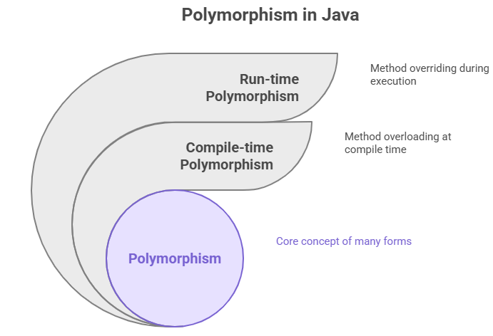
Dynamic Polymorphism
Static Polymorphism
Prof.Adarsh Ashok

Slide 33
Method Overloading
Same method name, different parameters
Resolved at compile time
class MathUtils {
int add(int a, int b) {
return a + b;
}
double add(double a, double b) {
return a + b;
}
}
Prof.Adarsh Ashok

Slide 34
What is Method Overriding?
Method Overriding in Java occurs when a subclass provides a specific implementation of a method that is already defined in its parent class.
The method in the subclass must have the same name, return type, and parameters as in the superclass.
It is used to achieve runtime polymorphism (dynamic method dispatch).
Overriding allows a child class to provide a specific behavior different from the parent class.
Prof.Adarsh Ashok

Slide 35
class Parent {
void show() {
System.out.println("This is parent class");
}
}
class Child extends Parent {
@Override
void show() {
System.out.println("This is child class");
}
}
Prof.Adarsh Ashok

Slide 36
What is super in Java?
The super keyword in Java is a reference variable used inside a subclass (child class) to refer to its immediate superclass (parent class).
It is primarily used to:
Access parent class constructors
Access parent class methods
Access parent class variables
Prof.Adarsh Ashok

Slide 37
Why Use super?
To differentiate between superclass and subclass members when they have same names.
To reuse functionality from the parent class.
To explicitly call parent class constructor when subclass needs to initialize inherited members.
Prof.Adarsh Ashok

Slide 38
Uses of super Keyword
1. Accessing Parent Class Constructor
You can use super() to call the constructor of the parent class.
This must be the first statement in the subclass constructor.
Syntax
super(); // Calls default constructor of parent
super(parameters); // Calls parameterized constructor of parent
Prof.Adarsh Ashok

Slide 39
class Person {
Person(String name) {
System.out.println("Name: " + name);
}
}
class Student extends Person {
Student(String name) {
super(name); // Calls Person's constructor
System.out.println("Student constructor called");
}
}
Prof.Adarsh Ashok

Slide 40
Accessing Parent Class Method
If a subclass overrides a method of its parent, super.methodName() can be used to call the parent’s version of the method.
Prof.Adarsh Ashok

Slide 41
What is Variable Shadowing in Java?
Variable Shadowing occurs when a local variable (declared inside a method, constructor, or block)
has the same name as an instance variable (class field).
In this case:
The local variable “shadows” (hides) the instance variable within its scope.
To access the hidden instance variable, we use this keyword.
Prof.Adarsh Ashok

Slide 42
public class Shadow {
// Instance variable
int number = 100;
void show() {
// Local variable with same name
int number = 50;
System.out.println("Local variable: " + number); // prints 50
System.out.println("Instance variable: " + this.number); // prints 100
}
public static void main(String[] args) {
Shadow obj = new Shadow();
obj.show();
}
}
Prof.Adarsh Ashok

Slide 43
Method and variable binding
Binding in Java
Binding means the process of connecting a method call or a variable reference to its actual code (definition) during program execution.
There are two types of binding in Java:
Static Binding (Early Binding / Compile-time Binding)
Happens at compile-time.
Used for:
Static methods
Final methods
Private methods
Variables (fields)
The compiler already knows which method or variable to call.
Prof.Adarsh Ashok

Slide 44
class Test {
static void show() {
System.out.println("Static method");
}
public static void main(String[] args) {
Test.show(); // resolved at compile time
}
}
Prof.Adarsh Ashok

Slide 45
2. Dynamic Binding (Late Binding / Runtime Binding)
Happens at runtime.
Used for:
Overridden methods (in inheritance & polymorphism).
The JVM decides which method to call based on the object type at runtime, not the reference type.
Prof.Adarsh Ashok

Slide 46
class Parent {
void display() {
System.out.println("Parent display");
}
}
class Child extends Parent {
@Override
void display() {
System.out.println("Child display");
}
}
public class Main {
public static void main(String[] args) {
Parent obj = new Child(); // reference type = Parent, object type = Child
obj.display(); // Runtime → Child display
}
}
Prof.Adarsh Ashok

Slide 47
Variables → Static Binding (compile time)
Methods → Dynamic Binding (runtime, if overridden)
Static, final, and private methods → Static Binding
Overridden methods → Dynamic Binding
Prof.Adarsh Ashok

Slide 48
The final Keyword in Java
The final keyword can be applied to variables, methods, and classes.
Final Variable
Once assigned, its value cannot be changed (constant).
It must be initialized at declaration or inside a constructor (for instance variables).
class FinalVariableExample {
final int MAX = 100; // must be initialized
void display() {
// MAX = 200; //Error: cannot assign a value to final variable
System.out.println("MAX = " + MAX);
}
}
Prof.Adarsh Ashok

Slide 49
Final Method
A final method cannot be overridden by subclasses.
Ensures implementation safety.
class Parent {
final void show() {
System.out.println("Final method in Parent");
}
}
class Child extends Parent {
// void show() Error: Cannot override final method
}
Prof.Adarsh Ashok

Slide 50
Final Class
A final class cannot be inherited.
Used when you want to prevent extension.
final class Vehicle {
void display() {
System.out.println("Vehicle class");
}
}
// class Car extends Vehicle Error: Cannot subclass final class
Prof.Adarsh Ashok

Slide 51
Special Cases with final
Blank Final Variable
Declared as final but not initialized immediately.
Must be initialized in the constructor.
class Student {
final int rollNo; // blank final variable
Student(int r) {
rollNo = r; // initialized in constructor
}
void display() {
System.out.println("Roll No: " + rollNo);
}
}
Prof.Adarsh Ashok

Slide 52
Final Reference Variable
A final object reference cannot point to another object.
But, the object’s internal data can be modified.
class Demo {
int x = 10;
}
public class Main {
public static void main(String[] args) {
final Demo obj = new Demo();
obj.x = 20; // allowed (data can change)
// obj = new Demo(); not allowed (reference can't change)
}
}
Prof.Adarsh Ashok

Slide 53
Abstract classes and interfaces
An abstract class is a special type of class that cannot be instantiated (you cannot create objects directly from it).
It is designed to be a base class that provides common features to subclasses, while leaving certain methods unimplemented for the subclasses to define.
It acts as a blueprint for other classes.
Prof.Adarsh Ashok

Slide 54
An abstract class is declared using the abstract keyword.
It can contain abstract methods (methods without implementation) and non-abstract methods (fully defined methods).
Abstract classes support data members, constructors, and methods just like normal classes.
They help in achieving partial abstraction (0–100%).
Prof.Adarsh Ashok

Slide 55
Why Abstract Classes? (Needs)
To provide a common base for related classes.
To enforce that certain methods must be implemented by subclasses.
To avoid code duplication by defining shared functionality in one place.
When multiple classes share some features but differ in implementation of others.
Example: All Animals make a sound, but the type of sound differs. So, Animal can be an abstract class with an abstract method sound().
Prof.Adarsh Ashok

Slide 56
// Abstract class
abstract class ClassName {
// Data members
int x;
// Constructor
ClassName() {
System.out.println("Abstract class constructor");
}
// Abstract method (no body)
abstract void abstractMethod();
// Non-abstract method (with body)
void normalMethod() {
System.out.println("This is a normal method in abstract class");
}
}
Prof.Adarsh Ashok

Slide 57
// Abstract class
abstract class Animal {
abstract void sound(); // Abstract method
void sleep() { // Non-abstract method
System.out.println("Sleeping...");
}
}
// Subclass 1
class Dog extends Animal {
void sound() {
System.out.println("Barks");
}
}
// Subclass 2
class Cat extends Animal {
void sound() {
System.out.println("Meows");
}
}
public class AbstractDemo {
public static void main(String[] args) {
Animal a1 = new Dog();
Animal a2 = new Cat();
a1.sound(); // Barks
a2.sound(); // Meows
a1.sleep(); // Sleeping...
}
}
Prof.Adarsh Ashok

Slide 58
Key Rules of Abstract Classes
Declared using the keyword abstract.
Cannot be instantiated directly.
May or may not contain abstract methods.
Can have constructors (executed when subclass object is created).
Can have static methods and final methods (but abstract methods cannot be final or static).
A subclass of an abstract class must:
Provide implementations for all abstract methods, OR
Be declared as abstract itself.
Abstract classes can have:
Fields/variables
Methods (abstract and concrete)
Constructors
Static methods
Final methods
Abstract classes support single inheritance (Java does not allow multiple inheritance for classes).
Prof.Adarsh Ashok

Slide 59
Interface
An interface in Java is a reference type (like a class) that defines a set of abstract methods (by default) that a class must implement.
It is used to specify a contract (what a class must do, not how).
Supports multiple inheritance of type (since a class can implement multiple interfaces).
Helps achieve 100% abstraction (before Java 8).
Interfaces are fundamental in Java for abstraction, polymorphism, and loose coupling.
Prof.Adarsh Ashok

Slide 60
Declared using the interface keyword.
Methods inside interfaces are implicitly abstract and public (before Java 8).
Fields inside interfaces are public, static, and final by default.
A class uses the implements keyword to provide definitions for an interface’s methods.
Why Interfaces? (Need)
To achieve abstraction.
To support multiple inheritance (Java does not allow multiple inheritance with classes).
To provide loose coupling between different modules.
To enforce a common standard/contract across unrelated classes.
Example: Comparable and Runnable interfaces.
Prof.Adarsh Ashok

Slide 61
// Interface
interface InterfaceName {
// constant (by default public, static, final)
int VALUE = 10;
// abstract method (implicitly public and abstract)
void abstractMethod();
// default method (Java 8+)
default void defaultMethod() {
System.out.println("Default implementation in interface");
}
// static method (Java 8+)
static void staticMethod() {
System.out.println("Static method in interface");
}
// private method (Java 9+)
private void helper() {
System.out.println("Helper method in interface");
}
}
Syntax
Prof.Adarsh Ashok

Slide 62
class Cat implements Animal {
public void sound() {
System.out.println("Meows");
}
public void sleep() {
System.out.println("Sleeping...");
}
}
public class InterfaceDemo {
public static void main(String[] args) {
Animal a1 = new Dog();
Animal a2 = new Cat();
a1.sound(); // Barks
a2.sound(); // Meows
a1.sleep(); // Sleeping...
}
}
Example
// Interface
interface Animal {
void sound(); // abstract method
void sleep(); // abstract method
}
// Class implementing interface
class Dog implements Animal {
public void sound() {
System.out.println("Barks");
}
public void sleep() {
System.out.println("Sleeping...");
}
}
Prof.Adarsh Ashok

Slide 63
Key Rules of Interfaces
Declared with interface keyword.
Cannot have constructors.
Cannot be instantiated directly.
All methods are abstract and public by default (before Java 8).
Fields are public, static, and final (constants).
A class that implements an interface must:
Provide implementation of all methods, OR
Be declared as abstract.
A class can implement multiple interfaces.
Interfaces can extend other interfaces (multiple inheritance allowed).
Prof.Adarsh Ashok

Slide 64
Multiple Inheritance with Interfaces
interface Printable {
void print();
}
interface Showable {
void show();
}
class Demo implements Printable, Showable {
public void print() {
System.out.println("Printing...");
}
public void show() {
System.out.println("Showing...");
}
}
public class MultipleInheritanceDemo {
public static void main(String[] args) {
Demo d = new Demo();
d.print();
d.show();
}
}
Prof.Adarsh Ashok

Slide 65
Object class
In Java, Object is the root class of the Java class hierarchy.
Every class in Java directly or indirectly inherits from the Object class.
Located in the java.lang package, so no need to import it explicitly.
If a class does not explicitly extend another class, it implicitly extends Object.
This makes Object the superclass of all classes in Java.
Provides common behavior to all classes.
Supports polymorphism (we can use Object type to reference any object).
Defines 11 methods that every class inherits.
Enables features like garbage collection, cloning, synchronization, equality checks, etc.
Prof.Adarsh Ashok

Slide 66
Methods of Object Class
1. public final Class<?> getClass()
Returns the runtime class of an object.
Useful for reflection.
String s = "Hello"; System.out.println(s.getClass()); // class java.lang.String
2. public int hashCode()
Returns an integer hash code value for the object.
Used in hashing-based collections like HashMap, HashSet.
Two equal objects must have the same hashCode.
String s1 = "Java";
String s2 = "Java";
System.out.println(s1.hashCode());
System.out.println(s2.hashCode()); // same hash
Prof.Adarsh Ashok

Slide 67
3. public boolean equals(Object obj)
Used to compare two objects for equality.
Default: compares memory addresses (reference equality).
Can be overridden for logical equality (e.g., comparing content in String class).
String s1 = new String("Java");
String s2 = new String("Java");
System.out.println(s1.equals(s2)); // true (content equality)
System.out.println(s1 == s2); // false (different objects)
Prof.Adarsh Ashok

Slide 68
4. protected Object clone() throws CloneNotSupportedException
Creates a copy (clone) of the object.
The class must implement Cloneable interface.
class Student implements Cloneable {
int id; Student(int id) {
this.id = id;
}
public Object clone() throws CloneNotSupportedException {
return super.clone();
} }
public class CloneDemo
{ public static void main(String[] args) throws CloneNotSupportedException {
Student s1 = new Student(101);
Student s2 = (Student) s1.clone();
System.out.println(s2.id); // 101 } }
Prof.Adarsh Ashok

Slide 69
5. public String toString()
Returns a string representation of an object.
Default: prints class name + @ + hashcode in hex.
Commonly overridden for meaningful output.
class Student {
int id = 1;
public String toString() {
return "Student ID: " + id;
} }
public class ToStringDemo {
public static void main(String[] args) {
Student s = new Student();
System.out.println(s); // Student ID: 1 } }
Prof.Adarsh Ashok

Slide 70
What is a Package in Java?
A package in Java is a way of organizing related classes, interfaces, and
sub-packages into a single unit (like a folder in a file system). It helps in:
Avoiding naming conflicts (two classes can have the same name if they are in different packages).
Making the project in module and maintainable.
Providing access control and encapsulation.
Allowing us to create reusable libraries (JAR files).
Prof.Adarsh Ashok

Slide 71
Why are they “Ready-made Toolkits”?
Because they provide:
Reusable code → no need to reinvent the wheel.
Consistency → standardized, tested, and optimized by Oracle.
Wide coverage → data structures, I/O, networking, databases, GUIs, etc.
Portability → works the same across platforms.
Prof.Adarsh Ashok

Slide 72
Types of Packages
Java has two types of packages:
Built-in Packages (Predefined)
Java comes with many standard libraries in the java.* and javax.* packages.
java.util → contains utility classes (e.g., ArrayList, HashMap, Date)
java.io → input-output classes (e.g., File, BufferedReader)
java.sql → database classes (e.g., Connection, ResultSet)
java.time → modern date & time API
Prof.Adarsh Ashok

Slide 73
. java.lang (Automatically Imported)
Core classes for the Java language.
Always imported by default.
Contains fundamental classes. Examples: Object, String, Math, Integer, Double, System, Thread.
public class LangExample {
public static void main(String[] args) {
System.out.println(Math.sqrt(25)); // 5.0
String s = "Tulip";
System.out.println(s.toUpperCase()); // TULIP
}
}
Prof.Adarsh Ashok

Slide 74
java.util (Utilities Package)
Collection framework, data structures, utility classes. Examples: ArrayList, HashMap, HashSet, Date, Collections, Scanner.
import java.util.ArrayList;
public class UtilExample {
public static void main(String[] args) {
ArrayList<String> flowers = new ArrayList<>();
flowers.add("Rose");
flowers.add("Tulip");
System.out.println(flowers);
}
}
Prof.Adarsh Ashok

Slide 75
java.io (Input/Output)
Classes for reading/writing data (files, streams). Examples: File, BufferedReader, BufferedWriter, InputStream, OutputStream.
import java.io.File;
public class IOExample {
public static void main(String[] args) {
File file = new File("test.txt");
System.out.println(file.exists() ? "File exists" : "File not found");
}
}
Prof.Adarsh Ashok

Slide 76
java.net (Networking)
Classes for networking (TCP, UDP, URLs). Examples: URL, Socket, ServerSocket, HttpURLConnection.
import java.net.InetAddress;
public class NetExample {
public static void main(String[] args) throws Exception {
InetAddress ip = InetAddress.getLocalHost();
System.out.println("Local IP: " + ip.getHostAddress());
}
}
Prof.Adarsh Ashok

Slide 77
java.sql (Database)
For database access using JDBC (Java Database Connectivity). Examples: Connection, DriverManager, ResultSet, PreparedStatement.
Prof.Adarsh Ashok

Slide 78
java.time (Date and Time API – Java 8 onwards)
Modern API for handling date & time. Examples: LocalDate, LocalTime, LocalDateTime, Duration, Period.
import java.time.LocalDate;
public class TimeExample {
public static void main(String[] args) {
LocalDate today = LocalDate.now();
System.out.println("Today: " + today);
}
}
Prof.Adarsh Ashok

Slide 79
java.awt (Abstract Window Toolkit – GUI)
GUI components, graphics, and user interface. Examples: Frame, Button, Label, Graphics.
javax.swing (Swing – GUI)
Lightweight GUI toolkit, built on top of AWT. Examples: JFrame, JButton, JLabel, JTable.
Prof.Adarsh Ashok

Slide 80
java.applet (Deprecated)
Used for creating applets
Other Useful Packages
java.security → security features like encryption.
java.text → text formatting (e.g., dates, numbers).
java.nio → new I/O package with buffers and channels.
java.rmi → Remote Method Invocation.
javafx.* → modern Java GUI framework (replacement for Swing).
Prof.Adarsh Ashok

Slide 81
Package | Purpose / Contains
java.lang | Core classes (String, Math, Object, Thread)
java.util | Collections, utilities, Scanner, Date
java.io | File & stream I/O
java.net | Networking (Socket, URL)
java.sql | Database (JDBC API)
java.time | Modern date & time API
java.awt | GUI components & graphics
javax.swing | Lightweight GUI toolkit
java.text | Formatting of text, dates, numbers
java.security | Cryptography & security features
java.nio | New I/O (buffers, channels, paths)
Prof.Adarsh Ashok

Slide 82
User-Defined Packages
What is a User-Defined Package?
A user-defined package is a custom package created by developers to organize related classes, interfaces, and sub-packages.
While built-in packages are Java’s ready-made toolkits, user-defined packages are like your own organized toolbox.
Benefits:
Keeps your project organized.
Avoids name conflicts.
Promotes code reusability.
Helps in team collaboration.
Prof.Adarsh Ashok

Slide 83
Steps to Create a User-Defined Package
Step 1: Create a class and declare package
Step 2: Compile with -d option
Step 3: Create another class to use the package
Step 4: Compile and Run
Prof.Adarsh Ashok

Slide 84
Step 1: Create a class and declare package
Every package must start with a package statement.
File: FlowerUtils.java
// Package declaration
package com.shop.flowers;
public class FlowerUtils {
public static void displayMessage() {
System.out.println("Welcome to the Flower Shop!");
}
}
Rule: The folder name must match the package name. Here → com/shop/flowers
Prof.Adarsh Ashok

Slide 85
Step 2: Compile with -d option
javac -d . FlowerUtils.java
-d . tells the compiler to create the folder structure according to the package name.
Output directory will be:
com/
└─ shop/
└─ flowers/
FlowerUtils.class
Prof.Adarsh Ashok

Slide 86
Step 3: Create another class to use the package
File: MainApp.java
import com.shop.flowers.FlowerUtils; // Import your package
public class MainApp {
public static void main(String[] args) {
FlowerUtils.displayMessage();
}
}
Prof.Adarsh Ashok

Slide 87
Step 4: Compile and Run
javac -d . MainApp.java java MainApp
Output:
Welcome to the Flower Shop!
Prof.Adarsh Ashok

Slide 88
Access Modifiers in Packages
public → accessible from anywhere.
default (no modifier) → accessible only within the same package.
protected/private → work normally with inheritance rules.
Prof.Adarsh Ashok

Slide 89
Advantages of User-Defined Packages
Better project organization (like folders).
Code reuse – You can use the same package in multiple projects.
Avoid name clashes.
Collaboration-friendly – Different teams can work on different packages.
Extensible – Easy to add new classes to an existing package.
Prof.Adarsh Ashok

Slide 90
CLASSPATH Environment Variable in Java
In Java, classes and packages are compiled into .class files.
The JVM (Java Virtual Machine) and the Java compiler (javac) need to know where to find these .class files or JAR files to run/compile a program.
The CLASSPATH environment variable tells the JVM and Java tools the location(s) of user-defined classes, packages, and libraries.
CLASSPATH is an environment variable in Java that specifies a list of directories, JAR archives, or ZIP archives containing class files.
It acts as a search path for the JVM when looking for classes not found in the Java standard library.
Prof.Adarsh Ashok

Slide 91
Default Behavior
If CLASSPATH is not set, Java uses the current directory (.) as the default classpath.
This means Java looks for .class files in the folder where the program is executed.
javac MyProgram.java
java MyProgram
Here, Java looks for MyProgram.class in the current directory.
Prof.Adarsh Ashok

Slide 92
Ways to Set CLASSPATH
Temporary Setting (Command Line)
You can set classpath temporarily for a single run using the -cp or -classpath option:
javac -cp .;C:\libs\myLibrary.jar MyProgram.java
java -cp .;C:\libs\myLibrary.jar MyProgram
. (Dot) → current directory
C:\libs\myLibrary.jar → external JAR file
(In Linux/Mac use : instead of ; as a separator.)
Prof.Adarsh Ashok

Slide 93
Permanent Setting (Environment Variable)
You can define CLASSPATH as a system environment variable:
Windows (Command Prompt):
set CLASSPATH=.;C:\Java\lib;C:\Java\myJars\myLib.jar
Linux/Mac (bash shell):
export CLASSPATH=.:/usr/local/java/lib:/home/user/myLib.jar
Prof.Adarsh Ashok

Slide 94
Access specifiers, Access Control / visibility.
Access specifiers (also called access modifiers) in Java define the scope or visibility of classes, methods, constructors, and variables.
They are used to enforce encapsulation and control how other classes interact with the members of a class.
Java provides four levels of access control:
private
default (no modifier)
protected
public
Prof.Adarsh Ashok

Slide 95
1. private
The most restrictive access level.
Members declared as private are accessible only within the same class.
They are not visible to other classes, even subclasses.
class A {
private int data = 10;
private void show() {
System.out.println("Data = " + data);
}
}
public class Main {
public static void main(String[] args) {
A obj = new A();
// obj.data; // Error: data has private access
// obj.show(); // Error: show() has private access
}
}
Prof.Adarsh Ashok

Slide 96
2. Default (Package-Private)
If no access modifier is specified, the member has default access.
Members are accessible only within the same package.
Cannot be accessed from classes in different packages.
class A {
int value = 100; // default access
void display() {
System.out.println("Value = " + value);
}
}
Prof.Adarsh Ashok

Slide 97
3. Protected
Members declared as protected are:
Accessible within the same package (like default).
Accessible in subclasses (child classes) even if they are in different packages.
package pack2;
import pack1.A;
class B extends A {
void display() {
System.out.println("Accessing protected member: " + num);
}
}
package pack1;
public class A {
protected int num = 50;
protected void show() {
System.out.println("Number = " + num);
}
}
Prof.Adarsh Ashok

Slide 98
4. public
The least restrictive access level.
Members declared as public are accessible from anywhere:
Same class
Same package
Different packages
Subclasses
public class A {
public int x = 200;
public void display() {
System.out.println("X = " + x);
}
}
class Main {
public static void main(String[] args) {
A obj = new A();
System.out.println(obj.x); // Allowed
obj.display(); // Allowed
}
}
Prof.Adarsh Ashok

Slide 99
Access Level | Within Class | Same Package | Subclass (diff pkg) | Other Packages
private | Yes | No | No | No
default | Yes | Yes | No | No
protected | Yes | Yes | Yes | No
public | Yes | Yes | Yes | Yes
Prof.Adarsh Ashok

