Slide 1
Real-Time Zebra-Crossing Detection on a Low-Cost FPGA Camera
A small 1-bit neural network that checks every camera picture, using under 0.3 W
Raj Mali · Pooja Nagvekar
Guides: Prof. Anuradha Joshi · Prof. Amaya Pethe
Vidyalankar Institute of Technology, Mumbai
ZEBRA CROSSING!
Notes:
Good morning. Our project detects zebra crossings live from a cheap camera, using a small chip called an FPGA. The decision is made by a tiny neural network that uses only 1-bit numbers, so it is fast and uses very little power: under 0.3 watts. The picture on the right is how our monitor shows a detected crossing: a green border and the words ZEBRA CROSSING.

Slide 2
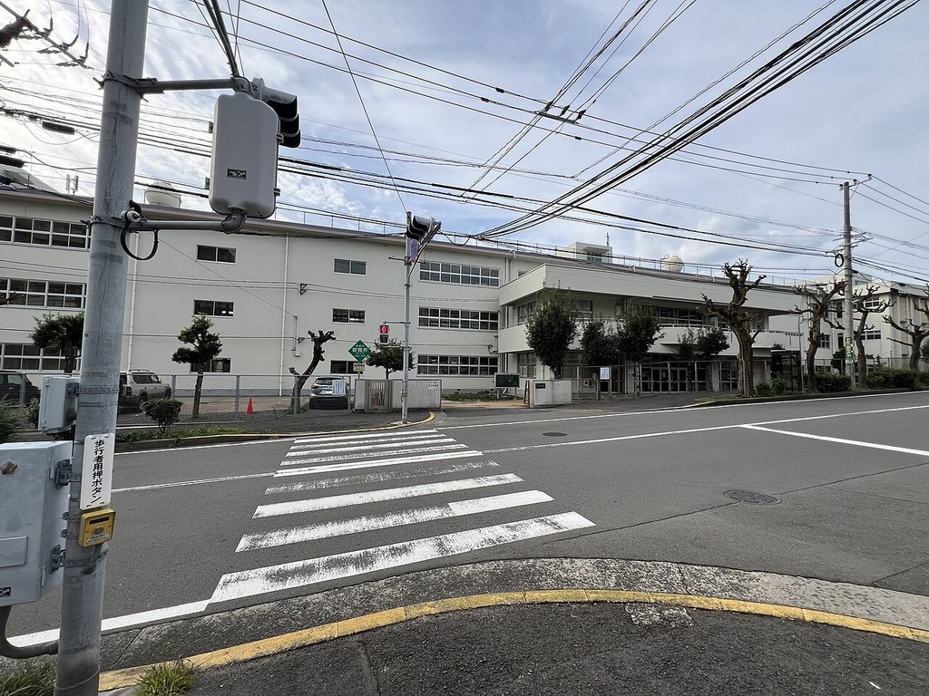



Why detect zebra crossings?
Safety for blind and low-vision people
A walking aid can tell them a crossing is just ahead.
Driver assistance
A car can warn the driver or slow down near a crossing.
It must work on the spot
No internet, no big computer, a small battery, and a quick answer.
Our goal: spot zebra crossings live from a cheap camera, on one small low-power chip, with answers we can trust.
Street photo: Wikimedia Commons (CC0)
Notes:
Why does this matter? First, for blind and low-vision people: a walking aid could tell them a crossing is ahead. Second, for cars: a driver-assist system can warn or slow down. In both cases the device must work on the spot: no internet, no big computer, a small battery, and a fast answer. So our goal was: detect crossings live, from a cheap camera, on one small low-power chip, with answers we can trust.

Slide 3





Our system at a glance
Camera
Prepare picture
1-bit network
Decision
Outputs
OV7670, 640×480 colour, 27 pictures a second
Gray, shrink to 80×60, fix the contrast
Finds the zebra pattern in 34 ms
Yes, No or Not sure, over 4 pictures
Monitor, LCD, LEDs and buzzer
Inside one FPGA chip: no processor, no software
Hardware we used: EDGE Artix-7 FPGA board · OV7670 camera · VGA monitor · LCD, LEDs, buzzer · laptop (optional)
Notes:
Here is the whole system. The camera takes 27 pictures a second. Inside the FPGA chip, three things happen: we prepare the picture, the neural network looks for the zebra pattern, and a decision block says yes, no or not sure. The answer is shown on a monitor, an LCD, LEDs and a buzzer. Important point: there is no processor and no software inside. The whole thing is a circuit we designed. The laptop is only optional, for showing results.

Slide 4



Why an FPGA, not a normal processor?
Normal processor (CPU)
FPGA (what we used)
Runs software, one instruction after another
Needs an operating system and memory chips
Uses several watts; timing can vary
We design the circuit itself
Many parts work at the same time
No software: the same speed every time
Our whole design uses under 0.3 W
Think of it like this: a CPU is one cook following a recipe step by step. An FPGA is a kitchen we build for exactly one dish, where every station works at once. We describe the circuit in Verilog, a language for hardware: like drawing a circuit diagram in text.
Notes:
Why an FPGA? A normal processor runs software, one instruction after another, and needs an operating system. An FPGA is different: it is a chip whose circuit we design ourselves. Many parts work at the same time, there is no software, and the speed is the same every time. A simple way to see it: a CPU is one cook following a recipe; an FPGA is a kitchen built for one dish, where every station works at once. We wrote the circuit in Verilog, which is a language that describes hardware, like a circuit diagram written as text.

Slide 5
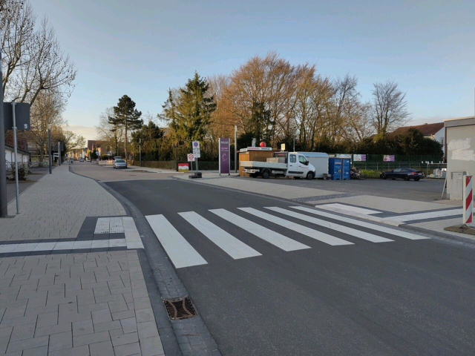
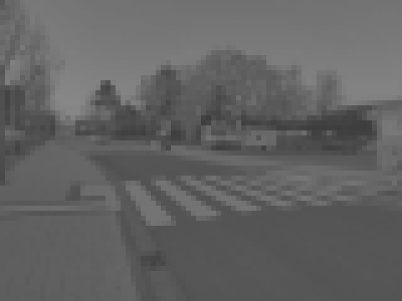
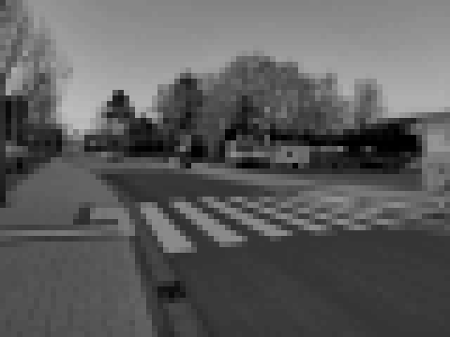
Step 1: Preparing the picture
1. Camera picture
640×480, in colour
2. Gray, shrunk to 80×60
Only 4,800 pixels, but dull, like our camera's pictures
3. After auto-contrast
The stripes stand out clearly again
Why shrink?
The network stays small and fast. 80×60 still shows the stripes; 40×30 was much worse (61.7 % against 79.1 %).
Why auto-contrast?
Dull camera pictures dropped accuracy to 47.7 %. Stretching the brightness brings it back to about 78 %, in only 0.15 ms.
Notes:
Step one is preparing the picture. The camera gives a 640 by 480 colour picture. We turn it gray and shrink it to 80 by 60, by averaging each 8 by 8 block of pixels. That is only 4,800 pixels, but the stripes are still visible. Our camera's pictures are dull: the gray values only cover the middle of the range. That alone dropped accuracy to about 48 percent. So we added auto-contrast: it stretches the brightness so the darkest part becomes black and the brightest becomes white. Accuracy came back to about 78 percent, and it takes only 0.15 milliseconds. (These three pictures show a street photo made dull the same way our camera does.)

Slide 6



Step 2: The neural network
Picture
80×60
Layer 1
32 maps, 40×30
Layer 2
64 maps, 20×15
Layer 3
64 maps, 10×7
Layer 4
64 maps, 5×3
Score
1 number
Looks at small windows
Learned, not programmed
Shrinks step by step
Each layer slides a 3×3 window over the picture. Early layers find edges, later ones stripes, the last one “a crossing”.
Nobody wrote a rule for “stripes”. The network learned the patterns from 11,000 example photos.
Each layer halves the picture size, so the last layer sees the whole scene as a small 5×3 summary.
Notes:
Step two is the neural network, a CNN. It has four layers and one output. Each layer slides a small 3 by 3 window across the picture and looks for patterns. The first layers find simple edges, later layers find stripes, and the last part decides whether it looks like a crossing. Nobody wrote a rule for stripes: the network learned these patterns itself from about 11,000 example photos. Each layer also halves the picture size, from 80 by 60 down to 5 by 3, and the output is one number: the score.

Slide 7
The key idea: a 1-bit network
Normal network: weights like 0.73 or −1.25, so every connection needs a multiplication: big, power-hungry circuits.
Our network: every weight and value is just +1 or −1, so each one is stored as a single bit.
0
multipliers needed for the network
Weights
+1
−1
+1
+1
11 KB
Inputs
+1
+1
−1
+1
Same?
✓
✗
✗
✓
all 93,408 weights fit inside the chip
Normal maths: (+1)(+1) + (−1)(+1) + (+1)(−1) + (+1)(+1) = 0
1-bit way: 2 same − 2 different = 0 same answer, no multiplier
64
Multiply becomes “same or different?” (an XNOR gate). Adding becomes counting.
values compared in one clock tick
Notes:
This is the key idea of the project. A normal network uses numbers like 0.73, so every connection needs a multiplier, which is a big and power-hungry circuit. In our network, every weight and every value is only plus one or minus one, so we store each as a single bit. Look at the example: multiplying plus-or-minus-one values just asks: are they the same? Same gives plus one, different gives minus one. Here, 2 are the same and 2 are different, so the answer is 2 minus 2 = 0, which is exactly what normal maths gives. In hardware, 'same or different' is an XNOR gate, and adding becomes counting the ones. So we need zero multipliers, all 93,408 weights fit in 11 kilobytes inside the chip, and we compare 64 values in one clock tick.

Slide 8




Step 3: How the chip runs the network
One engine, used again and again
The same small circuit runs all five layers, one after another.
Fast enough for every picture
A new camera picture arrives every
37.5 ms
64 checks every clock tick
Each tick it compares 64 values at once and counts the matches.
Our network needs
34.0 ms
Everything stays on the chip
Picture, weights and results sit in the chip's own memory.
Finished before the next picture comes
26.7
16 %
2.27 million ticks per picture
At 66.7 million ticks per second, that is 34 ms.
answers every second
of the FPGA chip used
Notes:
Step three: how does the chip actually run the network? We built one small engine and reuse it for all five layers, one after another. In every clock tick it compares 64 values at once and counts how many match. The picture, the weights and the results all stay in the chip's own memory. One picture needs 2.27 million clock ticks. Our clock runs at 66.7 million ticks per second, so that is 34 milliseconds. The camera sends a new picture every 37.5 milliseconds, so we finish before the next one arrives: every picture is checked, about 27 answers a second. And the whole design uses only 16 percent of this small FPGA.

Slide 9




Training the network (on a laptop)
1
2
3
4
Collect photos
Train
Convert to bits
Load into the FPGA
11,000 pictures from 14 sources: dashcams, streets, CCTV. Test photos are kept apart and never used in training.
In Python (PyTorch), 60 rounds. A big “teacher” network (ResNet-18) guides our small one.
Each weight becomes 1 bit. Each neuron's settings become one number: its threshold.
The same files fill the chip's memory and set up the circuit, so they always match.
Training trick: a 1-bit value cannot learn in small steps. So while training we keep a hidden normal number for each weight and use only its sign (+ or −). Learning passes through the sign step as if it were not there: the “straight-through estimator”.
Notes:
How did the network learn? We collected about 11,000 pictures from 14 sources: dashcams, street photos, CCTV. Test photos were kept completely separate. We trained on a laptop in Python with PyTorch for 60 rounds. A big, accurate network called ResNet-18 acted as a teacher and guided our small 1-bit network. Then we converted the result: each weight becomes 1 bit, and each neuron's settings, including batch normalisation, become one number called a threshold. The same files are loaded into the FPGA, so the software and the hardware always match. One trick: a 1-bit value cannot change in small steps, so during training we keep a hidden normal number and use only its sign. This is called the straight-through estimator.

Slide 10
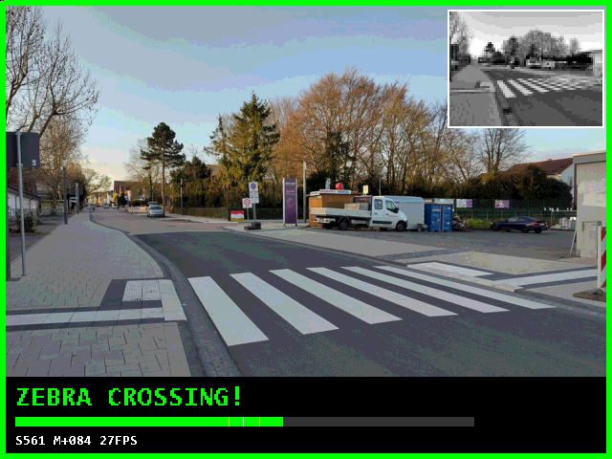
Step 4: The decision, honest about doubt
NO CROSSING
NOT SURE
ZEBRA CROSSING
← lower score
477
higher score →
The network gives a score from 0 to 960. Above 477 means crossing; below means no crossing.
Too close to 477? It says NOT SURE instead of guessing.
Average of the last 4 pictures: a steady answer that does not flicker.
What the monitor shows: green border, the decision, a score bar, and the 80×60 picture the network sees (top right). Frame from our design's simulation.
Shown on: monitor border colour, LCD text, LEDs and a buzzer beep.
Notes:
Step four is the decision. The network gives one score between 0 and 960. Above 477 means a crossing, below means no crossing. But when the score is very close to 477, the network is not confident, so instead of guessing, the system says NOT SURE. For a safety device, an honest 'not sure' is better than a wrong answer. We also average the last 4 pictures so the answer stays steady. The result is shown on the monitor with a green, red or yellow border, on the LCD, with LEDs, and with a beep.

Slide 11
Results: how accurate is it?
4 in 5
pictures correct overall (about 79 %)
19 in 20
street photos correct when it answers (95.7 %)
Test pictures were never seen in training. For the rest of the pictures it honestly says “not sure” (about half of them).
Notes:
How accurate is it? We tested on two sets of pictures the network had never seen: 524 dashcam frames and 115 street photos from different photographers. On all pictures, about 4 out of 5 are correct: 79 percent on both sets. When the system gives a confident answer, instead of 'not sure', it is right 90 percent of the time on dashcam frames and 95.7 percent on street photos, so about 19 out of 20. The price is that it says 'not sure' for about half of the pictures. For a safety aid we prefer that to a wrong answer.

Slide 12


Proof: the chip gives exactly the same answers
639 / 639
Python model
A software copy of the chip's exact maths, with the same bits and integers.
test pictures gave identical answers on the real FPGA board and in our Python model: bit for bit.
Circuit simulation
Every value inside every layer matched, not just the final answer.
Board self-test at power-up: ALL PASS
Real FPGA board
Pictures sent from the laptop over USB; every answer compared one by one.
Notes:
How do we know the chip is correct? We checked it in three stages. First, a Python model that does exactly the same integer and bit maths as the chip. Second, a simulation of the circuit: there, every value inside every layer matched the Python model, not just the final answer. Third, the real board: we sent all 639 test pictures from the laptop over USB, and all 639 answers were identical, bit for bit. The board also runs a self-test when it starts, and it reports ALL PASS.

Slide 13
Comparison: much less energy per answer
27× less
energy than a Jetson Nano GPU board
0.29 W
total power of our FPGA design (Jetson Nano: 10 W)
1 chip
camera to decision: no PC, no GPU, no internet
Energy per answer = power × time for one answer.
FPGA: Vivado estimate · Jetson Nano: CDNet paper · Laptop: i5-12500H, 45 W × measured time
Notes:
How does it compare with other ways of doing this? The chart shows the energy used for one answer. Our FPGA uses about 11 millijoules per answer. A published zebra-crossing network on a Jetson Nano GPU board uses about 302, so we use about 27 times less energy. Running the same 1-bit network on a laptop processor uses 366, and a full-size ResNet-18 on the laptop uses about 1,900. Our whole design draws about 0.29 watts, against 10 watts for the Jetson Nano, and everything from camera to decision happens on one chip.

Slide 14


Limitations and future work
Limitations
Next steps
About 1 in 5 hard street photos are still wrong
1-bit weights cost accuracy: a full-size network (ResNet-18) gets 95.7 % on the same small pictures
Night, glare and unusual angles are the hardest
It says yes or no, not where the crossing is
Train with real pictures from our own camera
Show where the crossing is in the picture
A bigger FPGA for a wider, more accurate network
A custom chip (ASIC) for battery-powered walking aids
Notes:
We are honest about the limits. About 1 in 5 hard street photos is still wrong. The 1-bit design costs some accuracy: a full-size network gets 95.7 percent on the same small pictures, but it needs multipliers and much more power. Night, glare and unusual camera angles are the hardest cases, and the system says yes or no but not where the crossing is. Next steps: train with pictures from our own camera, show where the crossing is, use a bigger FPGA for a wider network, and later a custom chip for a battery-powered walking aid.

Slide 15
Conclusion
34 ms
0.29 W
639/639
Real time
Every camera picture is checked
Low power
27× less energy than a Jetson Nano
Proven
Identical answers on the real board
Thank you. Questions?
Raj Mali · Pooja Nagvekar | Guides: Prof. Anuradha Joshi · Prof. Amaya Pethe | Vidyalankar Institute of Technology, Mumbai
Notes:
To conclude: we built a complete system, from camera to decision, on one small FPGA. It is real time: every camera picture is checked in 34 milliseconds. It is low power: 0.29 watts, about 27 times less energy per answer than a Jetson Nano. And it is proven: the real board gives exactly the same answers as our software model on all 639 test pictures. Thank you. We are happy to take your questions.

