Slide 1

Welcome To
E-MANDI

Slide 2
Problem:-
Usually the agricultural produce is purchased from the farmers at a low price and sold to the consumers at relatively very high price because of a large number of middlemen involved. Direct contact between the farmer and retail seller or wholesaler can reduce the number of middlemen involved in the marketing chain. A mobile based App that can facilitate the direct contact between producer (farmer) and buyer may reduce this wide price gap or a real time interactive system for communication between farmers and Mandis.

Slide 3
Solution:-
We are creating a portal where farmer and buyer can interact directly.
User have the option to search for a commodity according to the location of farmer. User can increase and decrease the distance parameter. Once he find the desired commodity, he can order the entity with two options. Either he can select the pick up option or he can choose for delivery. If the user select the delivery option he have to wait for the farmer approval to add the packing and delivery charges. If the user find the parcel service costly, he may terminate the charge here also. User can generate the requirements in advance also. He may get notified if someone can fulfill his requirement. Payment should be made before the delivery
Farmer have the option to get notified if some user buy his commodity. He can also respond to the advance query. He will be paid at the end of the month. In advance with the help of sales he may also find the statistics regarding sales in past few years. This will give him insight regarding crop production and sale.

Slide 4
INTRODUCTION
 The purpose of designing E-MANDI in php is to provide better solution to the farmers. Here administrator of the project can create farmer, Customer in to the SQL database where he can login into this web application. In this application first of all admin create farmers and Customer registration page through that he get password and enter in our e-mandi application.
 Under admin Moudle:
 Add product price list
 View product enquiry
 Sells products
 Search dealers stock
 Send notification

Slide 5
 Under farmers Module
 Add Crops information
 View product Price
 Enquiry Details on product
 Revert product

Under Customer Module
 Search product details
 View product price list
 Put enquiry
 View product response
 View notificaiton

Slide 6


OBJECTIVE & SCOPE OF THE PROJECT
The e-mandi is meant to keep the security of the admin and between the farmers and Customers.
A farmers can add product details.
A Customer can view the notification towards admin.
Admin can sell products between admin and user.
The main concern of this project is to improve the efficiency and effectiveness of the whole system.

Slide 7
Other Objectives
 User friendly interface.
 A central database holds the key to system.
 All forms are html templates driven
 Integration among all functional areas.
 The availability of the information is easy.
 Routine tasks are easily performed.
 It automates the redundant tasks.
 It will save time and money.
In summary we can say that main objective of the project is to make the work easy and smooth.
It will provide the better customer service and enhance the profi

Slide 8
TOOLS / PLATFORM, HARDWARE AND SOFTWARE REQUIREMENT SPECIFICATIONS
HARDWARE SPECIFICATION VIRTUAL MEMEORY
PROCESSOR
RAM HARD DISK MONITOR
CLOCK SPEED
SOFTWARE SPECIFICATION
OPERATING SYSTEM FRONT END
BACK END
: 32 BIT, Pentium – IV
: 40 GB
: SVGA Monitor (800 * 600RESOLUTIONS)
: 1 GB
: 266 MHz
: Windows 2000/XP.
: Java
: My Sql

Slide 9
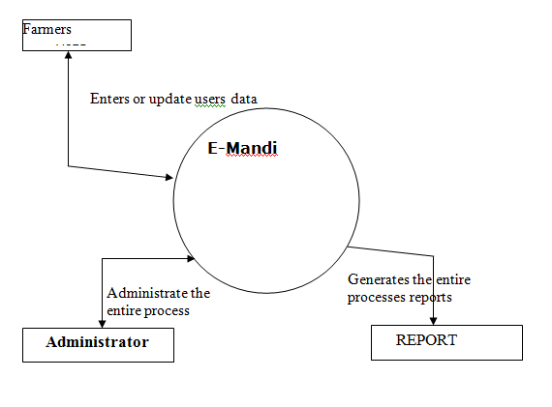
DATA FLOW DIAGRAM

Slide 10
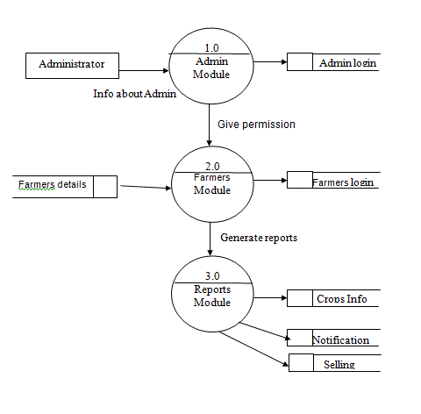
DATA FLOW DIAGRAM

Slide 11
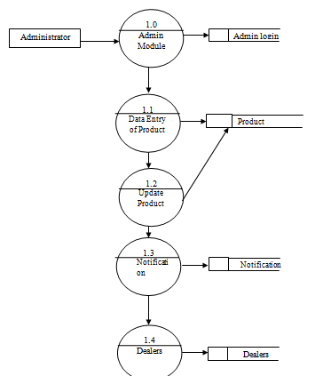
Data Flow Diagram

