Slide 1
(143,170,230)
(169,209,142)
(47,85,151)
(84,130,53)
(218,227,243)
(219,219,219)
(180,199,231)
(175,175,175)
(226,240,217)
(242,242,242)
(180,224,197)
(217,217,217)
A1 A2 A3 A4
B1 B2 B3 B4
C1 C2 C3 C4
(258,133,114)
(254,219,208)
(189,48,9)
(251,176,161)
D1 D2 D3 D4

Slide 2
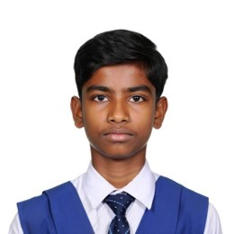

Maya Thompson
Maya Thompson
Class 4B
Class 4B
SafeReach
Traveling
Maya Thompson
Ready
Reached
Ready
Reached
Class 4B
SafeReach
Ready
Reached
Maya Thompson
Class 4B
Absent
Ready
Reached
Maya Thompson
Ready
Reached
Class 4B
SafeReach

Slide 3
Maya Thompson
Maya Thompson
Maya Thompson
Class 4B
Class 4B
Class 4B
SafeReach
Traveling
Absent
Ready
Reached
Ready
Reached
Ready
Reached
Maya Thompson
Ready
Reached
Class 4B
SafeReach
Maya Thompson
Ready
Reached
Class 4B
Traveling
Maya Thompson
Ready
Reached
Class 4B
Absent

Slide 4

Class 4
Ready
Reached
Section B
Students: 06
SafeReach: 90%
Mr. James Anderson
ID: EMP-10024
teacher@safereach.school
Class 4 - Section B
Mathematics
available
Hi frds…
9.30am
Teacher
Hello…
9.30am

