Slide 1
SEMINAR PRESENTATION PYTHON
Presented by-Rajnandini singh

Slide 2
CONTENTS
Introduction
Why this why not that
Python basics
Operators
Scope of python
Conclusion

Slide 3
INTRODUCTION
Python is Interpreted:
Python is Interactive:
Python is Object Oriented Language:
Python is a Beginner’s language:

Slide 4
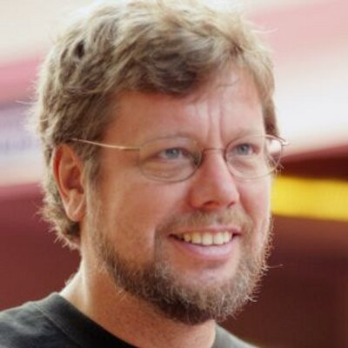
HISTORY
“Guido van Rossum”
He is a Dutch computer programmer who is best known as the author of the python programming language.
Python is the high level programming language.
Python 2 and Python 3 are two versions.

Slide 5
WHY THIS WHY NOT THAT
Presence of third party modules.
Extensive support libraries.
Open source and community development.
Learning easy and support available.
User-friendly data structures.
Productivity and speed

Slide 6
PYTHON BASICS
RESERVED WORDS :-
It cannot be used as constants or variable
Every python keyword should be in lower case
LINES AND INDENTATION :-
No need of braces in python.
Blocks of code are denoted by line indentation.

Slide 7
MULTIPLE LINE STATEMENTS :-
Statements in python typically end with a new line.
‘\’-continuation character.
Statement contained with [],{},() do not need to use the line continuation character.
QUOTATION IN PYTHON :-
Python accepts: single(‘’),double(“ “),triple(’’’)

Slide 8
ASSIGNING VALUES TO VARIABLES
Python variables do not need explicit declaration.
The declaration happens automatically when you assign a value to a variable .
PYTHON LISTS :-
A list contains items separated by commas and enclosed with in [].
Similar to arrays only difference is of using multiple data types.

Slide 9
PYTHON TUPLES :-
Tuple is an another sequence data type that is similar to the list.
Difference is – Tuple uses parenthesis ().

Slide 10
OPERATORS
Arithmetic operators
Relational operators
Logical operators
Bitwise operators
Assignment operators

Slide 11
CONCLUSION
So , we have come to know about python basics , its various syntax , modules used and also the increasing scope of python in software industry as well as human resource development.
The web development Framework django is widely used in social sites and other that we use in our day to day life

