Slide 1

Customer Shopping Behavior Analysis
Uncovering insights from 3,900 purchases to guide strategic business decisions

Slide 2

DATASET OVERVIEW
The Foundation
3,900
18
50
Total Purchases
Data Points
Locations
Transactions analyzed across all categories
Features per customer transaction
Geographic coverage across regions
4
Categories
Product segments tracked

Slide 3
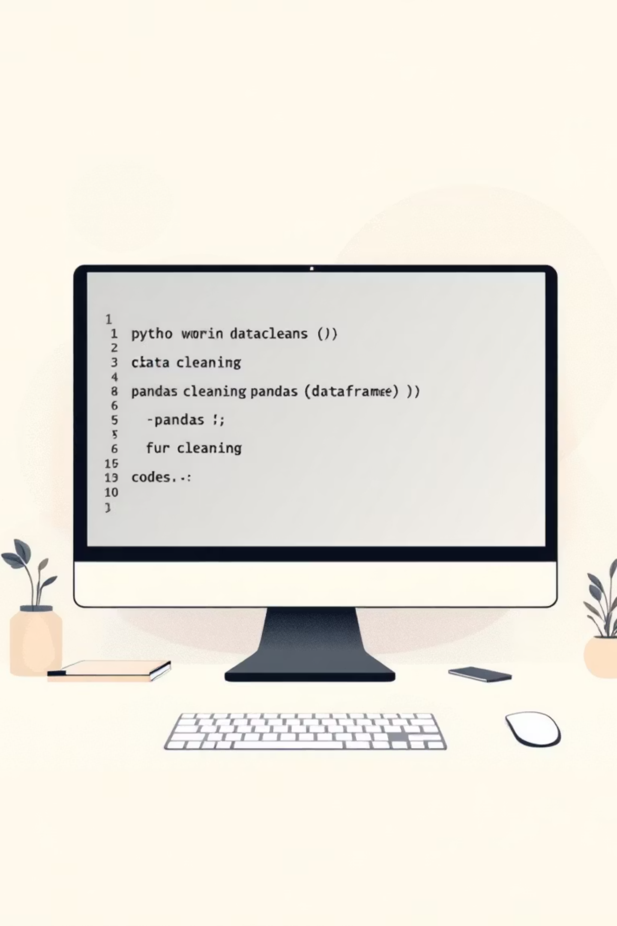
DATA PREPARATION
Python Analysis Pipeline
01
Data Loading & Exploration
Imported dataset, checked structure with df.info() and summary statistics
02
Missing Data Handling
Imputed 37 missing Review Ratings using median by category
03
Feature Engineering
Created age_group bins and purchase_frequency_days columns
04
Database Integration
Connected to MySQL Workbench for structured analysis

Slide 4
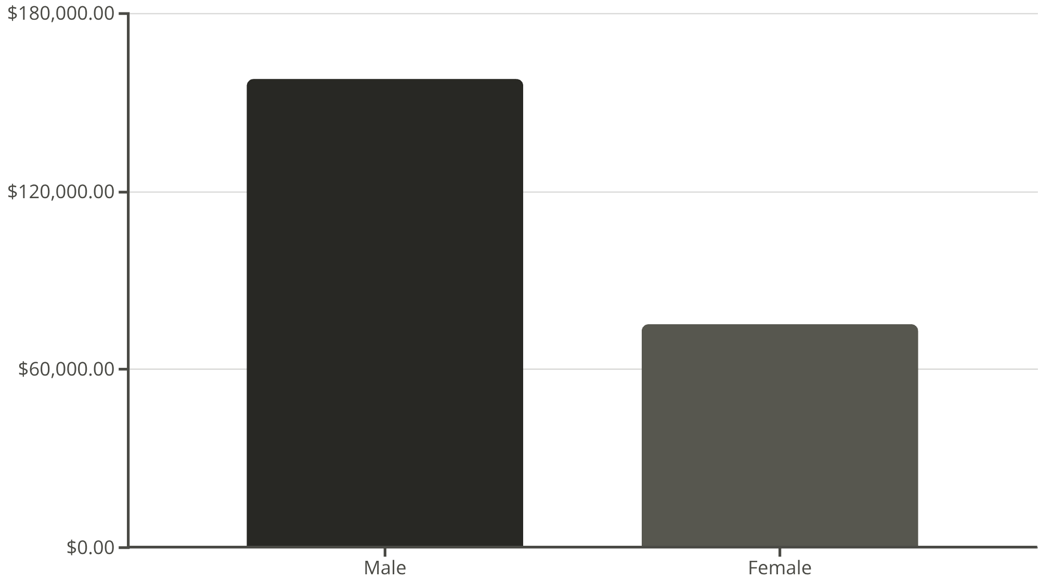
Revenue Insights
Gender Split
Male customers generate 2.1x more revenue than female customers
Total revenue: $233,081

Slide 5

TOP PERFORMERS
Highest-Rated Products
1
2
3
Gloves
Sandals
Boots
Rating: 3.86
Rating: 3.84
Rating: 3.82
4
5
Hat
Skirt
Rating: 3.80
Rating: 3.78
Average overall rating: 3.75 across all products

Slide 6



Customer Segmentation
Returning
701 customers
18% of customer base
Loyal
3,116 customers
80% of customer base
New
83 customers
2% of customer base

Slide 7


Subscription Analysis
Key Findings
Subscribers: $59.49 avg spend
Non-subscribers: $59.87 avg spend
27%
958 repeat buyers are subscribers
Subscribers
1,053 customers
73%
Non-Subscribers
2,847 customers

Slide 8
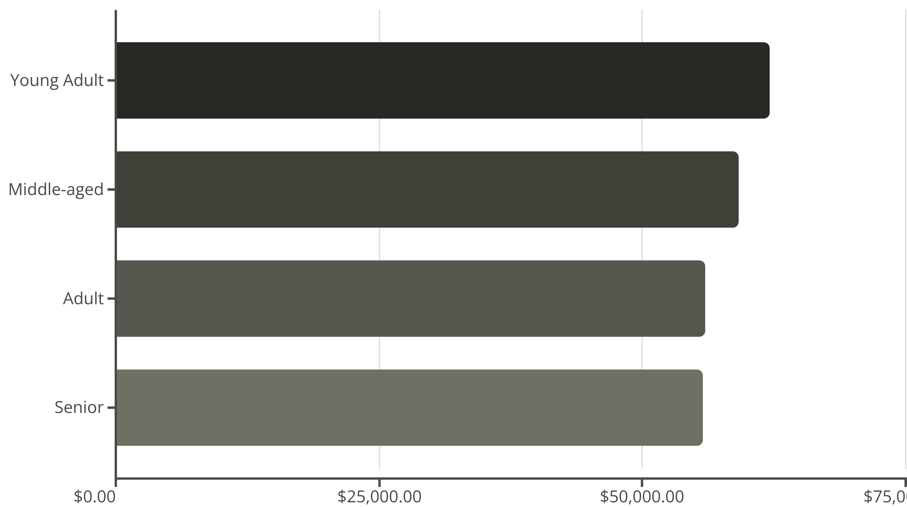
AGE DEMOGRAPHICS
Revenue by Age Group
Young adults lead revenue generation, followed closely by middle-aged customers

Slide 9
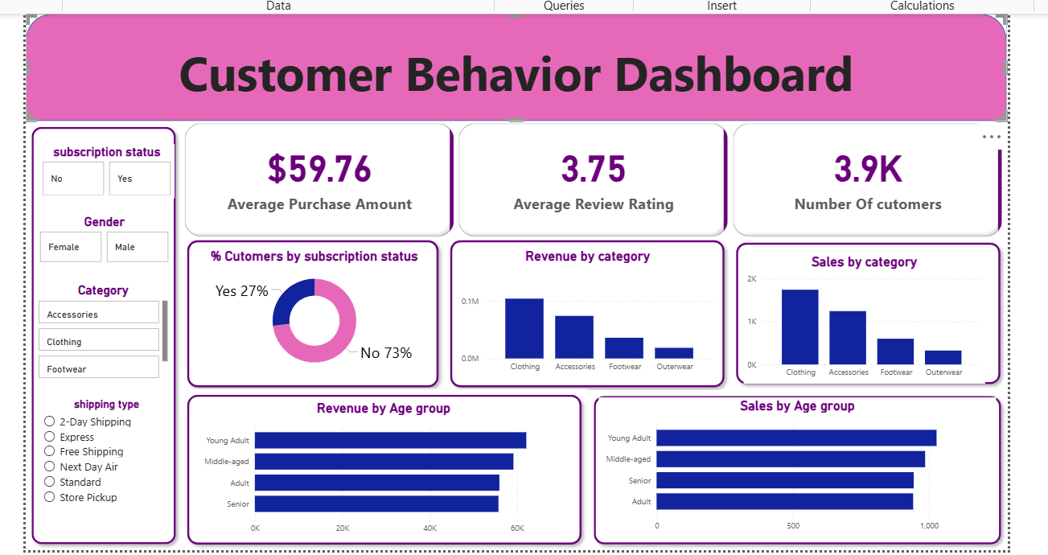
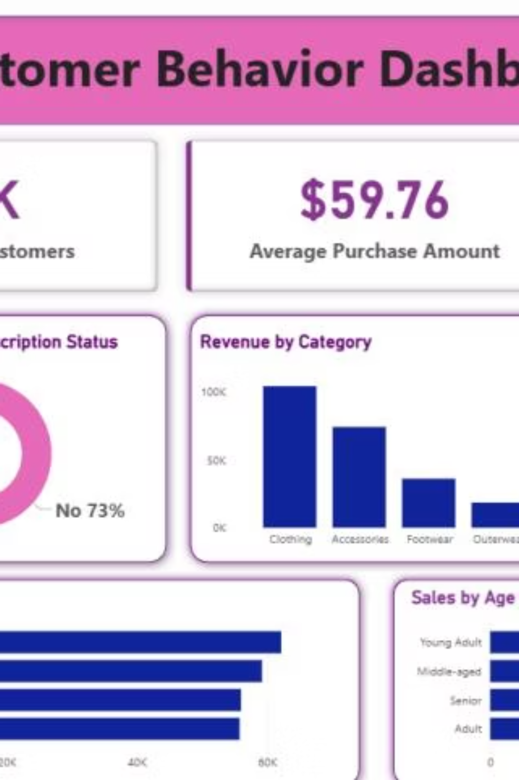
Power BI Dashboard
Key Metrics
Top Category
Interactive Filters
3.9K customers
Clothing leads with $100K revenue and 1,800 sales
Gender, subscription, category, shipping type
$59.76 avg purchase
3.75 avg rating

Slide 10

ACTION PLAN
Strategic Recommendations
Boost Subscriptions
Promote exclusive benefits to convert non-subscribers
Loyalty Programs
Reward repeat buyers to increase retention
Discount Strategy
Balance promotions with margin control
Targeted Marketing
Focus on high-revenue age groups and express shipping users

