Slide 1
CMR College of Engineering & Technology
(UGC Autonomous)
Accredited by NAAC with “A” Grade
Kandlakoya, Medchal Road, Hyderabad-501401
Department of Computer Science & Engineering
A Blockchain based Autonomous Decentralized Online Social Network
Guide Name:
V. Narasimha
Assistant Professor
Batch Number - 17
19H51A05A4: K.Divya
19H51A05E1: N.Raju
19H51A05H5: M.Sathvika
CMRCET - CSE
‹#›

Slide 2
Contents
Abstract
Literature review
Existing works
Results of Existing System
Proposed System
Implementation
Plan of Execution
‹#›

Slide 3
Abstract
Online social networks (OSN) are becoming more important in people’s daily life, however, all popular OSNs are centralized, and this raises a series of security, privacy and management issues.
A decentralized architecture based on blockchain technology provides the ability to solve above issues. An OSN service is developed based on blockchain technology in order to make it operate decentralized.
Large volume of data normally required low-security requirements can be stored in Interplanetary Filesystem (IPFS) to make data decentralized.
A decentralized autonomous organization is developed for user autonomy, users can self-manage the OSN in a democratic way.
CMRCET-CSE
‹#›

Slide 4
Literature Review
Online Social Network (OSN) is a platform for people to build connections with each other via the Internet. It is a major platform that the public can obtain and disseminate information, exchange views and share their lives on it.
It is hard for users to protect their contents on the OSN when the servers crash down. To make matters worse, if the servers are hacked, security information includes password, security problems, address of users is possible to be leaked.
This makes personal information of users at risk of leakage and abuse. Such problems of centralized OSNs boost researchers to consider develop an OSN based on the decentralization framework.
Decentralized OSNs have the potential to provide a safer and more controllable social network environment for users where privacy and information are more controllable for their owners.
‹#›

Slide 5
In general, a decentralized OSN is usually operated by a peer-to-peer mechanism in which each node stores some parts of data and support the service. However, it is not binding on malicious acts, and lack of self-management and sustainable developing abilities.
In this project, we proposed an autonomous decentralized online social network architecture based on blockchain technology.
Block chain is able to provide a safe and trusted peer-to-peer mechanism where participants have unique identities and private keys. The private key has the highest control right of the corresponding account and is stored in user’s own device.
Moreover, all transactions in blockchain need to be signed by the private key, so cheating can be avoided.
‹#›

Slide 6
Blockchain is widely considered as a revolutionary technology that has the ability to reform human life greatly. The first mature implementation of blockchain is Bitcoin came out in 2008, it is a decentralized public cryptocurrency, it does not rely on any centralized entity, every user can join or leave the network freely and all operation rules are formulated in its source code.
The decentralized autonomous organization is a virtual entity with a certain number of members or shareholders, where its members or shareholders can operate it through autonomous programs such as voting to spend funds of the DAO and change its code. The DAOs are established and operated based on blockchain and smart contracts, the decentralization of blockchain ensure the DAOs are decentralized, not under someone’s control.
An existing system investigates Blockchain’s capacities to provide a robust and secure decentralized model for Internet. The paper conducts a critical review on recent Blockchain-based methods capable for the decentralization of the future Internet.
We identify and investigate two research aspects of Blockchain that provides high impact in realizing the decentralized Internet with respect to current Internet and Blockchain challenges while keeping various design in considerations.
‹#›

Slide 7
Online social networks (OSN) are becoming more important in people’s daily life, however, all popular OSNs are centralized, and this raises a series of security, privacy and management issues.
Blockchain has made an impact on today’s technology by revolutionizing the financial industry through utilization of cryptocurrencies using decentralized control. This has been followed by extending Blockchain to span several other industries and applications for its capabilities in verification.
With the current trend of pursuing the decentralized Internet, many methods have been proposed to achieve decentralization considering different aspects of the current Internet model ranging from infrastructure and protocols to services and applications.
‹#›

Slide 8
S.NO | Author | Name of the journal | Title of the paper | year | Inference
1 | Amit Kumar Tyagi Amit Kumar Tyagi, S U Aswathy Amit Kumar Tyagi, S U Aswathy, Terrance Frederick Fernandez | 2020 4th International Conference on Electronics, Communication and Aerospace Technology (ICECA) | Blockchain and Aadhaar based Electronic Voting System | 2020 | In summary, this work provides a simple, reliable concept using Blockchain technology and Aadhaar for deploying paperless electronic voting in India
2 | Nour Diall,; Weidong Shi, Lei Xu, Zhimin Gao; Lin Chen, Yang Lu,Nolan Shah | 2018 International Conference on eDemocracy & eGovernment (ICEDEG) | Blockchain based Decentralized-File-Sharing-System-using-IPFS | 2018 | We provide a concrete use case to demonstrate the usage of DAO e-government and evaluate its effectiveness.
‹#›

Slide 9
3 | Mihir Nevpurkar, Chetan Bandgar, Ranjeet Deshmukh, Jay Thombre, Rajashri Sadafule, Suhasini Bhat | International Research Journal of Engineering and Technology (IRJET) | Decentralized File Storing and Sharing System using Blockchain and IPFS | 2020 | This paper proposes the design and architecture of an advanced as well as secured web application for storing and sharing the data. A simple, affordable, easy to use and most secured system is proposed to solve the data security issues like integrity, authenticity and data unavailability
4 | Anusree K , Jagan Sathiaseelan Vadekkat , Abhinu R Dev , Abhinav | International Research Journal of Engineering and Technology (IRJET) | Decentralized File Transfer System Blockchain-based File Transfer | 2022 | The purpose of this project was to solve the need for blockchain applications to exchange larger files with sensitive information within an organization.
‹#›

Slide 10
Existing Works
Many applications have already taken rather simple and traditional approaches to integrating social network information with user location and context information. The most common form of application simply extends access to social networks to mobile phones or provides social network interfaces optimized for access from these mobile phones.
For instance applications such as the iPhone or Blackberry Facebook applications allow the user to natively interact with Facebook through his/her phone. Some work has taken a sensor network approach to mobile social networks, turning the phone into sensor extension of the social network.
This approach is rather unidirectional, focusing on enriching the social network (and its desktop applications) through the user's context. However, these applications do not consider that both the user's context and social network users information can be more than the sum of their parts when integrated deeply on the user's mobile device.
CMRCET-CSE
‹#›

Slide 11
1. Blockchain based
Decentralized-File-Sharing-System-using-IPFS
Blockchain is a decentralized distributed database existing on multiple computers at the same time. It is constantly growing as new sets of recordings, or ‘blocks’, are added to it.
Each block contains a timestamp and a link to the previous block, so they actually form a chain.
Everyone in the network gets a copy of the whole database. Old blocks are preserved forever and new blocks are added to the ledger irreversibly, making it impossible to manipulate by faking documents, transactions and other information.
The blocks are cryptographically linked together.
‹#›

Slide 12
2. Decentralized File Storing and Sharing System using Blockchain and IPFS
In recent years, decentralized cryptocurrency (such as Bitcoin , Ethereum, Zcash, etc.) have become hot topics and the blockchain, being the underlying technology of cryptocurrency, has been paid more attention. There are many fields in which data security is the main aim of the system. Blockchain is being used nowadays for achieving data security in number of fields. It plays major role in ensuring data security in the financial field.
Along with this, blockchain is being used in many other non-financial fields. Such as: decentralized supply chain , identity-based PKI, decentralized proof of document existence, decentralized IOT, decentralized storage, etc.Ethereum is a new decentralized application platform of smart contract. Smart Contracts can be created, deployed and executed with the help of Ethereum. Once the smart contract is deployed, it starts executing automatically according to the logic written within it.

Slide 13
3. Decentralized File Transfer System Blockchain-based File Transfer
InterPlanetary File System (IPFS)
InterPlanetary File System (IPFS) is a decentralized file sharing network that recognizes files based on their content. It employs a distributed hash table to obtain information about file locations and node connectivity (DHT). The following sample explains how IPFS works. When you submit a file to IPFS, it's split into chunks, each with up to 256 kilobytes of data and/or links to other chunks. To identify each chunk, a cryptographic hash, also known as a content.
Solana
Solana is a blockchain platform that is open to the public. SOL is the company's proprietary cryptocurrency. Solana uses the Proof of Stake and "Proof of History" mechanisms to establish an agreement, which the Solana White Paper argues will improve efficiency. Solana was identified as "a potential long-term challenger to Ethereum" by Bloomberg journalist Joanna Osinger in 2021, citing faster trade speeds and cost savings.

Slide 14
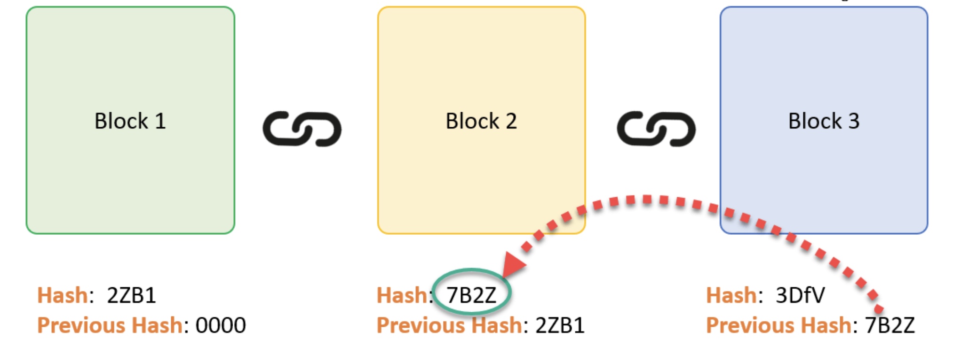
BLOCKCHAIN
‹#›

Slide 15
SHA-256 Hashing Algorithm
We use the SHA-256 algorithm to generate a unique hash of the entire block that is used by the corresponding blocks to form the chain (via the previous hashes). IPFS as well uses this algorithm to generate the hash of the shared file. The SHA-256 hashing algorithm is employed because of the following advantages: One-way:- Once the hash is generated, we can’t revert to the original data from the hash. Deterministic:- For a particular input, the hash generated, always remains the same i.e. same input always gives the same hash. Quick computation of the hash.
AES Encryption
AES Encryption is a form of symmetric, cryptographic encryption that depends on a shared key between the sender and receiver to access any file (here the file key) . If we had not employed the AES encryption, any connected user to the blockchain can access the file hash and thus, the shared file using the hash, directly from the IPFS.
‹#›

Slide 16
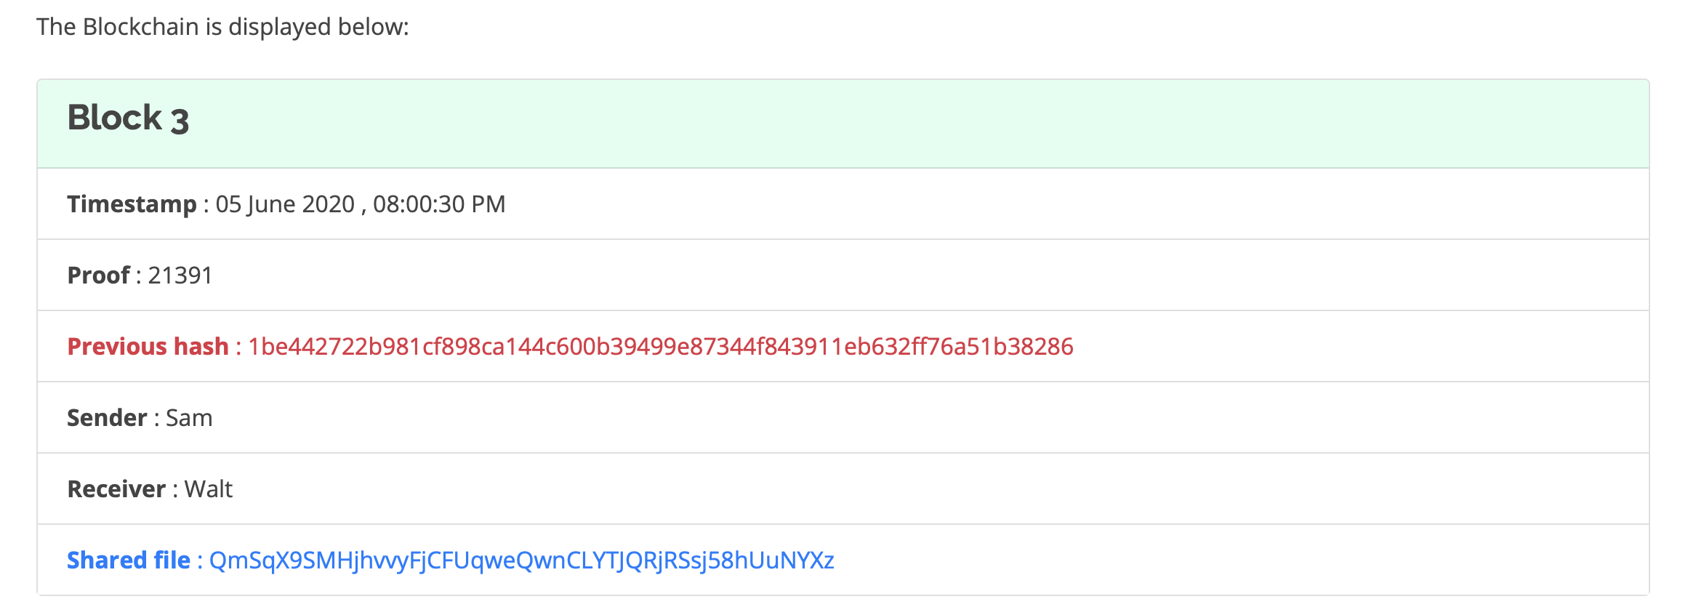
Block Structure Nounce to uniquely represent a block
SHA-256 hash of the Block 2
Data stored in the block chain
Hash of the shared file generated by IPFS using AES Encryption and SHA256 hashing algorithm
‹#›

Slide 17
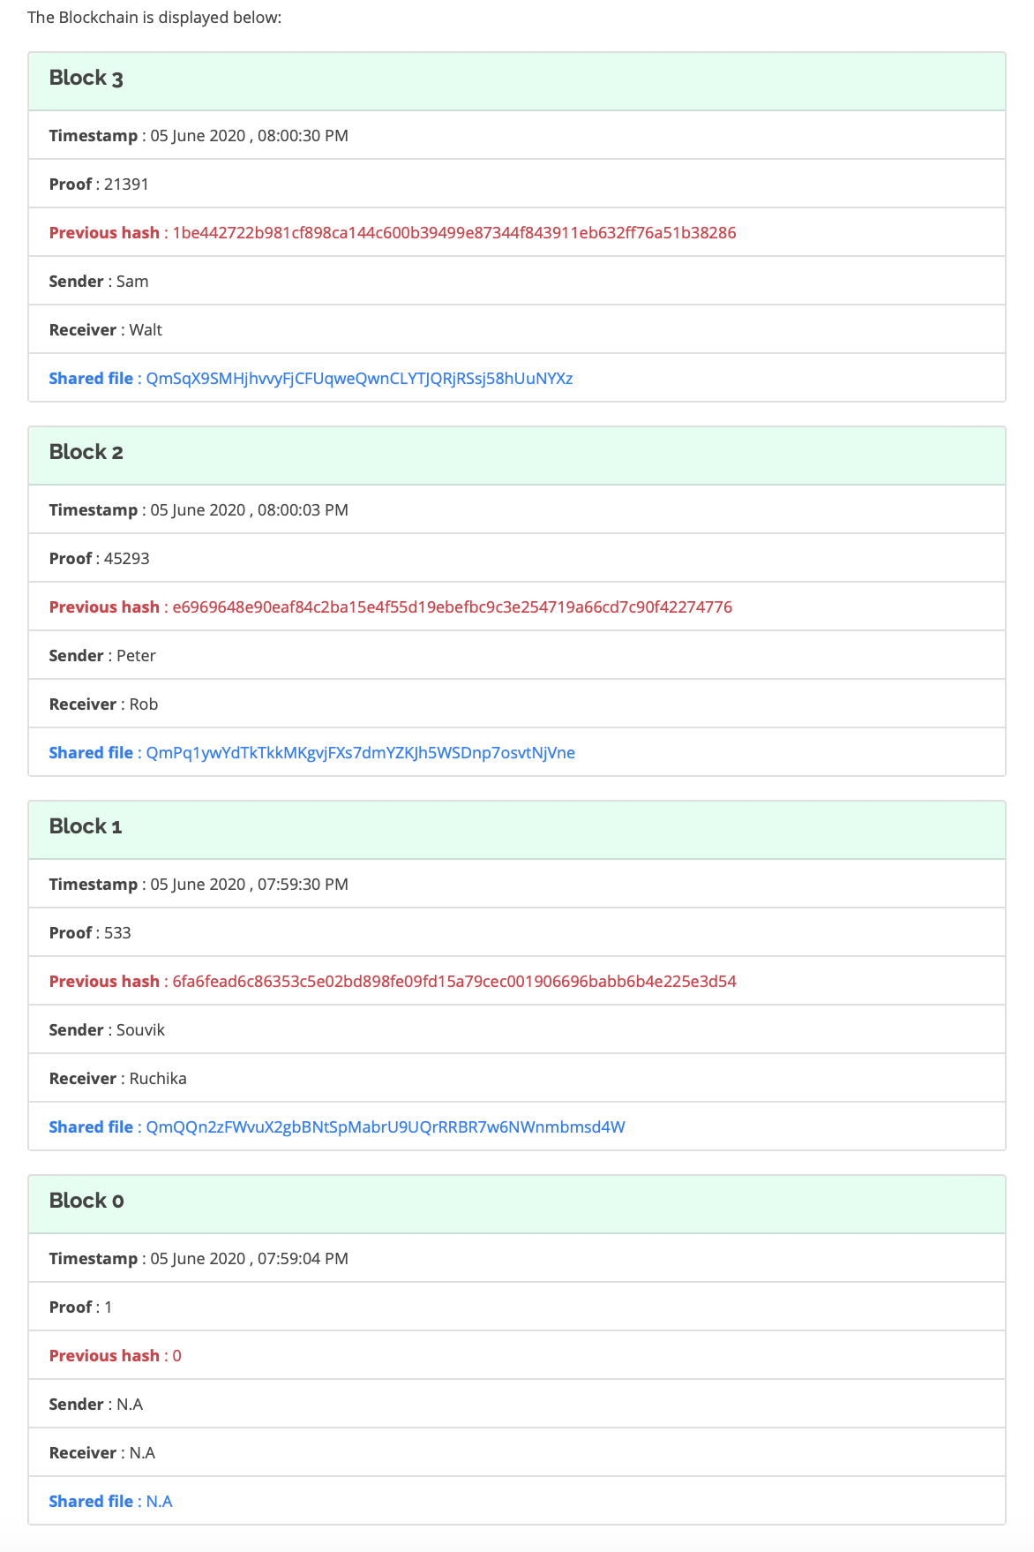
Blockchain with three blocks cryptographically linked together while file sharing
Blocks are linked together cryptographically using the SHA-256 hashes of the previous blocks
Genesis Block
‹#›

Slide 18
IPFS - Interplanetary File System
IPFS is a versioned file system which can store files and track file versions over time.
It is a protocol and peer-to-peer network for storing and sharing data in a distributed file system.
It uses content-addressing to uniquely identify each file in a global namespace connecting all computing devices.
It uses Distributed Hash Tables (DHT). In DHT the data is spread across a network of computers, and efficiently coordinated to enable efficient access and lookup between nodes.
‹#›

Slide 19
4.Aadhaar Based voting system using blockchain technology
The authority must login first with the provided session ID.
The voter can now begin the process of voting with proper authentication through OTP(one time password) on the respective linked mobile number.
If the voter is valid then the system will check for for the voters age and the address to which he can give vote.
the voting palette will be opened with candidate names,their parties and logos.
Now the voter can give his vote by clicking vote button.
one voter can give his vote only once,i.e after one time voting buttons are disabled and the vote is automatically logged out.
Same process continues for many more voters irrespective of their voting wards.
‹#›

Slide 20
Implementation of Existing Methods
Step 1 - Setting up Environment Instead of developing the app against the live Ethereum blockchain, we have used an in-memory blockchain (think of it as a blockchain simulator) called testrpc.
npm install ethereumjs-testrpc web3
Step 2 - Creating Voting Smart Contract
npm install solc
Replace your aadhaar no and phone number for running project
Step 3 - Testing in node console
Not required just for testing in node console- After writing our smart contract, we'll use Web3js to deploy our app and interact with it.
‹#›

Slide 21
Implementation of Proposed System
The system proposed an autonomous decentralized online social network architecture based on block chain technology. Block chain is able to provide a safe and trusted peer-to-peer mechanism where participants have unique identities and private keys.
The private key has the highest control right of the corresponding account and is stored in user’s own device. Moreover, all transactions in block chain need to be signed by the private key, so cheating can be avoided.
In order to give the system abilities of self management and sustainable development, a decentralized autonomous mechanism powered by block chain is embedded in the architecture. The rest of the system is organized as follows.
Firstly, we introduce the background of related technologies used in this architecture. Secondly, a detail description of the architecture is discussed. Thirdly, functions of this project are showed. Finally, a conclusion is made.
CMRCET-CSE
‹#›

Slide 22
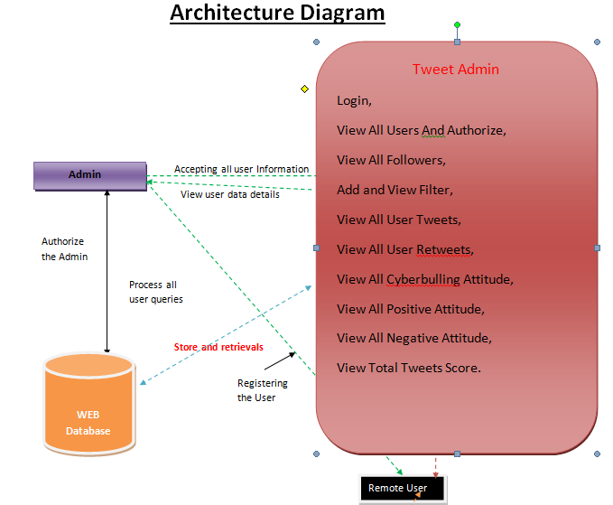
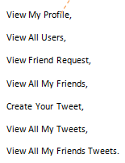
CMRCET-CSE
‹#›

Slide 23
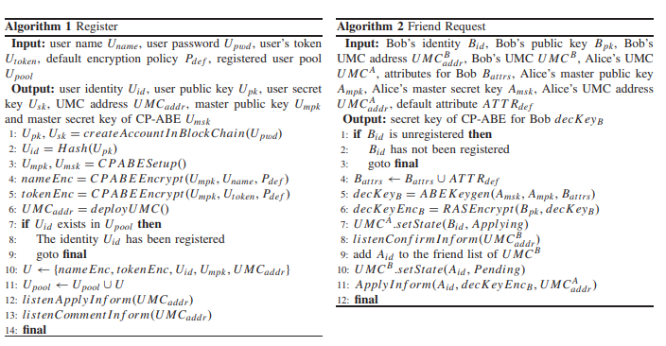
‹#›

Slide 24
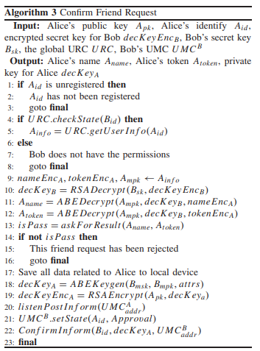
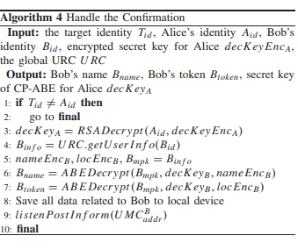
‹#›

Slide 25
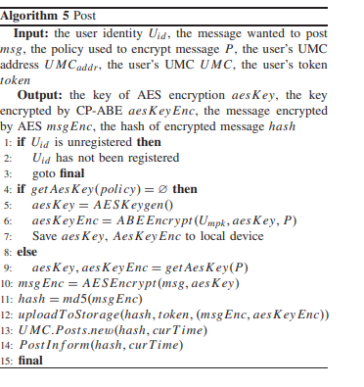
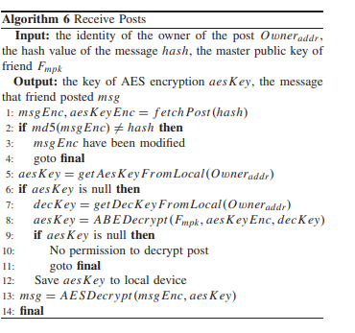
‹#›

Slide 26
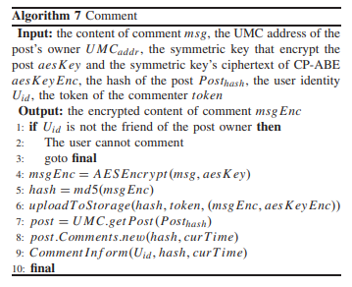
‹#›

Slide 27
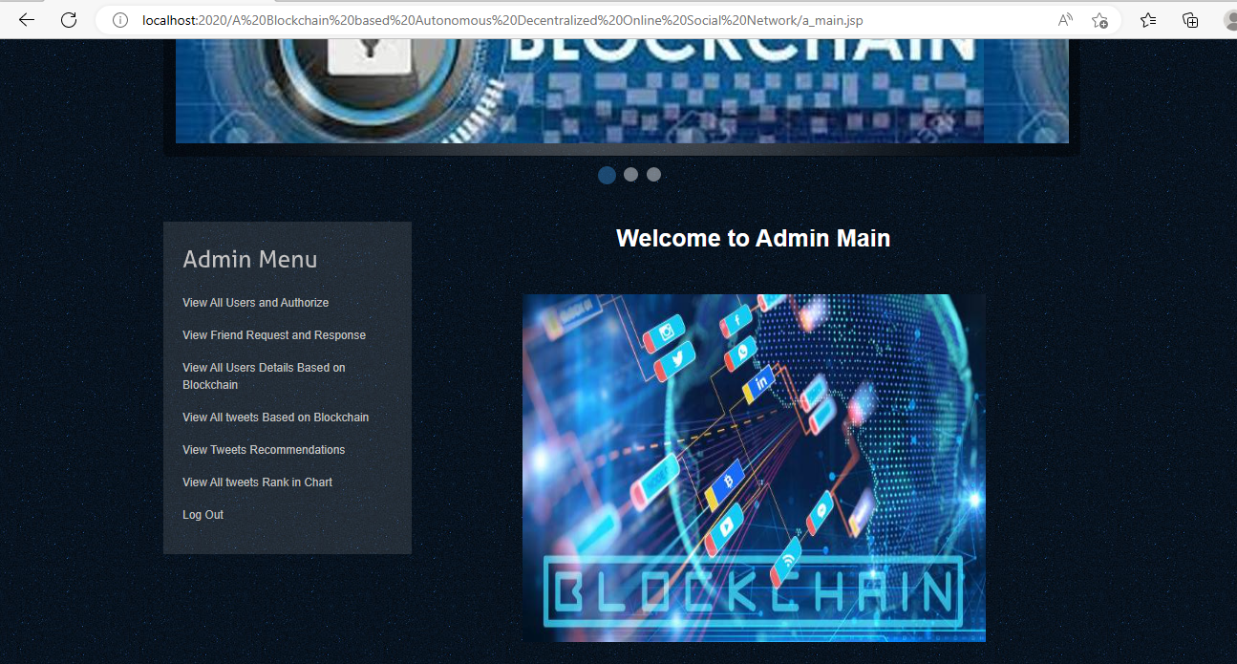
‹#›

Slide 28
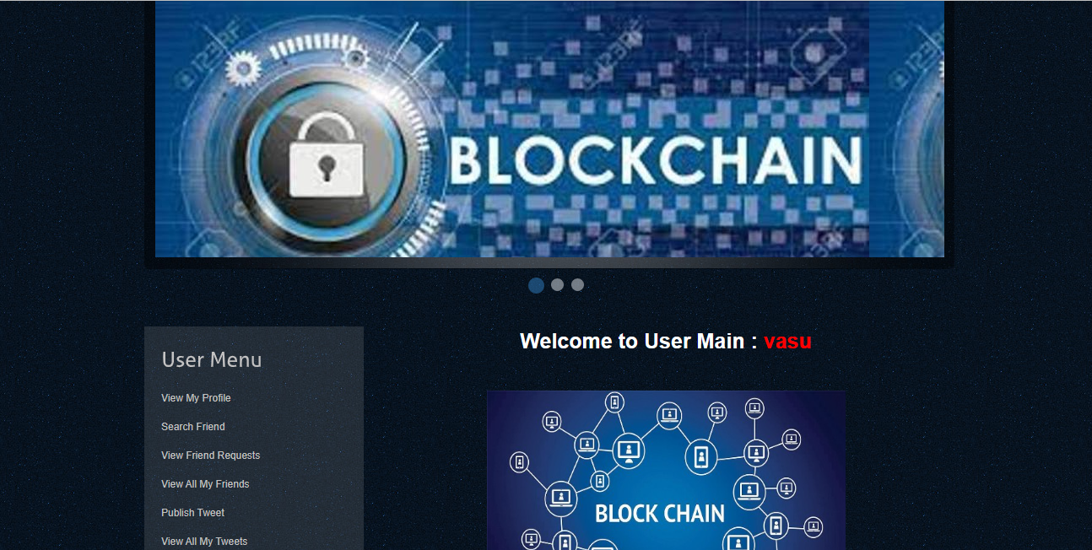
‹#›

Slide 29
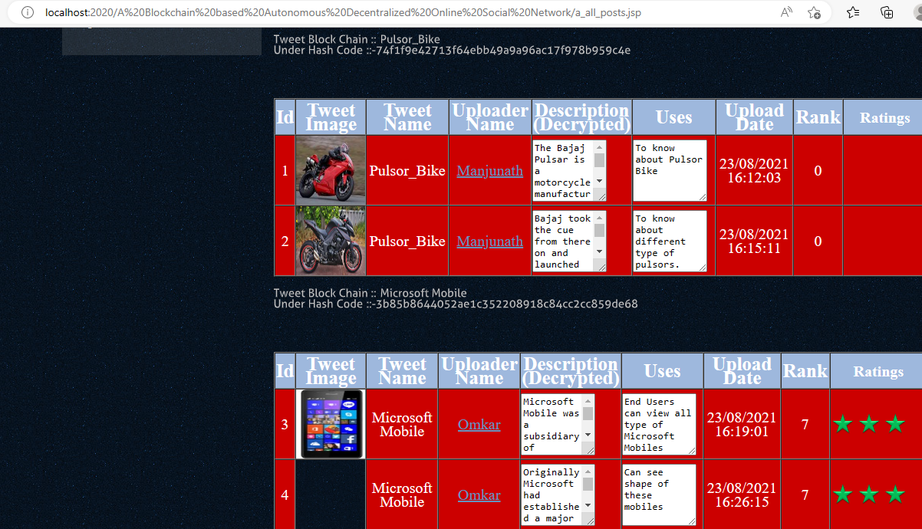
‹#›

Slide 30
Proposed Method Description
A. Initial Setup
Each user who wants to use this system should use CLI client to generate a private key at the first time. The private key is vital important security information for users, it is used to sign transaction, confirm the identification of users and evident the ownership of the account. The encryption algorithm for private key is ED25519. And the private key file is stored in the same path where CLI client is.
B. Publish Tweets
Users can send a transaction which is about tweet publishing by using CLI client. Once the blockchain received the transaction, it checks the transaction type first, ensure it is publishing tweets action, then, a certain amount of tokens are paid from user automatically to prevent spam tweets and resource abuse. Next, the tweet content is uploaded to IPFS, and the CID and related data (address of the user, tweet title, gas used) is recorded in blockchain for further query. Once the transaction is committed by nodes, the publishing process is completed and user gets the result. Each tweet has a hash ID to identify itself in the blockchain for further management.
‹#›

Slide 31
C. Publish Comments
The workflow of publishing comments is similar to publishing tweets. But users need to indicate the hash ID of the tweet that they want to comment on when they send a transaction for commenting. After the comment is successfully published, a mapping is added in the related tweet to indicate the comment based on the comment hash ID.
D. Vote Tweets and Comments
Users can up vote the tweet that they like, or down vote the tweet that they dislike. Sending a tweet or comment vote transaction can implement this process. This can reflect a user's contribution to the social network
E. Read Tweets or Comments
For each tweet or comment have a unique hash ID, users can use the hash ID to read the tweet or comment through the CLI client. The reading process nearly has no system resource consumption, so, this process is fast and users need not pay tokens for it
‹#›

Slide 32
Plan of Execution
•Github link of the project repository
CMRCET-CSE
‹#›

Slide 33
THANK YOU

