Slide 1
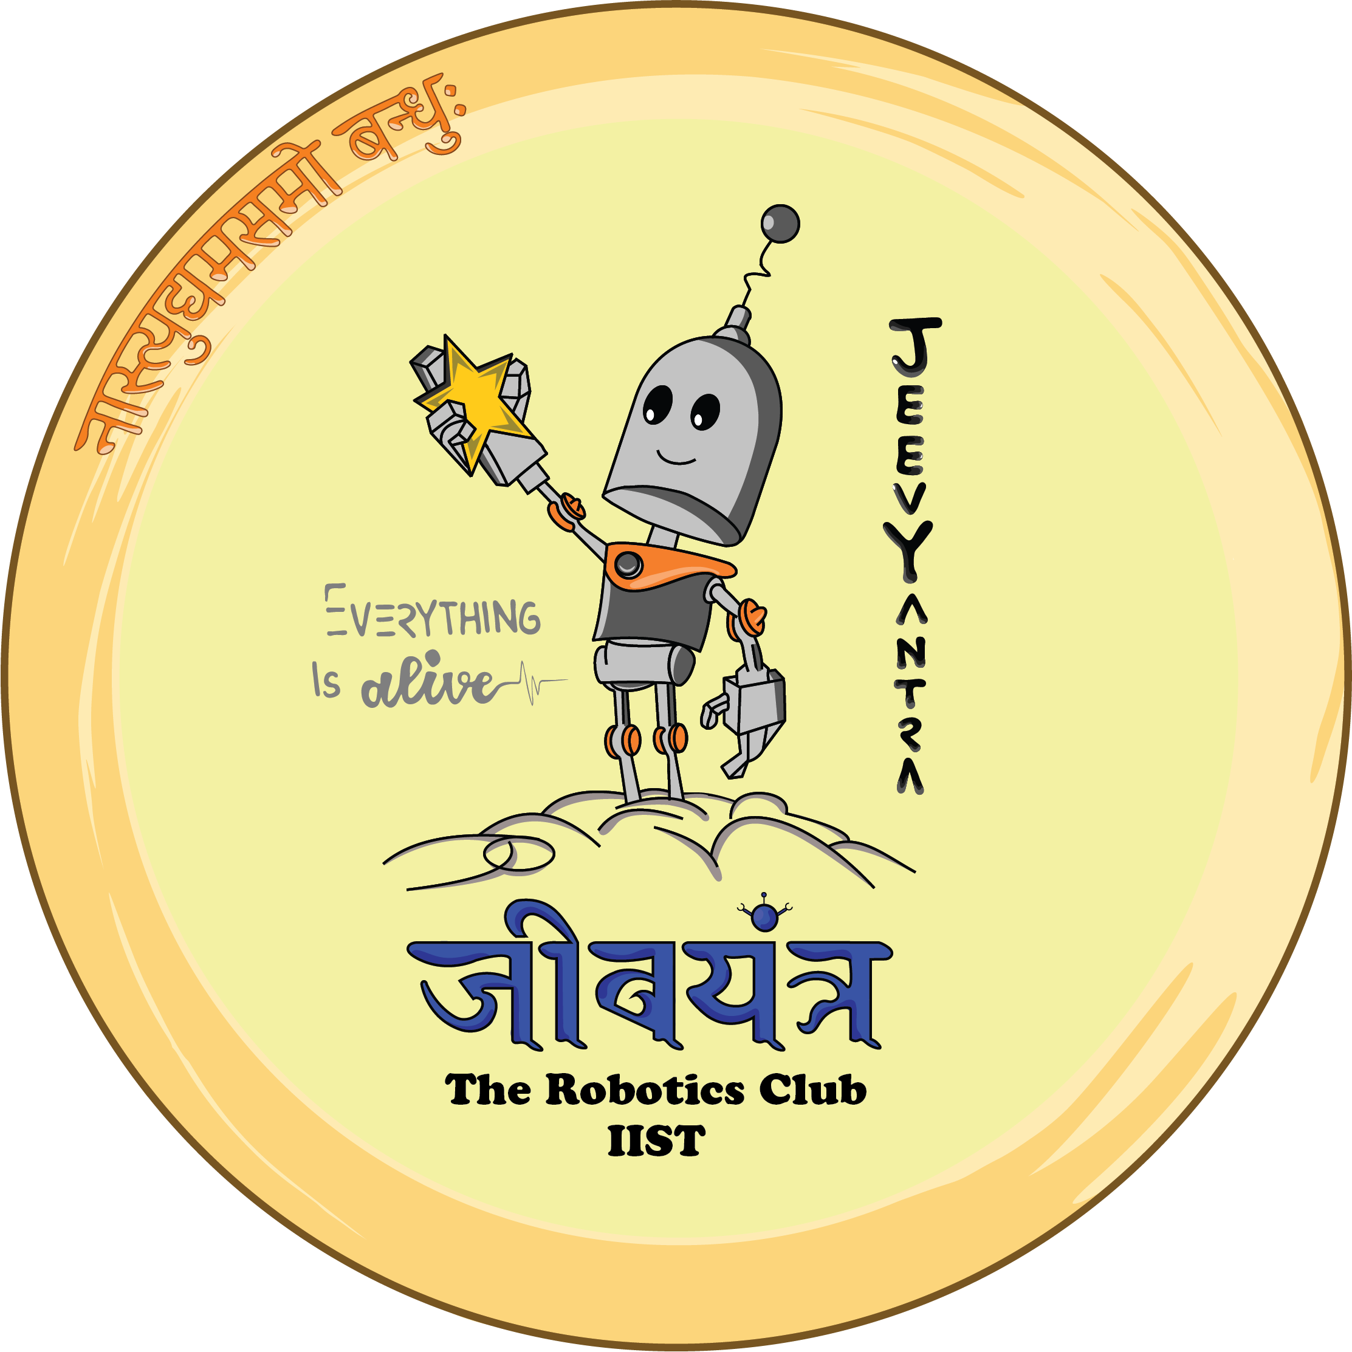
JeevYantra
Robotics Club | IIST

Slide 2
Aṣṭamaḥ
8th chapter of our learning session
Projectile with MuJoCo – Part 1
17 August 2024
Rajneesh Singh
B.Tech. 4th Year ECE(Avionics)
President, JeevYantra (Robotics Club IIST)

Slide 3
MuJoCo
MuJoCo is a free and open-source general purpose physics engine
aims to facilitate research and development in robotics, biomechanics, graphics and animation, and other areas where fast and accurate simulation is needed.
MuJoCo stands for Multi-Joint dynamics with Contact.
initially developed by Roboti LLC, it was acquired and made freely available by Google DeepMind in October 2021, and open sourced in May 2022.

Slide 4
Installation
pip3 install mujoco
pip3 install mujoco-python-viewer

Slide 5
Step 1
Create an XML file
XML files set up the simulation environment and its objects.
Let us create a sphere on a platform.

Slide 6
xml syntax
XML documents must contain one root element that is the parent of all other elements:
<root>
<child>
<subchild>.....</subchild>
</child>
</root>
In our case, root element is mujoco

Slide 7
<mujoco>
<worldbody>
<geom type="plane" size="10 1 0.1" rgba=".8 .8 .8 1"/>
<body pos="0 0 1">
<joint type="free"/>
<geom type="sphere" size=".1" rgba="0 1 1 1"/>
</body>
</worldbody>
</mujoco>

Slide 8
<mujoco>
<worldbody>
<geom type="plane" size="10 1 0.1" rgba=".8 .8 .8 1"/>
<body pos="0 0 1">
<joint type="free"/>
<geom type="sphere" size=".1" rgba="0 1 1 1"/>
</body>
</worldbody>
</mujoco>

Slide 9
<mujoco>
<worldbody>
<geom type="plane" size="10 1 0.1" rgba=".8 .8 .8 1"/>
<body pos="0 0 1">
<joint type="free"/>
<geom type="sphere" size=".1" rgba="0 1 1 1"/>
</body>
</worldbody>
</mujoco>

Slide 10
<mujoco>
<worldbody>
<geom type="plane" size="10 1 0.1" rgba=".8 .8 .8 1"/>
<body pos="0 0 1">
<joint type="free"/>
<geom type="sphere" size=".1" rgba="0 1 1 1"/>
</body>
</worldbody>
</mujoco>

Slide 11
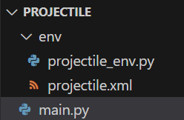
Step 2
Create the python file
We will write the program in object orientated way.
Create a folder for your project (say Projectile)
Inside Projectile folder make another folder env
Move the projectile.xml file inside env folder

Slide 12
projectile_env.py
import mujoco as mj
import mujoco_viewer
import os
class ProjectileEnv:
def __init__(self,args):
self.xml_file = args['xml_file']
xml_directory = os.getcwd() + "/env"
self.xml_path = os.path.join(xml_directory,self.xml_file)
self._mj_init()
def step(self):
mj.mj_step(self.model,self.data)
self.render()
def _mj_init(self):
self.model = mj.MjModel.from_xml_path(self.xml_path)
self.data = mj.MjData(self.model)
self.viewer = mujoco_viewer.MujocoViewer(self.model, self.data,hide_menus=True)
def render(self):
self.viewer.render()
def stop(self):
if self.viewer.is_alive:
self.viewer.close()

Slide 13
main.py
def main(args):
from env.projectile_env import ProjectileEnv
env = ProjectileEnv(args)
for i in range(5000):
env.step()
env.stop()
if __name__ == "__main__":
args={}
args['xml_file'] = 'projectile.xml'
main(args)

Slide 14
customize the camera's position and angle in the simulation view

Slide 15
projectile_env.py
def __init__(self,args):
self.xml_file = args['xml_file']
xml_directory = os.getcwd() + "/env"
self.xml_path = os.path.join(xml_directory,self.xml_file)
self.cam_azi = args['cam_azi']
self.cam_ele = args['cam_ele']
self.cam_dist = args['cam_dist']
self._mj_init()
def _mj_init(self):
self.model = mj.MjModel.from_xml_path(self.xml_path)
self.data = mj.MjData(self.model)
self.viewer = mujoco_viewer.MujocoViewer(self.model, self.data,hide_menus=True)
self.viewer.cam.azimuth = self.cam_azi
self.viewer.cam.elevation = self.cam_ele
self.viewer.cam.distance = self.cam_dist

Slide 16
main.py
def main(args):
from env.projectile_env import ProjectileEnv
env = ProjectileEnv(args)
for i in range(5000):
env.step()
env.stop()
if __name__ == "__main__":
args={}
args['xml_file'] = 'projectile.xml'
args['cam_azi'] = 90
args['cam_ele'] = -10
args['cam_dist'] = 5
main(args)

Slide 17
Set the gravity
projectile_env.py
def gravity_field(self,gx,gy,gz):
self.model.opt.gravity[0] = gx
self.model.opt.gravity[1] = gy
self.model.opt.gravity[2] = gz
main.py
env = ProjectileEnv(args)
env.gravity_field(0,0,-9.81)

Slide 18
Change the initial position of ball
projectile_env.py
class ProjectileEnv:
class QPOS_ADR():
BALL_POS_X = 0
BALL_POS_Y = 1
BALL_POS_Z = 2
def ball_position(self,posx,posy,posz):
self.data.qpos[self.QPOS_ADR.BALL_POS_X] = posx
self.data.qpos[self.QPOS_ADR.BALL_POS_Y] = posy
self.data.qpos[self.QPOS_ADR.BALL_POS_Z] = posz
mj.mj_forward(self.model,self.data)

Slide 19
Launch the projectile
projectile_env.py
class ProjectileEnv:
class QVEL_ADR():
BALL_VEL_X = 0
BALL_VEL_Y = 1
BALL_VEL_Z = 2
def ball_velocity(self,vx,vy,vz):
self.data.qvel[self.QVEL_ADR.BALL_VEL_X] = vx
self.data.qvel[self.QVEL_ADR.BALL_VEL_Y] = vy
self.data.qvel[self.QVEL_ADR.BALL_VEL_Z] = vz

Slide 20
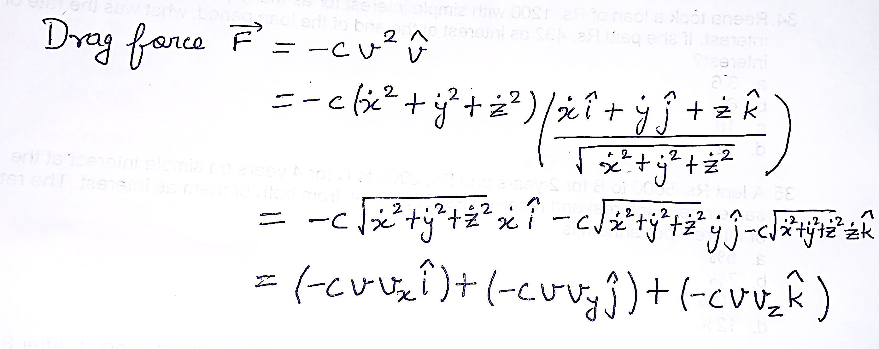

Slide 21
Homework
Apply drag force
Hint:
def controller():
vx = data.qpos[0]
vy = data.qpos[1]
vz = env.qpos[2]
v = np.sqrt(vx**2 + vy**2 + vz**2)
c = 1.0
data.qfrc_applied[0] = -c * v * vx
data.qfrc_applied[1] = -c * v * vy
data.qfrc_applied[2] = -c * v * vz

Slide 22
References
Overview - MuJoCo Documentation
XML Reference - MuJoCo Documentation
GitHub - rohanpsingh/mujoco-python-viewer: Simple renderer for use with MuJoCo (>=2.1.2) Python Bindings.

Slide 23

Pranaam

