Slide 1

JeevYantra
Robotics Club | IIST

Slide 2
Navamaḥ
9th chapter of our learning session
Projectile with MuJoCo – Part 2
24 August 2024
Rajneesh Singh
B.Tech. 4th Year ECE(Avionics)
President, JeevYantra (Robotics Club IIST)

Slide 3
Python
Interested in
  Artificial Intelligence
  Machine Learning
  Data Science
  Robotics
  ??? How to start
  Start with Python, one of the easiest and most loved language

Slide 4
Let’s understand some nerd terms
Programming
High level language
Compiler
Interpreter

Slide 5
Why Python?
Python is simple & easy (easiest among all the languages I worked with)
Free and open source
High Level Language
Portable
Versatile language
  Data science, ML, AI, Robotics
  Web development
  Games

Slide 6
Let’s start the ancient way
print(“Namaskaram”)

Slide 7
Python Character Set
Letters : A to Z, a to z
Digits : 0 to 9
Special Symbols : - + * / etc
Whitesapces : Blank spaces, tab, carriage return, etc
Other characters

Slide 8
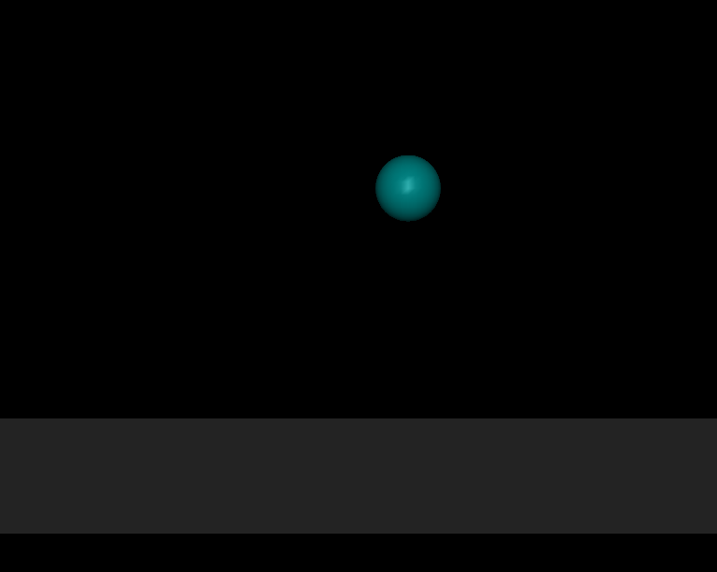
In Aṣṭamaḥ we have created a sphere falling on a platform

Slide 9
Set the initial position of ball
projectile_env.py
class ProjectileEnv:
class QPOS_ADR():
BALL_POS_X = 0
BALL_POS_Y = 1
BALL_POS_Z = 2
def ball_position(self,posx,posy,posz):
self.data.qpos[self.QPOS_ADR.BALL_POS_X] = posx
self.data.qpos[self.QPOS_ADR.BALL_POS_Y] = posy
self.data.qpos[self.QPOS_ADR.BALL_POS_Z] = posz
mj.mj_forward(self.model,self.data)

Slide 10
Launch the projectile
Give an initial velocity in x and z direction

Slide 11
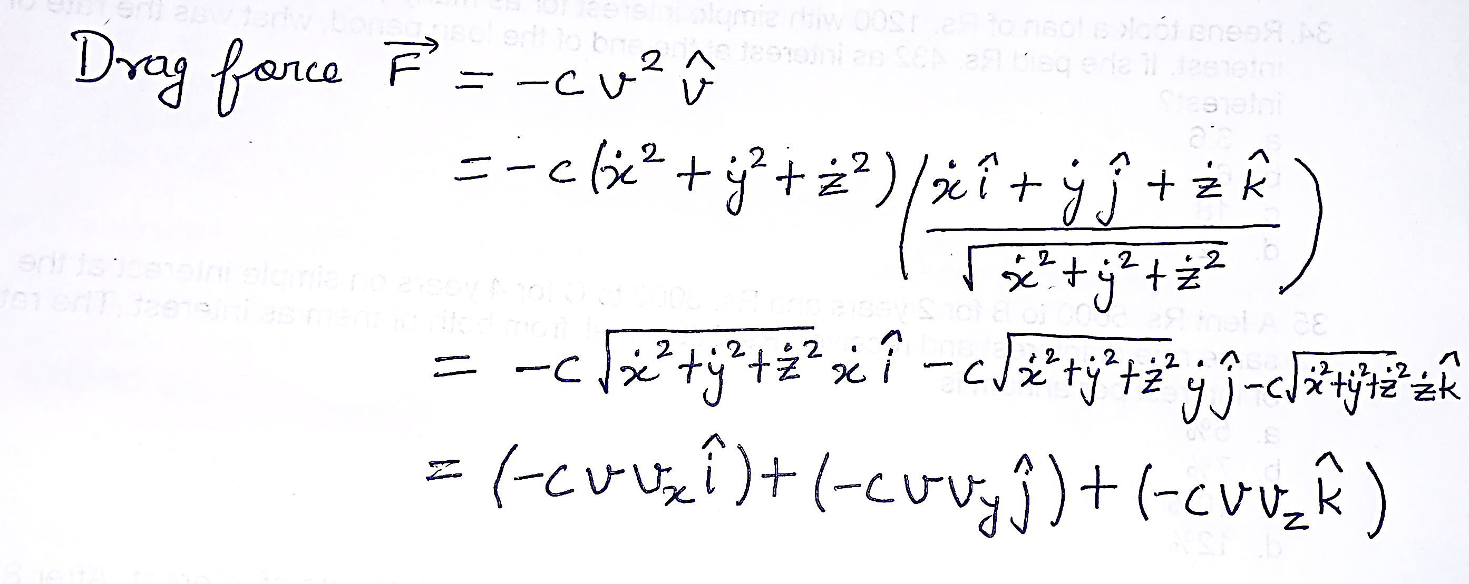
Add drag force

Slide 12
References
Overview - MuJoCo Documentation
XML Reference - MuJoCo Documentation
GitHub - rohanpsingh/mujoco-python-viewer: Simple renderer for use with MuJoCo (>=2.1.2) Python Bindings.
https://github.com/RajneeshSingh111/Projectile_with_drag
https://mujoco.readthedocs.io/en/stable/APIreference/APItypes.html

Slide 13

With love, light and laughter
Pranaam

