Slide 1
Application Portfolio Assessment & Modernization
Cognizant PoV

Slide 2








Cognizant’s Perspective On Portfolio Assessment & Modernization
Through Portfolio Modernization, Organizations can transform a highly complex, costly and moderately effective application landscape to an agile, lean and productive portfolio, aligned with key business needs and adaptable to an ever changing macro climate.
Reduction in time to market
Re-allocation of management efforts to strategic tasks
Effective use of portfolio rationalization can self fund transformation initiatives and Optimize TCO
Achieve cost efficiency by migrating suitable applications to cloud
Business Innovation
Ease of Governance
Value of Operation
Cost of Quality
Process Improvement
IT Efficiency
Digital Transformation
Cloud Readiness
Re-investment in transformation initiatives
Enhanced compliance
Streamlining of review/inspection, rework and retest
Value Generated
Current State
Future State
Improved automation
Accelerate progress against digital business goals
Value associated with
maintaining
applications
nearing retirement
Overall
Savings*
Running
Retirement
applications
Application Portfolio Rationalization
Impact
Funds for transformational and digital initiatives
Funds available for growth and
development
Run the business
=
Development funds
+
Operations
+
Application
Maintenance
Reduction in support/ development FTEs
Retirement of aging applications
Operations and
applications
maintenance
Improve speed of IT delivery
Portfolio simplification and risk reduction
Reduced costs
from
Optimization
Operations
+
Application maintenance
Reduction in defects / issues and reduced turnaround time
Optimization of regulatory compliance effort
Time
Reduction in duplicate or conflicting functionality
Reduction of management and documentation efforts
*Average YoY savings: ~12-15% of OpEx

Slide 3
Customized Assessment Approach to Suit Client Objective And Portfolio Needs
Portfolio Modernization can be either Business / IT / Process driven. Cognizant’s framework can be customized to each approach; however, the core tenets fundamentally remain unchanged.
Business Driven | IT Driven | Process Driven
Current State
Future State
Identify Business Strategy
EA Transformation Focus: management Excellence
Cost
Agility
L1 Process
Application Rationalization
PaaS Migration
Process 1
Process 2
Process …N
Establish Enterprise Architecture
Enterprise Solutioning: Biz. Driven Initiatives
App 1
App 1
App 1
Application Replatforming
DevOps / CD
App 2
App 2
App 2
Define Future State Architecture
EA Transformation Focus: Operational Excellence
App…N
App…N
App…N
ITaaS Enablement
L2 Process
Process 1
Process 2
Process …N
Define Rationalization Roadmap
EA Future State: Applications,
Technology
App 1
App 1
App 1
IaaS Migration
App 2
App 2
App 2
Establish Governance
App…N
App…N
App…N
Legacy
Apps.
Industry Standards
PaaS / Microservices

Slide 4
Application Validation, Assessment and Dispositioning Approach
Comprehensive end-to-end approach, assisted by data, processes, and toolsets that accelerate the overall efforts for analysis
Key Inputs
Application Analysis
Business Impact, Technology & Stack Analysis Insights
Deliverables
App
Inventory
Business Value
Technical Value
Business Impact Analysis
Technology Heat Map
Reference Architecture
App Disposition
Risk
Cost
Analyze business impact based on survey questionnaire
Identify redundancy, prioritize opportunities to rationalize & roadmap
R1
Retire
Decommission
Regulations
Proven Framework that can be customized for parameters and weightages for D&B
Use to Identify Tech upgrade / migration needs
R2
Rehost
Lift & Shift
Business Vision
Infrastructure Analysis
Technical Reviews
Service Modeling
R3
R4
Replatform
Upgrade & Replace
Functional Inputs
Dependency Mapping
Migration Options
Rehost
Refactor
App Portfolio Rationalization
R5
R6
Refactor & Re-eng.
Modernize
Cloud Suitability
Business Continuity
Testing Analysis
Technical Value
Replatform
App Dispositions / Reporting / Insights
Technical Inputs
Re-validated app complexity
Test Cases
Retain
App Migration strategies
Lift & Shift, Lift & Optimize, Lift & Transform
Cost Inputs
Integration & Automation
Schemas
Business Value
PODs, Waves, migration planning
Tech Stack
Integration & Dependencies
Code Driven + Questionnaires
App Characteristics
App Insights
Tech Insights
Tech Stack fitment, Resilience, Security, Elegance and Agility
Business Impact, dependencies & Resilience
Technology modernization blockers & roadmaps
Business Cases, Roadmaps
Source Code
Code Scan
Architecture Walkthrough
Apps Survey
Validation
End-to-End App Portfolio Management, Lifecycle Management Platform (e.g., Alfabet, LeanIX)
Notes:
Zorik – 5 mins

Slide 5

Implementation Approach for Portfolio Modernization
*Separate efforts required for this Due Diligence
Multi-pass Application Portfolio Rationalization
PASS 1 – Assessment Preparation
Cleaning up of App Inventory, Qualification of applications and Sprint planning
PASS 2 – Application Assessment
Initial disposition based on the data collected and business user interviews
PASS 3 – Deep dive*
Deep dive analysis to identify target state and associated impacts.
Inventory Cleanup
Sprint 1
Sprint ..
Sprint n
Summarize Benefits
Application Portfolio
Data Collection
Target State
Playback
Data Analysis
Assessment Questionnaire
Initial Disposition
Recommendations
Stakeholder Interviews
Opportunities
Final Disposition
Qualified Opps.
Playback Opportunities & Agree
Stakeholder Identification
Estimate Costs
Qualify Apps for Assessment
Develop Assumptions
Sprint Planning
Calculate Financial / Non-Financial Impact
Schedule Interviews
Summarize Findings
Implementation Roadmap
Application Inventory and Sprint Planning
Assessment Findings and Recommendations
Opportunity Prioritization
Business Case

Slide 6

Assessment Objectives and Expected Outcomes
Scope
Tool based assessment, analysis and preparation of migration plan for # EOL Physical Servers, # Applications, # Storage devices, and # Virtual servers and # Applications with EOS OS.
Objectives & Outcomes
Inventory
Identify
Collect
Define
Recommend
Validate
All assets including apps, infra, databases, middleware and services
Legacy platforms, technical stacks and EOL details
Configurations, cross-dependencies, performance metrics and utilization data
Move groups, DR/HA requirements, optimal configurations and target sizing
App, Infra, DB disposition and migration strategy to P2C/P2V
Target landing zones, automation tools, costs and performance requirements
Notes:
Slide for - Ramana

Slide 7
Structured Portfolio Assessment Activities
OBJECTIVES
Pass 1
Pass 2 (Iterative)
Pass 3
DELIVERABLES
Preparation
Data Collection
Data Analysis
Recommend
Deep Dive
Analyze and Optimize Application Portfolio
Leverage Inputs including
Application landscape
Business strategy
Business / Technical inputs
Enhancements
Documentation
Inflight initiatives
Cloud presence
Security
Complexity
Risk/compliance
Issues, risks and challenges
Inputs
Application inventory
Org structure
Geography spread
Other application attributes
Activities
Identify application owners, SMEs and team mapping
Obtain access to respective SharePoint
Request for the Application data
Key Deliverables
Data collection schedule
Overall engagement plan
CAST Highlight access and agent installation
Inputs
Application Data
Obtain existing artefacts
Activities
Review data quality
Interview key stakeholders
Validate assumptions
Collect / consolidate the data from stakeholders and other sources
Create interview notes collecting all information required for analysis
Run Code Scan
Key Deliverables
Collected data
Updated assumptions log
Documents collected
Code scan results
Inputs
Application data collected
Activities
Analyze application landscape from the data collected
Generate BV & TV
Plot the 6R disposition of the apps
Create Functional Model (L0-L1-L2)
Plot Technical Landscape (Heat map) of the portfolio
CAST Highlight Code scan analysis
Key Deliverables
6R disposition
Portfolio Functional View
Portfolio Technical view
Activities
Finalize the App disposition
Finalize the Rationalization and Modernization opportunities
Finalize the Decommission opportunities
Create Target State View
Qualify opportunities for Deep dive
Final Portfolio playback & signoff
Key Deliverables
Sprint Report
Qualified opportunities list
High level roadmap
Activities
Prioritize opportunities for deep dive
Deep dive sessions with stakeholders
Customize ROI calculator
Build business case for each opportunity and detailed roadmap
Target solution for Reengineer and Re-platform candidates
Key Deliverables
Business Case
Opportunity wise ROI
Implementation timelines & roadmap
6R Mapping of applications
Functional Heat Map of applications
Technology / Solution recommendations
Application Portfolio Rationalization Roadmap
Identified challenges and risk
Prioritized Opportunities
Timelines
Decommission strategy
Business Case
8 – 10 Weeks *
* ~ 200 – 300 apps - This is indicative and subject to change based on the portfolio size and complexity
& Due diligence for Business case identification on the opportunities requires separate efforts

Slide 8
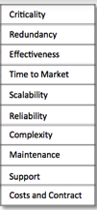
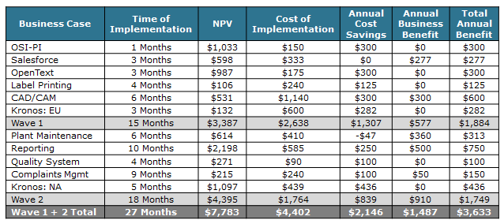
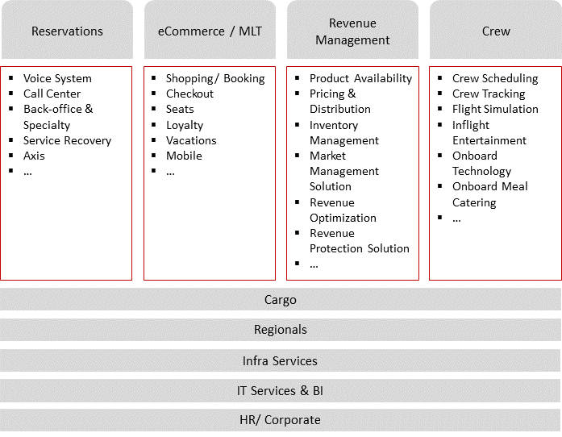
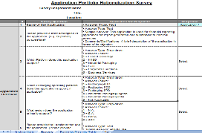
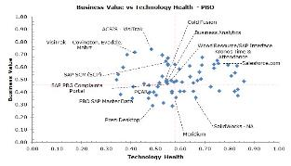
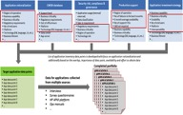
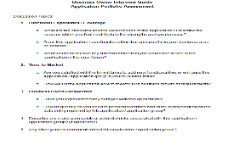
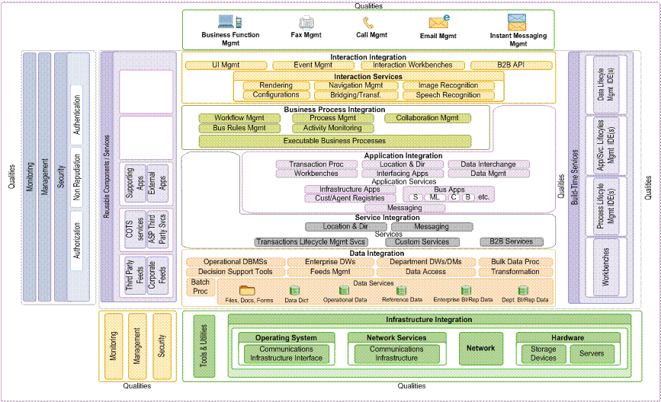
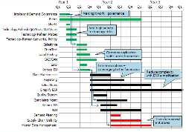
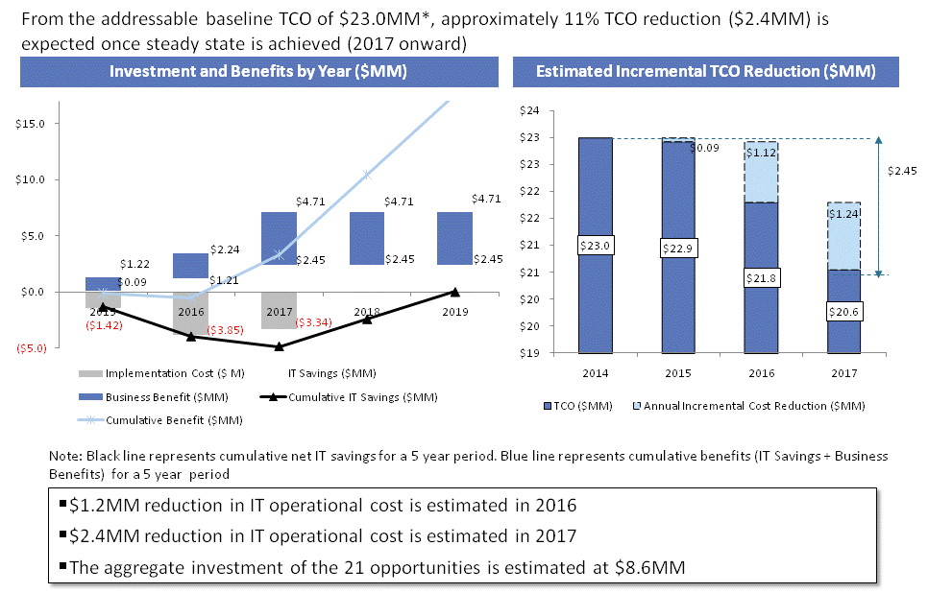
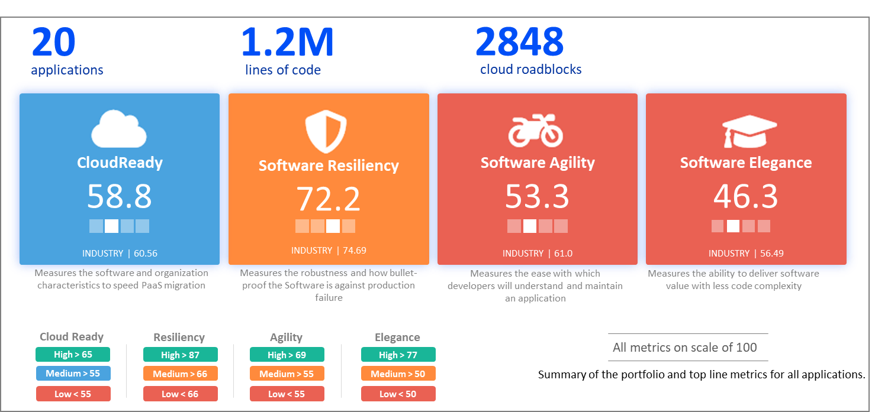
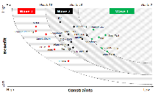
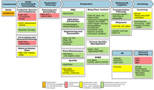
Each phase of the Assessment + Cloud suitability work stream yields a defined set of deliverables which shall be tailored to your specific portfolio goals and objectives…
Prepare and Data Collection
Data Analysis
Recommendation & Roadmap
Business Capability Landscape
IT Survey
Application Profiling
Opportunity Profile
Business Case
Application Process Maps & Data Points
Business
Interviews
Application Value and Maturity Analysis
Cost Benefit Analysis and Opportunity Prioritization
Implementation
Roadmap

Slide 9
Our experience in performing Application Portfolio Modernization…
… Will help us adapting the best practices for performing Assessment + Modernization assessment to identify opportunities in to realize 10% - 20% Cost optimization…
Large Media Company
in Europe
Large Apparel retailer
in US
Large home appliances manufacturer in Europe
A large Manufacturing Company in US
A leading independent oil and gas company in UK
Optimize application footprint | Ability to prioritize traceability | Business-aligned portfolio
Optimize application footprint | Reduce TCO | Reduce Business/IT risk | Faster time to market
Optimize application portfolio |
Improve transparency in current IT product portfolio
Objective
Optimize application portfolio | Reduce TCO
Portfolio Rationalization | License and Vendor Rationalization
# of Applications : 656
# of LoB's : 4
Geographic regions : 5
No of Countries : 20+
# of Applications : 160+
# of LoB's : 3
# of Applications : ~1200
# of LOB’s : Multiple
Geographic regions : 5
# of Applications : ~450+
# of LOB’s : 4
Geographic regions : Global
# of Applications : ~260+
Across 6 Services
Scope
Apps overlapping functionalities | Loosely defined ‘IT product’ | Absence of robust governance for post APO execution
Data and application redundancies with brand/ location customizations | Fragmented operations | Multiple process | Systemic silos & disjoint information structures etc.,
Apps overlapping functionalities | Apps server based installation across GEO
Apps overlapping functionalities | Legacy applications have higher interfacing complexities
Majority of applications are COTS >~50% | Heterogeneous technology landscape | Lacking Persona aligned services
Observation
Defined 6R disposition for Apps inventory & Cloud migration strategy for the portfolio
Detailing 6R mapping | Replace legacy apps with COTS products in market
Decommissioning (Factory) / modernization | Functional consolidation | Migrate to S4Hana, Migrate to SWIFT
Defined 6R disposition for Apps | Defined a new reference architecture based on client’s key business functions
Application Portfolio | Infrastructure and Data Centre Optimization | License optimization | Vendor Rationalization
Output
60+ & 20+ apps – Short & long term decommissioning | 4 year Operational Transformation strategy with $18Mn benefit
10+ & 20+ apps – Short & long term decommissioning | Redundant functionalities highlighted for 8 applications
Cost benefits of ~19 M Euros | Higher transparency of apps landscape in terms of business alignment
Cost Benefit of ~$12 Mn from decommissioned modernization opportunity | ~40% reduction in overall application portfolio
Opportunities to reduce IT cost by £11.9m over 5 years from a baseline spend of £8.5m per year (25% saving)
Benefit
High-range / scale (No. of apps)
Mid-range / scale (No. of apps)
Low-range/scale (No. of apps)
Notes:
Kantar, Kohl’s, B/S/H, Matel, Ithaca

Slide 10
Indicative Effort Required From Stakeholders
Roles | Key Responsibilities | Indicative Effort Required
Program Sponsor | Ensure commitment from the UnitingCare IT and Business Leadership for the program Communicate objectives and expectations | 3% to 5% per week
Application Rationalization Engagement Manger | Provide signoff of templates and deliverables Ensure participation of the necessary stakeholders Ensure data availability on time Work closely with Cognizant team on a daily basis towards successful execution of the program Provide insights and inputs about UnitingCare specific aspects Manage conflicting priorities of UnitingCare stakeholders for this exercise on an ongoing basis. Remove blockages | 100% per week until end of Pilot phase and then 50 % until end of project
Project Assistant | Work closely with Engagement Manger and Cognizant Project Team to coordinate meetings with the UnitingCare stakeholders Blocking calendar and the resources required for the various meeting Project coordination to ensure timely availability and usage of the resources | 40% per week
IT Product Managers | Provide necessary inputs in surveys, workshops, 1 on 1 sessions, as required Participate in opportunity qualifications Work with Cognizant to identify pilot Application scope | 4 to 6 hrs. per Application Manager for interview and play back
Application Business Owners | Provide inputs on the application functionality gap Provide inputs on non-functional user experience Provide necessary inputs in surveys, workshops, 1 on 1 sessions, as required | 4 to 6 hrs per Application Owner/SME for interviews
Enterprise Architect | Provide inputs on architecture roadmap Provide necessary inputs in surveys, workshops, 1 on 1 sessions, as required | 10%to 12% a week during Pilot phase

Slide 11
Thank You
ADM Client Enablement & Transformation
ADMCET@cognizant.com

