Slide 1
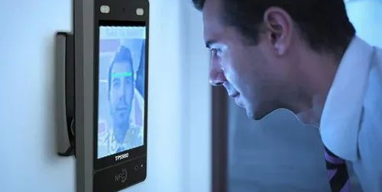

Automatic-Attendance-System-using-Facial-Recognition
By: Mohit Hajela (Class 6)

Slide 2
About:
. This application is user-friendly and flexible which helps you to track attendance of the students effectively.
It is an Integrated Solution that allows you to have thorough attendance review and eliminate duplicate data entry and errors in time and attendance entries

Slide 3

KEY FEATURES
Auto Attendance system Using Real Time Face Recognition
Face Recognition
Mouth Detection
Nose Detection
Eyes Detection

Slide 4
Why to use this application:
avoid manual effort and which is time consuming
it is tedious to keep records in bulk
reduce the chances of fake attendance which is high in paper-pen attendance
using automated system, paperwork will be reduced and it will save time and environment

Slide 5

Target Users
Universities
Offices and Industries (future scenarios)
Banking
Air ports

Slide 6
Technology Used
OpenCV (for image processing )
WPF (for user interface)
C# (for implementing business logic)
Entity Framework (for database management)

Slide 7

How OpenCV Works
Real-Time Processing: Optimized for fast, real-time detection.
Pre-Built Algorithms: Offers ready-to-use face detection models like Haar Cascades.
Cross-Platform: Works on Windows, Linux, macOS, Android, and iOS.
Machine Learning Integration: Easily integrates with TensorFlow and other ML libraries.
Large Community: Strong support and active development ensure reliability and growth.

Slide 8
Why OpenCV
Feature | Why | How it Helps
Real-Time Processing | Face detection often needs to be performed in real time, such as in security cameras or facial recognition systems. | OpenCV is optimized for real-time image and video processing, allowing efficient face detection on various devices.
Pre-Built Face Detection Algorithms | Implementing face detection from scratch can be complex and time-consuming. | OpenCV provides pre-built algorithms like Haar Cascades and DNN modules, which are optimized for accuracy and performance.
Cross-Platform Support | Face detection may need to be deployed on multiple platforms, including Windows, Linux, macOS, and mobile operating systems. | OpenCV is cross-platform, making it suitable for deployment on different devices and operating systems.
Integration with Machine Learning | Combining traditional computer vision techniques with machine learning enhances face detection accuracy. | OpenCV integrates with libraries like TensorFlow and PyTorch, facilitating advanced face detection and recognition tasks.
Large Community and Active Development | A strong support base is crucial for troubleshooting and rapid development of new features. | OpenCV has a vast community and comprehensive documentation, aiding in finding solutions and implementing projects effectively.

Slide 9
11009590
11009591 11009601
11009592 11009600
11009594 11009598
11009595 11009599
11009596 11009597
Roll Numbers :

Slide 10
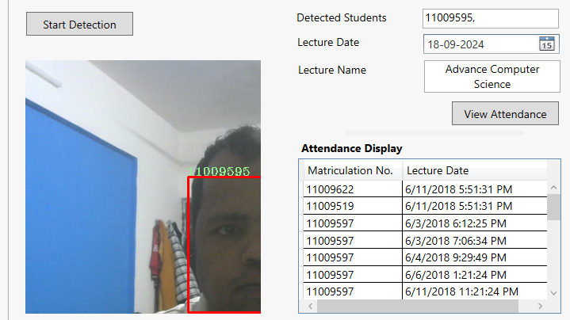
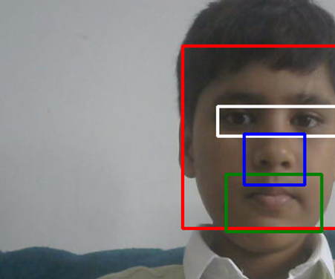
11009595

Slide 11
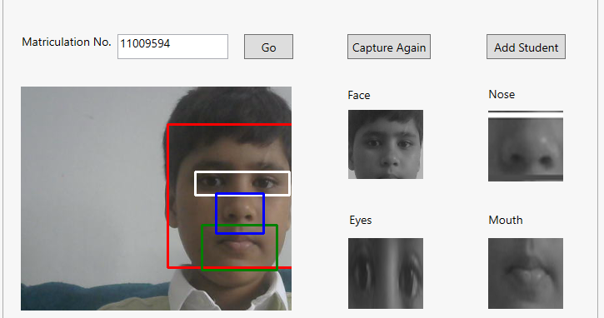

Slide 12
Voice Calculator
Less time consuming
Works with Voice
Fast calculation

Slide 13
Digital Diary
Less time consuming in Typing
As you say it writes
Voice recogniser

