Slide 1
Multi-focus Colour Image Fusion based on Stationary Wavelet Transform (SWT) & Intensity Hue Saturation (IHS)
Presented by: Deepak Kumar & Divyansh Garg
15JE001423 15JE001394

Slide 2
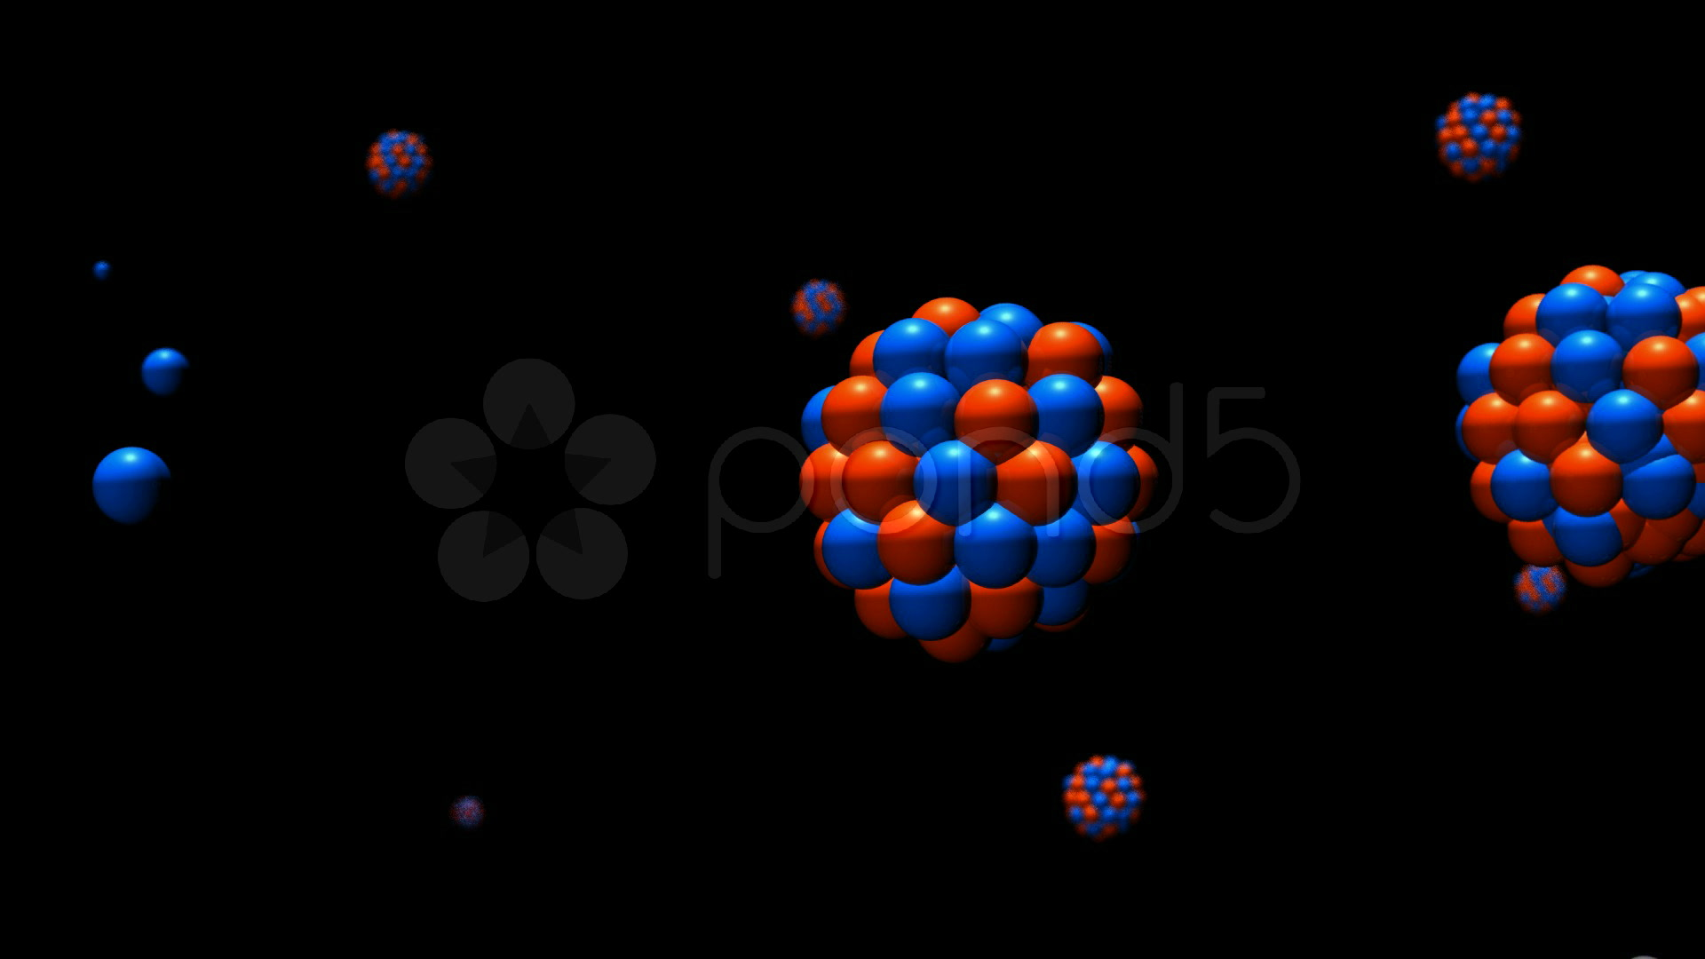
What is Image Fusion?

Slide 3
Evolution of Image Fusion
Simple Image Fusion Techniques
Pyramid decomposition based image fusion
Wavelet transform based image fusion

Slide 4
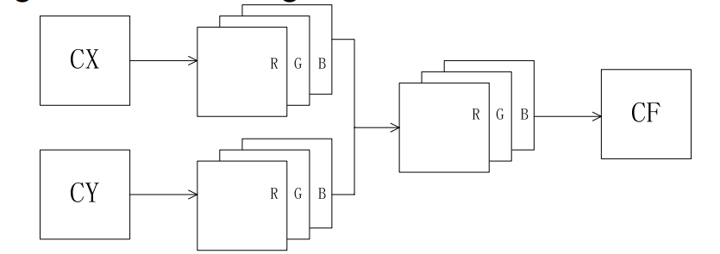

Simple Image fusion
Spatial Average Image Fusion Method

Slide 5
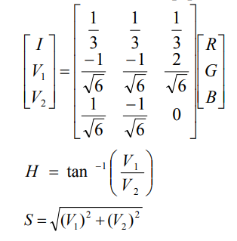
Intensity-Hue-Saturation (IHS) Image Fusion Method
HIS transform is used for geologic mapping because the IHS transform could allow diverse forms of spectral and spatial landscape information to be combined into a single data set for analysis.
enhances spatial details of the multispectral image and improve the textural characteristics of the fused
The color distortion of HIS technique is often significant.

Slide 6
Stationary Wavelet Transform (SWT) fusion method
The discrete wavelet transform allows the image decomposition in different kinds of coefficients preserving the image decomposition.
Such coefficients coming from different images can be appropriately combined to obtain new coefficients so that the information in the original images is collected appropriately.
Once the coefficients are merged, the final fused image is achieved through the inverse discrete wavelets transform (IDWT), where the information in the merged coefficients is also preserved.

Slide 7
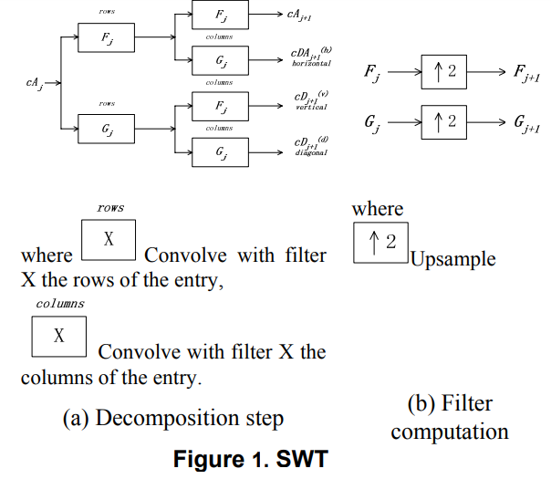
Block Diagram of SWT

Slide 8
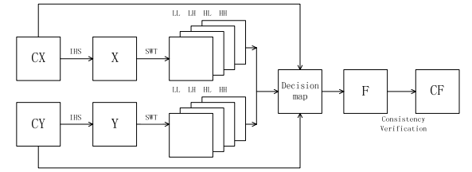
SWT+IHS fusion method

Slide 9
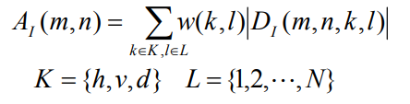

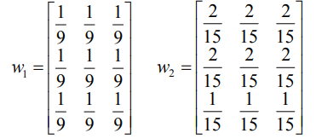
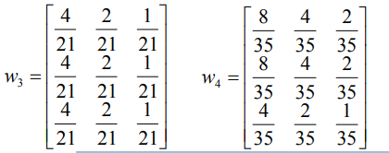
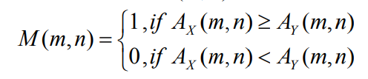
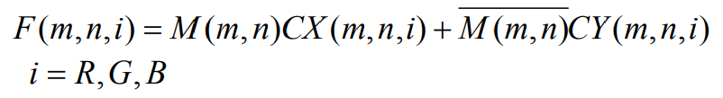
Procedure

Slide 10

Consistency Verification
Consistency verification is performed on each pixel of F. If a center pixel comes from image CX while the majority of surrounding pixels come from image CY, the center pixel is then changed to come from image CY and vice versa.

Slide 11
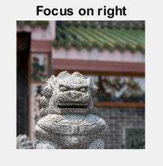
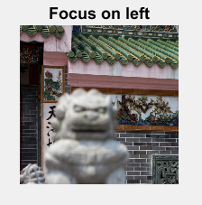
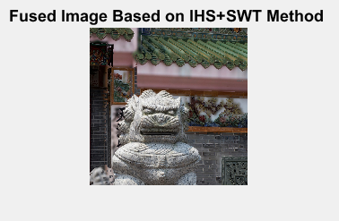
Results

Slide 12
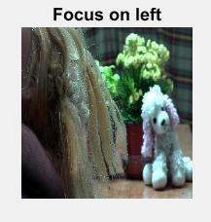
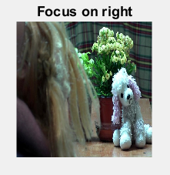
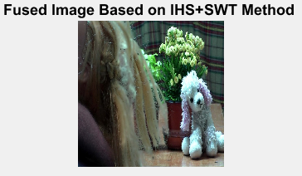

Slide 13
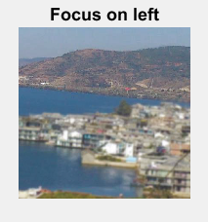
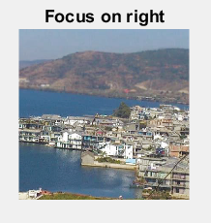
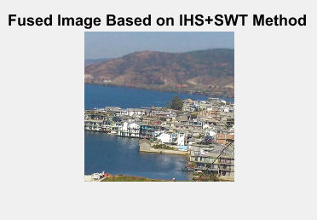

Slide 14
THANK YOU

