Slide 1
Sorting Visualizer
Made by – Rajnish

Slide 2
Introduction
Sorting is a fundamental concept in computer science.
This project helps visualize how different sorting algorithms work.
It helps students understand sorting logic in an interactive way.

Slide 3
Objective
To visualize and understand sorting algorithms through animations.
Allow users to control array size and speed of sorting.
Make learning sorting more interactive and fun.

Slide 4
Features
Visualizes 6 different sorting algorithms.
Adjustable array size and speed.
User-friendly interface.
Color-coded comparisons and swaps.
Real-time bar animations.

Slide 5
Sorting Algorithms Implemented
- Bubble Sort
- Selection Sort
- Insertion Sort
- Merge Sort
- Quick Sort
- Heap Sort

Slide 6
Tools & Technologies Used
Frontend: HTML, CSS, JavaScript
Editor: Visual Studio Code

Slide 7
Project Workflow
1. User inputs array size and speed.
2. User selects a sorting algorithm.
3. Bars are displayed based on array values.
4. Sorting animation starts with color indication.
5. Final sorted array is displayed.

Slide 8
Challenges Faced
Making the site responsive with CSS as a beginner.
Implementing sorting algorithms in JavaScript instead of C/C++.
Synchronizing visual animation with logic.

Slide 9
Future Enhancements
Add more sorting algorithms (e.g., Radix, Bucket).
Improve UI/UX design.
Add sound or explanation voice-over.
Store user progress using backend support.

Slide 10
Results
Successfully visualized 6 sorting algorithms.
Responsive design works across devices.
Improved understanding of algorithm behavior.

Slide 11
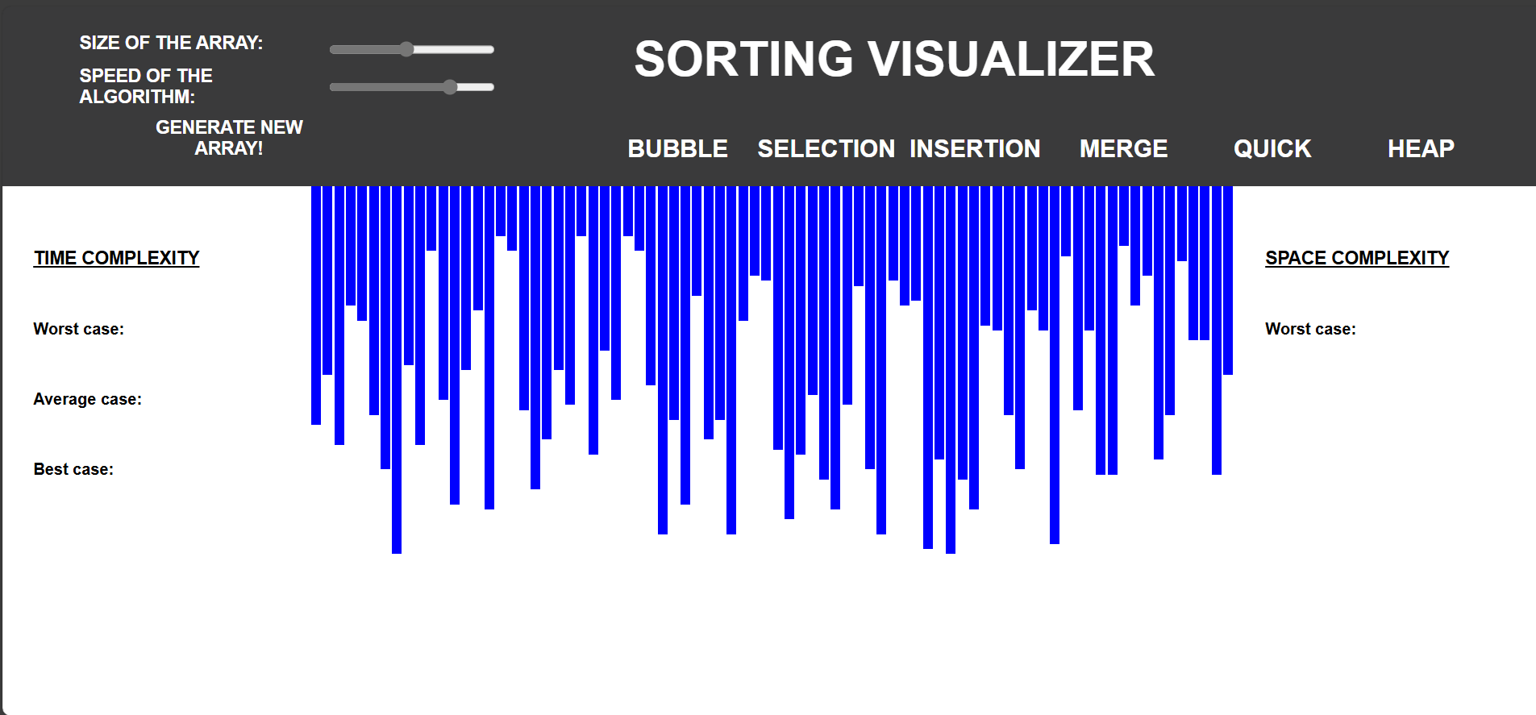
Screenshots
• Home Page

Slide 12
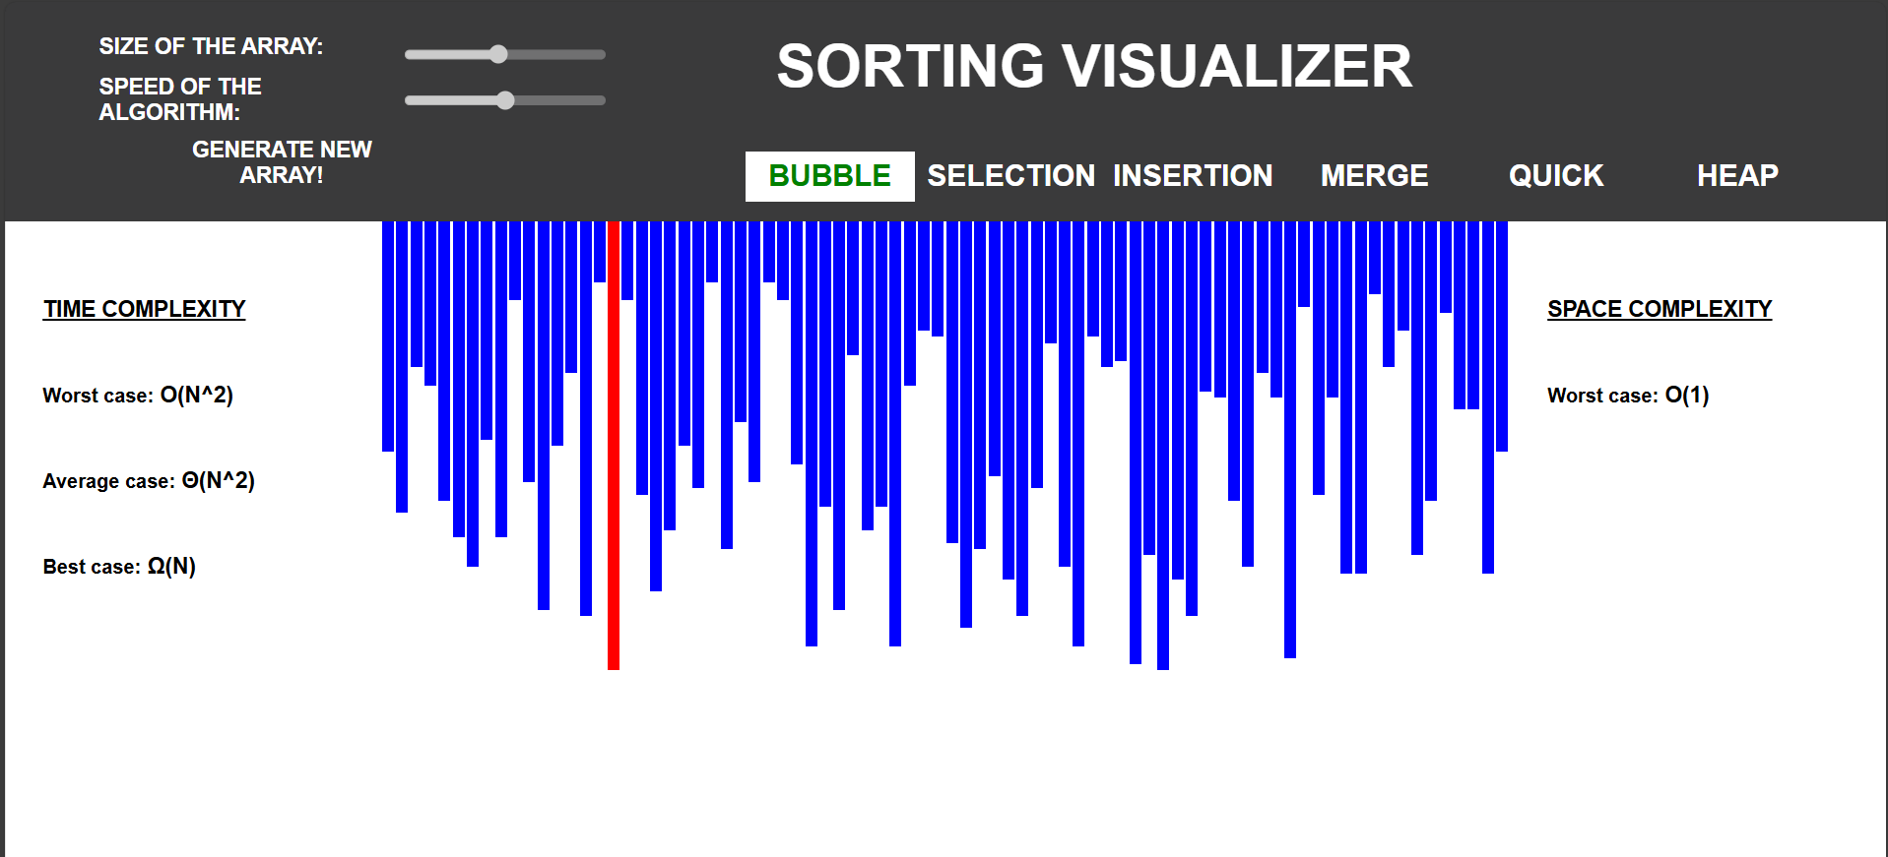
• Sorting in Action

Slide 13
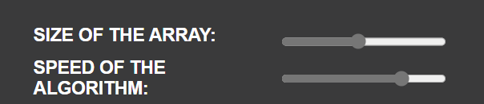
• Speed and Size Controls

Slide 14
Conclusion
The project achieved its goal of creating an interactive tool to learn sorting.
Helped enhance frontend development and logical thinking skills.
Serves as a valuable tool for educational demonstrations.

