Slide 1
Care Transition Efficiency & Placement Outcome Analytics
Internship Project – Unified Mentor
Process Efficiency Evaluation of the UAC Care Pipeline
Name: RAJOLI VISHNU VARDAN REDY
Internship ID: UMID12012677832
Duration: 3 Months

Slide 2
Project Background
UAC Program operates as a multi-stage care and reunification pipeline
Speed and continuity are critical for child welfare outcomes
Traditional monitoring focuses mainly on custody counts

Slide 3
Problem Statement
Lack of visibility into CBP → HHS transfer efficiency
Discharges not clearly aligned with inflows
Care backlogs remain hidden without process metrics

Slide 4
Project Objectives
Measure care transition efficiency
Evaluate discharge and placement outcomes
Identify delays and system bottlenecks

Slide 5
UAC Care Pipeline Flow
CBP Custody
HHS Care
Sponsor Placement

Slide 6
Dataset Overview
Daily time-series operational dataset
Covers CBP intake, transfers, HHS care, and discharges

Slide 7
Key Performance Indicators (KPIs)
Transfer Efficiency Ratio
Discharge Effectiveness Index
Pipeline Throughput
Backlog Accumulation Rate
Outcome Stability Score

Slide 8
Dashboard Implementation
Interactive dashboard built using Streamlit
Live KPIs and trend analysis
Deployed on Streamlit Community Cloud

Slide 9
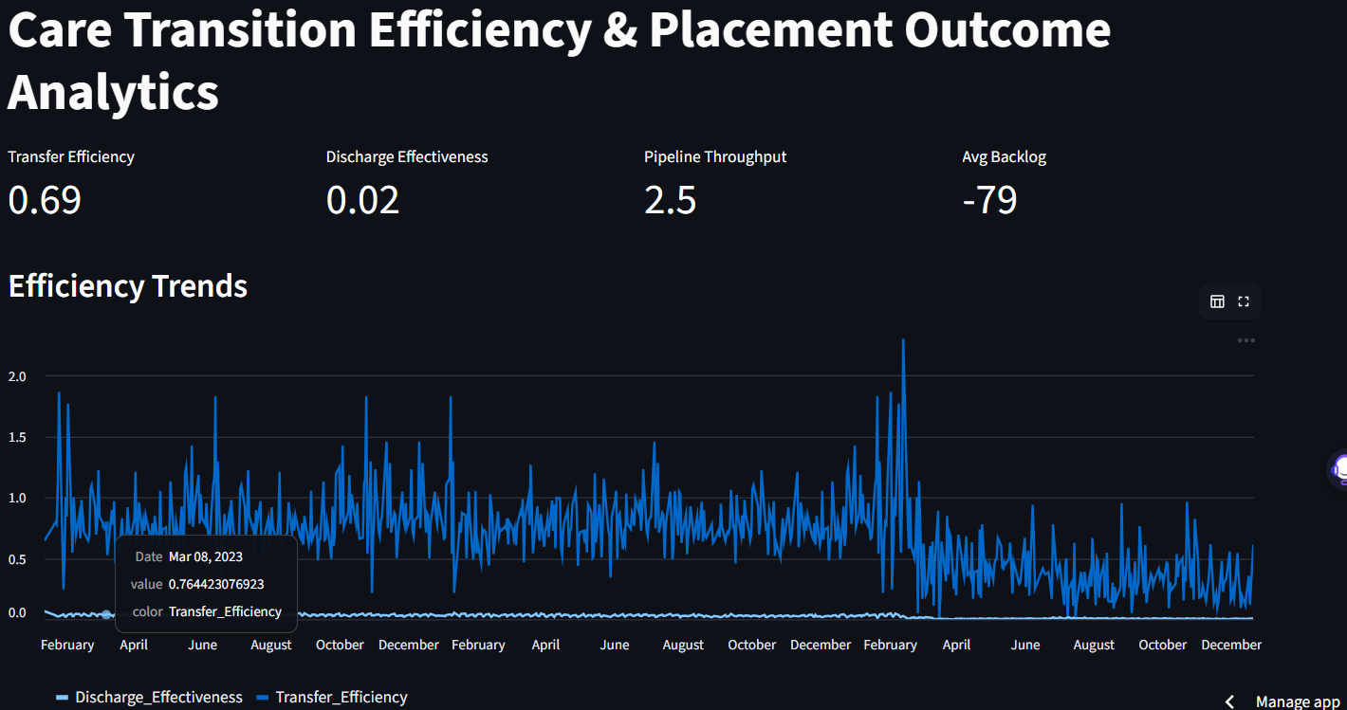

Slide 10
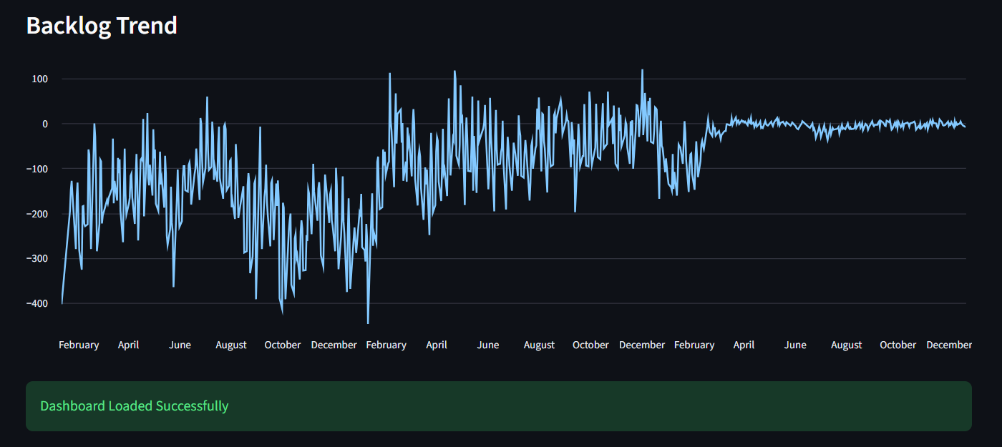

Slide 11
Results & Insights
Transfers are relatively stable
Sponsor placement is the primary bottleneck
Backlogs increase when discharges slow

Slide 12
Recommendations
Streamline sponsor vetting and placement
Use KPIs as early warning indicators
Improve surge-period coordination

Slide 13
Conclusion
Shift from capacity monitoring to efficiency analysis
Dashboard supports data-driven decision-making
Improves reunification timelines and outcomes

