Slide 1
Constrained Piano-Sonata-Like Music Composition Using MRF Team - Cucumburn
Members
B03902010 耿宗揚 B03902015 簡瑋德 B03902086 李鈺昇

Slide 2
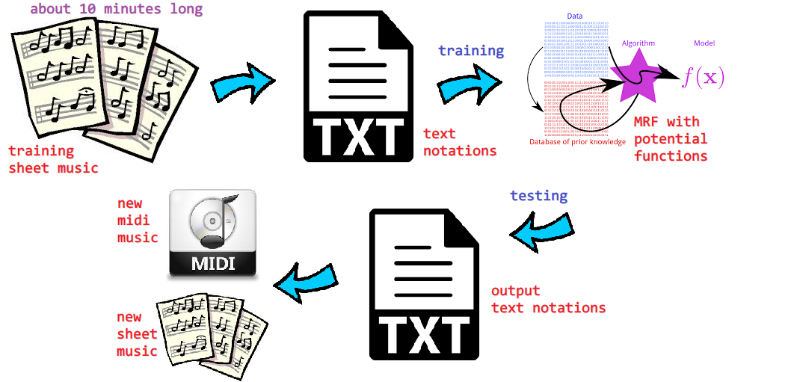
Framework

Slide 3
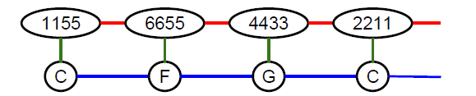
Goal
Machine completes a musical period (樂段) given fixed notes (音符) at some beats (拍子)
We use MRF to represent the period, for example
Assign values (output) to variables in a 2-by-N grid MRF, given some variables (input) fixed

Slide 4
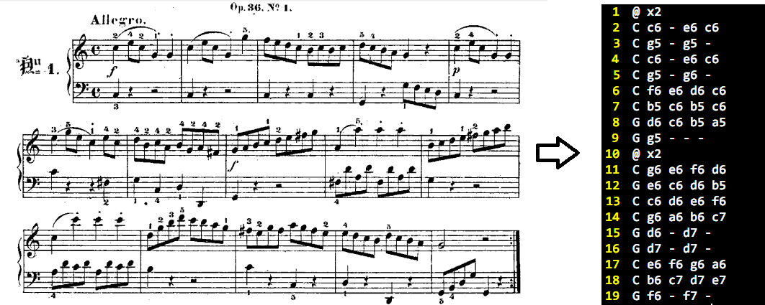
Training Data
clementi_op36_no1_mv1 to clementi_op36_no6_mv1
IMSLP400313-PMLP648020-Clementi_-_Sonatinas

Slide 5
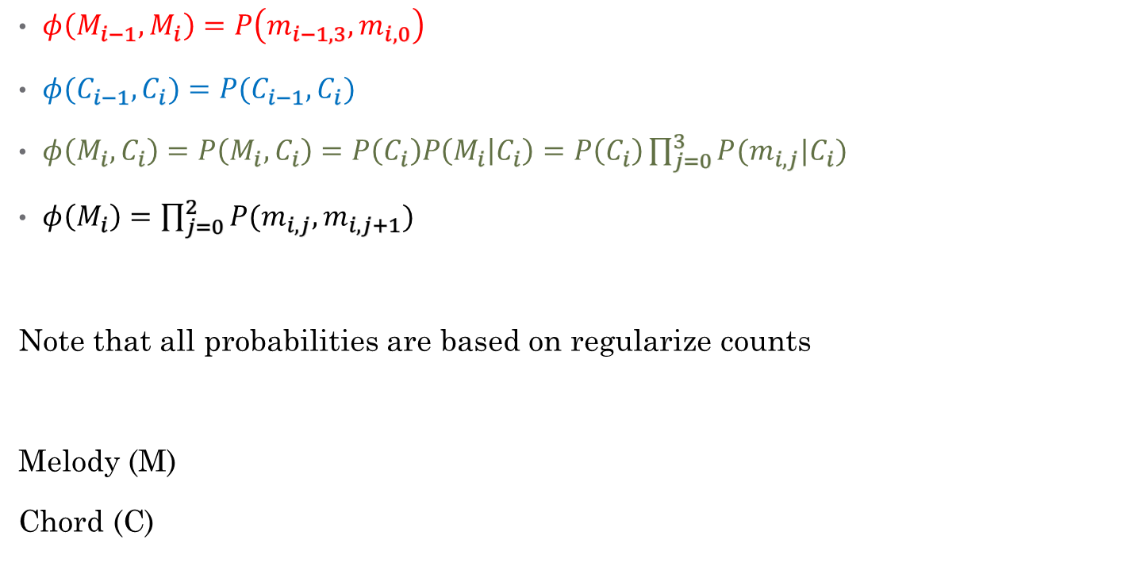
Potential Functions
$φ\left(M_{i−1},M_{i}\right)=P\left(m_{i−1,3},m_{i,0}\right)$
$φ(C_{i−1},C_{i})=P(C_{i−1},C_{i})$
$φ\left(M_{i},C_{i}\right)=P\left(M_{i},C_{i}\right)=P\left(C_{i}\right)P\left(M_{i} | C_{i}\right)=P\left(C_{i}\right)\prod_{j=0}^{3}{P(m_{i,j}|C_{i})}$
$φ\left(M_{i}\right)=\prod_{j=0}^{2}{P(m_{i,j},m_{i,j+1})}$
Note that all probabilities are based on regularize counts
Melody (M)
Chord (C)

Slide 6
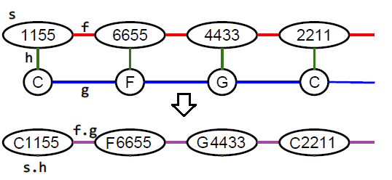

Viterbi
Melody Node: $N^{4}$ different values, where $N$ is the range of the melody
Chord Node: $5$ different values ($C$, $D_{m}$, $F$, $G$, $A_{m}$)
New Node: $5N^{4}$ different values
The converted graph can be solved using dynamic-programming

Slide 7

Experiments
https://www.csie.ntu.edu.tw/~b03902086/md_experiment.html

Slide 8
Questions

Slide 9
Thank You

