Slide 1
Constrained Piano-Sonata-Like Music Composition Using MRF Team - Cucumburn
Members
B03902010 耿宗揚 B03902015 簡瑋德 B03902086 李鈺昇

Slide 2
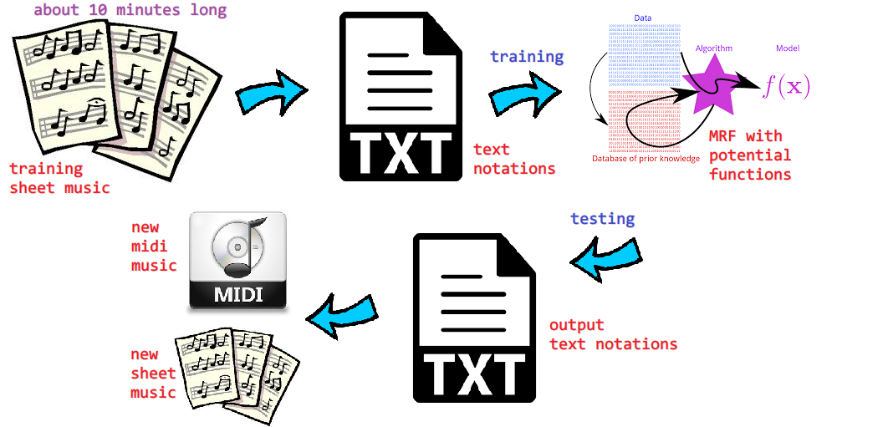
Framework

Slide 3
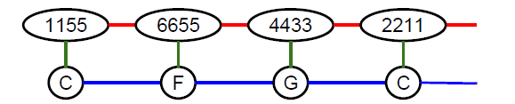
Goal
Machine completes a musical period (樂段) given fixed notes (音符) at some beats (拍子)
We use MRF to represent the period, for example
Assign values (output) to variables in a 2-by-N grid MRF, given some variables (input) fixed
Define “unit”

Slide 4
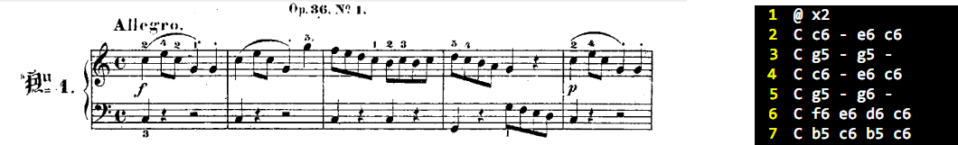
Training Data
Clementi op36
imslp.org/wiki/12_Sonatinas_(Clementi,_Muzio)
Each line in the text file is a unit.

Slide 5
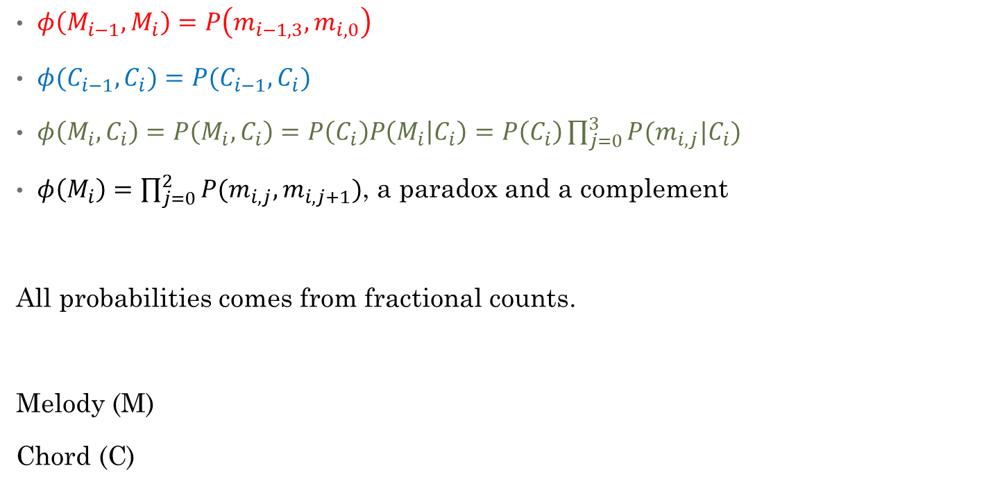
Potential Functions
$φ\left(M_{i−1},M_{i}\right)=P\left(m_{i−1,3},m_{i,0}\right)$
$φ(C_{i−1},C_{i})=P(C_{i−1},C_{i})$
$φ\left(M_{i},C_{i}\right)=P\left(M_{i},C_{i}\right)=P\left(C_{i}\right)P\left(M_{i} | C_{i}\right)=P\left(C_{i}\right)\prod_{j=0}^{3}{P(m_{i,j}|C_{i})}$
$φ\left(M_{i}\right)=\prod_{j=0}^{2}{P(m_{i,j},m_{i,j+1})}$, a paradox and a complement
All probabilities comes from fractional counts.
Melody (M)
Chord (C)

Slide 6
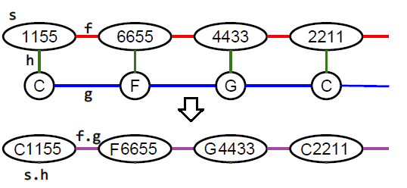
Viterbi
Domain of converted node is M × C where M is the domain of melody node and C the domain of chord node.
Use variable elimination with dynamic programming to do Viterbi on the converted MRF.
Time complexity: O(|M|²|C|² L) where L is #unit.

Slide 7
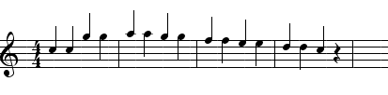

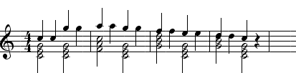
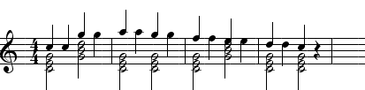
Experiments
Input:
Proposed output:
Naïve output:

Slide 8
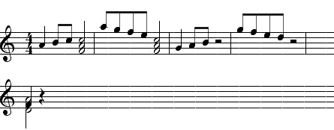
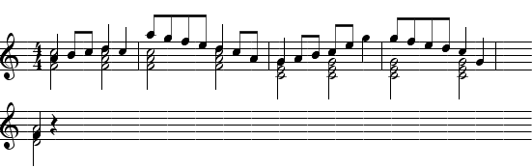
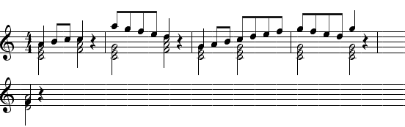
Experiments
Input:
Proposed output:
Naïve output:
Original:

Slide 9
Experiments
Input:
Proposed output:
Naïve output:

Slide 10
A Remark
Our proposed model is good at connecting angles of a melody line (voice leading), but rarely create angles. This is the effect of maximum likelihood.
However, angles are often characteristics of a work, and are that how people remember a song.

Slide 11
Questions

Slide 12
Thank You

