Slide 1
Specific Piano-Sonatina-Like Music Period Composition Using MRF Team – Music composition
Members
B03902010 耿宗揚 B03902015 簡瑋德 B03902086 李鈺昇

Slide 2
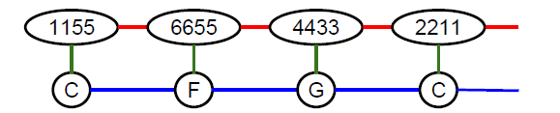
Goal
Assume a music period consists of a melody and a chord progression.
Machine completes a music period given fixed melody fragments and chords at some beats.
Using a 2-by-L grid MRF to represent the period:
Assign values (output) to variables in MRF given values (input) of some variables fixed
Define “unit”

Slide 3
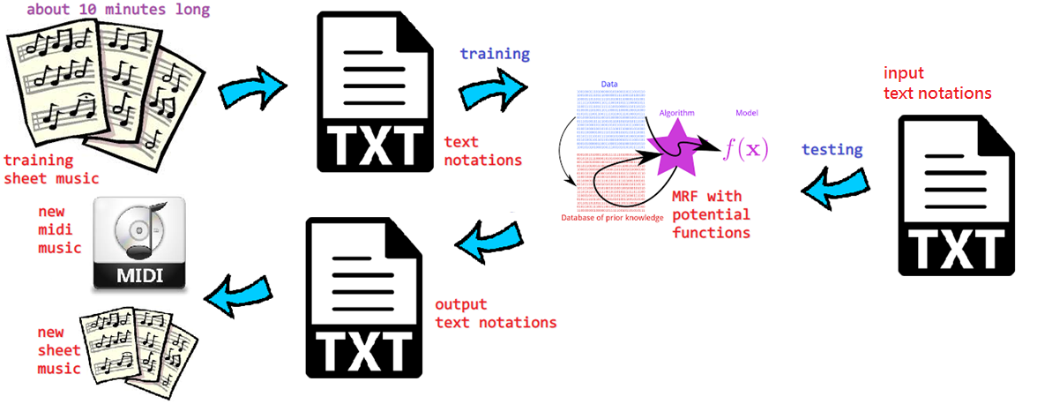
Framework

Slide 4
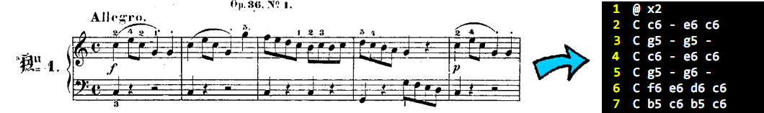
Training Data
About 1400 units from Clementi op36
imslp.org/wiki/12_Sonatinas_(Clementi,_Muzio)
Each line in the text file is a unit.

Slide 5
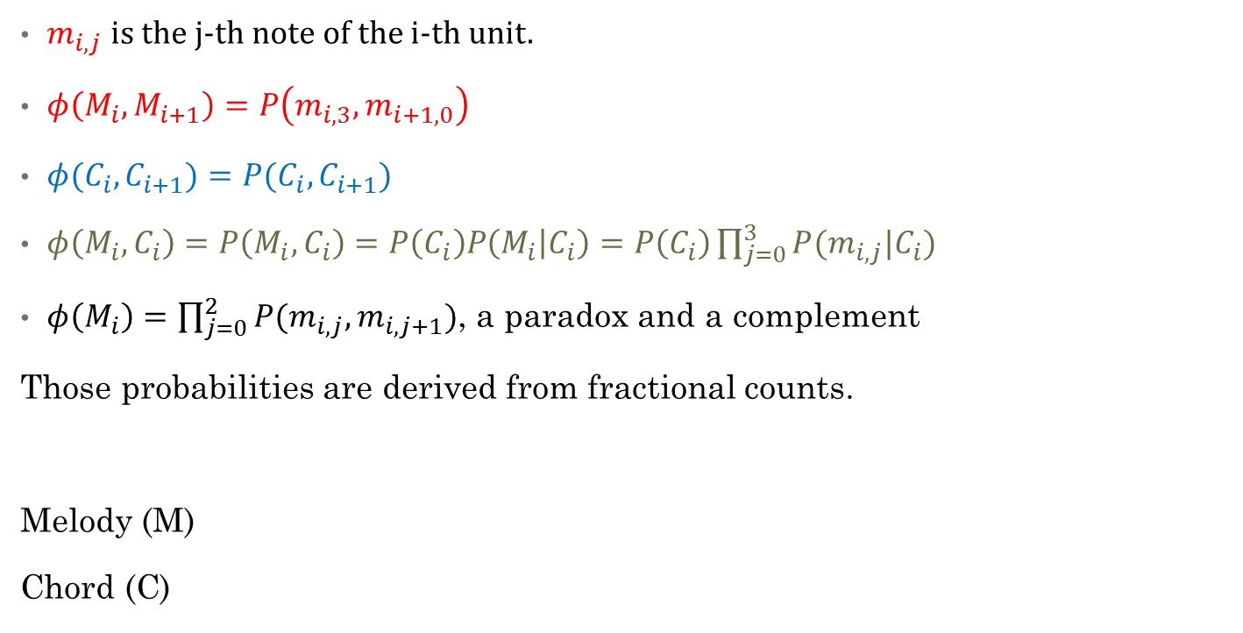
Potential Functions
$m_{i,j}$ is the j-th note of the i-th unit.
$φ\left(M_{i},M_{i+1}\right)=P\left(m_{i,3},m_{i+1,0}\right)$
$φ(C_{i},C_{i+1})=P(C_{i},C_{i+1})$
$φ\left(M_{i},C_{i}\right)=P\left(M_{i},C_{i}\right)=P\left(C_{i}\right)P\left(M_{i} | C_{i}\right)=P\left(C_{i}\right)\prod_{j=0}^{3}{P(m_{i,j}|C_{i})}$
$φ\left(M_{i}\right)=\prod_{j=0}^{2}{P(m_{i,j},m_{i,j+1})}$, a paradox and a complement
Those probabilities are derived from fractional counts.
Melody (M)
Chord (C)

Slide 6
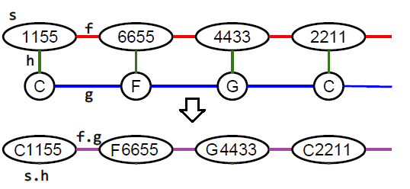
Viterbi Algorithm
Domain of converted node is M × C where M is the domain of melody node and C the domain of chord node.
Use variable elimination with dynamic programming to do Viterbi on the converted MRF.
Time complexity: O(|M|²|C|² L) where L is #unit.

Slide 7
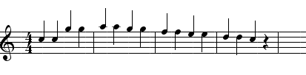

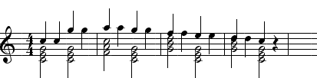
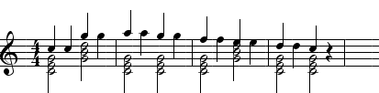
Experiments
Input:
Proposed output:
Naïve output:

Slide 8
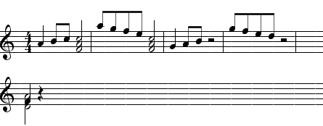
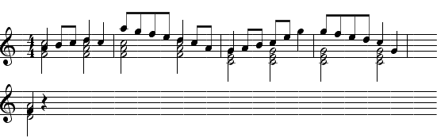
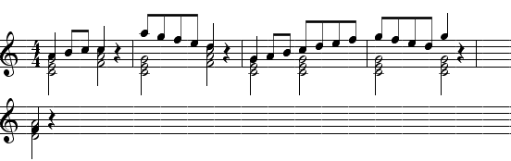
Experiments
Input:
Proposed output:
Naïve output:
Original:

Slide 9
Experiments
Input:
Proposed output:
Naïve output:

Slide 10
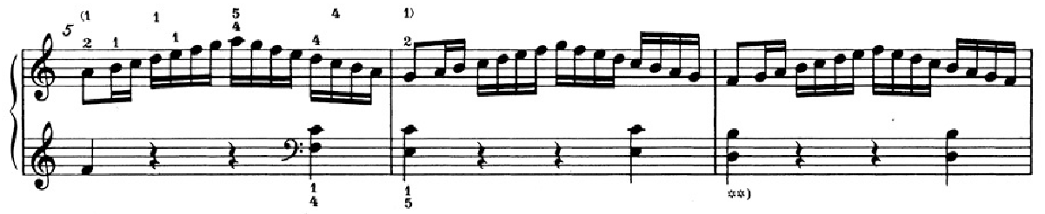
Remarks
The proposed model is good at connecting peaks and valleys of a melody line, but it rarely creates peaks and valleys. This is the effect of maximum likelihood.
However, peaks and valleys of a song are often the parts by which listeners are impressed.

Slide 11
Questions

Slide 12
Thank You

