Slide 1
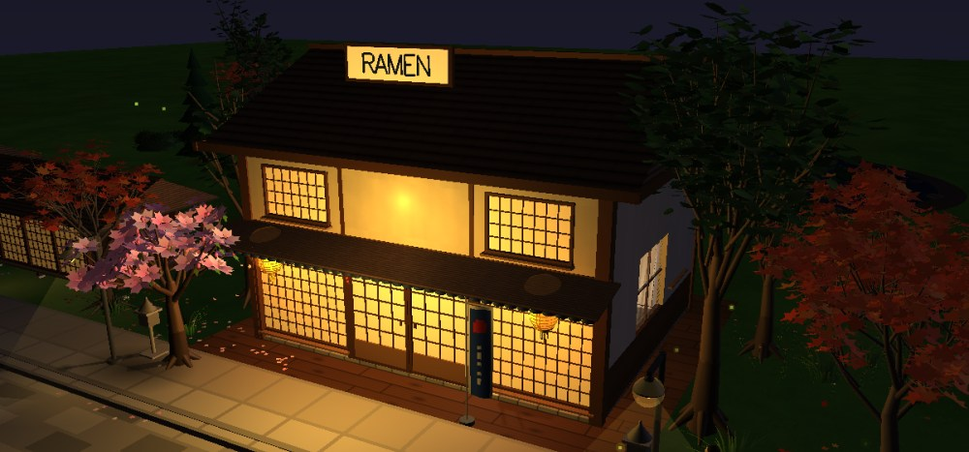
The Ramen Shop
A Japanese ramen village in OpenGL
CSE 4102 · Computer Graphics Project
Rajorshi Das
Roll 2107060 · Dept. of CSE, KUET
Supervisors: Md Tajmilur Rahman, Md. Mubtashim Abrar Nihal
Notes:
Good morning. My project is The Ramen Shop: a cozy Japanese ramen village built from scratch in C++ and OpenGL. Everything you will see is generated in code: no model files and no image files are loaded.

Slide 2
Project overview
Idea: a small ramen-ya on a quiet Japanese street that can be explored day and night
The shop: dining counter, open kitchen, two tables and a tatami room upstairs
The village: 10 houses, cobblestone street, 12 street lamps, cherry, maple and pine trees, a lake with ducks
Life: a cyclist, a walking person, a cat, a wind chime, swaying trees, steam and fireflies
Built from scratch: every object from basic shapes, every texture painted by the program
8
13
lights, each switchable
textures painted in code
7
0
camera modes
model or image files
C++17 · OpenGL fixed function + GLSL 1.20 shaders · FreeGLUT · GLEW · about 15,000 lines in 18 files
Notes:
A small ramen shop on a Japanese street that you can explore by day and night. Around it is a whole village with houses, a street, trees and a lake, and it is alive with a cyclist, a person, a cat and many small animations. The scene uses all 8 OpenGL lights, 13 textures painted by the program itself, 7 cameras, and not a single model or image file.

Slide 3
Proposed features and what I implemented
Proposed
Added beyond the proposal
Translation, rotation, scaling
✓
Hierarchical modelling
✓
+ Shadows (stencil + shadow map)
Perspective camera
✓
Orthographic view
HUD
+ Glass refraction
+ CPU ray tracing
Ambient · diffuse · specular
✓
Gouraud shading
✓
+ Animated characters
Phong shading
✓
Flat shading
—
+ Physics wind chime
Skybox
✓
Textures
✓
+ Ramen cooking game
✓ implemented · HUD = used for the game's 2D overlay · — not implemented
Notes:
Here is what I proposed and what I delivered. All proposed transformations, hierarchy, the perspective camera, the three lighting terms, Gouraud and Phong shading, the skybox and textures are implemented. The orthographic view is used for the game's 2D HUD, and flat shading was the one item I did not implement. On top of the proposal I added shadows, glass refraction, a real CPU ray tracer, animated characters, a physics-based wind chime and a cooking game.

Slide 4
How the program is organised
Every frame (16 ms)
main · camera
window, frame loop, 7 cameras, input
shapes · texture
primitives, materials, 13 textures
1
Input + clock
2
Camera + lights
scene · exterior
sky, shop, village, characters
furniture · food
counter, kitchen, bowls, lanterns
3
Shadow map
lighting · shader
8 lights, Phong GLSL shader, fog
shadowmap · refraction
soft shadows, glass refraction
4
Sky + ground
5
Exterior + interior
rtcore · rtscene · rtpass
CPU ray tracer and compositing
game · objects
cooking game, movable objects
6
Glass + ray tracing
7
HUD + swap
Notes:
The code is split into small modules. Every frame the program reads input and advances one animation clock, sets the camera and lights, renders the shadow map, draws the sky and ground, then the outside and inside of the shop, then the glass and ray-traced objects, and finally the 2D HUD.

Slide 5
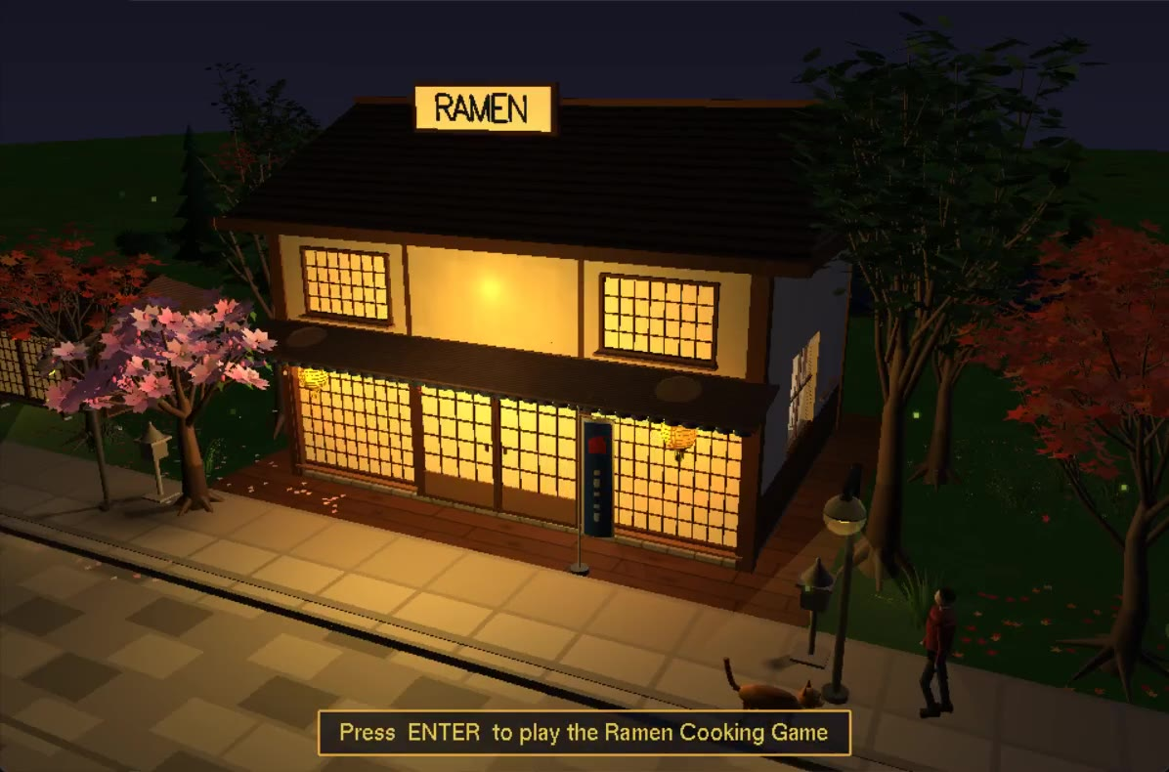
Project demo
Notes:
Place the demo video on this slide (Insert > Video), on top of the picture. While it plays, explain each feature as it appears.

Slide 6
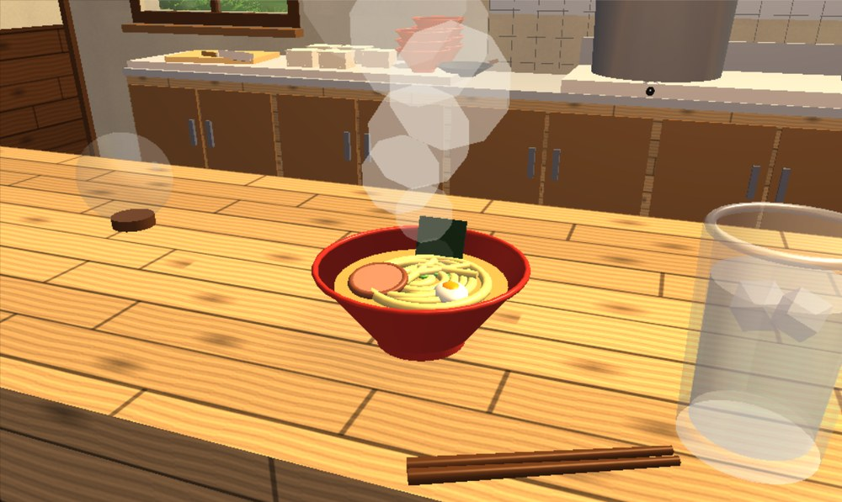
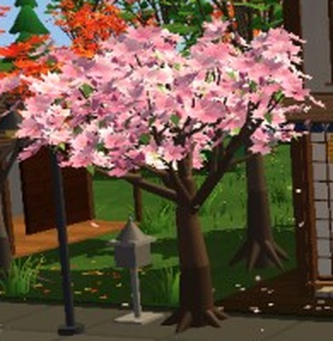
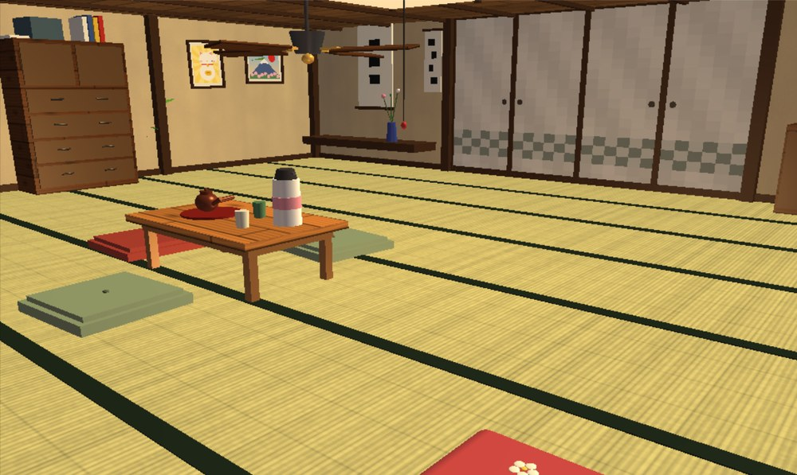
Modelling: every object from basic shapes
Ramen bowl: lathe, tori, ellipsoids
Cherry tree: recursive branches
Tatami room: boxes and textures
Primitives: cube, cylinder / cone, sphere, torus, planes and wedges, scaled into planks, ellipsoids and tubes
Lathe: a profile turned around the y axis makes bowls, lamp shades and the wind-chime bell
Recursion: a branch spawns 3, then 2 thinner children; compiled once into display lists
every part: M = T · Rx · Ry · Rz · S
lathe: p(s,θ) = (r cos θ, y, r sin θ)
Notes:
Every object is built only from a handful of basic shapes. Special shapes come from a lathe, a profile turned around an axis, and trees come from recursion. Every part is placed with the same matrix: translate, rotate, scale.

Slide 7
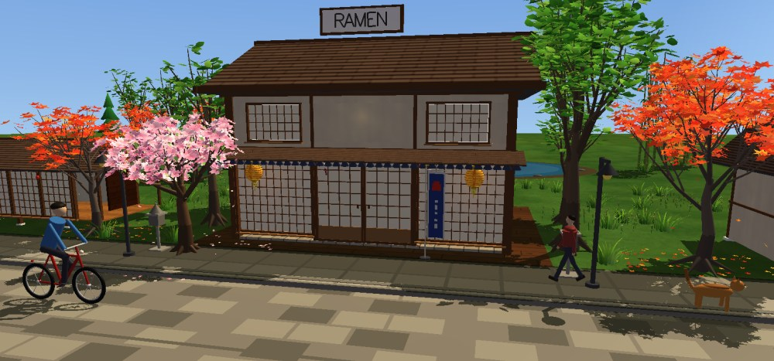
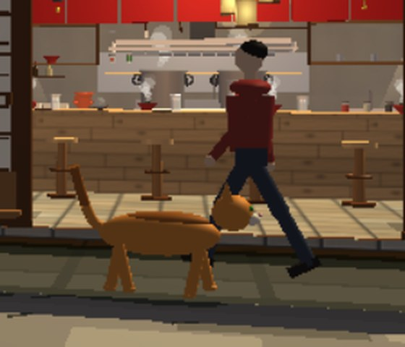
3D transformations and hierarchies
Cyclist, person and cat: joint hierarchies
A child part moves with its parent
Translation: cyclist, person, cat, ducks, sliding doors, steam
Rotation: wheels θ = d / r, fan blades, doors, pendulums, swaying branches (pivot)
Scaling: planks from cubes, cat × 1.8, bicycle × 1.4, user scaling of objects
pivot rotation: T(c) · R(θ) · T(−c)
glPushMatrix / glPopMatrix
Notes:
All three transformations are used everywhere. With the matrix stack a child is drawn in its parent's frame, so when the hip turns, the knee and foot follow.

Slide 8
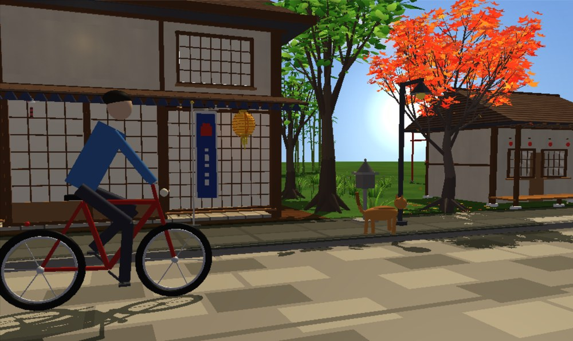
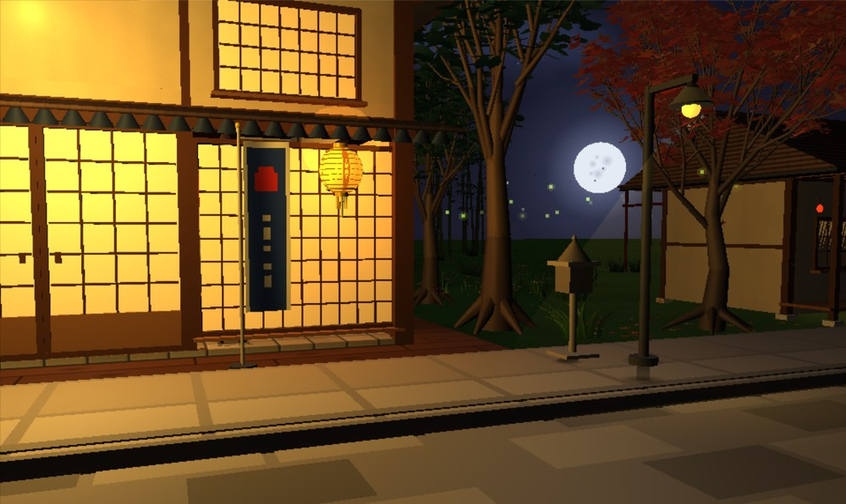
Sky: sun, moon, stars and clouds
Day: sun glow and blue sky
Night: cratered moon, fireflies, lamp
Skybox: drawn first with depth writes off and the camera translation removed, so it is infinitely far
Sun = 5 camera-facing discs with additive halos; moon = disc + 6 craters; 132 twinkling stars; 12 billboard clouds
Key T switches day and night: sky, sun / moon light, lamp glow, fog and shadows
sky: mix(horizon, zenith, t), t = (e/90°)^0.55
glow (additive): C = α·Cs + Cd
Notes:
The sky is a skybox drawn first, so it always looks infinitely far away. The sun is five glowing discs blended additively, the moon has six craters, there are 132 twinkling stars and billboard clouds. One key switches the whole scene between day and night.

Slide 9
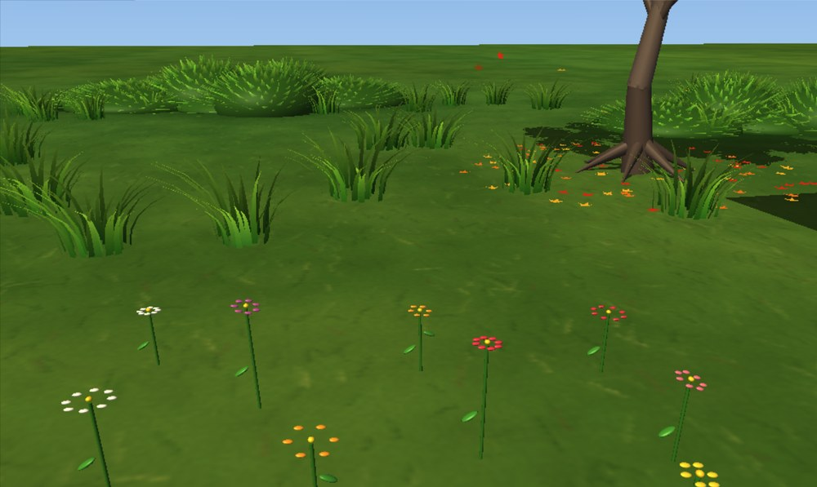
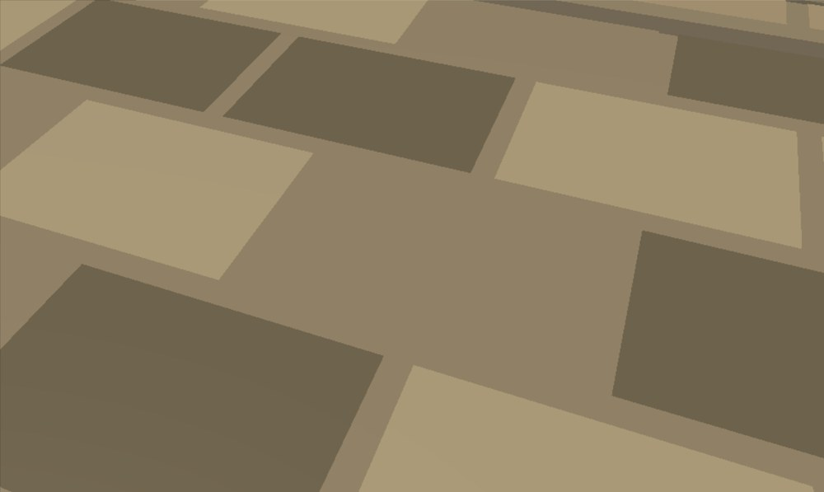
Procedural textures: grass and cobblestone street
Grass texture with 3D tufts and flowers
Cobblestone street and flagstone sidewalk
Grass: 4 greens mixed by noise, thousands of thin blade strokes, grain; a large macro layer hides the repeat
About 500 real 3D grass tufts (30 arching blades each) sway in the wind
Also painted in code: wood, floor tile, plaster, roof tile, tatami, water, clouds
value noise + fractal Brownian motion
fBm = Σ 2^−(k+1) · n(2^k x, 2^k y)
Notes:
No image files are used: every texture is painted by the program at start-up. The grass mixes greens by noise and then paints thousands of blade strokes; 3D tufts stand on top. The street is a brick pattern of stones whose shade comes from a hash. Mipmaps keep them from shimmering.

Slide 10
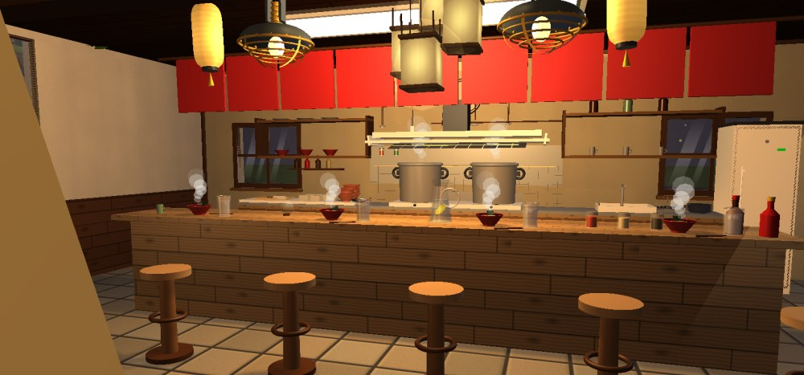
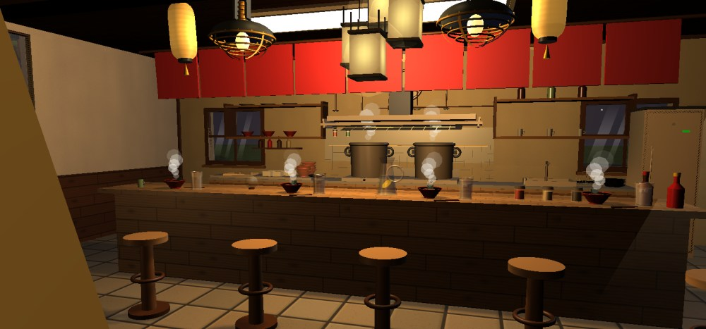
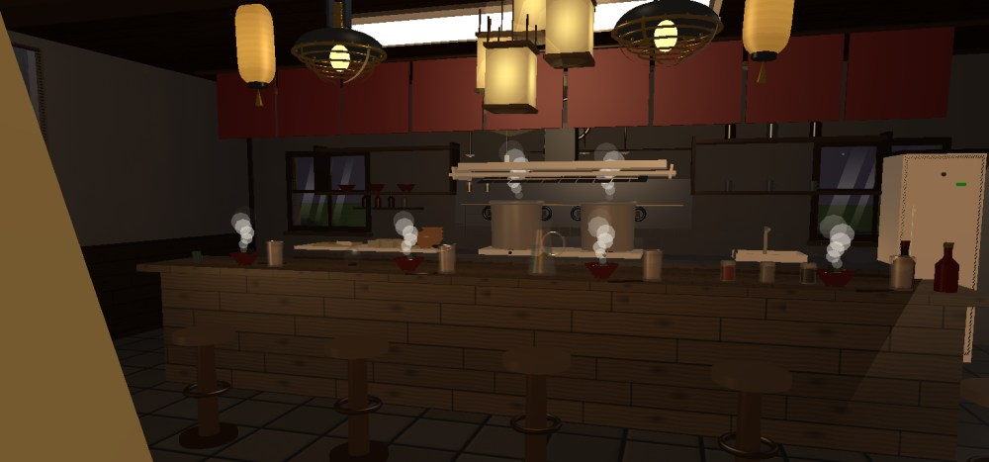
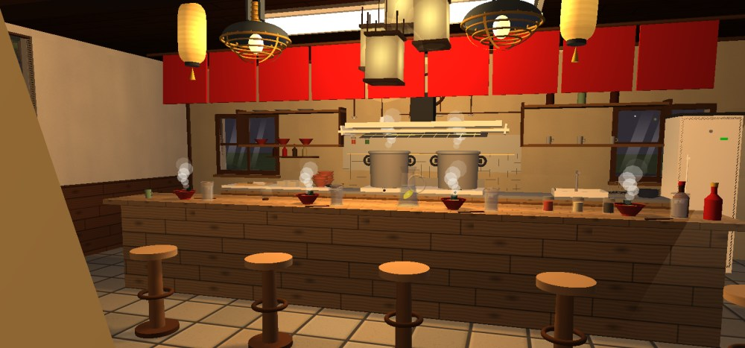
Lighting: ambient, diffuse and specular
No ambient
No diffuse
All terms on (night)
I = e + Σ aᵢ [ ka·La + kd·Ld·(N·L) + ks·Ls·(N·H)ⁿ ], aᵢ = 1 / (kc + kl·d + kq·d²)
8 lights: sun / moon (directional), lamps (point), table lamps (spot 28°)
Keys 1–7 switch each lamp; − = \ remove one term from every light
No specular
Notes:
Lighting follows the Phong model: ambient plus diffuse plus specular, with attenuation over distance and a cone for spot lights. Each of the 8 lights has its own three colours, and I can switch off each term to show its effect.

Slide 11
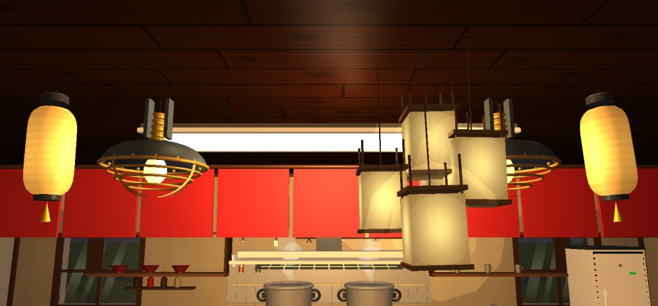
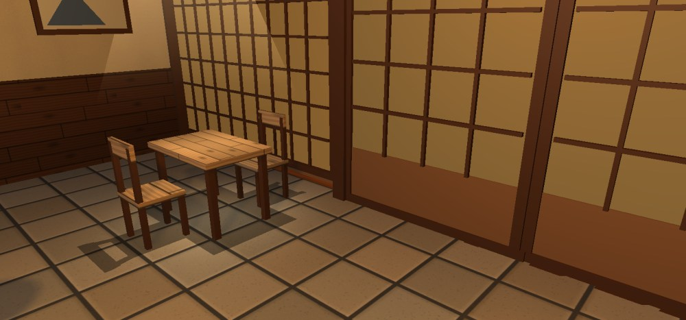
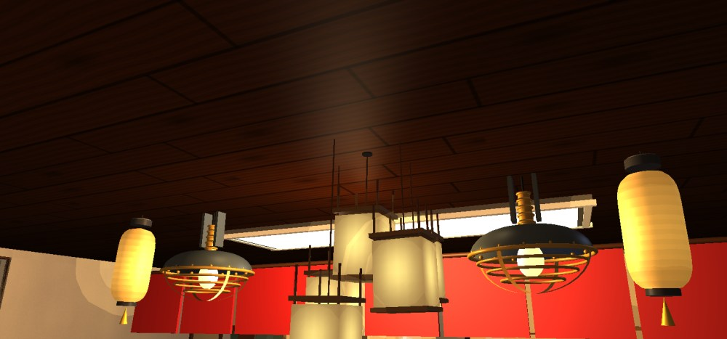
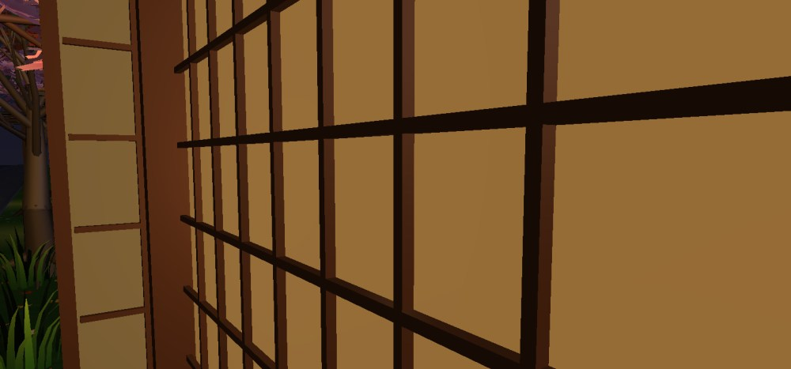
Eight switchable lights
Only 8 OpenGL lights
The four outdoor lights (lanterns, street lamps, sign) are re-assigned to interior lamps while the inside is drawn.
Pendant lamps (1)
Table spot lamp (2)
A lamp that is off lights nothing
Global ambient is zero, and glowing paper fades with its lamp.
Light tour (key 8)
The camera flies to each fixture and switches it on, showing its glow and light pool.
Box lanterns (4)
Lantern tower (6)
Notes:
Every lamp in the shop is a real light that can be switched on and off. OpenGL only has eight, so the outdoor lights are reused for interior lamps while the inside is drawn. The light tour flies the camera to each lamp in turn.

Slide 12
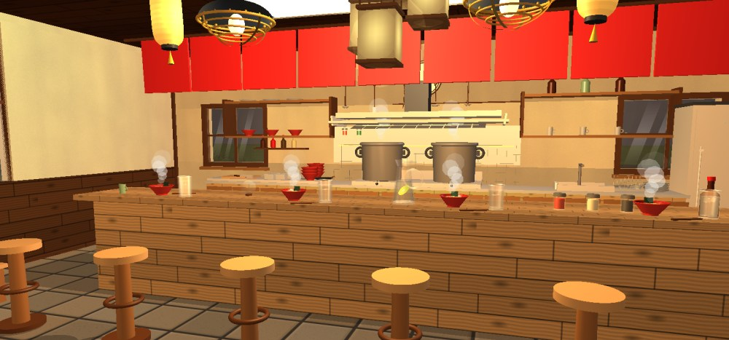
Gouraud vs Phong shading
Gouraud: light per vertex, colour interpolated
Phong: normal interpolated, light per pixel
Gouraud = fixed-function path; a highlight inside a triangle is lost
Phong = my GLSL 1.20 fragment shader: 8 lights, spot cones, attenuation, fog and the shadow lookup
Specular uses Blinn's half vector H = normalize(L + V); key G switches the two
Gouraud: C = λ₁C₁ + λ₂C₂ + λ₃C₃
Phong: N = normalize(λ₁N₁ + λ₂N₂ + λ₃N₃)
Notes:
Gouraud shading computes the light at the vertices and blends the colours, so highlights between vertices disappear. My Phong shader blends the normal and computes the light for every pixel, giving the long glossy streaks on the counter.

Slide 13
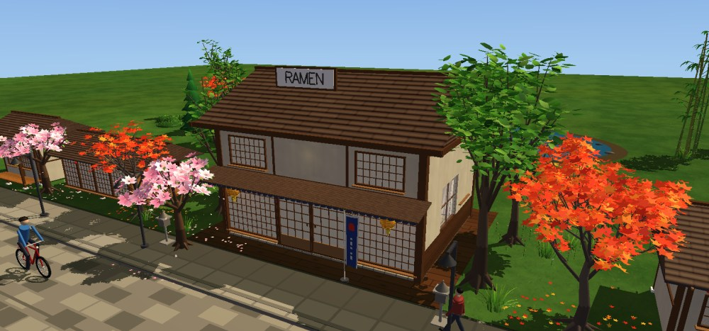
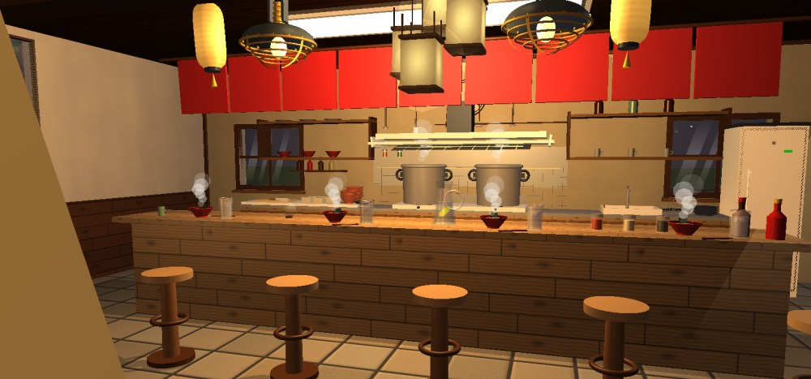

Shadows: stencil projection and soft shadow map
Sun shadows (stencil)
Projected only
Shadow map + PCF (key Y)
Sun: the outdoor scene is flattened onto the ground into the stencil buffer, then one dark layer is blended, so overlaps never darken twice
Inside: furniture projected from the lamps; key Y adds a 512 × 512 depth map with 3 × 3 percentage-closer filtering
x' = x − (sₓ / s_y)·y, z' = z − (s_z / s_y)·y
soft: s = (1/9) Σ [ z_L ≤ z_map + ε ]
Notes:
Outdoors the scene is drawn a second time, flattened onto the ground along the sun direction, only into the stencil buffer, then one dark layer is blended. Inside, a shadow map with 3 by 3 filtering gives soft edges.

Slide 14
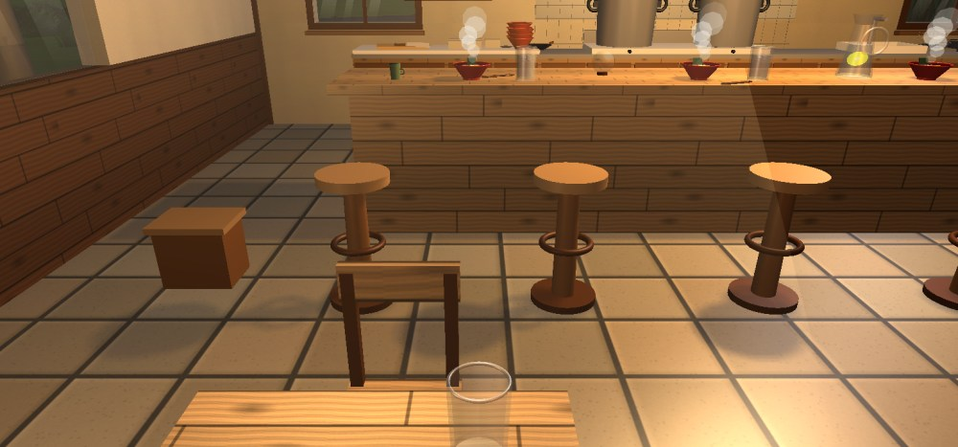
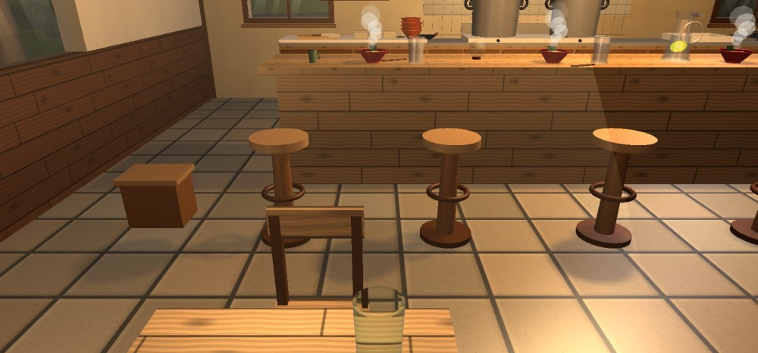
Glass refraction
Key Z off: plain transparent glass
Key Z on: the table behind is bent
The tumbler is drawn last; the screen behind it is copied into a texture
A GLSL shader shifts the lookup by refract(I, N, 1/1.5) and adds a Fresnel reflection and a sharp highlight
All other glassware is alpha-blended in a final transparent pass with depth writes off
Snell: n₁ sin θ₁ = n₂ sin θ₂ (glass n = 1.5)
Schlick: F = 0.04 + 0.96(1 − cos θ)⁵
Notes:
The empty tumbler on the table really bends what is behind it. The screen behind it is copied into a texture and the shader shifts the lookup by the refraction direction, plus a Fresnel reflection.

Slide 15
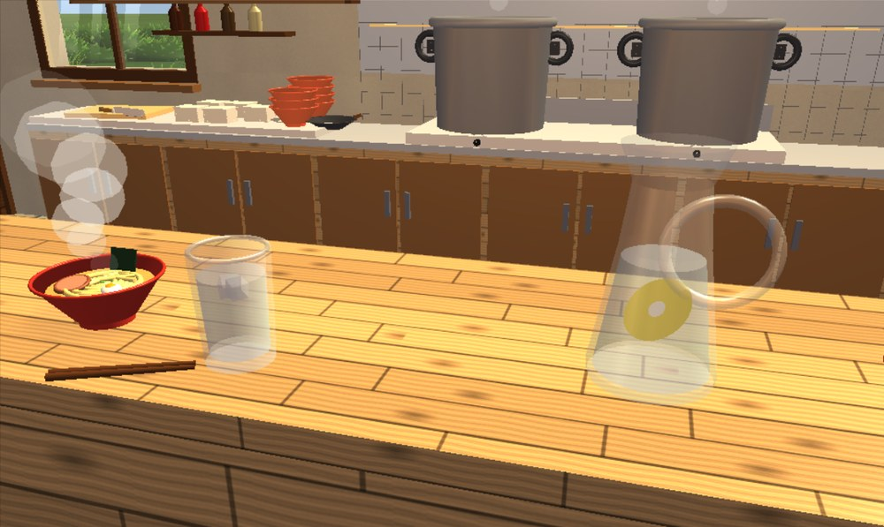
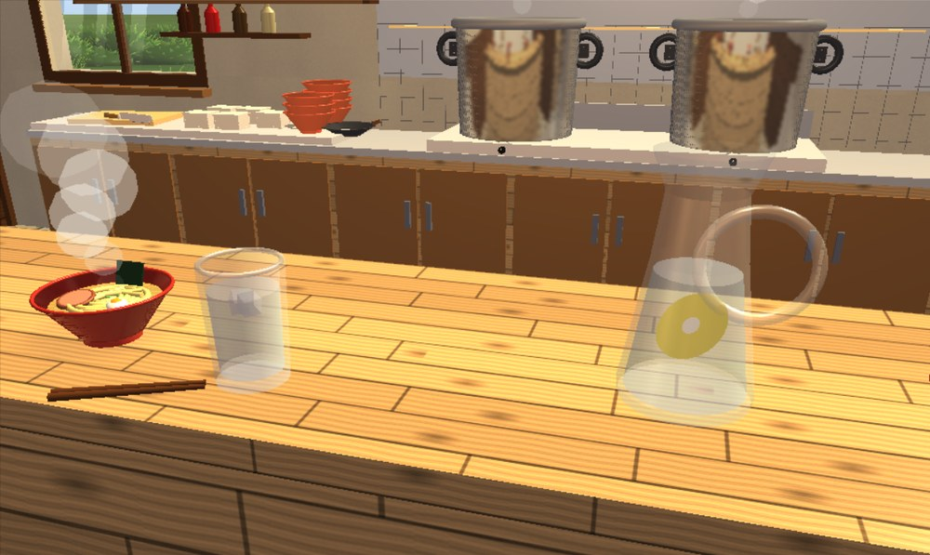
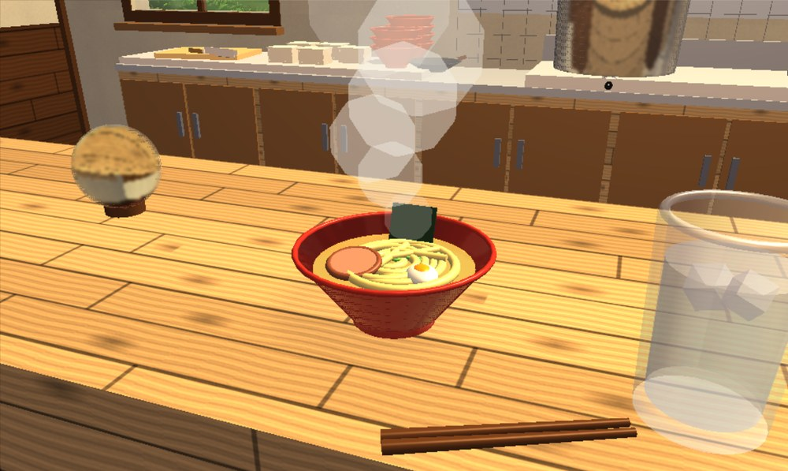
Ray tracing: real reflection and refraction
OpenGL only (R off)
Ray traced: pots reflect the shop
Glass ball refracts the counter
CPU ray tracer for 8 objects: 2 steel pots, 4 ramen bowls, the glass ball and the mirror
Exact ray–sphere, cone, disk and box tests; a BVH skips groups of shapes; up to 3 bounces
8 threads and a ray budget keep it near 13 ms; the result is composited where the depth matches
reflect: r = d − 2(d·n)n
refract: n₁ sin θ₁ = n₂ sin θ₂
Fresnel: F = F₀ + (1 − F₀)(1 − cos θ)⁵
Notes:
Key R turns on a real ray tracer on the CPU for eight objects. Rays find the nearest shape with exact formulas and a bounding volume hierarchy. Metal, glaze and the mirror reflect, weighted by the Fresnel term, and the glass ball refracts with Snell's law. The work is shared by 8 threads and drawn over the OpenGL frame.

Slide 16
Animated characters: cyclist, person and cat
Cyclist: rolling wheels, legs on the pedals
Walking person and the shop cat
Cyclist: wheels turn by θ = d / r; knees from two-bone inverse kinematics
Person: hip → knee → foot hierarchy, thigh ±28°, knee bend 35°, arms swing opposite
Cat: a state machine — walk, turn, sit and wash its face, then walk on
two-bone IK: a = (L₁² − L₂² + d²) / 2d
h = √(L₁² − a²)
Notes:
The characters are built from spheres and cylinders. The cyclist's wheels roll without slipping and its knees are solved with the law of cosines so the feet stay on the pedals. The cat follows a small state machine and sometimes sits down to wash its face.

Slide 17
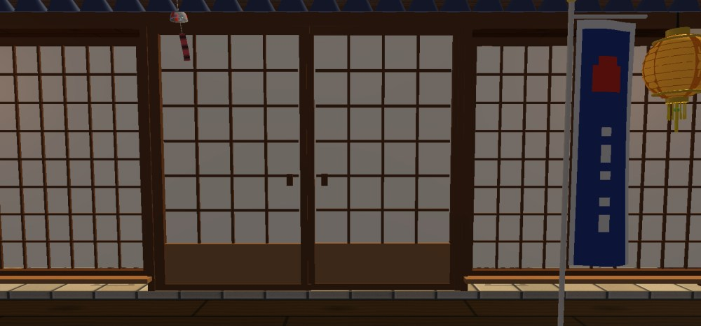
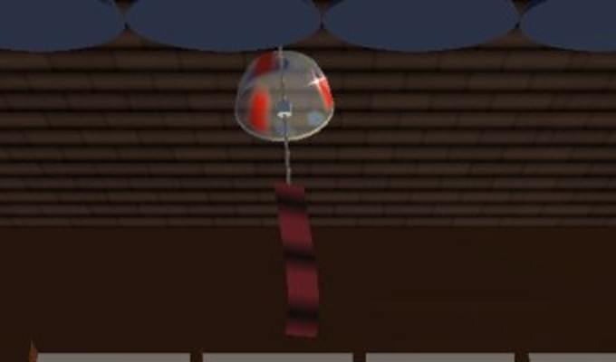
Physics: the glass wind chime and the banner
Bell, clapper and paper strip
θ̈ = −(g/L)·sin θ − c·θ̇ + k·w(t)
Porch: nobori banner and wind chime
Bell and paper strip are two pendulums pushed by gusty wind; 8 small steps per frame
The strip catches more wind; at 0.42 rad the clapper strikes, bounces back and the glass glints
The banner is a 12 × 28 grid moved by a travelling wave, calm at the pole and strong at the free edge
Notes:
The wind chime is real physics: two pendulums driven by wind and integrated in small steps. When the strip swings far enough the clapper hits the glass and the rim glints. The banner next to it waves with a travelling wave.

Slide 18
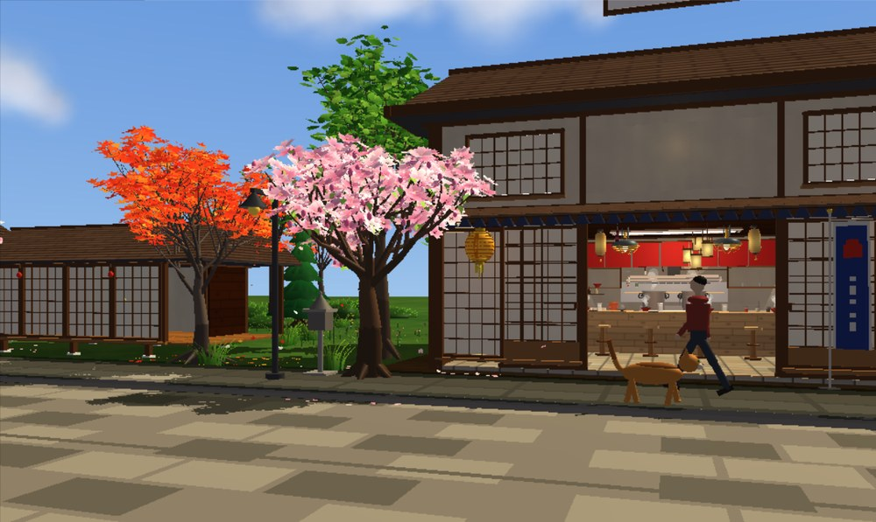
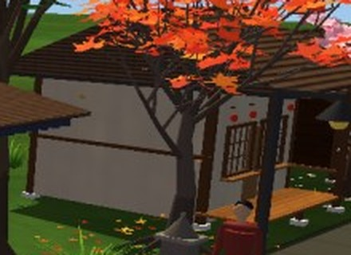
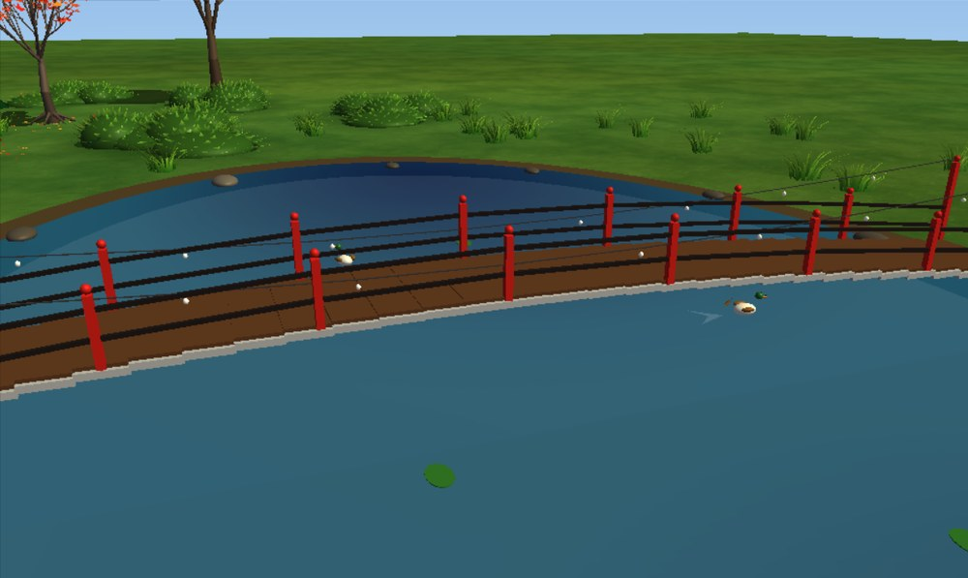
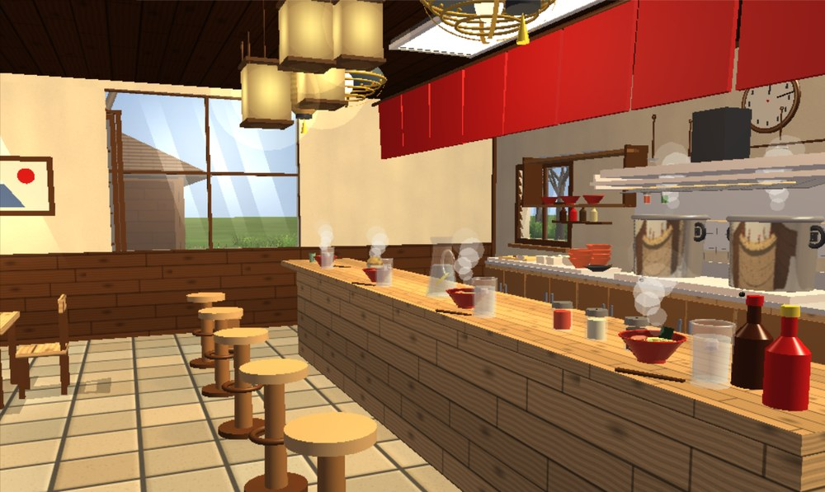
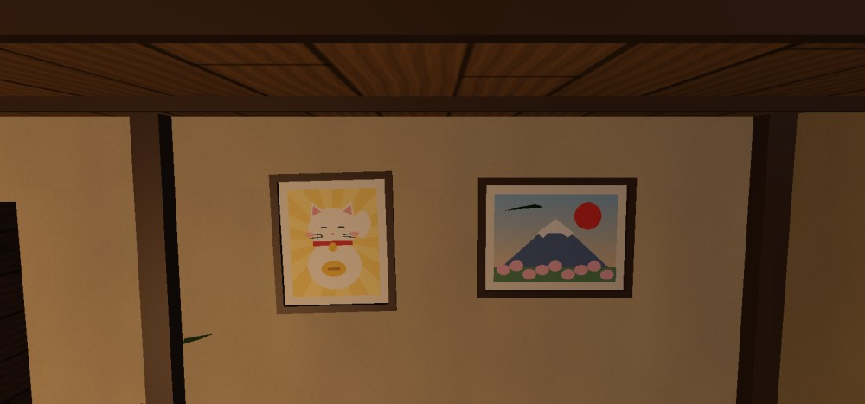
The village and the shop
Shop, cherry and maple trees
Neighbouring house
Lake, bridge, lily pads and duck
Pictures drawn from 2D shapes
Dining counter and kitchen
Ramen bowl with steam
Notes:
The whole village: the shop with cherry and maple trees, ten houses of two designs, a lake with a wooden bridge and ducks, and inside the dining counter, the steaming bowls and wall pictures drawn from 2D shapes and clipped with Sutherland–Hodgman.

Slide 19
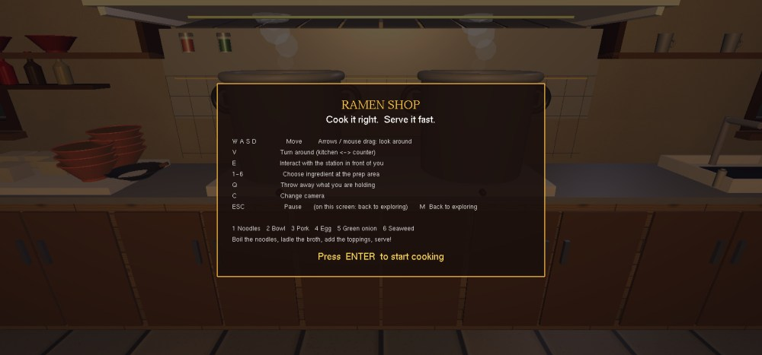
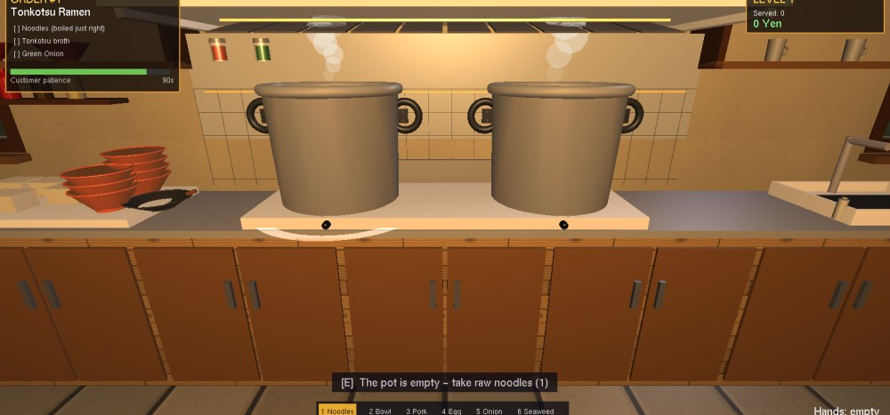
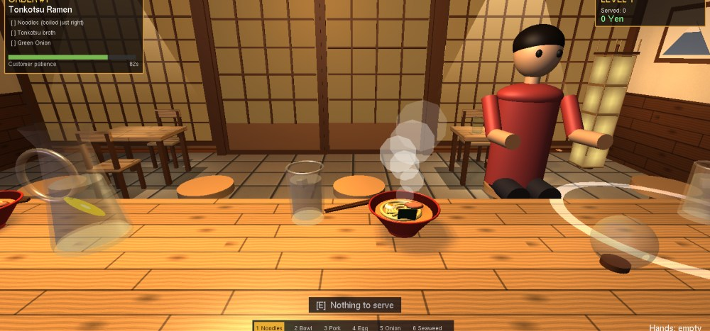
Ramen cooking game
Title screen
Order board
A customer orders
Menu
Taking order
Cooking
Serving
Result
Boil noodles (perfect 6–9 s, ruined > 12 s), add broth and toppings, then serve
HUD and order board use an orthographic projection; up to 4 levels
Q = 0.5·accuracy + 0.35·cook + 0.15·time
stars = round(5Q)
Notes:
A small game inside the shop runs on a state machine: a customer orders, I boil the noodles for the right time, add broth and toppings and serve. The bowl is scored on accuracy, cooking and time.

Slide 20
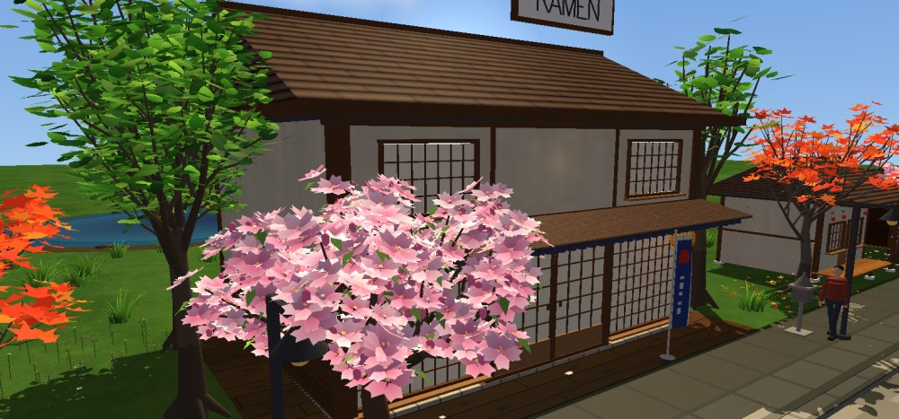
Conclusion
Delivered
Every proposed feature except flat shading, plus shadows, refraction, ray tracing, characters, physics and a game.
Challenges solved
Only 8 lights (reused indoors), lights that did not switch off (zero ambient), z-fighting shadows (depth test off in that pass).
Future work
Shadow maps for every lamp, a GPU ray tracer, and customers who walk into the shop by themselves.
Notes:
To conclude: I delivered all proposed features except flat shading and added several advanced ones. The main challenges were OpenGL's 8-light limit, making switched-off lights truly dark, and shadow z-fighting. Next I would add shadows for every lamp and move the ray tracer to the GPU.

Slide 21
Thank you
Questions? · Rajorshi Das, Roll 2107060
Notes:
Thank you for listening. I am happy to answer any questions.

