Slide 1
Marvin Product Development Model
Seer Systems
Rajpreet, August 2025

Slide 2
Modular Vs Microkernel Architecture
Discuss on the type of architecture we want:
Modular gives a better maintenance in terms of programming separate modules.
Microkernel is more useful for ‘High Security’ scenarios
Microkernel allows for a better separation of low and high privilege tasks and processes
OS Emulator
Scheduler
USB
Audio
Kernel (high privilege)
FS2
FS1
Video
FS1
Audio
Modular
Processes
Microkernel

Slide 3
User Programs
Libraries
System Call Interface
User Level
Kernel Level
Network
File Management
Process Control
Hardware Control
Hardware

Slide 4

Ontology
Knowledge Representation
State Space Search
Semantics
Logic
Constraints
Adversarial Reasoning
Planning
Search

Slide 5

Ontology
Knowledge Representation
State Space Search
Semantics
Search
Logic
Constraints

Slide 6

Seer Systems
Program
Deploy
Manage

Slide 7
Seer Systems
Program
Deploy
Manage

Slide 8




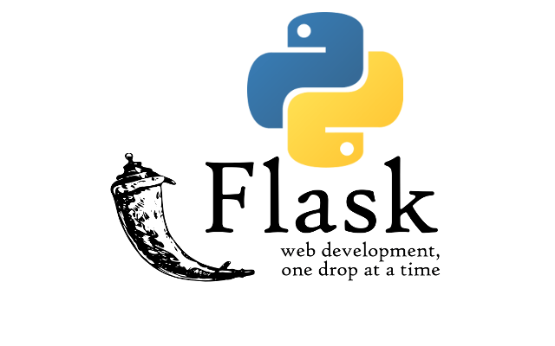
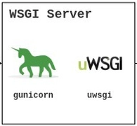


AI Agentic Backend
Hosting Platform
GenAI Models
Gemini
Cloud Run Service
Cloud Run with GPU
File Upload or Query
Running frameworks:
Vector Database
Agent Development Kit
AlloyDB
Streamed Response
User
Tools
Custom Tools for Agents
File Store in Alloy DB
Retrieval Mechanism
File Categorization
Entities and Relations Extraction
.sl code
Fig: SeerVault’s High-Level Architecture

Slide 9

AI Agentic Backend
Hosting Platform
GenAI Models
Gemini
Cloud Run with GPU
File Upload or Query
Vector Database
VectorDB Agent
File Storage Agent
AlloyDB
Streamed Response
User
File Retriever Agent
Tools
Custom Tools for Agents
File Store in Alloy DB
Retrieval Mechanism
File Categorization
Entities and Relations Extraction
Fig: SeerVault’s High-Level Architecture

Slide 10
AI Agentic Backend
Hosting Platform
File Upload or Query
Write: Communication
VectorDB Agent
File Storage Agent
Streamed Response
User
Read: Communication
File Retriever Agent
Tools
Custom Tools for Agents
File Store in Alloy DB
Retrieval Mechanism
File Categorization
Entities and Relations Extraction
Fig: SeerVault’s High-Level Architecture

Slide 11
AI Agentic Backend
Hosting Platform
GenAI Models
Gemini
Cloud Run Service
Cloud Run with GPU
File Upload or Query
Running frameworks:
Vector Database
Agent Development Kit
AlloyDB
Streamed Response
User
Tools
Custom Tools for Agents
File Store in Alloy DB
Retrieval Mechanism
File Categorization
Entities and Relations Extraction
.sl code
Fig: SeerVault’s High-Level Architecture

