Slide 1
Document Insertion in Blockchain using Smart Contracts

Slide 2
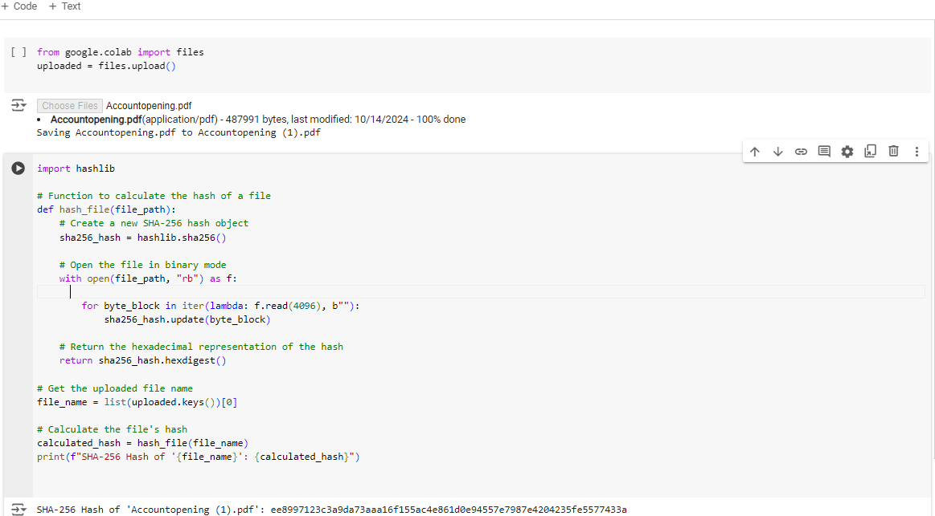
The code to upload a file in Google Colab and calculates the SHA-256 hash using python’s hashlib library.
The hash of the file Accountopening.pdf ---ee8997123c3a9da73aaa16f155ac4e861d0e94557e7987e4204235fe5577433a
.

Slide 3
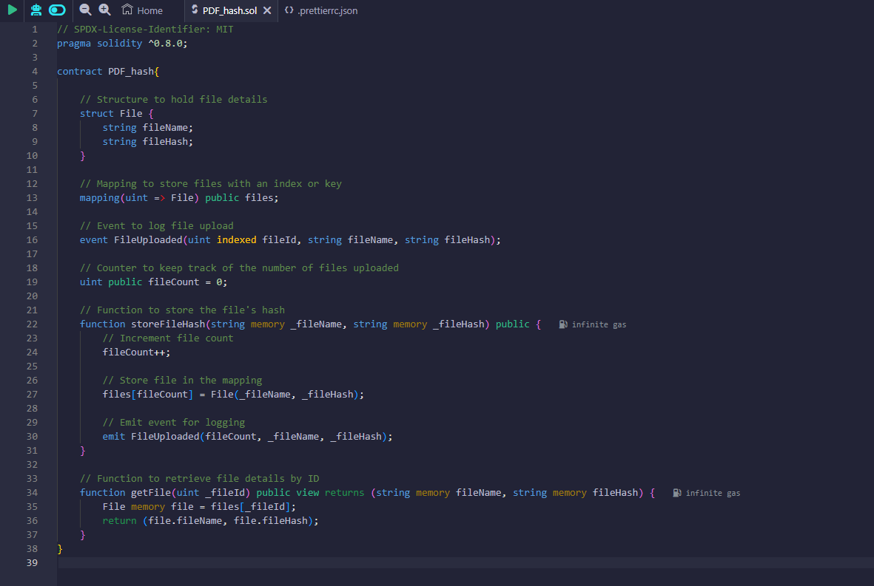
This smart contract, PDF_hash, was created in the Remix IDE to store and manage the hashes of documents, ensuring their integrity on the blockchain

Slide 4
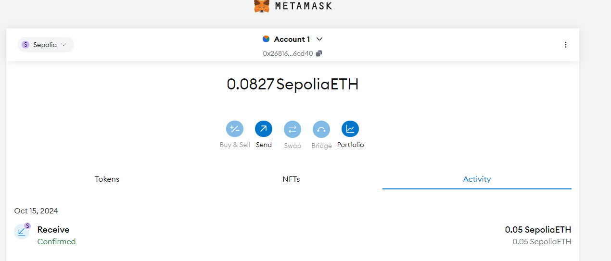
Interaction with MetaMask
MetaMask was used to connect the smart contract to the Ethereum blockchain, ensuring secure interaction and transaction approval.
Once the document hash is generated, MetaMask allows the transaction to be confirmed and uploaded to the blockchain.

Slide 5
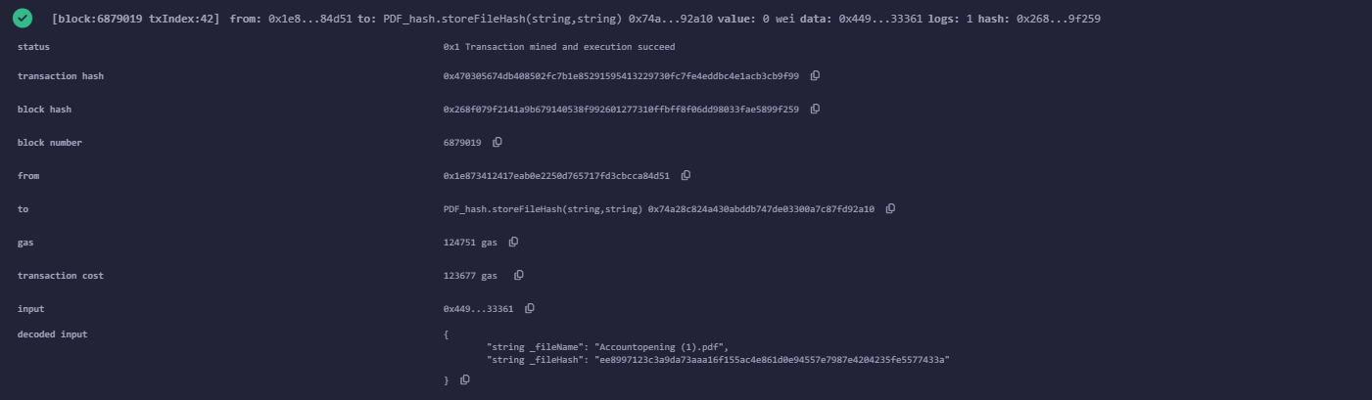
After the file was successfully uploaded, a transaction hash was generated as proof of the action. Transaction hash: 0x470305674db408502fc7b1e85291595413229730fc7fe4eddbc4e1acb3cb9f99

Slide 6
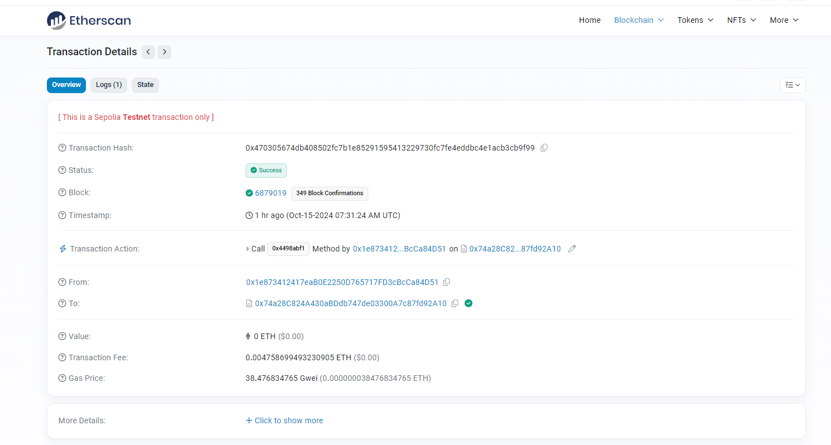
Transaction Details Overview:
These details are proof of the transaction’s success, providing transparency and immutability through the Ethereum blockchain.

