Slide 1

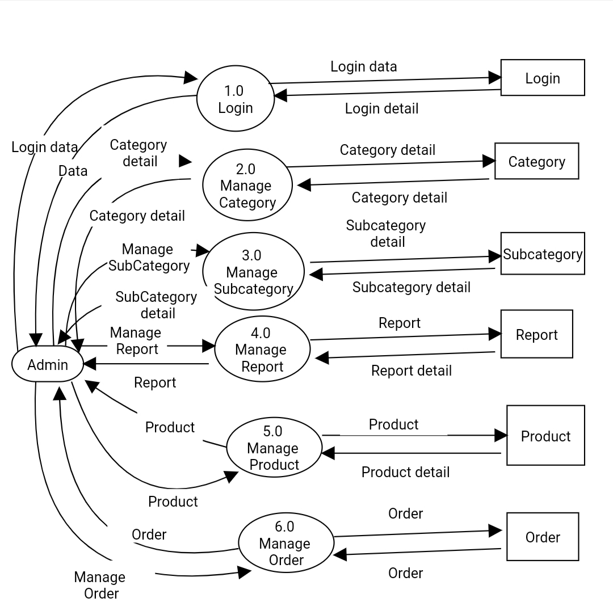
1st level DFD of Admin Side
Page:2

Slide 2
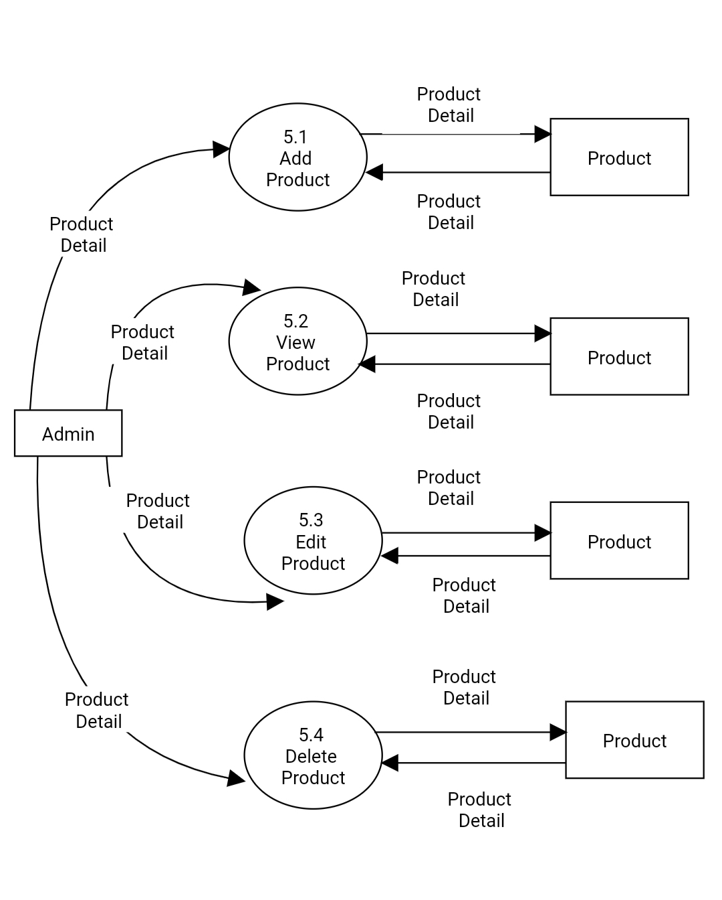
2nd level DFD for Manage Product
Page:7

Slide 3
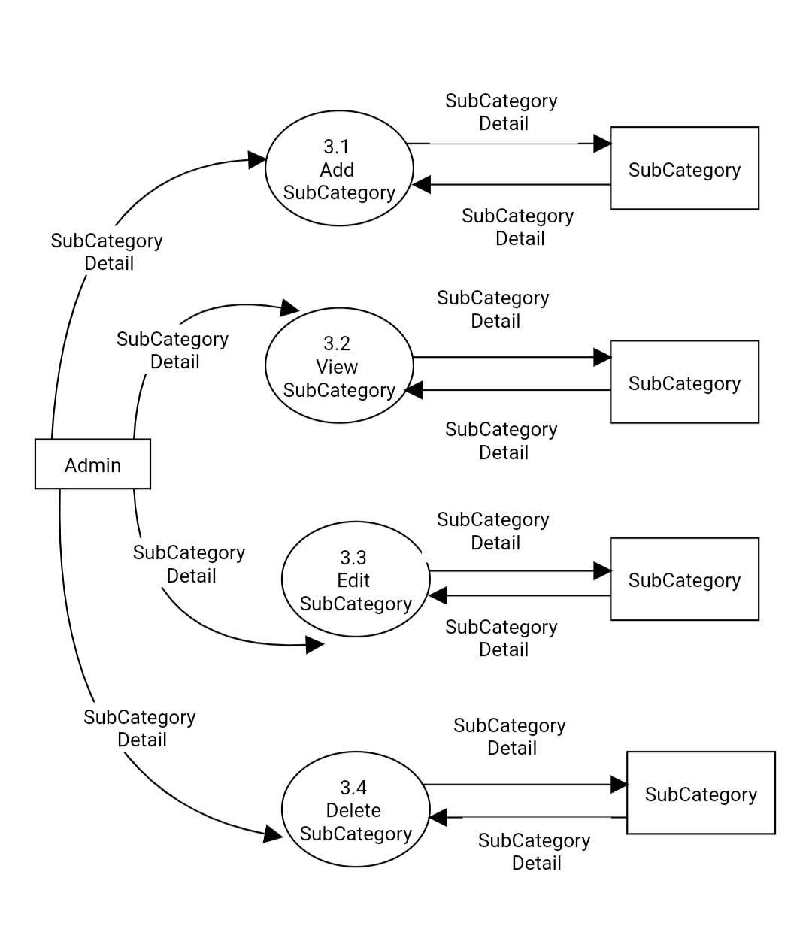
2nd level DFD for Manage subcategory
Page:6

Slide 4
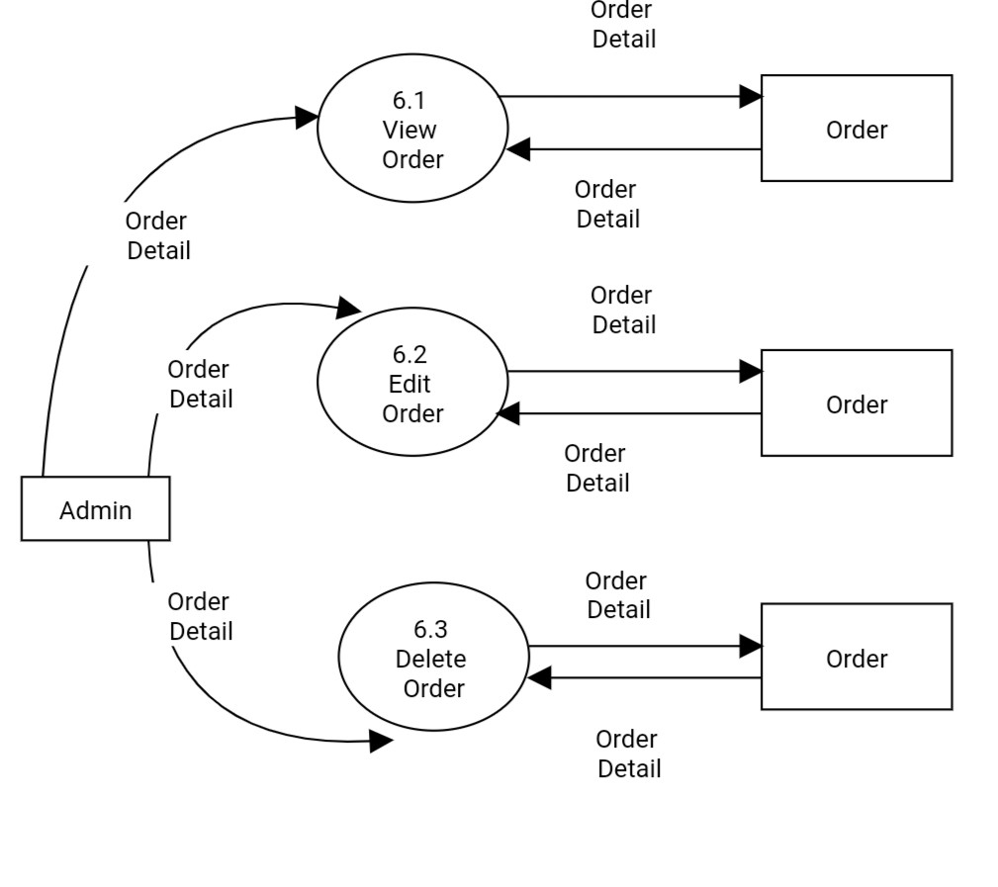
2nd level DFD for Manage Order By Admin
Page:4

Slide 5
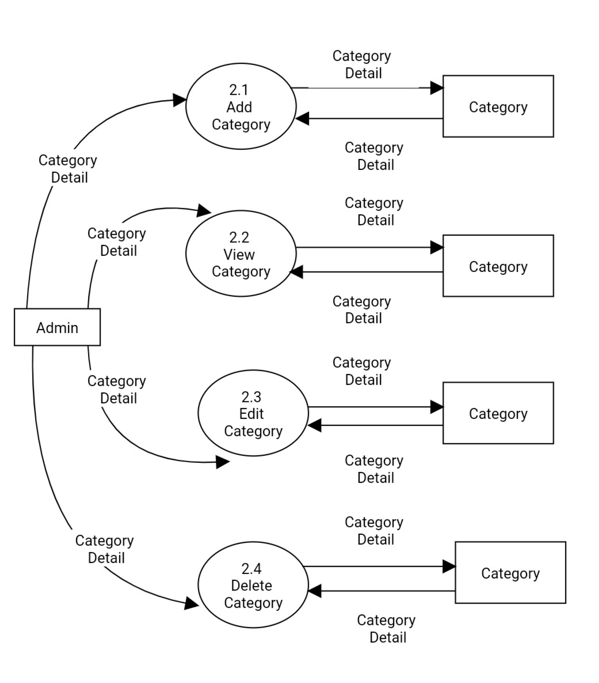
2nd level DFD for Manage category
Page:5

Slide 6
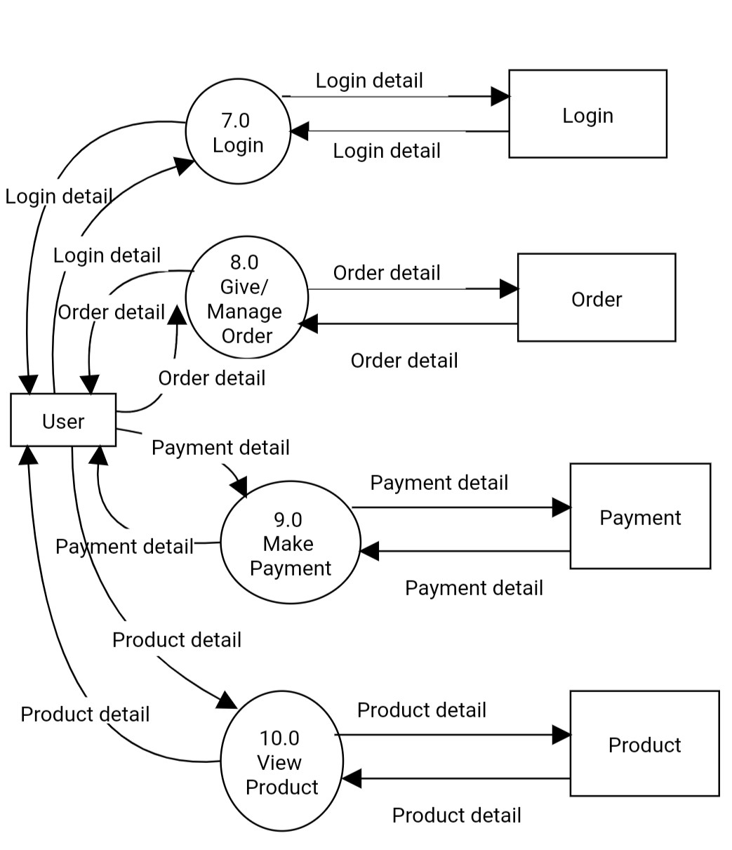
1st level DFD of User Side
Page:3

Slide 7
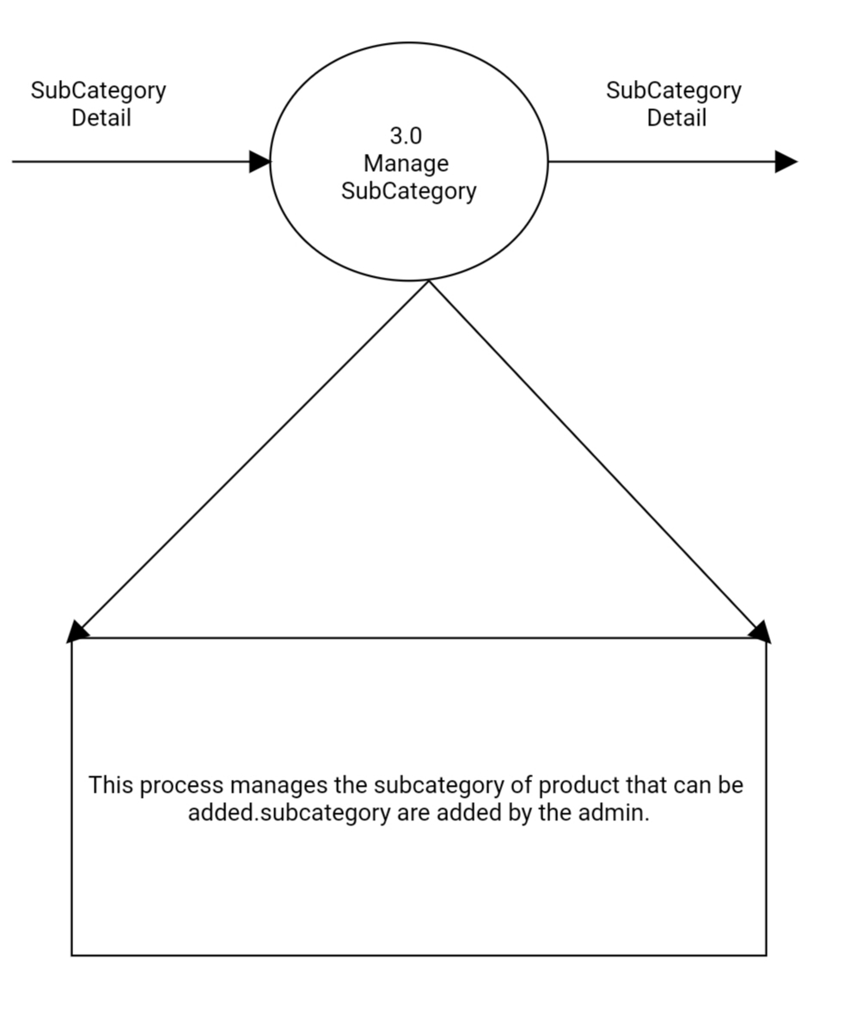
Process Specification Of Manage subcategory
Page:12

Slide 8
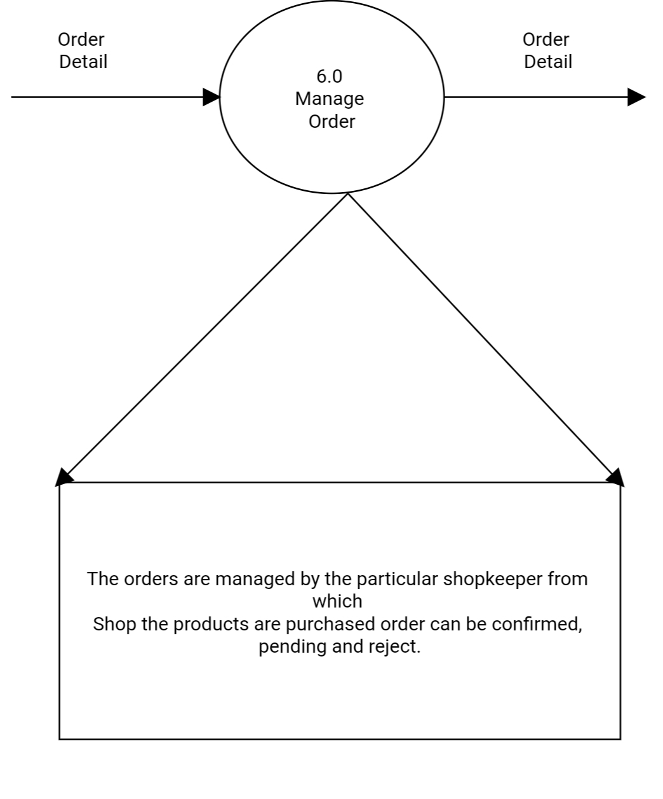
Process Specification Of Manage order
Page:13

Slide 9
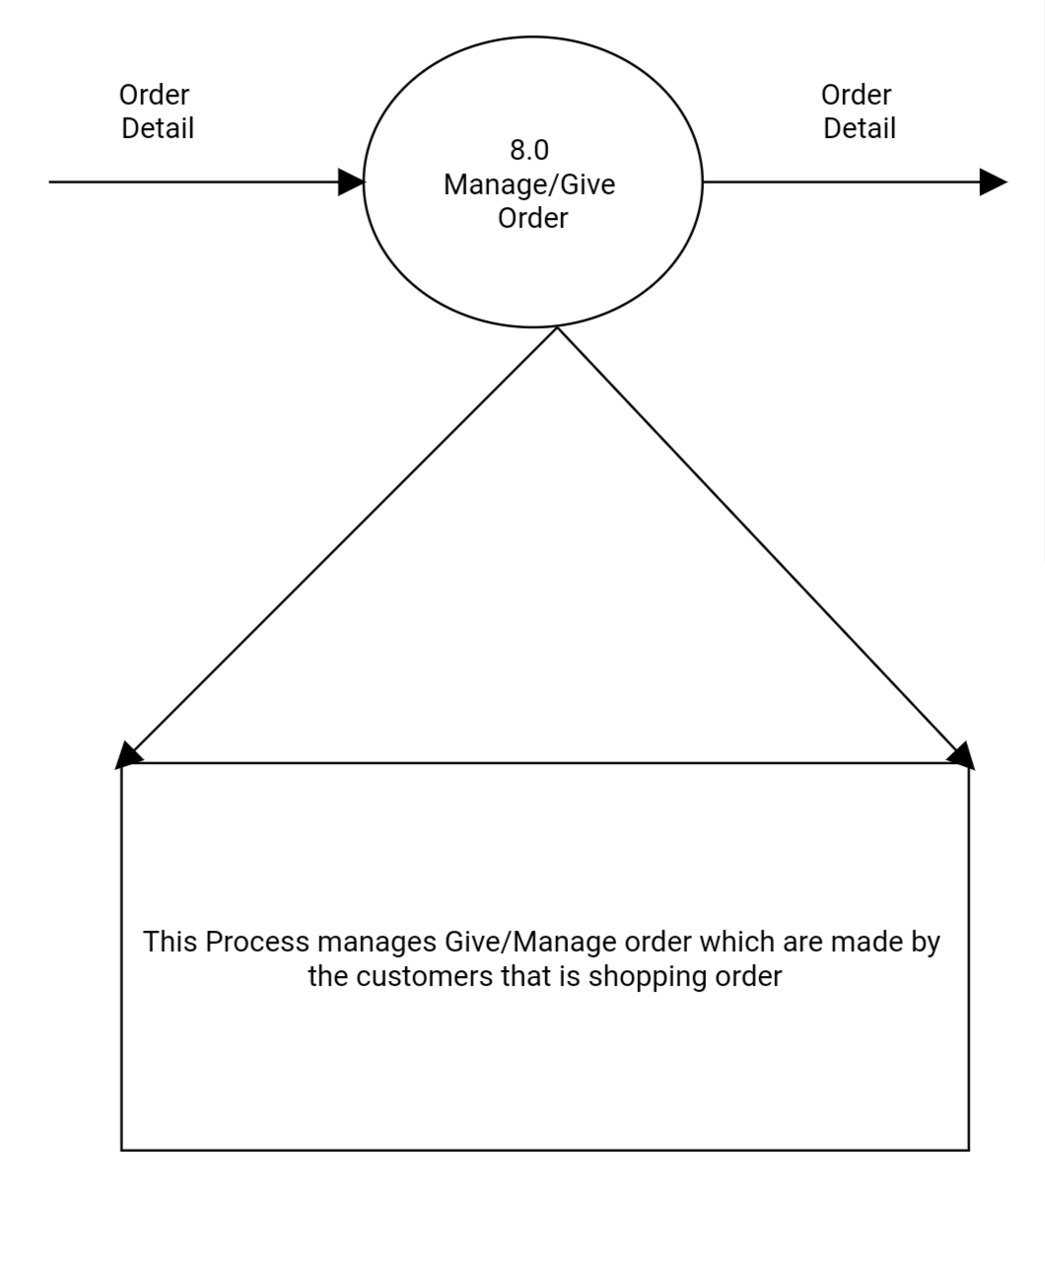
Process Specification Of Manage /Give order
Page:14

Slide 10
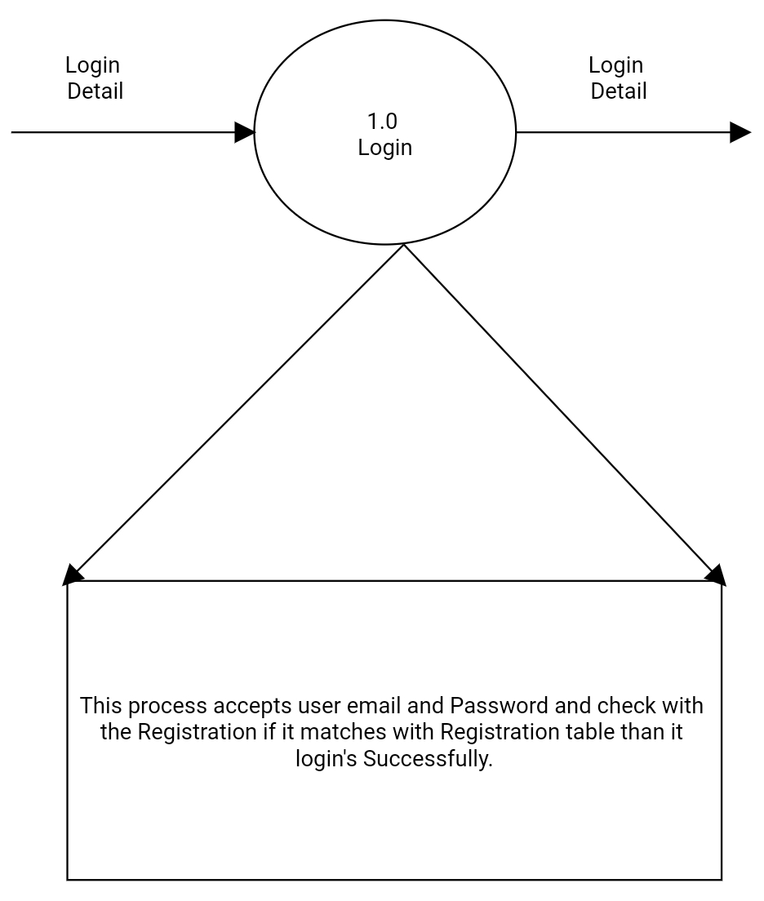
Process Specification Of Login
Page:9

Slide 11
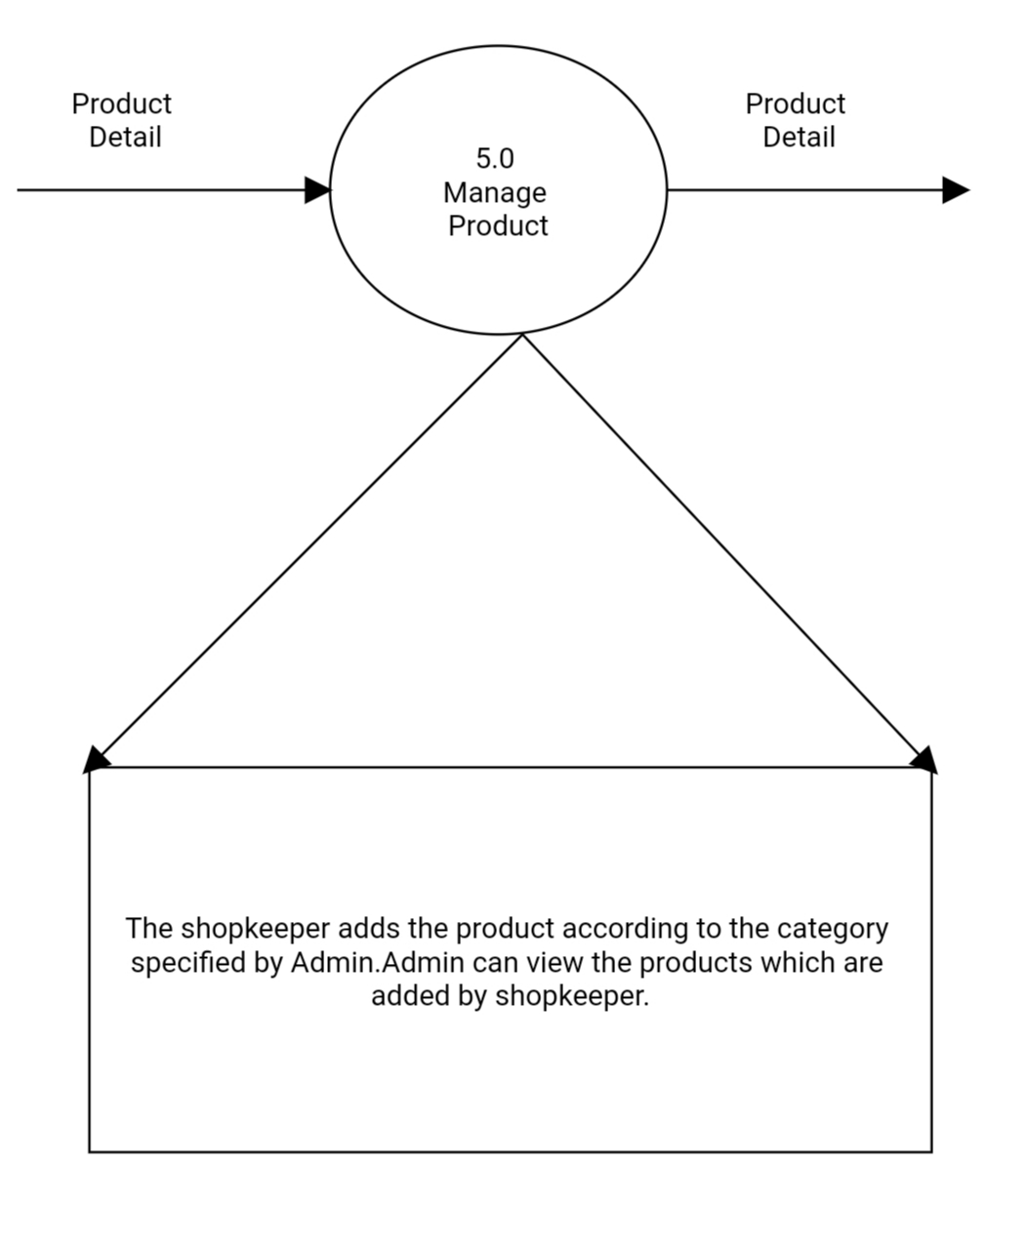
Process Specification Of Manage Product
Page:10

Slide 12
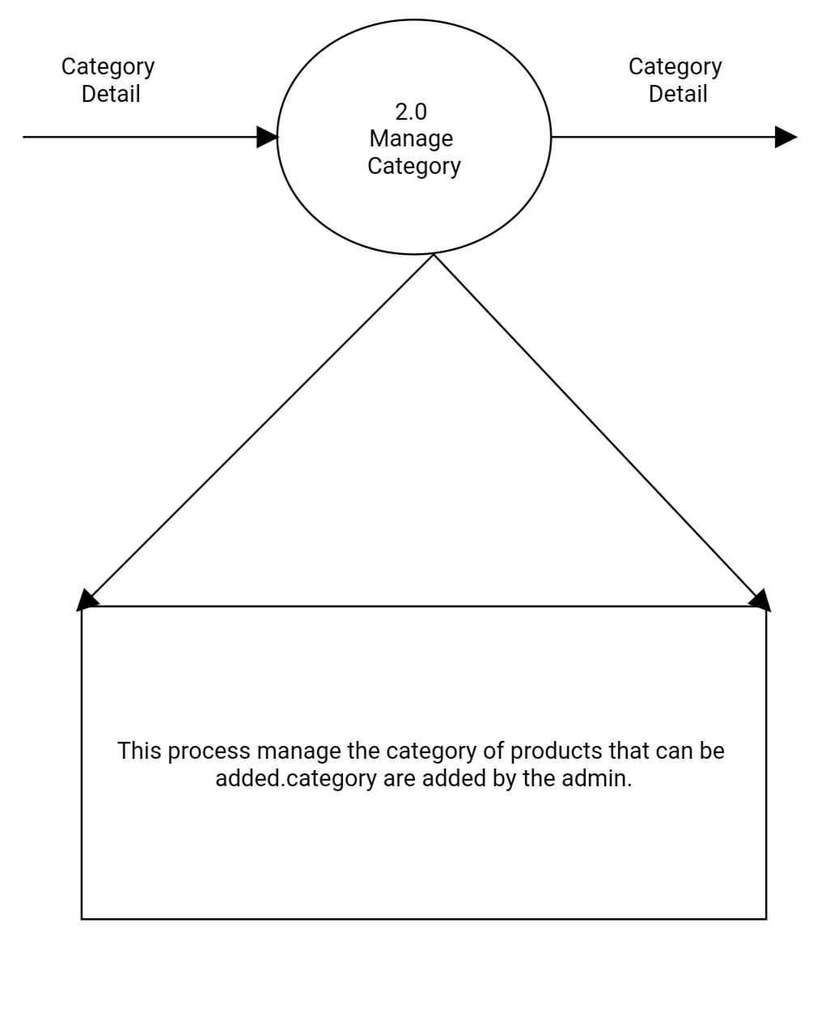
Process Specification Of Category Detail
Page:11

Slide 13
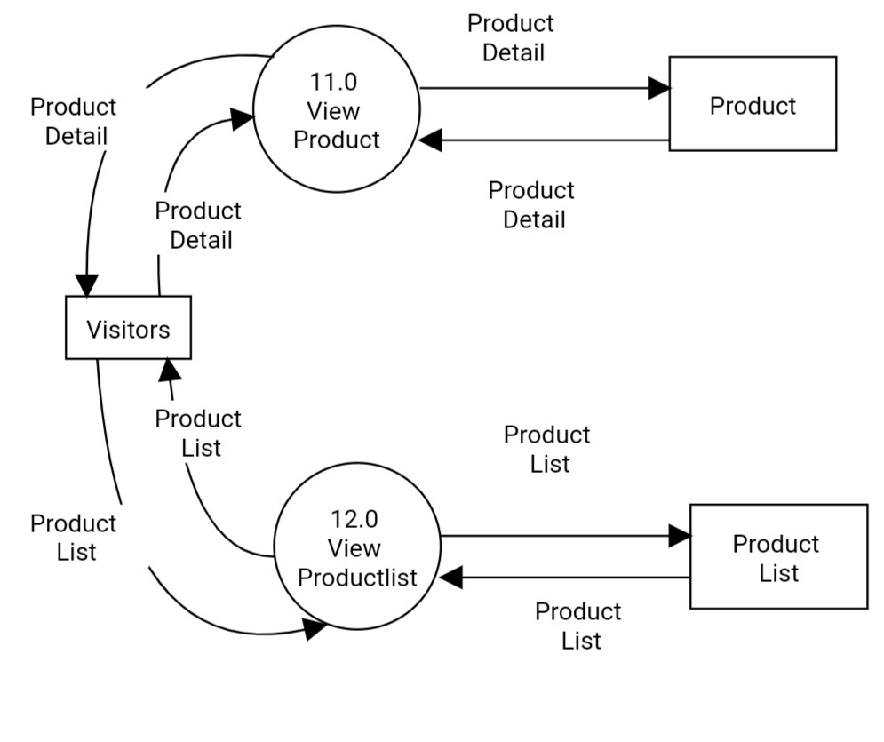
1st level DFD of Visitor Side
Page:3

Slide 14
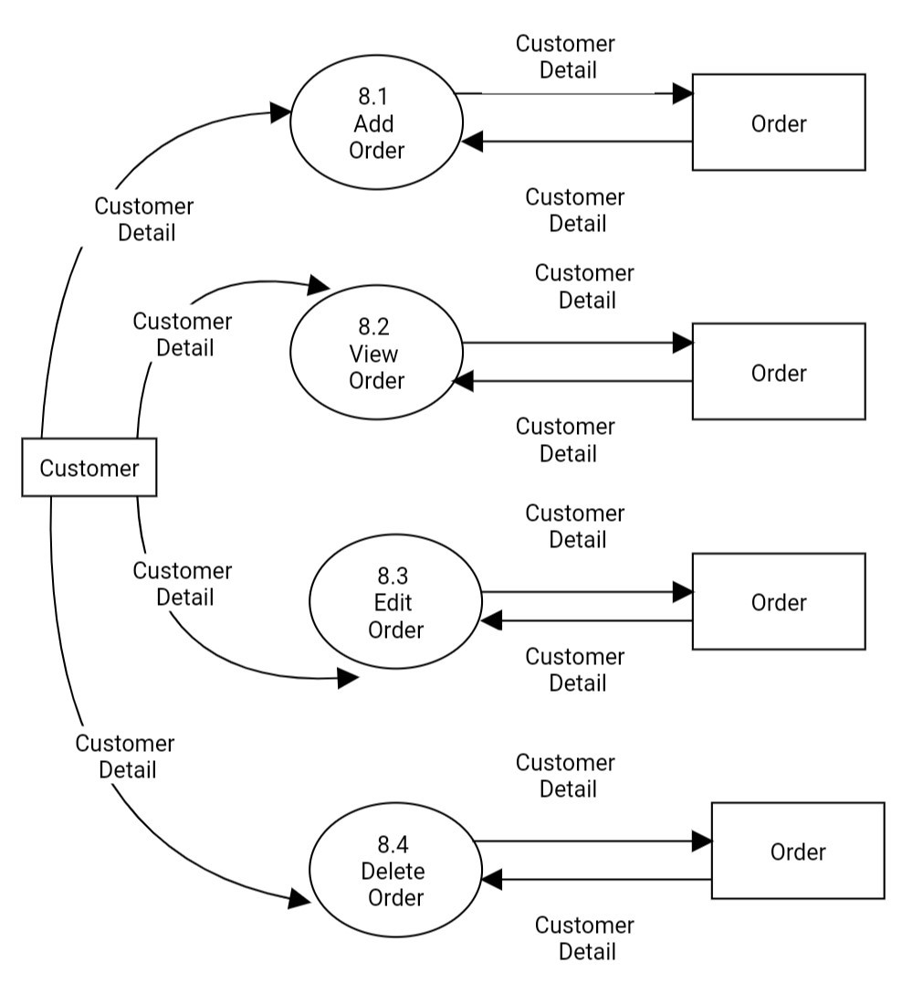
2nd level DFD of customer side
Page:8

Slide 15
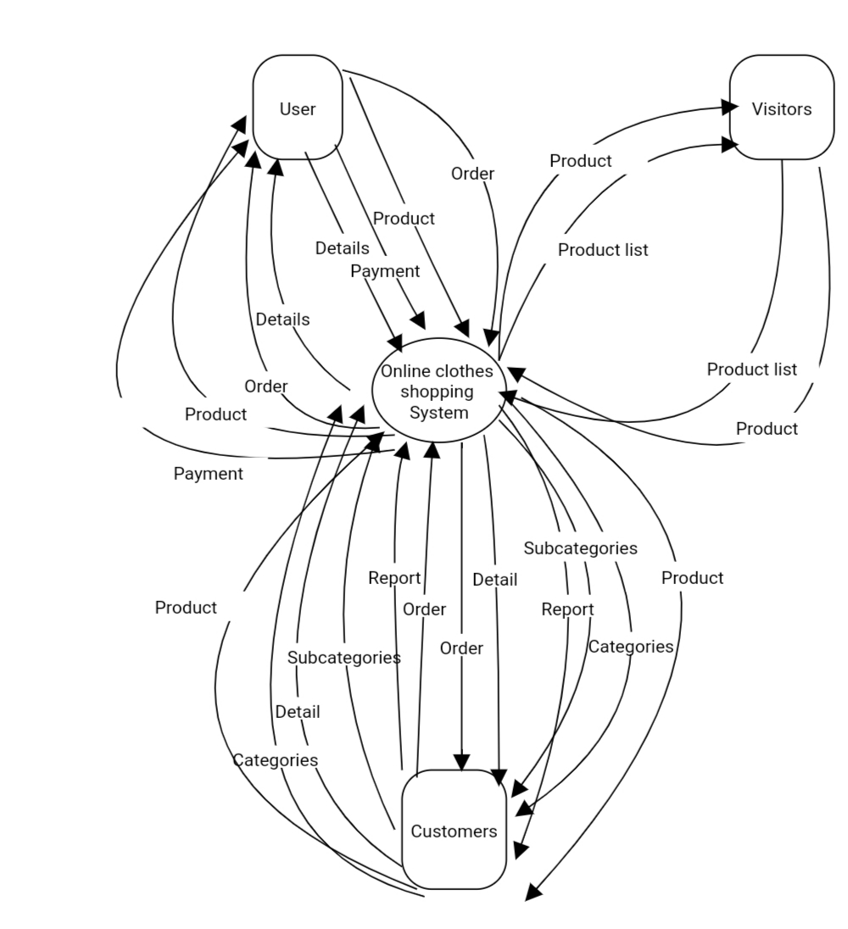
Context level DFD of Admin Side
Page:1

