Slide 1




SMART KOPARGOAN HACKATHON
TITLE PAGE
Problem Statement ID – skh007
Problem Statement Title- Smart Labour and Farm Machinery Sharing Platform
Theme- Agriculture & Rural Innovation
PS Category- Software
Team ID- YC637A
Team Name- Phoenix
sanjivani.edu.in
skh.sanjivaniuniversity.com

Slide 2
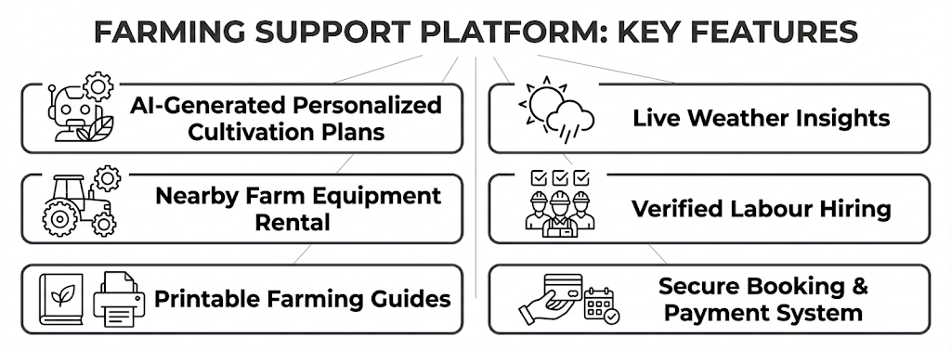
FarmFleet AI
Phoenix
Proposed Solution
FarmFleet AI is an AI-powered smart farming platform that combines agricultural equipment rental, AI-based crop planning, weather intelligence, labour hiring, secure online payments, and digital farming reports into one integrated ecosystem.
How it Addresses the Problem
Innovation
AI + Equipment Rental in one platform.
Weather-aware farming recommendations.
Smart farming calendar with weekly activities.
PDF farming guide generation.
Farmer-friendly multilingual design.
sanjivani.edu.in
skh.sanjivaniuniversity.com
2

Slide 3
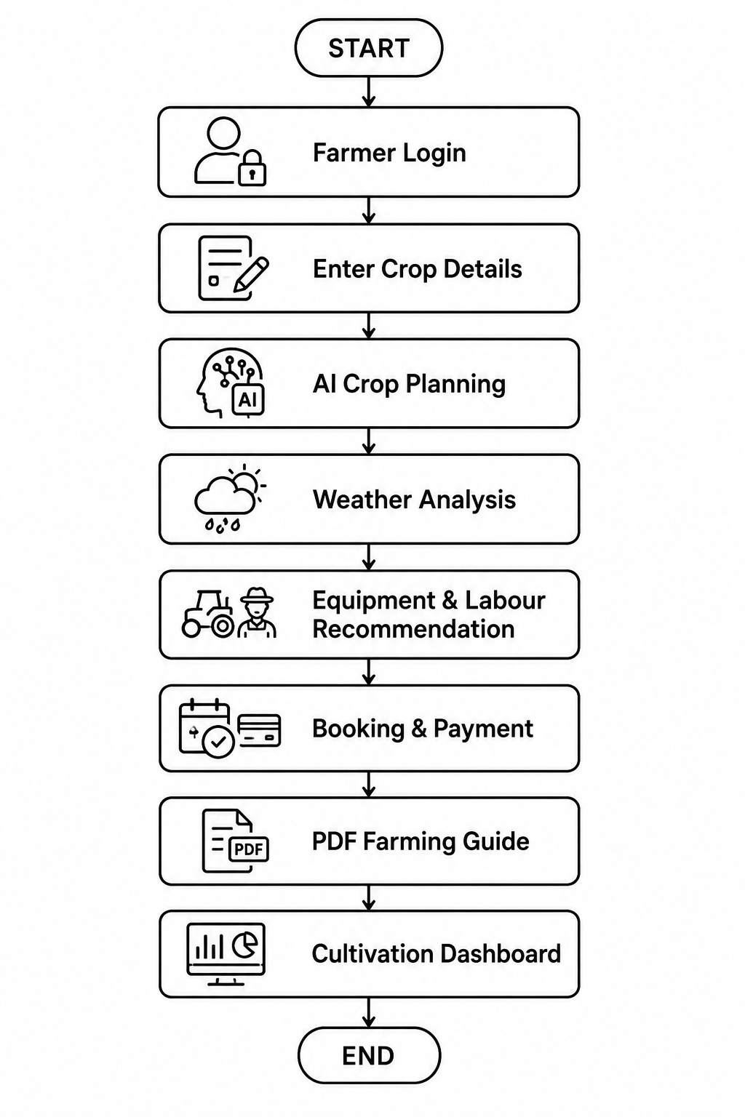
TECHNICAL APPROACH
Phoenix
Implementation Workflow
Technologies Used
Frontend: React 19 , TypeScript, Tailwind CSS, React Query
Backend: Node.js, Express.js
Database: MongoDB
Other: JWT Authentication, Cloudinary, PDFKit , Nodemailer, Razorpay, Google Gemini API
sanjivani.edu.in
skh.sanjivaniuniversity.com
2

Slide 4
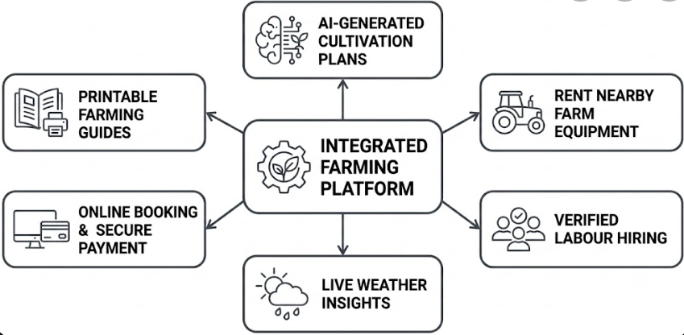
FEASIBILITY AND VIABILITY
Phoenix
Project Feasibility
Potential Challenges
Internet connectivity in rural areas.
Weather prediction accuracy.
Farmer adoption of digital platforms.
Real-time equipment availability.
Solutions
Offline support (Future Scope)
AI-assisted recommendations
Multilingual interface
Secure authentication
Cloud-based scalable backend
sanjivani.edu.in
skh.sanjivaniuniversity.com
2

Slide 5
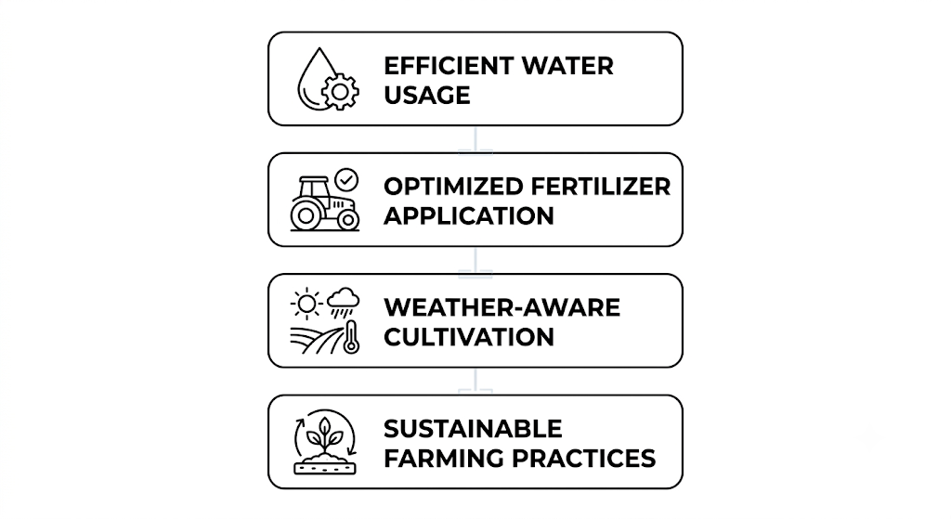
IMPACT AND BENEFITS
Phoenix
Target Audience
Farmers
Equipment Owners
Farm Labour
Agricultural Entrepreneurs
Environmental Benefits
Social Impact
Reduces farming costs.
Improves crop planning.
Saves farmers' time.
Encourages scientific farming.
Promotes digital agriculture.
Economic Benefits
Additional income for equipment owners.
Better machinery utilization.
Increased farming productivity.
Reduced cultivation risks.
sanjivani.edu.in
skh.sanjivaniuniversity.com
2

Slide 6
RESEARCH AND REFERENCES
Phoenix
Research Sources
Indian Council of Agricultural Research (ICAR)
Government Agriculture Portals
OpenWeather
Google Gemini API Documentation
MongoDB Documentation
React Documentation
Node.js Documentation
Express.js Documentation
JS Farm Services
Future Scope
Voice assistant in regional languages
IoT-based farm monitoring
Drone integration
Crop disease detection using AI
Market price prediction
Android & iOS application
sanjivani.edu.in
skh.sanjivaniuniversity.com
2

