Slide 1
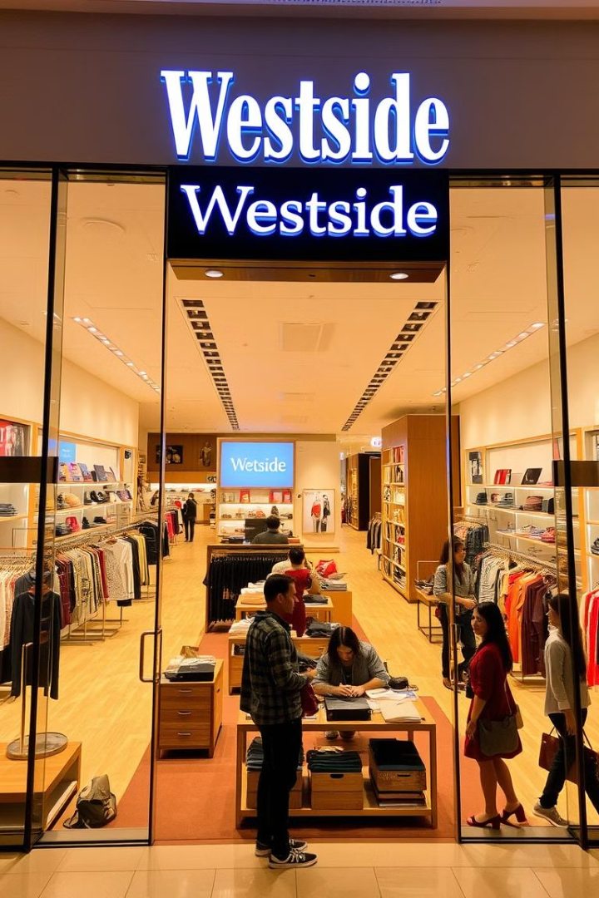


Westside Store
Your Modern Online Shopping Destination
NAME : RAJODIYA RAJKUMAR KETANBHAI
ENROLL NO : 230021780210108
BRANCH : IT
BATCH : C4

Slide 2

Introduction to Westside Store
Westside Store is a cutting-edge online shopping platform designed to provide a seamless and enjoyable e-commerce experience. We empower users with intuitive navigation, personalized features, and secure transactions, bringing the convenience of online retail directly to their fingertips.

Slide 3
Project Objectives
The core objective of Westside Store was to create a robust and user-friendly platform that simplifies the online shopping journey. We focused on:
Effortless Browsing
Personalized Experience
Streamlined Transactions
Intuitive product discovery and easy navigation.
Wishlist functionality for saving favorite items.
Efficient shopping cart and secure order processing.

Slide 4




Key Technologies Utilized
Westside Store leverages a modern tech stack to deliver a responsive and scalable application:
React
Express.js
For building dynamic and interactive user interfaces.
A fast and minimalist web framework for the backend.
MongoDB
LocalStorage
A NoSQL database for flexible and scalable data storage.
For efficient client-side data persistence.

Slide 5
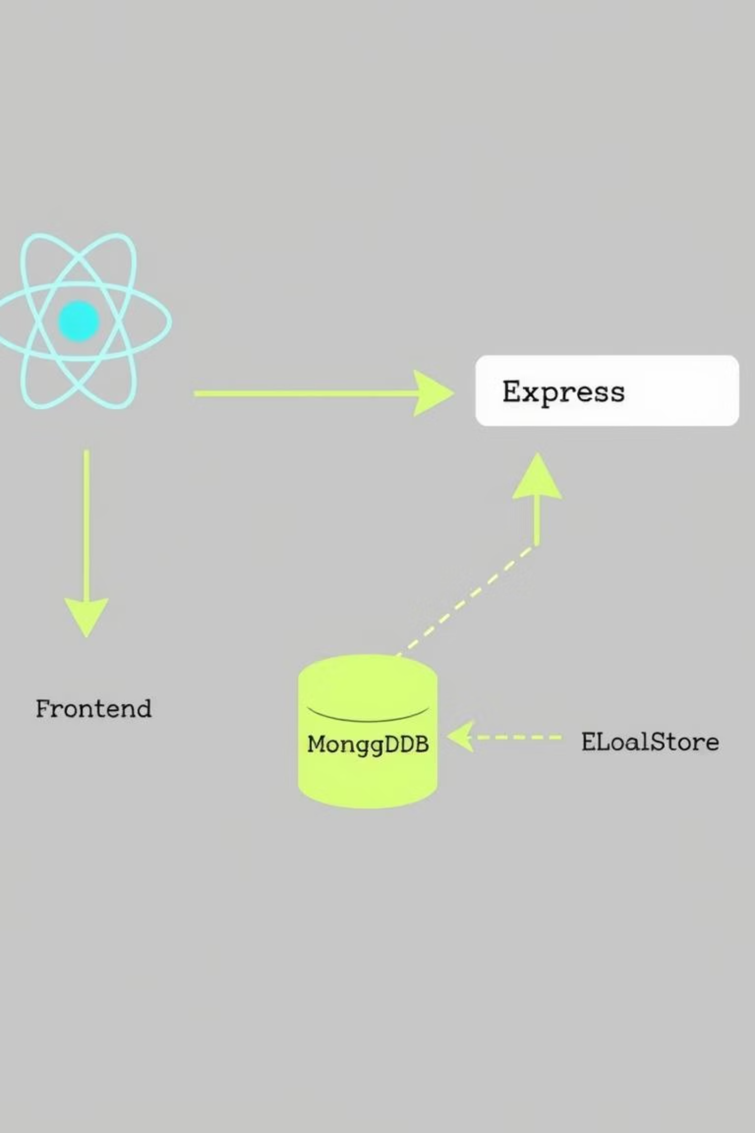
System Architecture Overview
Our architecture ensures a clear separation of concerns and efficient data flow:
Frontend (React)
Backend (Express.js)
Handles user interactions and renders the UI.
Manages API requests and business logic.
Database (MongoDB)
Client-Side (LocalStorage)
Stores all persistent application data.
Temporarily stores user data for faster access.

Slide 6
Robust Database Design
Our MongoDB schema is structured to efficiently manage essential e-commerce data:
Collection
Purpose
Users
Stores user credentials, profiles.
Products
Contains detailed information about all available items (price, description, images).
Contacts
Records customer inquiries and feedback from the contact form.

Slide 7
Key Features
Westside Store offers a comprehensive suite of features to enhance the user shopping experience:
Secure Authentication
Seamless Signup and Login processes for user accounts.
Extensive Product Catalog
Intuitive Product Listing with detailed item views.
Efficient Shopping Cart
Add to Cart functionality for managing selected items.
Personalized Wishlist
Ability to save desired products for future purchase.
Streamlined Checkout
Secure Payment processing for order completion.
Direct Communication
An easy-to-use Contact Form for support and inquiries.

Slide 8




User Workflow Journey
From discovery to confirmation, our user journey is intuitive and efficient:
Browse Products
Add to Cart
Users explore the catalog.
Selected items move to the cart.
Checkout
Order Confirmation
Payment and shipping details are confirmed.
Successful purchase notification.

Slide 9
Challenges & Solutions
Developing Westside Store presented unique challenges, each met with thoughtful solutions:
Database Connection Errors
LocalStorage State Management
Scalability
Designed the backend with modular components and stateless APIs to support future growth and increased user load.
Implemented robust error handling and retry mechanisms using middleware to ensure seamless communication between Express.js and MongoDB.
Developed a custom hook for React to synchronize application state with LocalStorage, ensuring data persistence across sessions and a smooth user experience.

Slide 10



Future Enhancements & Conclusion
We envision exciting future developments for Westside Store, continuing to enhance its capabilities:
Advanced Payment Gateways
Comprehensive Admin Panel
Real-time Order Tracking
Allowing users to monitor their order status from purchase to delivery.
Integration with multiple online payment providers for greater flexibility.
A dedicated interface for efficient product, order, and user management.

Slide 11
Thank you

