Slide 1
Restaurant : Order Food online
Presented By:-
Amar Suryawanshi
Kshitija Jadhav
Rajesh Chinni

Slide 2
Agenda
We have designed an online food ordering website for a restaurant which lets the customer order whatever they want on the restaurant’s menu from the comfort of their homes.
A new customer would have to create an account and then log in to access the menu whereas a returning customer can just directly login.
To encompass the entire functioning of the restaurant we have added pages like home page which includes signup/login, register page which includes the customers’ basic information and logout page.

Slide 3
PAGES Designed
Home
Register
Display Menu
Add Item
Cart
Remove food
Remove item
Billing
Logout

Slide 4
Tables in the database
Billing
Cart
Menu
User_details

Slide 5
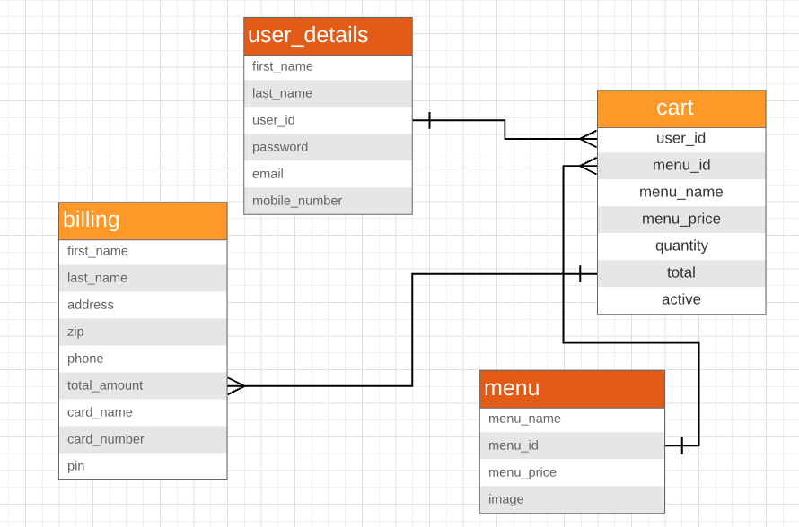
ER diagram

Slide 6
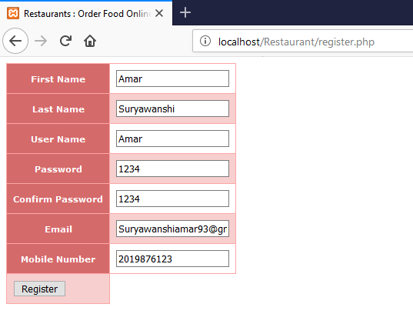
Register

Slide 7
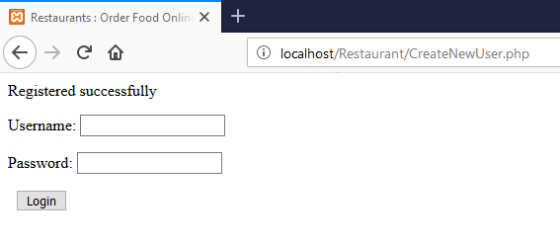
Login for new user

Slide 8
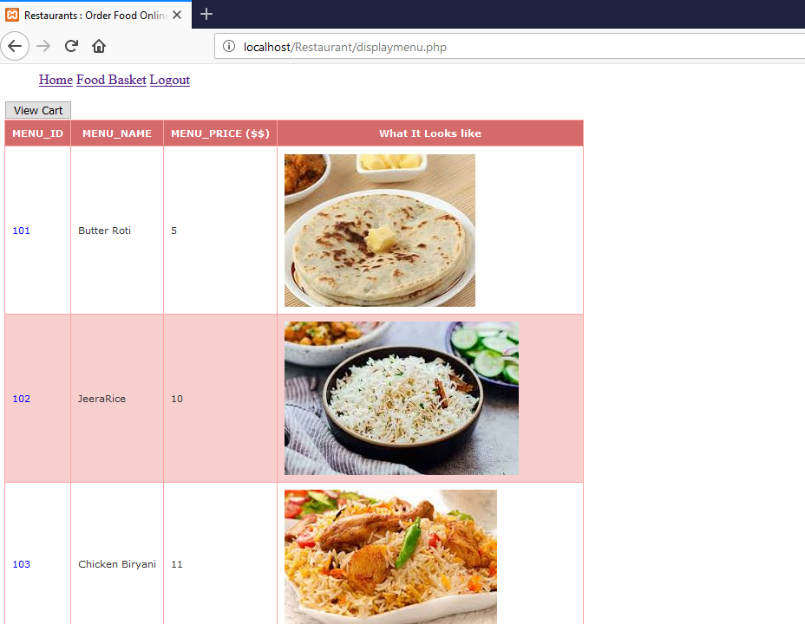
DISPLAY MENU

Slide 9
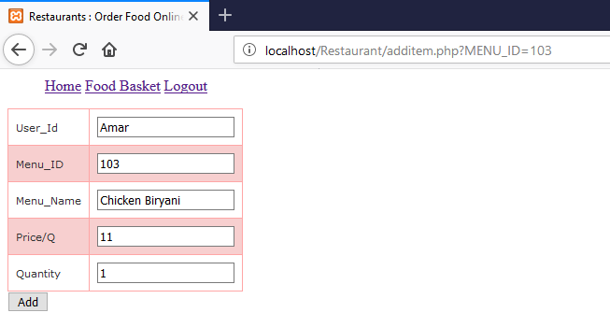
ADD ITEM

Slide 10
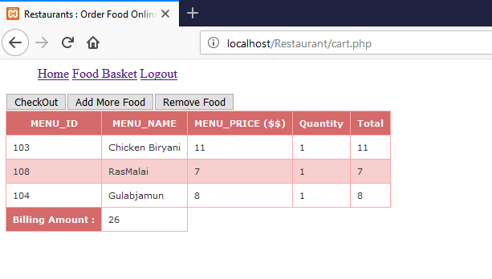
CArt

Slide 11
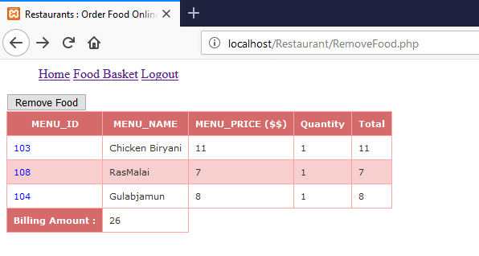
Remove Food

Slide 12
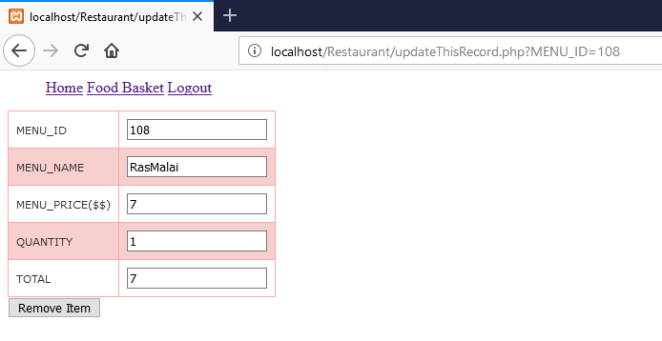
Remove Item

Slide 13
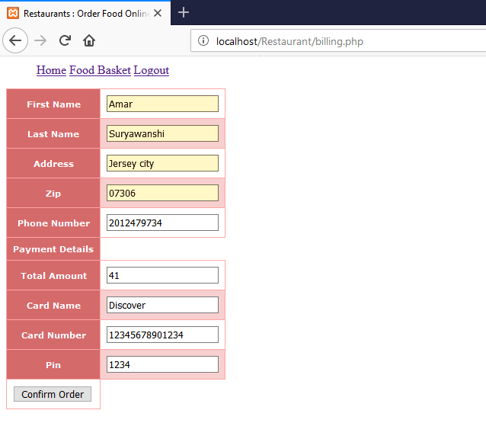
Billing

Slide 14
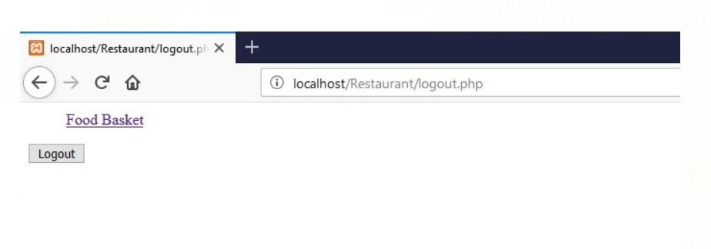
LOGOUT

Slide 15
Functions used
fetchAllMenu
fetchThisItem (used in additem.php)
fetchThisMenu (to get the details about the cart)(used in updatethisrecord.php)
AddNewItem
fetchCart
CalculateAmount
Deletethisrecord (to delete from cart table)
checkLogin
billing
DeleteRecord (used to update active status)
createNewUser

Slide 16
Thank you
QUESTIONS

