Slide 1
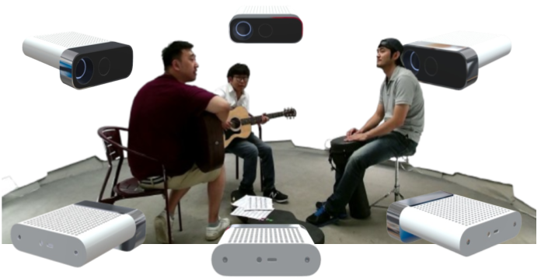

LiVo
LiVo
2D Compress - Color
2D Decompress - Color
2D Compress - Depth
2D Decompress - Depth
Capture
Pre-processing
3D Generation
(3DGS,
Point Cloud)
3D Reconstruction
Rendering
Bandwidth Adaptation
Network
3D Compress - Geometry
3D Decompress - Geometry
GS-NFS
3D Compress - Attributes
3D Decompress - Attributes
GS-NFS

