Slide 1

Energy Optimization of Air-Conditioners using Heat-Maps
Team: IIIoT, IIIT Hyderabad
Rhishi Pratap Singh, Upender Reddy, Siddharth Mehrotra and Dr. Sachin Chaudhari

Slide 2
Pitch-up Idea
To come up with a solution which can manage the energy consumption of Acs.
Understanding the distribution of cooling in an area.
Energy optimization with even distribution of cooling.

Slide 3
Solution- Built UP
Sensor Deployment: Audi-02, CDS, IISc
Component Used: Raspberry Pi, DHT 11
Analytics Platform: Services Bus Queue (IoT Hub) by Microsoft Azure and ThingSpeak API.
Programming Language: Python, P.
Operating System: Ubuntu 14.0 LTS.
Communication Channel over API: TCP/IP

Slide 4
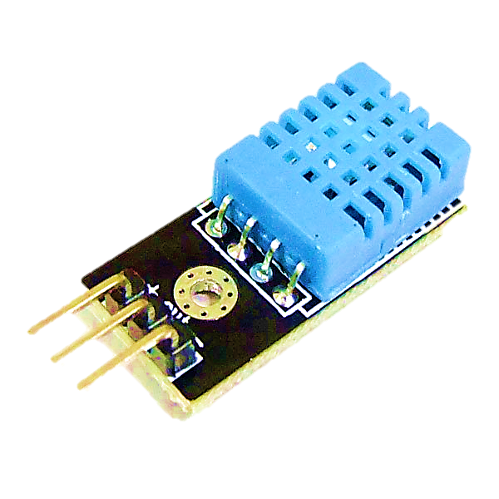





Architecture
IIIoT/Sensor01
MQTT Protocol
Windows Azure Service Bus Analytics
+
IIIoT/Sensor02
MQTT Protocol
IIIoT/RasberryPi3
IIIoT/Sensor03
ThingSpeak API (Heat Map)
MQTT Protocol
Actuator

Slide 5
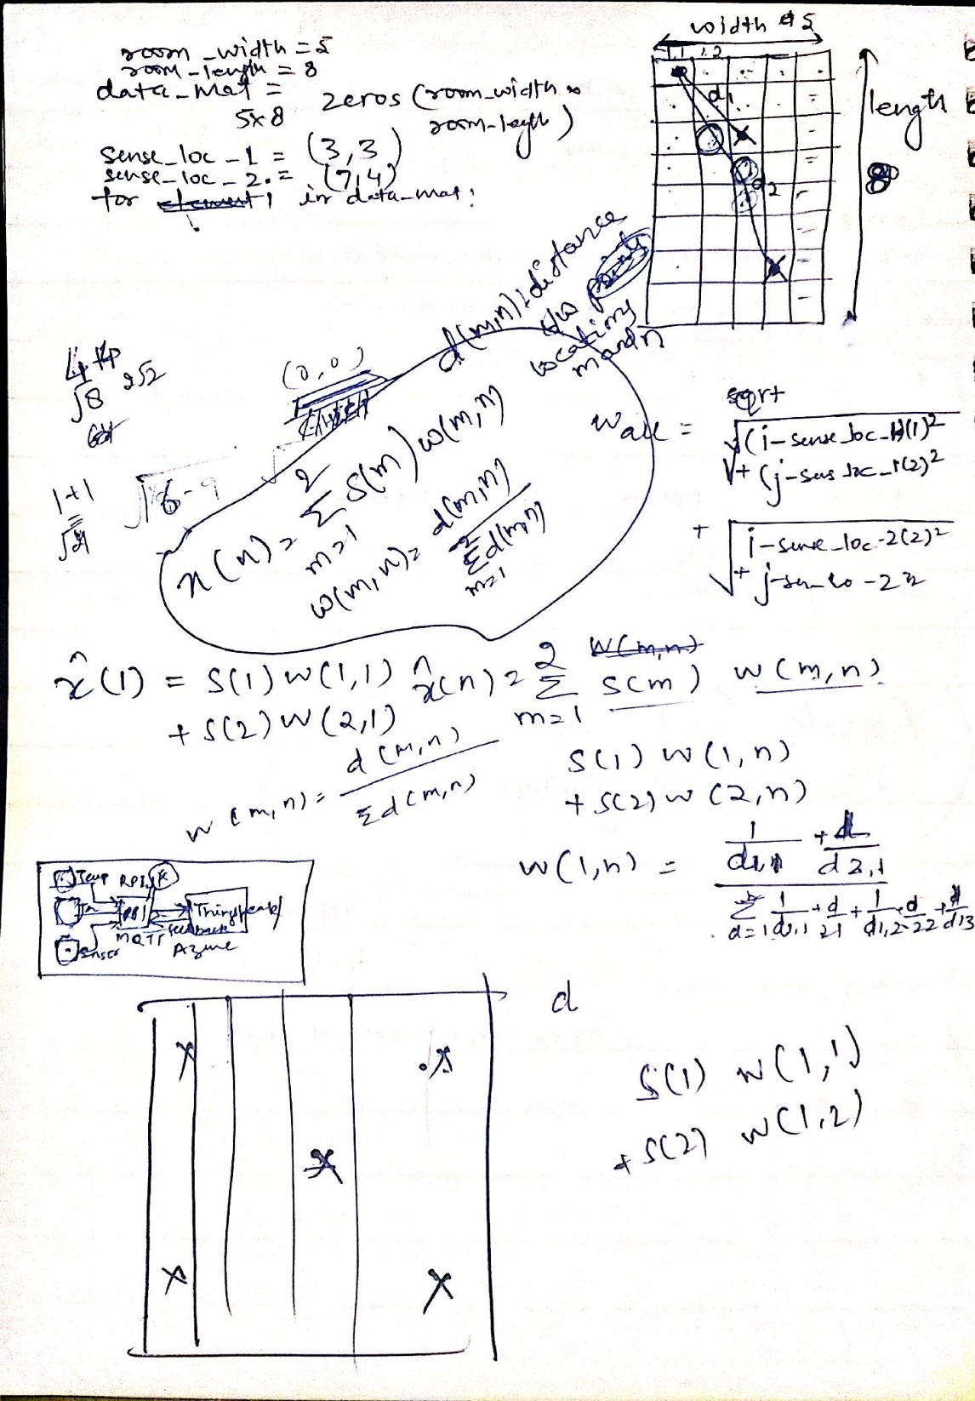
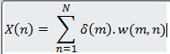
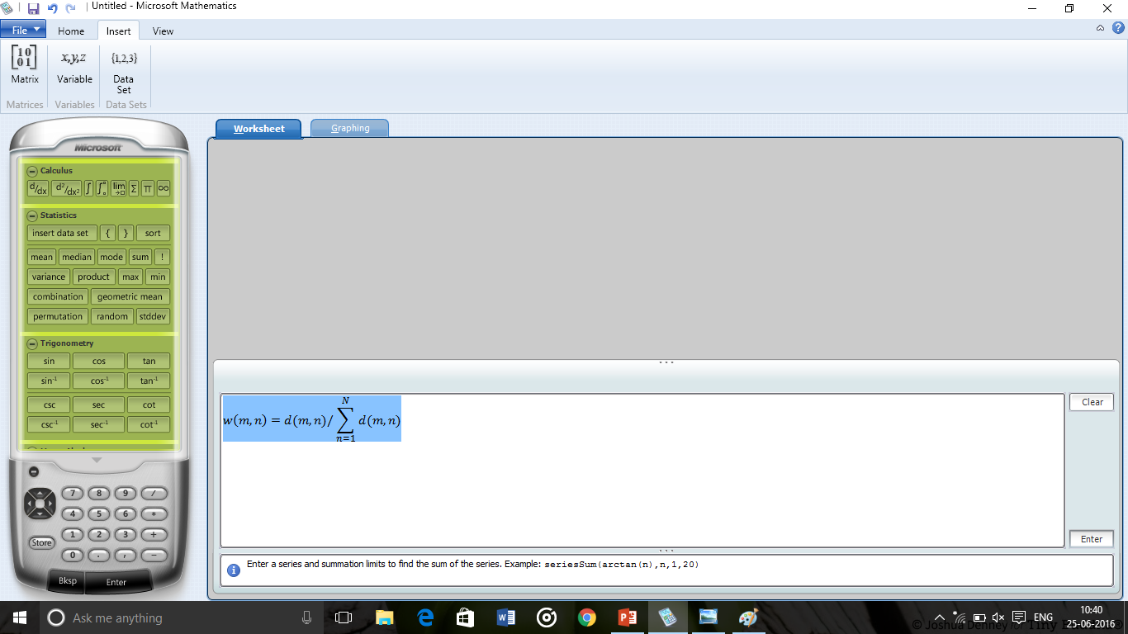
Mathematical Model

Slide 6
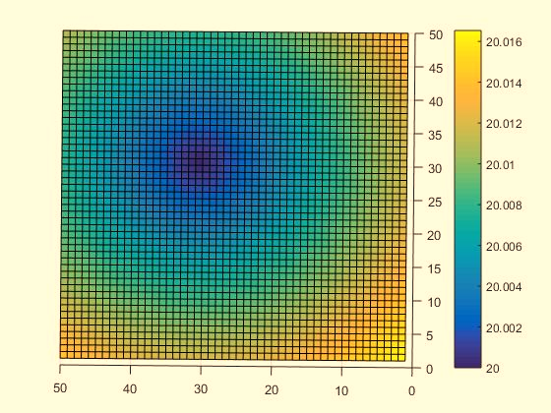
Results

Slide 7
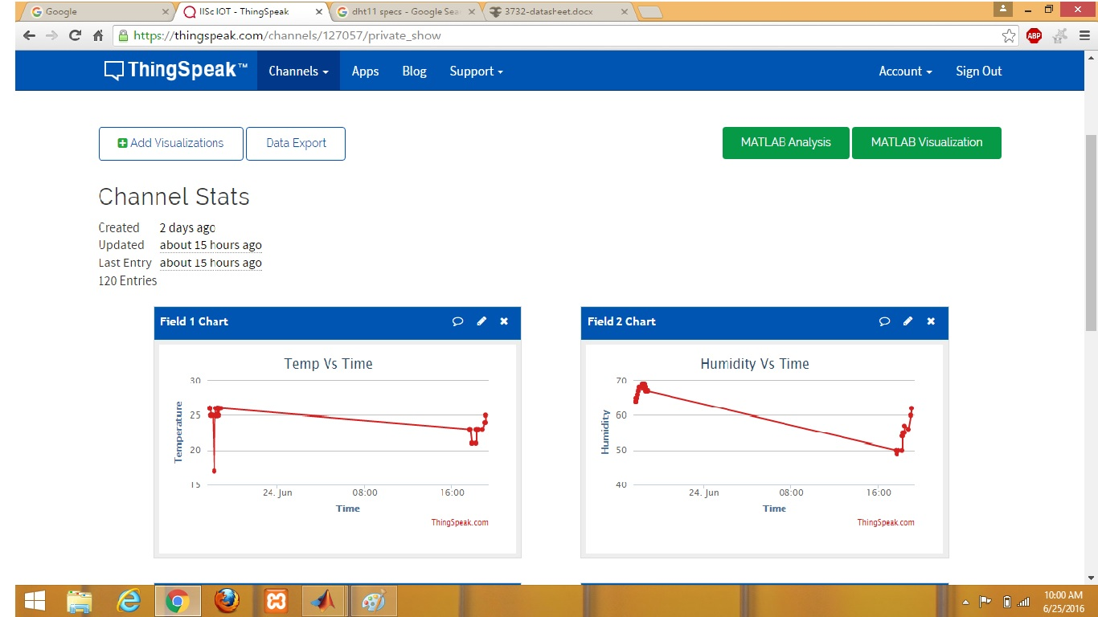

Slide 8
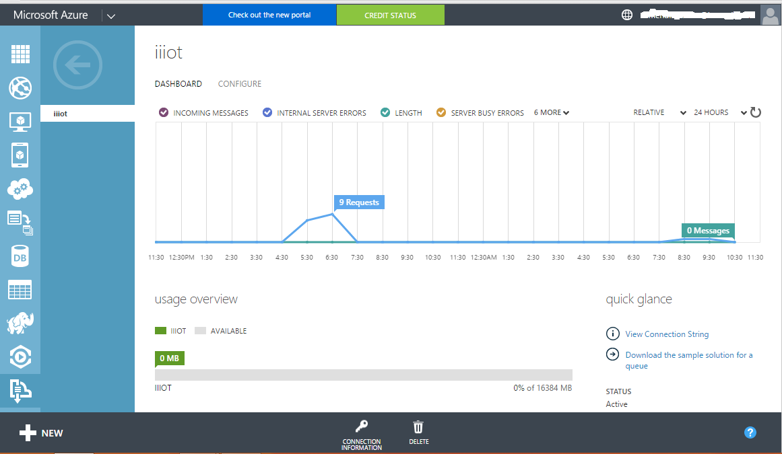

Slide 9
Societal Impact
Pharmaceutical Industry.
Energy efficiency.
Smart Building.

Slide 10
Thanks ☺

