Slide 1
Health Monitoring System: Activity Tracking
TEAM: ACTIVE SENSE – IIT KHARAGPUR
MEMBERS: URBI CHATTERJEE
SNIGDHA DAS
ILORA MAITY

Slide 2
Introduction
The consumers and healthcare service providers using smart phones are growing exponentially throughout last decade.
The adoption of this technology is rapid; two-thirds of physicians and 42% of the public used smartphones.
As of February 2010, there were nearly 6,000 such apps within the Apple App Store.
Of these, 73% were intended for use by consumer or patient end-users, while 27% were targeted to healthcare professionals.

Slide 3
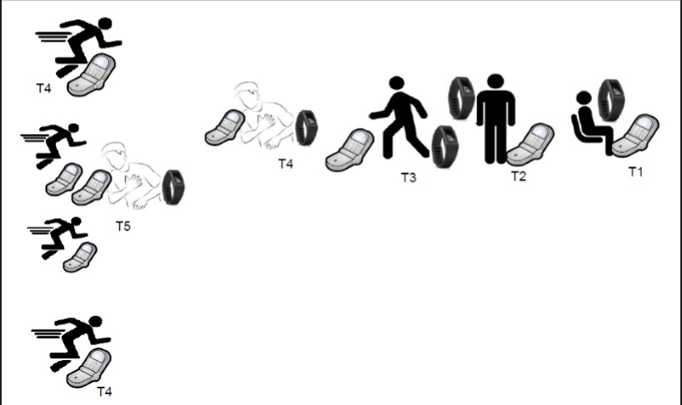
Why Health Monitoring
The specialist at a distance can monitor the patient health condition and take necessary actions in emergency.
This system is also available in reasonable prices.
Embedded technology is used to monitor the patient activities very easily.

Slide 4
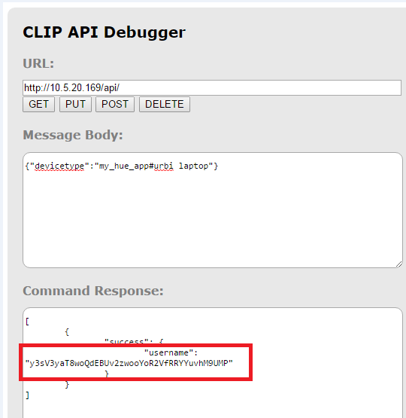
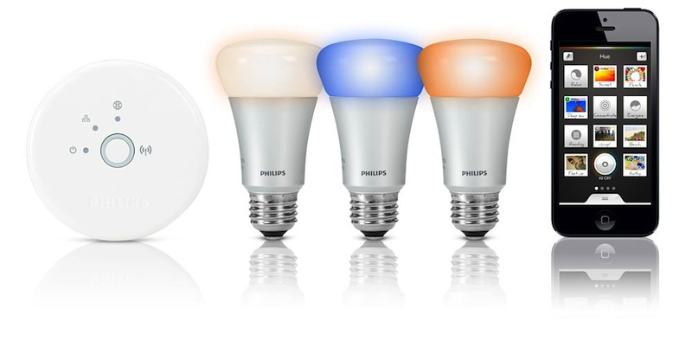
Security Impact on Popular IoT devices

Slide 5
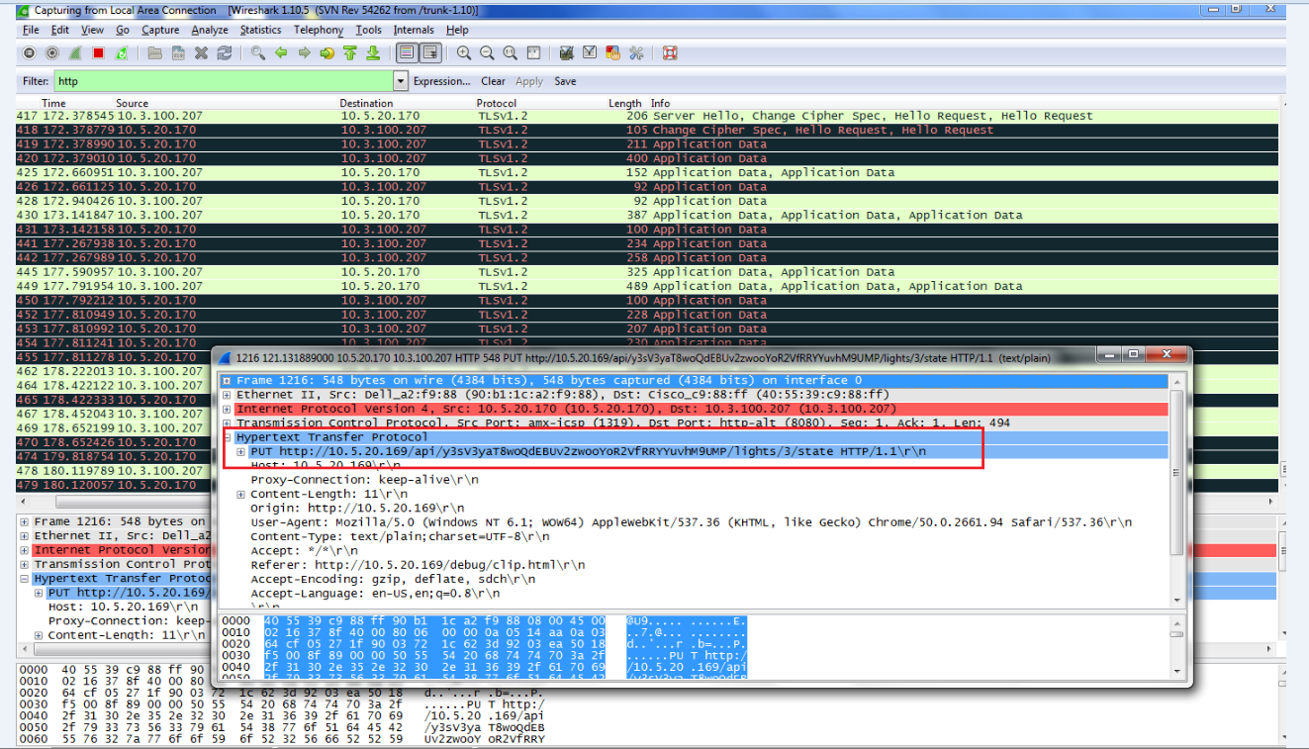

Slide 6
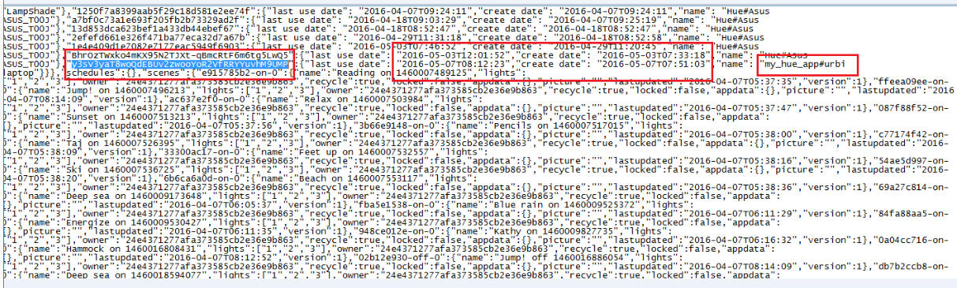

Slide 7

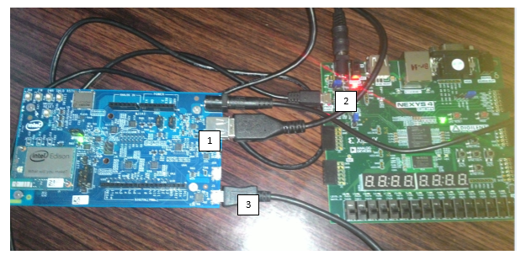
Mitigation Approach
For Authentication, Physically Unclonable Functions are used as Fingerprint of Devices.
A challenge-response mechanism in which the mapping between an applied input (“challenge”) and the corresponding observed output (“response”) is dependent on the complex and variable nature of a physical material.
For message authentication and privacy, MIRACL SDK is used to implement several symmetric and asymmetric key schemes such as AES, DES, 3DES, RSA, ECC.

Slide 8
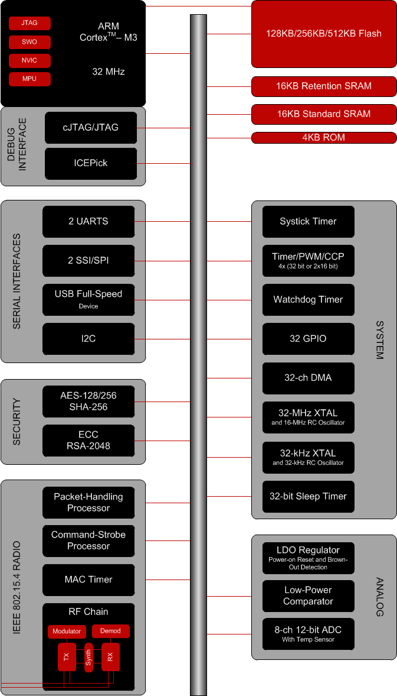
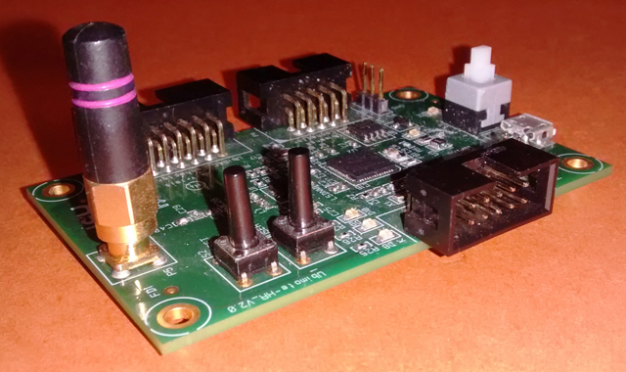
Examples of Security Modelues for IoT

Slide 9
The list of sensors/devices/software/tool chain used
Pulse Sensor
Accelerometer
Atmega32 microcontroller
Raspberry Pi
AVR-ISP programmer module
LCD display
Android Studio
Siddhi-mqtt

Slide 10
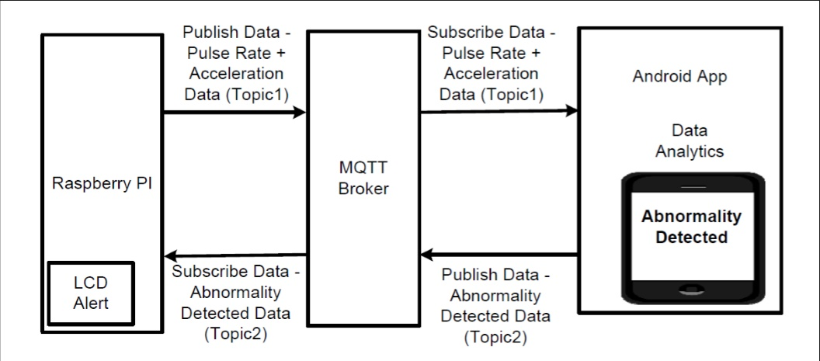
Architecture

Slide 11
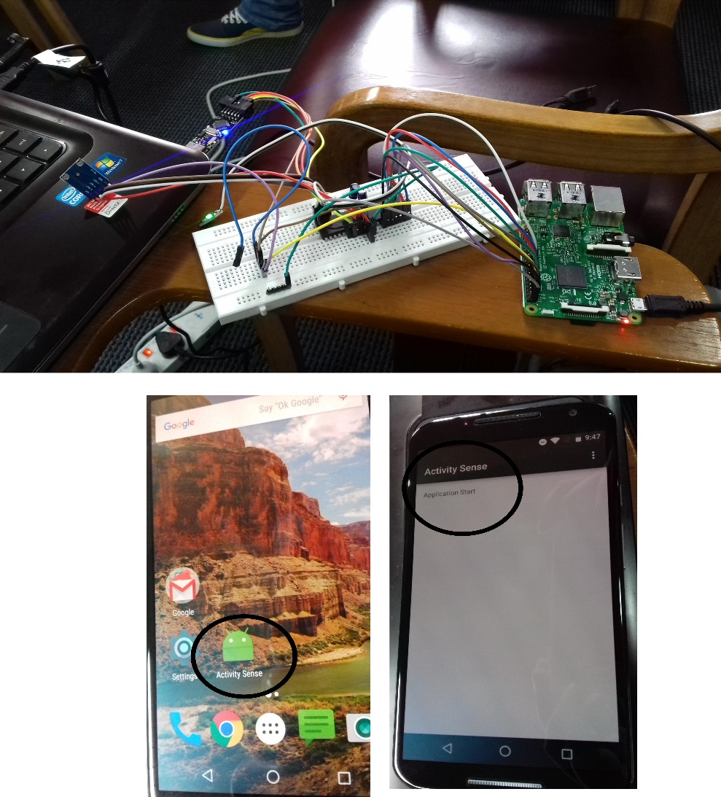
Implementation

Slide 12
Future Work
Data Analytics
Generating notification message to medical centers in case of health issues.
Monitor health status of all employees in an organization so that medical attention can be provided in time and sick leaves can be reduced.
Data Security
Monitoring the power usage of the Raspberry Pi after implementing security protocols.
Based on the study, improve those protocols to optimize the power usage.

Slide 13
THANK YOU

