Slide 1
Smart Home Power Monitoring System
By
Team14
Ravenclaw_Phoenixes
Aravind
Imbesat Rizvi Hassan
Ankit Shrivastava

Slide 2
Objective
To sense and monitor the power consumption in household and understand the usage based on the activity of a user.
Monitoring the power profile of an appliance and look for possible faults in the appliance
Suggesting the user to turn of appliances or even repair faulty appliances reduce the power consumption.

Slide 3
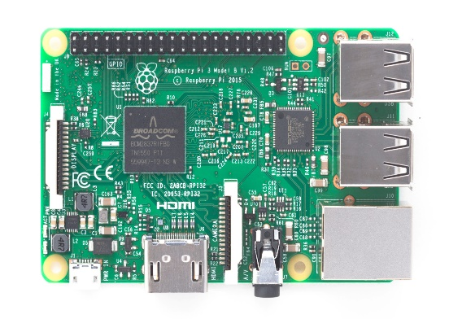

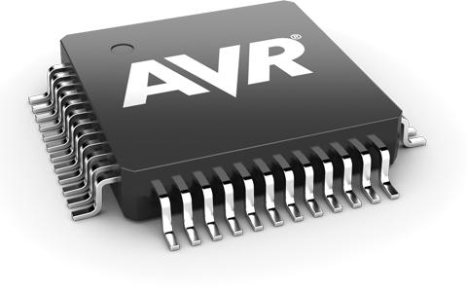
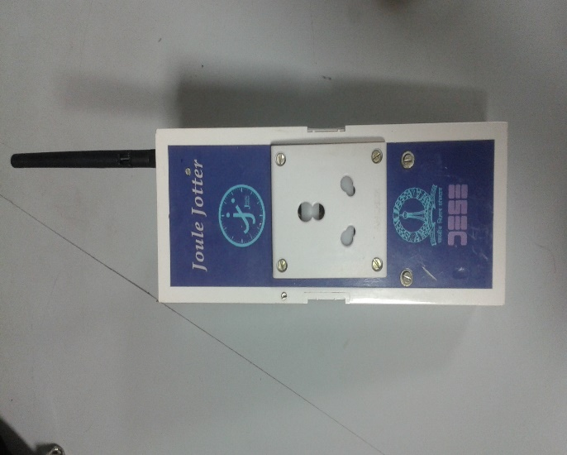
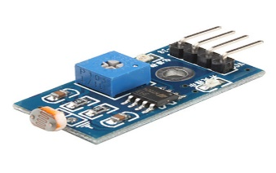
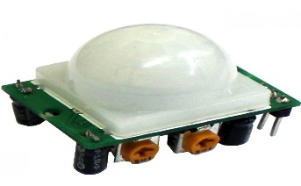
Cloud Database
MQTT
Raspberry Pi
MQTT
Consumption
Data and alerts
)
Atmega 32 (ADC)
Light Sensor
Motion Sensor
Joule Jotter

Slide 4
What have we done?
Sensor data is collected by a raspberry pi based client side system and sent to the cloud.
Joule Jotter reads the electrical parameters of a particular appliance or set of appliances and wirelessly sends the data to remote server. This data is sent to the cloud.
Disaggregation of appliance data and determining which appliance is operating and based on the sensor data we determine if a particular appliance has to be ON or not.
Factorial Hidden Markov Model

Slide 5
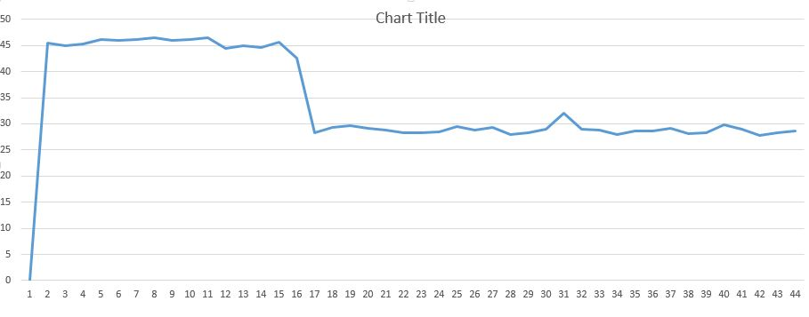
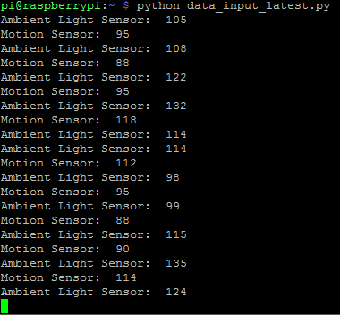
Results

Slide 6
Future Expansions
Complete smart home automation based on the person’s activity.
Incorporating additional sensors like temperature and humidity.
RTC and LCD interfacing for Pi.

