Slide 1
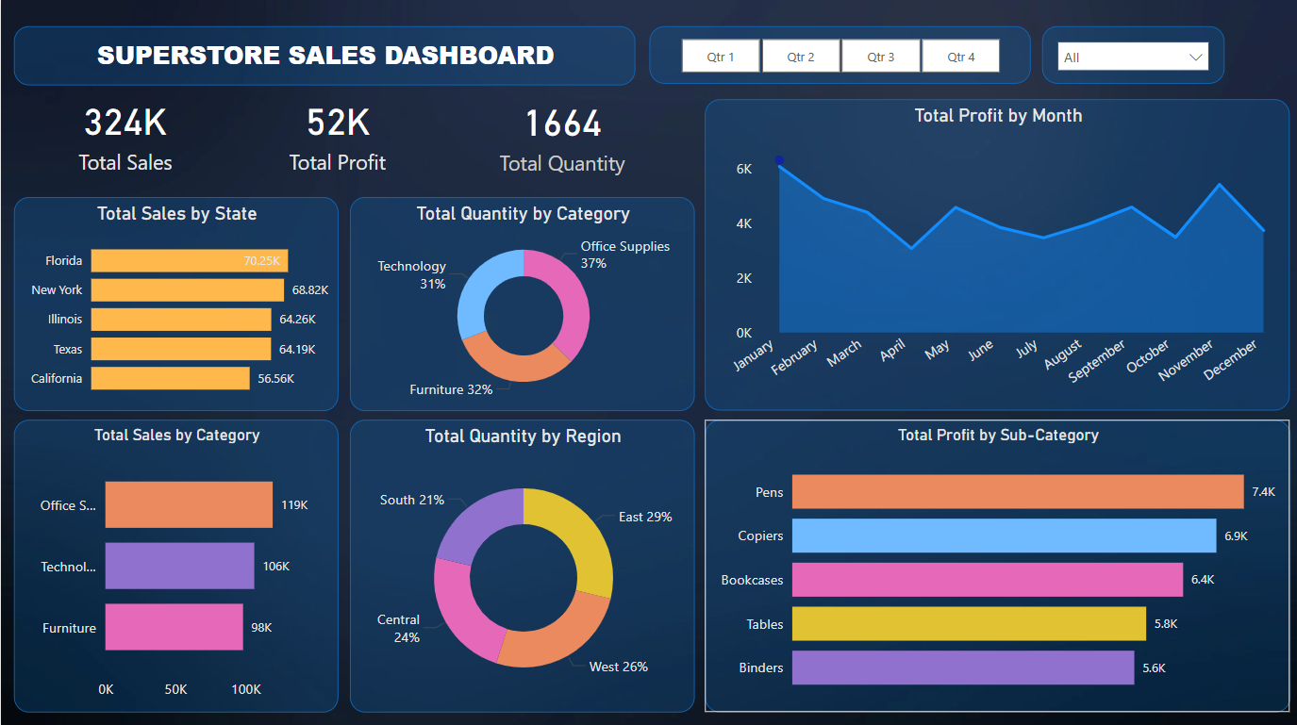
Superstore Sales Dashboard Summary
Visual Overview of Sales Performance
Tool Used: Power BI Desktop

Slide 2
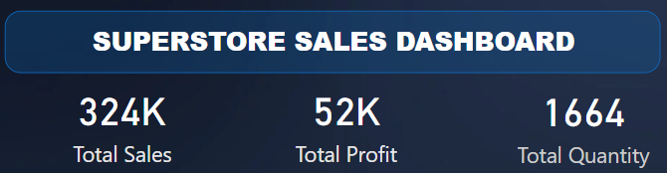
Key Metrics
Total Sales: ₹324K
Total Profit: ₹52K
Total Quantity Sold: 1,664 Units

Slide 3
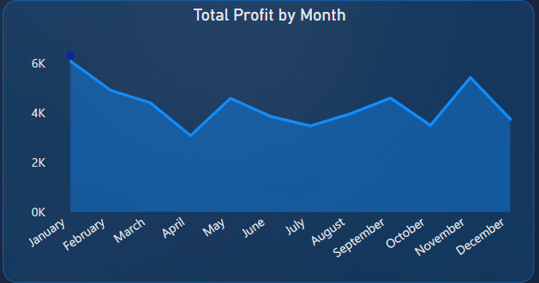
Total Profit by Month
Monthly breakdown of profit
Steady increase across the year
Peak months likely around Q3–Q4
Profit ranges from ₹0K to ₹6K+

Slide 4
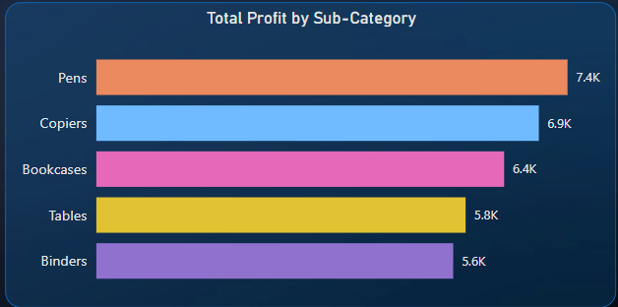
Profit by Sub-Category
Pens: ₹7.4K
Copiers: ₹6.9K
Bookcases: ₹6.4K
Tables: ₹5.8K
Binders: ₹5.6K

Slide 5
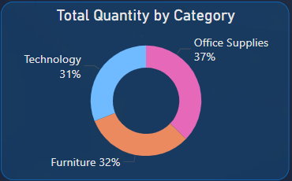
Quantity by Category
Office Supplies: 37%
Furniture: 32%
Technology: 31%

Slide 6
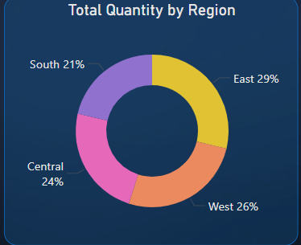
Quantity by Region
East: 29%
West: 26%
Central: 24%
South: 21%

Slide 7
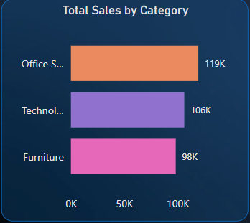
Sales by Category
Office Supplies: ₹119K
Technology: ₹106K
Furniture: ₹98K

Slide 8
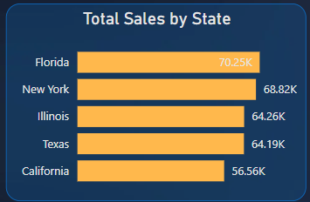
Sales by State
Florida: ₹70.25K
New York: ₹68.82K
Illinois: ₹64.26K
Texas: ₹64.19K
California: ₹56.56K

Slide 9

Quarterly Trend Option
Power BI filter supports viewing by Quarter (Q1 to Q4)
Helps in identifying seasonal patterns

Slide 10
Conclusion
Pens and Copiers generate highest profit
Office Supplies lead in total sales
Florida and New York are top-performing states
Strong performance seen in Q3–Q4
Dashboard enables regional, category-wise, and time-based insights

