Slide 1
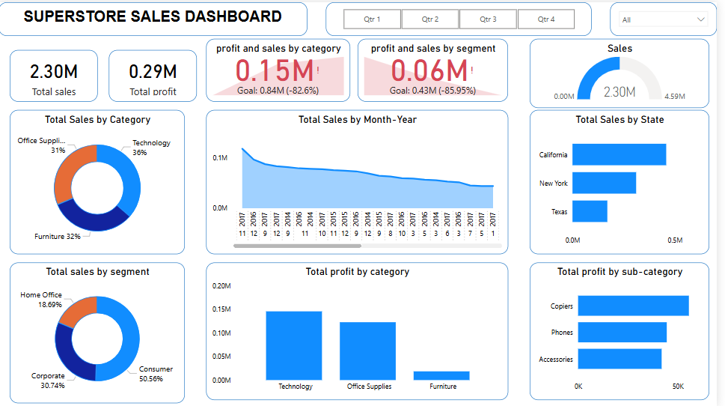
Superstore Sales Dashboard Insights
Data Analyst Internship - Task 8

Slide 2
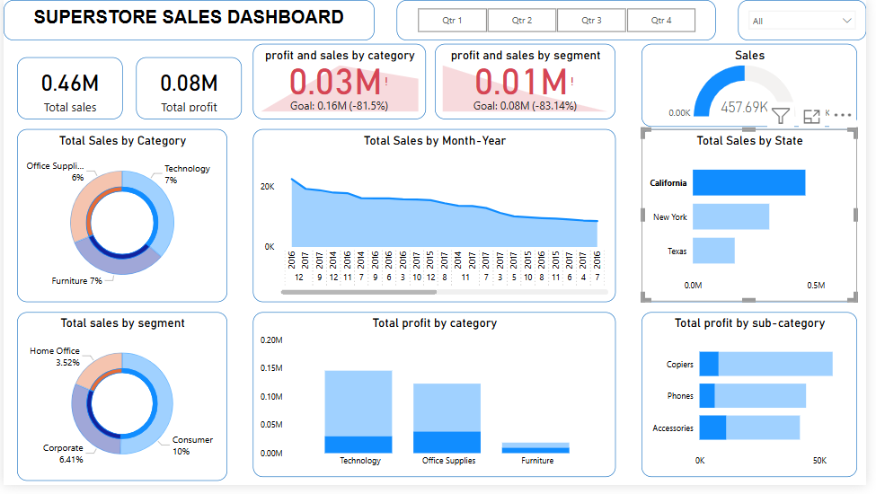
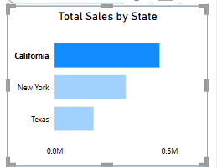
Key Insights from Dashboard
1. California is the Sales Leader:
- Highest total sales, outperforming New York and Texas

Slide 3
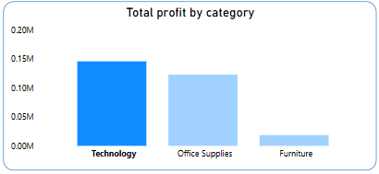
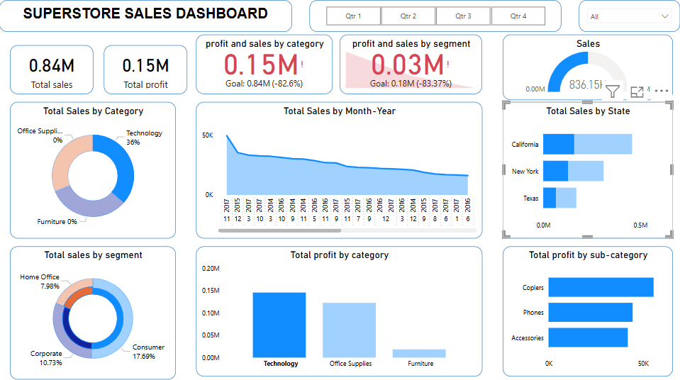
2. Technology Category Delivers the Highest Profit:
- 36% of sales but largest share of profit.

Slide 4

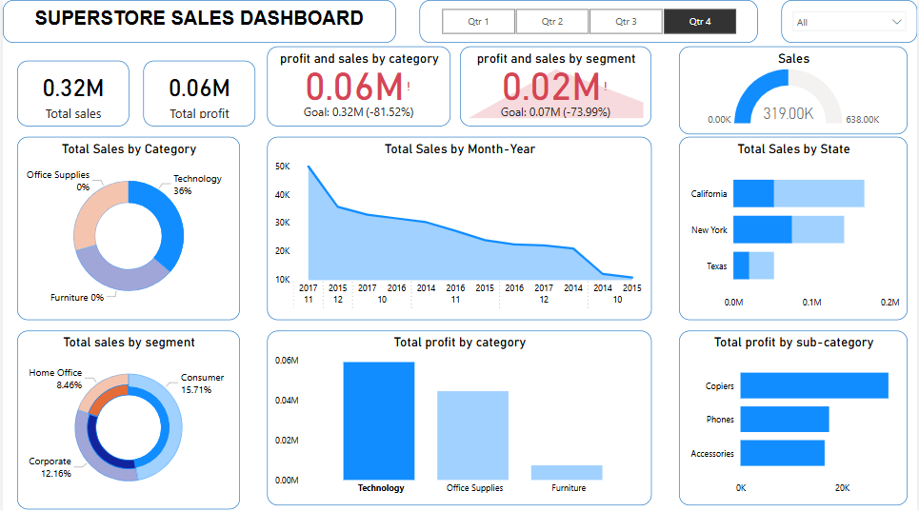
3. Q4 Outperforms Other Quarters:
- Strong seasonal trend due to holiday purchases.

Slide 5
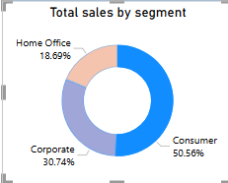
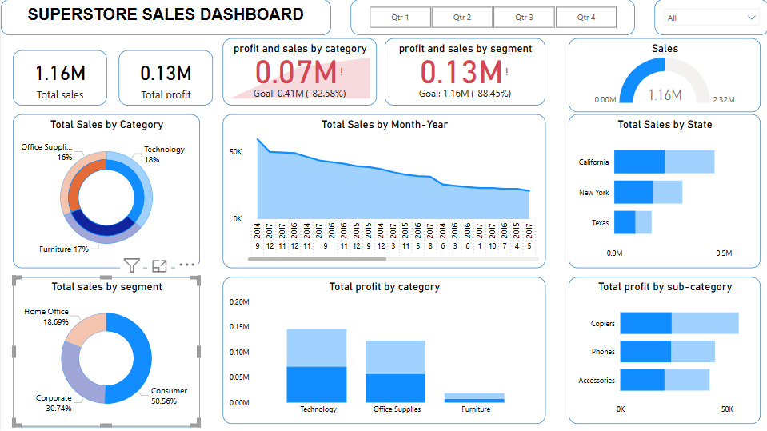
4. Consumer Segment Dominates Revenue:
- Contributes over 50% of total sales.

