Slide 1
Healthcare Insurance Analytics Platform
Capstone Project Presentation
Presented by: Rajshree Thapa

Slide 2
Business Problem Statement
Healthcare insurance company wants to improve revenue and customer insights.
Data collected from multiple sources.
Goal is to analyze customer behavior, claims, and policy trends.
Insights help customize insurance offers and improve business strategy.

Slide 3
Architecture & Technology Stack
AWS S3 used for raw and cleaned data storage.
PySpark used for data cleansing and transformation.
Amazon Redshift used for analytics and reporting.
Databricks / EMR used for big data processing.
GitHub used for version control and deployment.

Slide 4
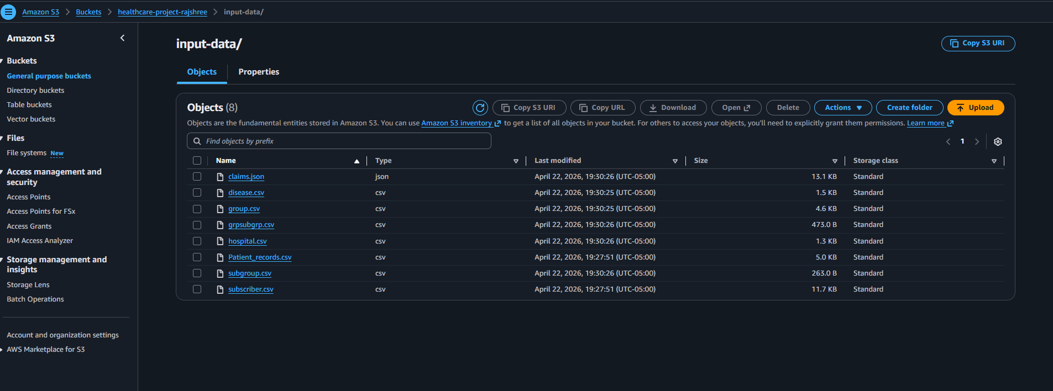
Data Ingestion using AWS S3
Raw input data and cleaned datasets uploaded into S3 buckets.

Slide 5
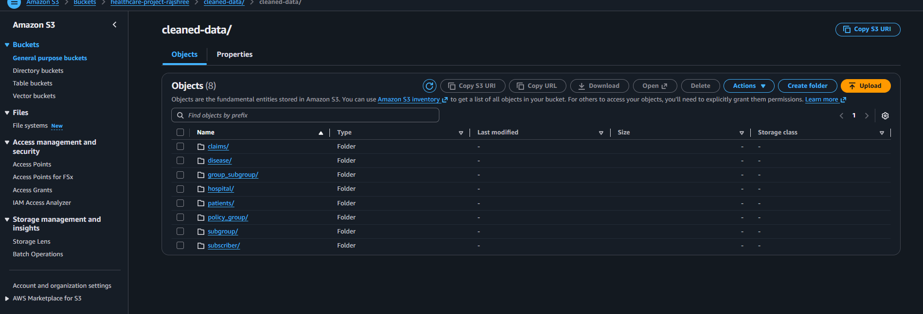
Data Ingestion using AWS S3
Cleaned Data Storage in AWS S3

Slide 6
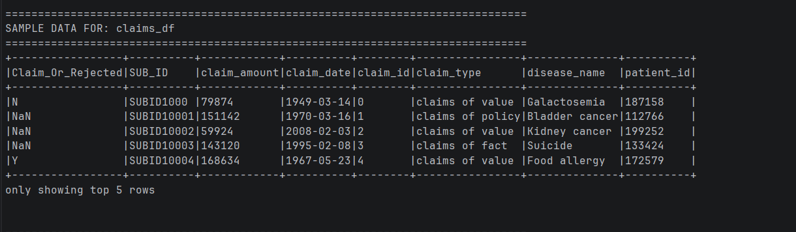
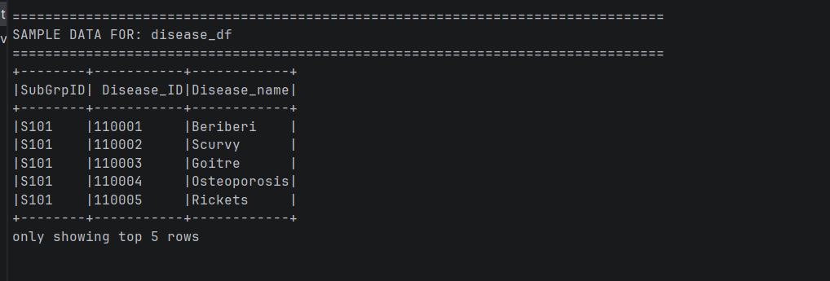
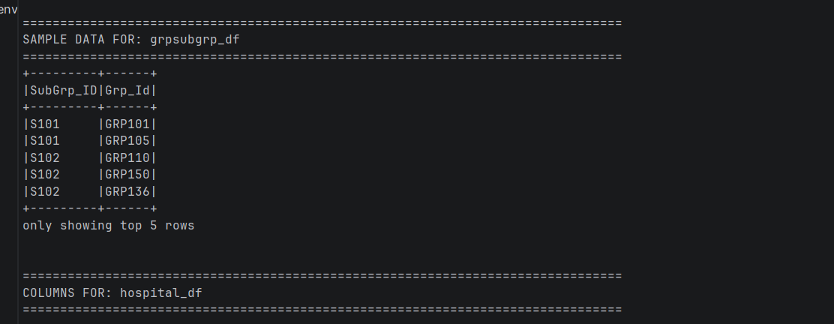
PySpark Data Processing
PySpark used for schema validation, transformations, and data cleansing.

Slide 7
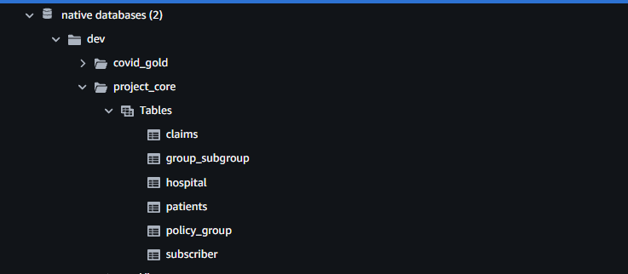
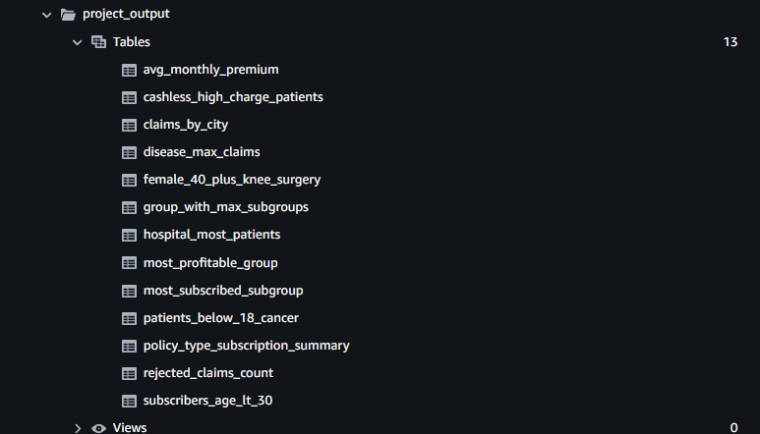
Redshift Data Warehouse
Cleaned datasets loaded into Redshift schemas and output tables created.

Slide 8
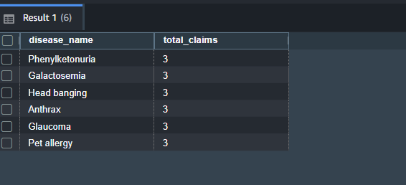
Business Use Case Outputs - Part 1
SQL query outputs for Disease with Maximum Claims.
Notes:
helps insurance company identify high-risk diseases
useful for premium planning and risk analysis

Slide 9
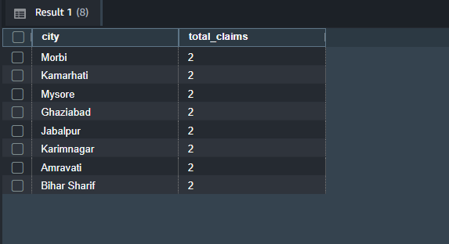
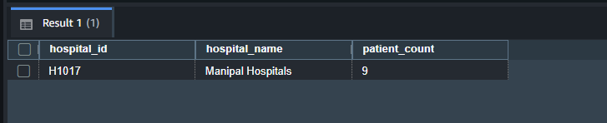
Business Use Case Outputs - Part 2
Insights related to Claims by City and Hospital Serving Most Patients.

Slide 10
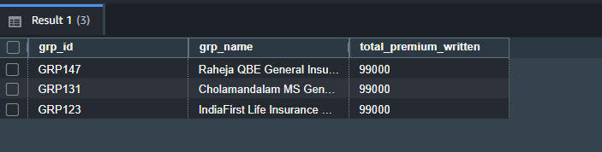
Business Use Case Outputs - Part 3
Results showing most profitable group.

Slide 11
Project Outcomes & Conclusion
Built an end-to-end healthcare analytics pipeline.
Implemented data cleaning and transformation using PySpark.
Generated business insights using Redshift analytical queries.
Solution can help improve customer targeting and increase revenue.

