Slide 1

Analysis Of
Products
By
RAJSINGH
rajbgi377@gmail.com

Slide 2

Project Overview
Objective: Use data analytics to uncover trends in Flipkart’s sales and profit performance.
Data Scope: 38K+ transactions, ₹2M+ sales, across 3 main categories (Technology, Furniture, Office Supplies).
Key Areas of Analysis:
Sales trends over time Discount impact on profit Category and product-level performance
Business Value:
Applies descriptive and diagnostic analytics to support business intelligence and decision-making in e-commerce.

Slide 3

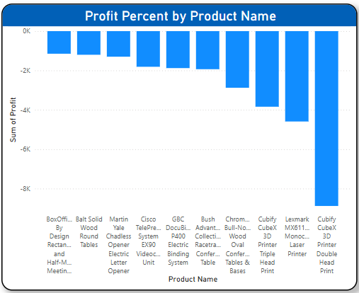
Cut Loss-Making Products :
Observation:
Products like vacuums and surge protectors have profit margins as low as -275%.
Real-Time Use:
Eliminate or renegotiate terms for these products to stop revenue leakage and boost overall profitability.

Slide 4
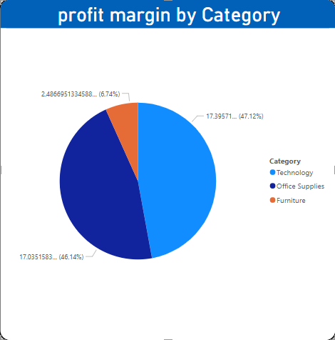
Invest More in Technology Category
Observation:
Technology contributes nearly half of the total profit and maintains strong margins (~47%).
Real-Time Use:
Allocate more marketing and inventory to Technology products for high ROI.

Slide 5
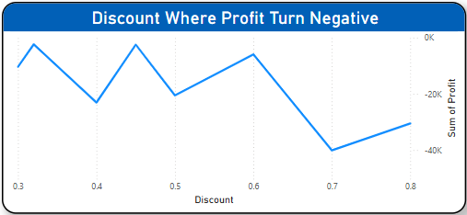
Stop Discounts Beyond 30%
Observation:
Profits sharply drop below zero when discounts exceed 30%, regardless of category .
Real-Time Use:
Cap discounts at 30% max to avoid loss-making orders.

Slide 6

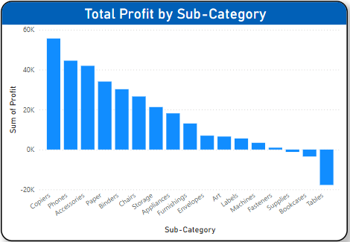
Focus on High-Profit Sub-Categories
Observation:
Sub-categories like Copiers, Phones, Accessories generate the highest profits .
Real-Time Use:
Prioritize these for bundling, upselling, or targeted offers.

Slide 7

Conclusion
This project reveals key insights to improve profitability and efficiency in e-commerce operations.
Key Business Decisions :
Stop loss-making products (up to -27% profit).
Invest in Technology category (47% of total profit).
Cap discounts at 30% to avoid losses.
Apply category-wise discount rules.
Promote high-profit sub-categories like Copiers.
Plan for peak months (March, Sept, Nov).
Bundle high-sales, low-profit items.
Automate pricing based on profit trends.
These actions support smarter pricing, better product focus, and data-driven business growth.

Slide 8


