Slide 1
IBM University Engagement Project Submission
“Exploring the Power of Agentic AI with IBM Granite and LangFlow”

Slide 2

Project Title – Simplify AI – Course Content Simplification Agent
Domain of Project – Education (EdTech / Artificial Intelligence in Education)
Student Name | Recent Passport Photo | Email ID | Mobile number [WhatsApp]
Raj Soni |  | Rajsethsss777@gmail.com | 7355695908
Recommended font style and size:
Font Style: Arial
Font Size (Heading): 28
Font Size (Content): 20

Slide 3
Problem Statement -
Problem Statement: Simplify AI – Course Content Simplification Agent
The Challenge
Students often struggle to understand complex educational content, technical concepts, and programming topics. Traditional study materials may contain difficult language and lengthy explanations, making learning challenging for beginners.
Students also spend considerable time preparing summaries, understanding keywords, creating questions and answers, and making revision notes. There is a need for an AI-powered solution that makes learning easier, faster, and more accessible.
The Objective
Build an AI-powered Course Content Simplification Agent (SimplifyAI) that helps students understand complex study materials in simple language.
The solution aims to:
Content Simplification – Convert complex study material into easy-to-understand explanations.
Step-by-Step Explanation – Explain technical concepts and programming code section by section.
Keyword Extraction – Identify important terms and provide simple meanings.
Summary Generation – Create short summaries of lengthy study materials.
Question & Answer Generation – Generate practice questions and answers for better understanding.
Quick Revision Notes – Prepare short notes to help students revise important concepts.
Beginner-Friendly Learning – Support students with different levels of knowledge.

Slide 4
Proposed Solution -
Proposed Solution: Simplify AI – Course Content Simplification Agent
The proposed solution is Simplify AI, an educational assistant designed to make complex study materials easier for students to understand. It helps learners simplify educational text, programming concepts, and technical topics into clear and beginner-friendly explanations.
The system allows users to paste educational content or code and select their preferred learning level: Beginner, Intermediate, or Expert. It then organizes the content into useful learning formats.
Key Features
Content Simplification: Converts complex educational content into simple and easy-to-understand language.
Step-by-Step Explanation: Breaks down technical topics and programming concepts into clear steps.
Keyword Extraction: Identifies important terms and provides their meanings.
Summary Generation: Creates short summaries to help students revise topics quickly.
Question & Answer Generation: Provides practice questions and answers based on the provided content.
Quick Revision Notes: Creates concise notes for exam preparation and revision.
The browser-based application is developed using HTML, CSS, and JavaScript. A separate practical demonstration was performed using IBM watsonx.ai Prompt Lab with the Meta Llama 3.3 70B Instruct model to generate simplified explanations, keywords, summaries, questions, and revision notes.
Overall, SimplifyAI aims to make learning easier, save students' study time, and support effective self-learning through organized and beginner-friendly educational content.

Slide 5
Technology Used -
HTML5 – Used to create the structure of the Simplify AI web application.
CSS3 – Used to design an attractive, clean, and user-friendly interface.
JavaScript – Used to handle user input, content processing, output generation, and interactive features.
IBM watsonx.ai – Used for the practical AI demonstration through Prompt Lab.
Meta Llama 3.3 70B Instruct – Used in IBM watsonx.ai Prompt Lab to generate simplified explanations, important keywords, summaries, questions and answers, and revision notes.
Visual Studio Code (VS Code) – Used for project development and code editing.
Web Browser – Used to run and access the application locally.

Slide 6
Application Components Used -
1) User Input Component – Allows students to paste educational text or programming code into the application.
2) Learning Level Selection – Allows users to select Beginner, Intermediate, or Expert level according to their knowledge.
3) Content Processing Component – Processes the entered content using the application's JavaScript-based rule engine.
4) Output Generation Component – Displays different learning outputs, including simplified explanations, keywords, summaries, Q&A, and revision notes.
5) Copy Component – Allows users to copy generated content for study and revision.
6) Clear/Reset Component – Allows users to clear the input and start a new learning session.
7) IBM watsonx.ai Prompt Lab (Separate AI Demonstration) – Used with Meta Llama 3.3 70B Instruct to demonstrate AI-powered educational content simplification.

Slide 7
Simplify AI Application Workflow
1. Student Input
Paste educational text or programming code.
↓
2. Select Learning Level
Beginner / Intermediate / Expert
↓
3. JavaScript Content Processing
Process the entered content using predefined rules.
↓
4. Generate Learning Outputs
Explanation • Keywords • Summary • Q&A • Notes
↓
5. Display, Copy & Reset
View the generated outputs, copy useful content, or reset the application.

Slide 8
Architecture Blueprint – Simplify AI
Simplify AI follows a simple browser-based application architecture consisting of the following layers:
1. User Interface Layer
HTML5 and CSS3
Text input area
Learning level selection
Output tabs and action buttons
2. Application Logic Layer
JavaScript-based processing
Content analysis using predefined rules
Learning-level-based output generation
3. Output Generation Layer
Simplified Explanation
Important Keywords
Short Summary
Questions and Answers
Quick Revision Notes
4. User Interaction Layer
Copy generated content
Clear input
Reset the application
5. AI Demonstration Layer (Separate)
IBM watsonx.ai Prompt Lab
Meta Llama 3.3 70B Instruct
AI-generated educational explanations and study materials

Slide 9

Role of AI in the Solution – Simplify AI
Artificial Intelligence helps Simplify AI transform complex educational content into simple and understandable learning materials. It supports students by generating structured explanations and study resources.
The system provides different learning outputs, including simplified explanations, important keywords, short summaries, questions and answers, and quick revision notes.
Students can select their learning level—Beginner, Intermediate, or Expert—to get content according to their understanding.
The application uses JavaScript-based predefined rules to process the entered content and generate learning outputs. A separate practical demonstration using IBM watsonx.ai Prompt Lab with Meta Llama 3.3 70B Instruct shows how AI can further support educational content simplification.
This approach helps students understand difficult topics, save study time, and prepare more effectively for examinations.
Overall, Simplify AI aims to make learning easier, more accessible, and student-friendly through intelligent educational assistance.

Slide 10
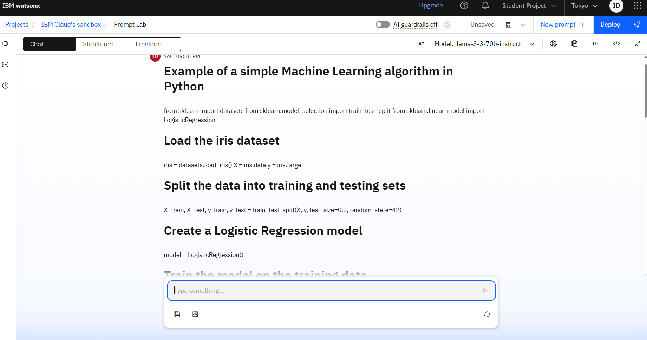
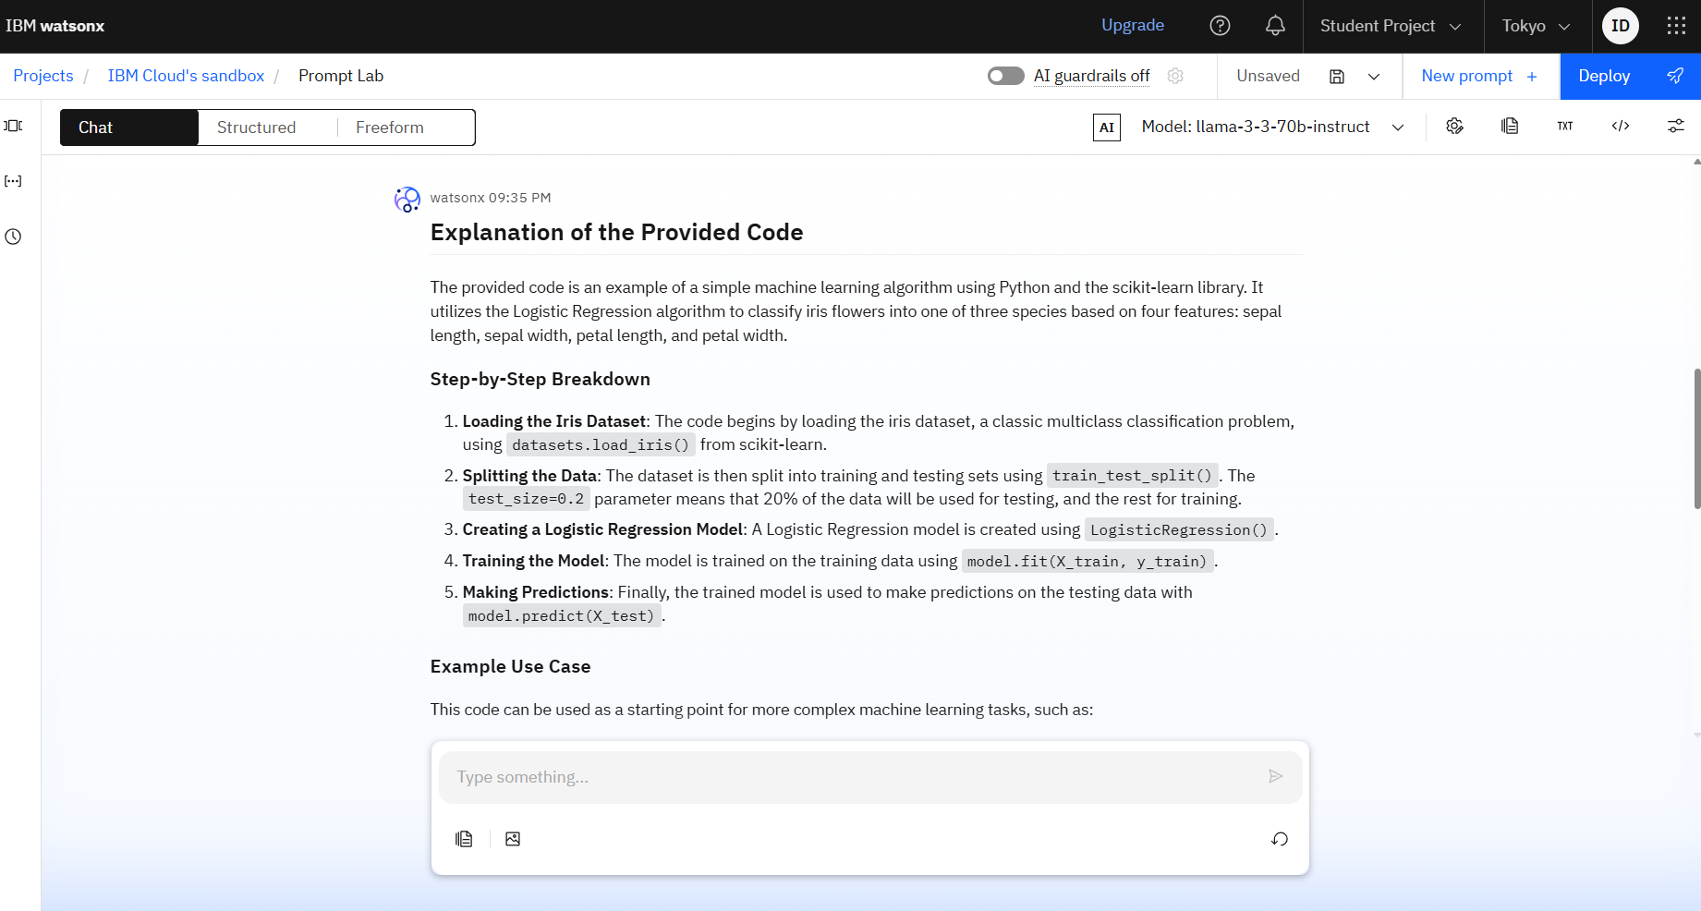
Token Usage
11,761 token are used
Before Prompt
After the Prompt
·
·
·

Slide 11
Novelty and Uniqueness – SimplifyAI
Simplify AI stands out by combining multiple learning-support features with a separate AI-powered practical demonstration.
Multi-Level Learning – Offers Beginner, Intermediate, and Expert levels to support students with different understanding levels.
Multiple Learning Outputs – Provides simplified explanations, important keywords, summaries, Questions & Answers, and quick revision notes in one application.
Beginner-Friendly Interface – Uses a simple and easy-to-use interface for students.
Time-Saving Learning – Helps students understand complex educational topics and Python code more easily.
Interactive Features – Includes copy, clear, reset, and output tabs for a better user experience.
IBM watsonx.ai Demonstration – Demonstrates AI-powered code explanation using Meta Llama 3.3 70B Instruct through IBM watsonx.ai Prompt Lab.
Practical Educational Focus – Supports self-learning and helps BCA students revise technical concepts effectively.
This makes Simplify AI a student-friendly learning assistant, designed to make complex educational content easier to understand.

Slide 12
Git Hub Link
Rajsoni0152/Simplify-AI: SimplifyAI – Course Content Simplification Agent | A student-friendly educational tool that simplifies complex study materials and Python code into explanations, keywords, summaries, Q&A, and revision notes.
·
·
·

Slide 13
Future Scope – Additional Enhancements
1. Integration with Educational Platforms & Learning Devices
Simplify AI can be integrated with online learning platforms and digital study devices to access educational materials, track learning progress, and provide personalized study suggestions. This will help students manage their learning activities more effectively.
2. AI-Powered Voice Assistant & Multilingual Support
Enhancing SimplifyAI with a voice-enabled assistant and multiple language options will improve accessibility. Students will be able to ask questions through voice and receive explanations in English, Hindi, and other regional languages, making learning easier for diverse users.
·
·
·

Slide 14
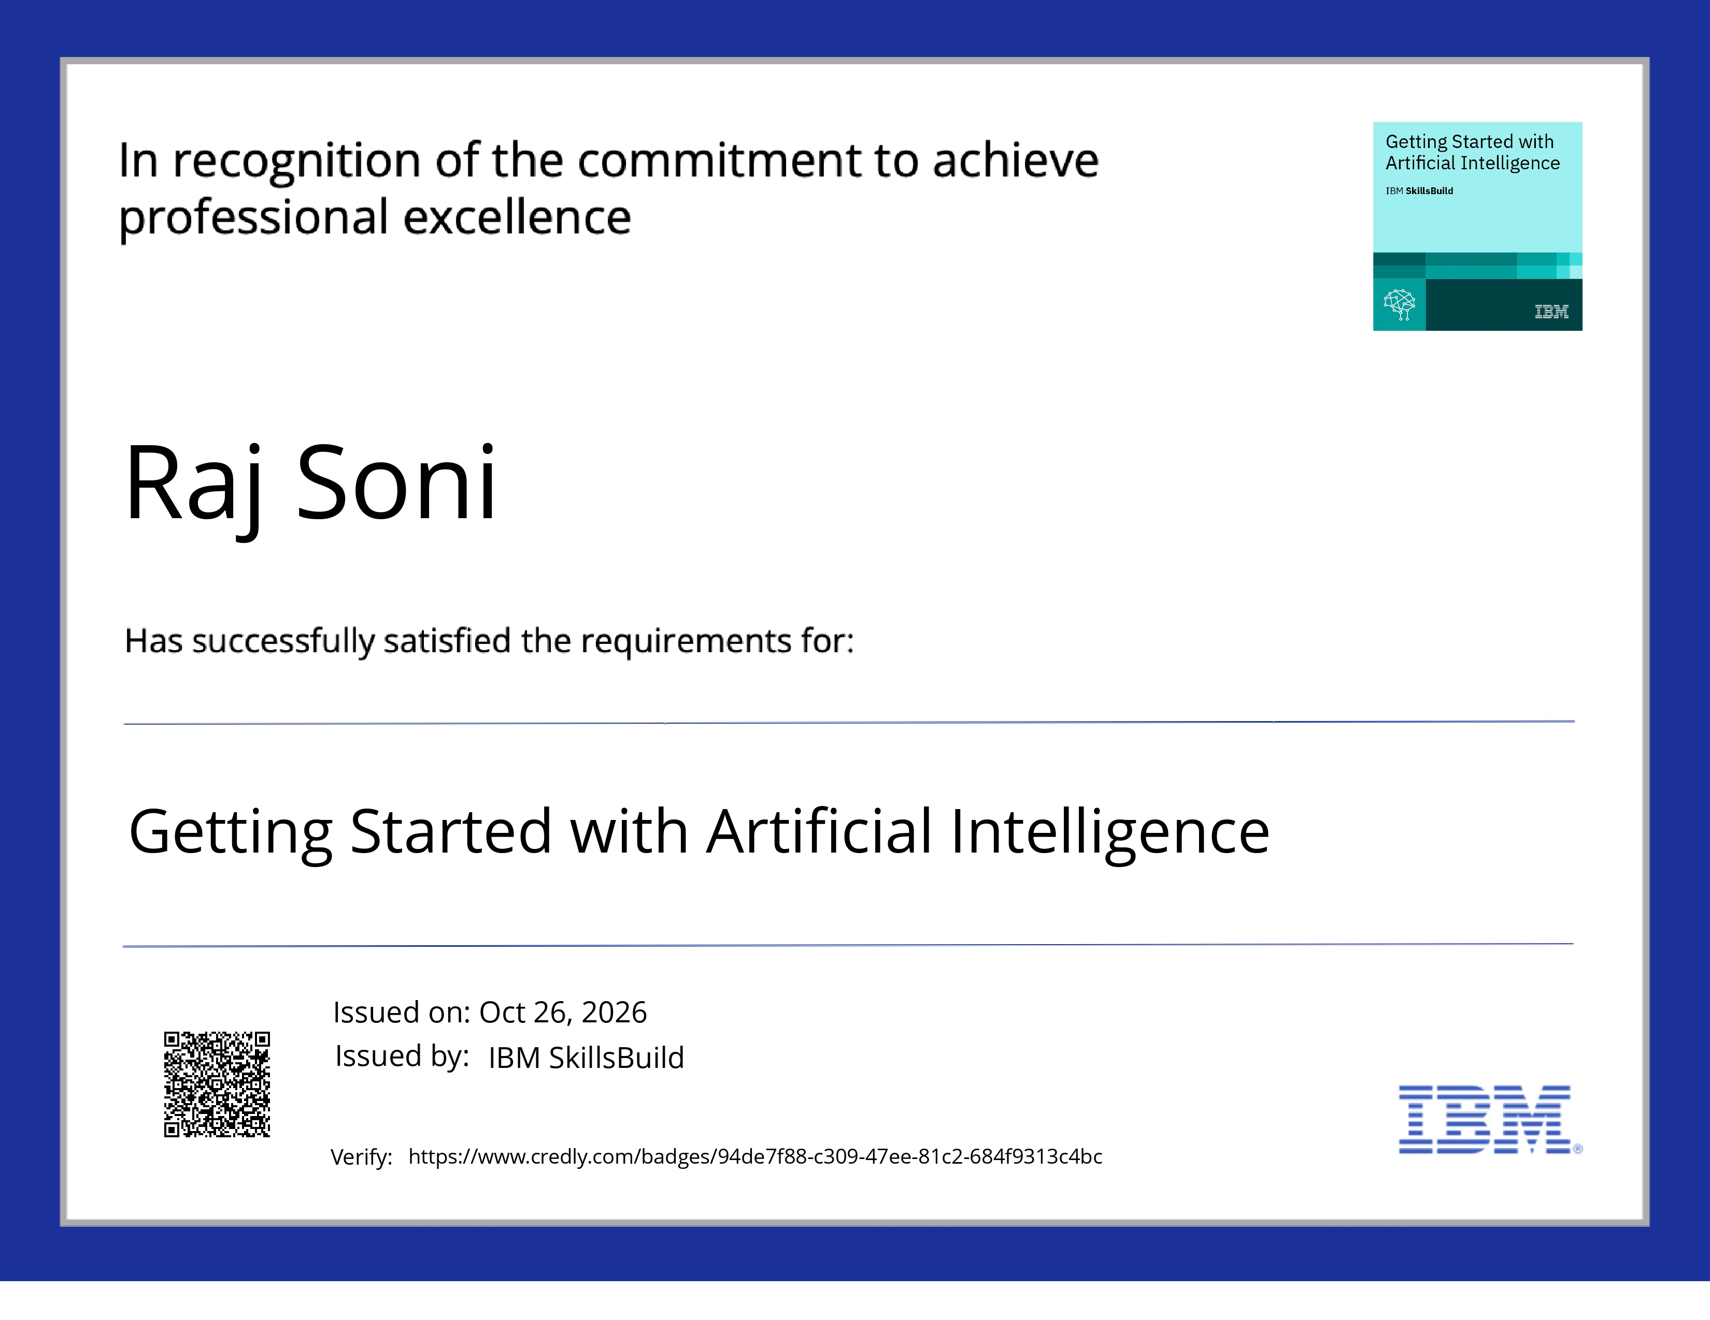
Certificates Earned:
Please add your credly certificate

Slide 15

Certificates Earned:​
Add your IBM BOB Certificate

Slide 16


