Slide 1

Basic Details of the Team and Problem Statement
Ministry/Organization: AICTE, MIC-Student Innovation
PS Code: SM971
Problem Statement Title : Student Innovation - Work clothing that has sensors embedded in it to securely transmit data to managers about hazardous conditions and the worker’s physical conditions improving overall safety.
Team Name: Iconic Zippy’s
Team Leader Name: Sundar Raj A
Institute Code (AISHE): 1-8932081
Institute Name : Karpagam Institute Of Technology, Coimbatore.
Theme Name: Disaster Management

Slide 2
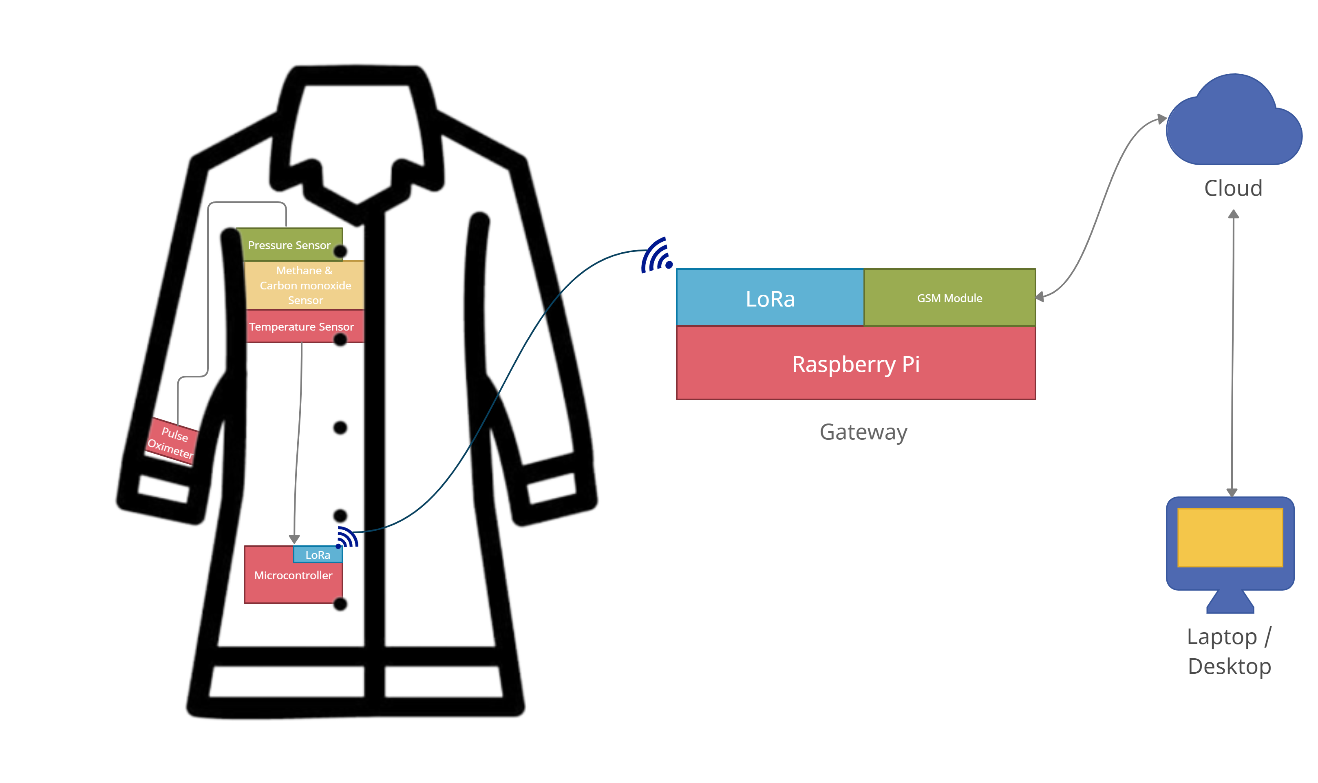
Idea/Approach Details
PROTOTYPE DIAGRAM:
Describe your idea/Solution/Prototype here:
Our ultimate aim is to develop an IoT based smart suit embedded with sensors ensuring safety of human who works under disaster prone area.
Here we have designed a suit embedded with different sensors such as BMP180 , MQ2 ,MQ9 and MAX30100 for sensing Pressure and Temperature , Methane, inflammable gases and to sense pulse rate and oxygen level of human body respectively.
Each suit with LoRa module together with sensors and microcontroller(Atmega328p) forms a node powered with a rechargeable battery source .
The data from each node is transmitted to a gateway which comprises of LoRa module , microprocessor (Raspberry Pi) and GSM module(SIM900) . The node and gateway together forms a Wide Area Network which is powered by solar or battery source.
Further the data from the gateway is transmitted to the cloud where it is stored and there the manager can monitor the employees physical conditions .
When the live data is found to exceed or deceed from the loaded normal threshold values , the manager is alerted .In addition to that employees are alerted using buzzer. A SOS system is also added which can be used in extreme emergency .
Describe your Technology stack here:
Base: IoT using LoRa Network.
Gateway creation using Raspberry Pi
Collection of Data via Cloud
Web application : Front end: HTML, CSS, JavaScript, jQuery
Back end Database : MySQL
Framework: Django, Bootstrap

Slide 3
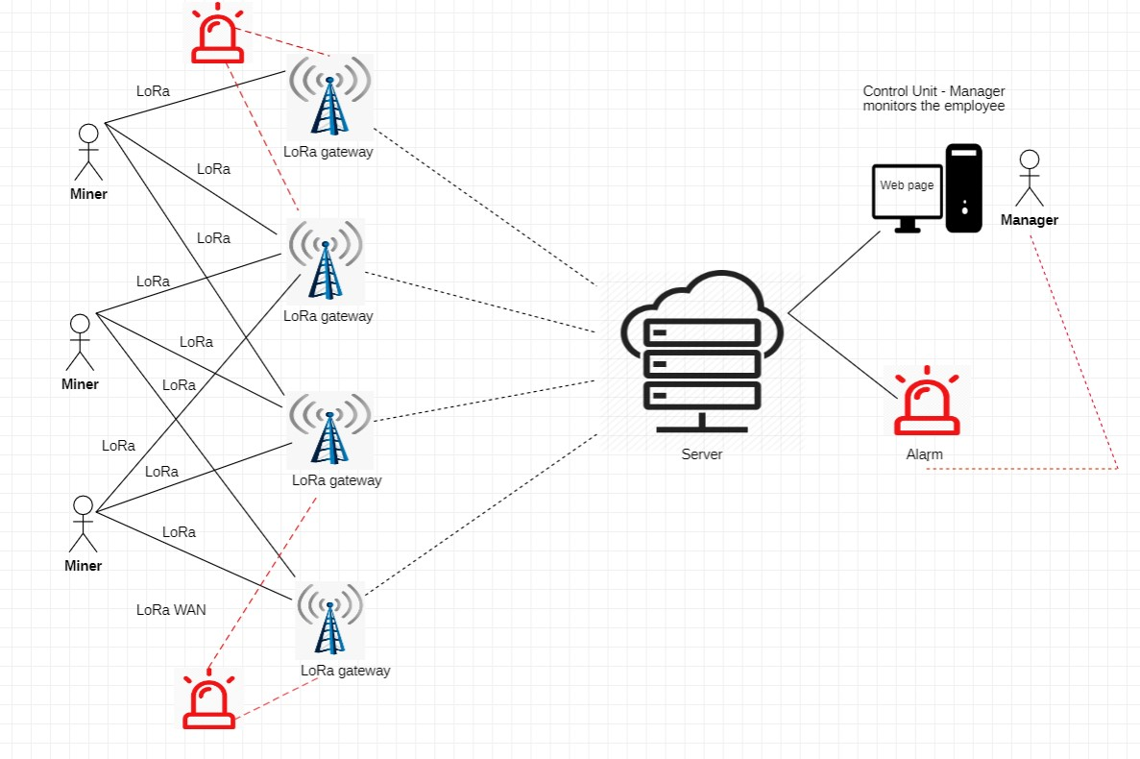
Idea/Approach Details
Describe your Use Cases here:
The data collected via LoRa module and microcontroller in suit to LoRa gateway forms Wide Area Network . Then the live data is further collected and processed in cloud that is viewed by the manager via webpage .
In case of emergency , an additional alarm system is also provided around the gateway and to the manager.
Describe your Dependencies / Show stopper here
DEPENDENCIES: Our smart suit depends upon battery source and cellular network.

Slide 4
Team Member Details
Team Leader Name: SUNDAR RAJ . A
Branch : BE Stream : ECE Year : III
Team Member 1 Name: ATHULYA.A.S
Branch : BE Stream : ECE Year : III
Team Member 2 Name: MATHAN RAJ.A.R
Branch : BE Stream : CSE Year : III
Team Member 3 Name: MITHUN KUMAR.N
Branch : BE Stream : ECE Year : III
Team Member 4 Name: NITHIYA SRI.R
Branch : BE Stream : ECE Year : III
Team Member 5 Name: SUSHVIN.M
Branch : BE Stream : CSE Year : III
Team Mentor 1 Name: JENITON.S
Category : Expertise : Domain Experience :
Team Mentor 2 Name: RAGUPATHI.N
Category : Expertise : Domain Experience :

