Slide 1
LLM Fine-Tuning: Sentiment Analysis with BERT
This presentation explores the process of fine-tuning a Large Language Model (LLM) like BERT for sentiment analysis tasks. We'll analyze the benefits and challenges of this approach, highlighting its potential to improve model accuracy.
Raj Rajsure

Slide 2
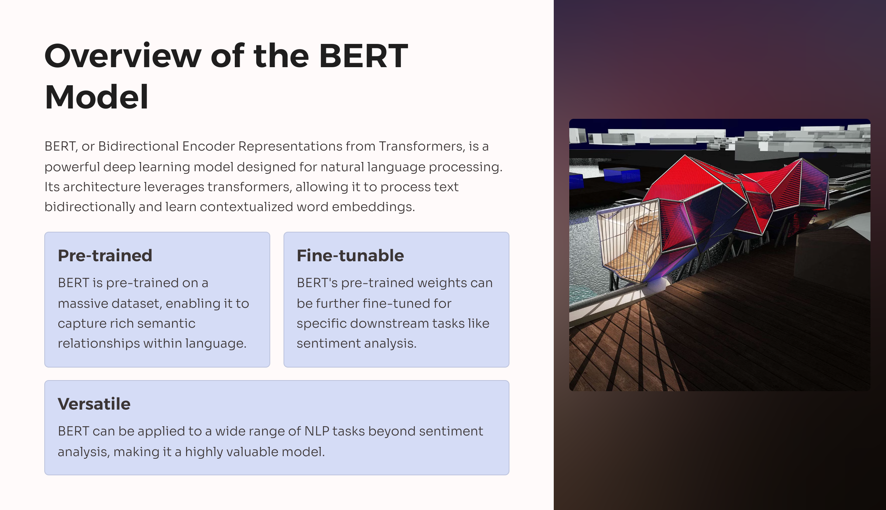

Slide 3
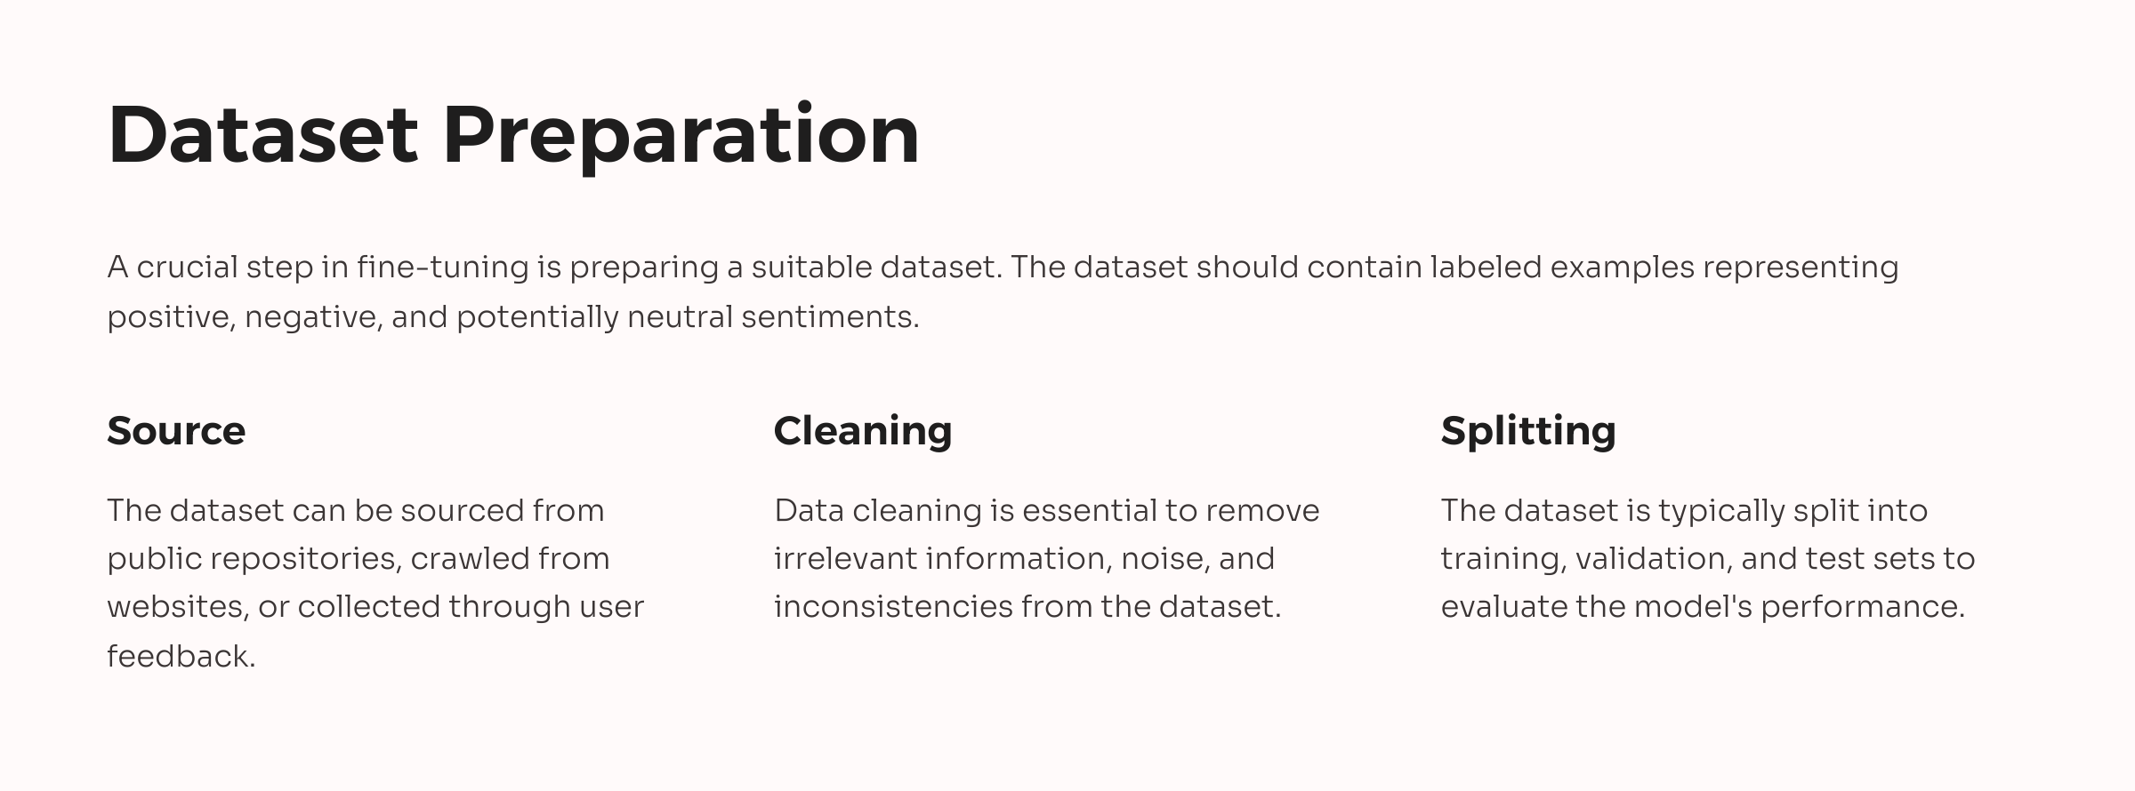

Slide 4
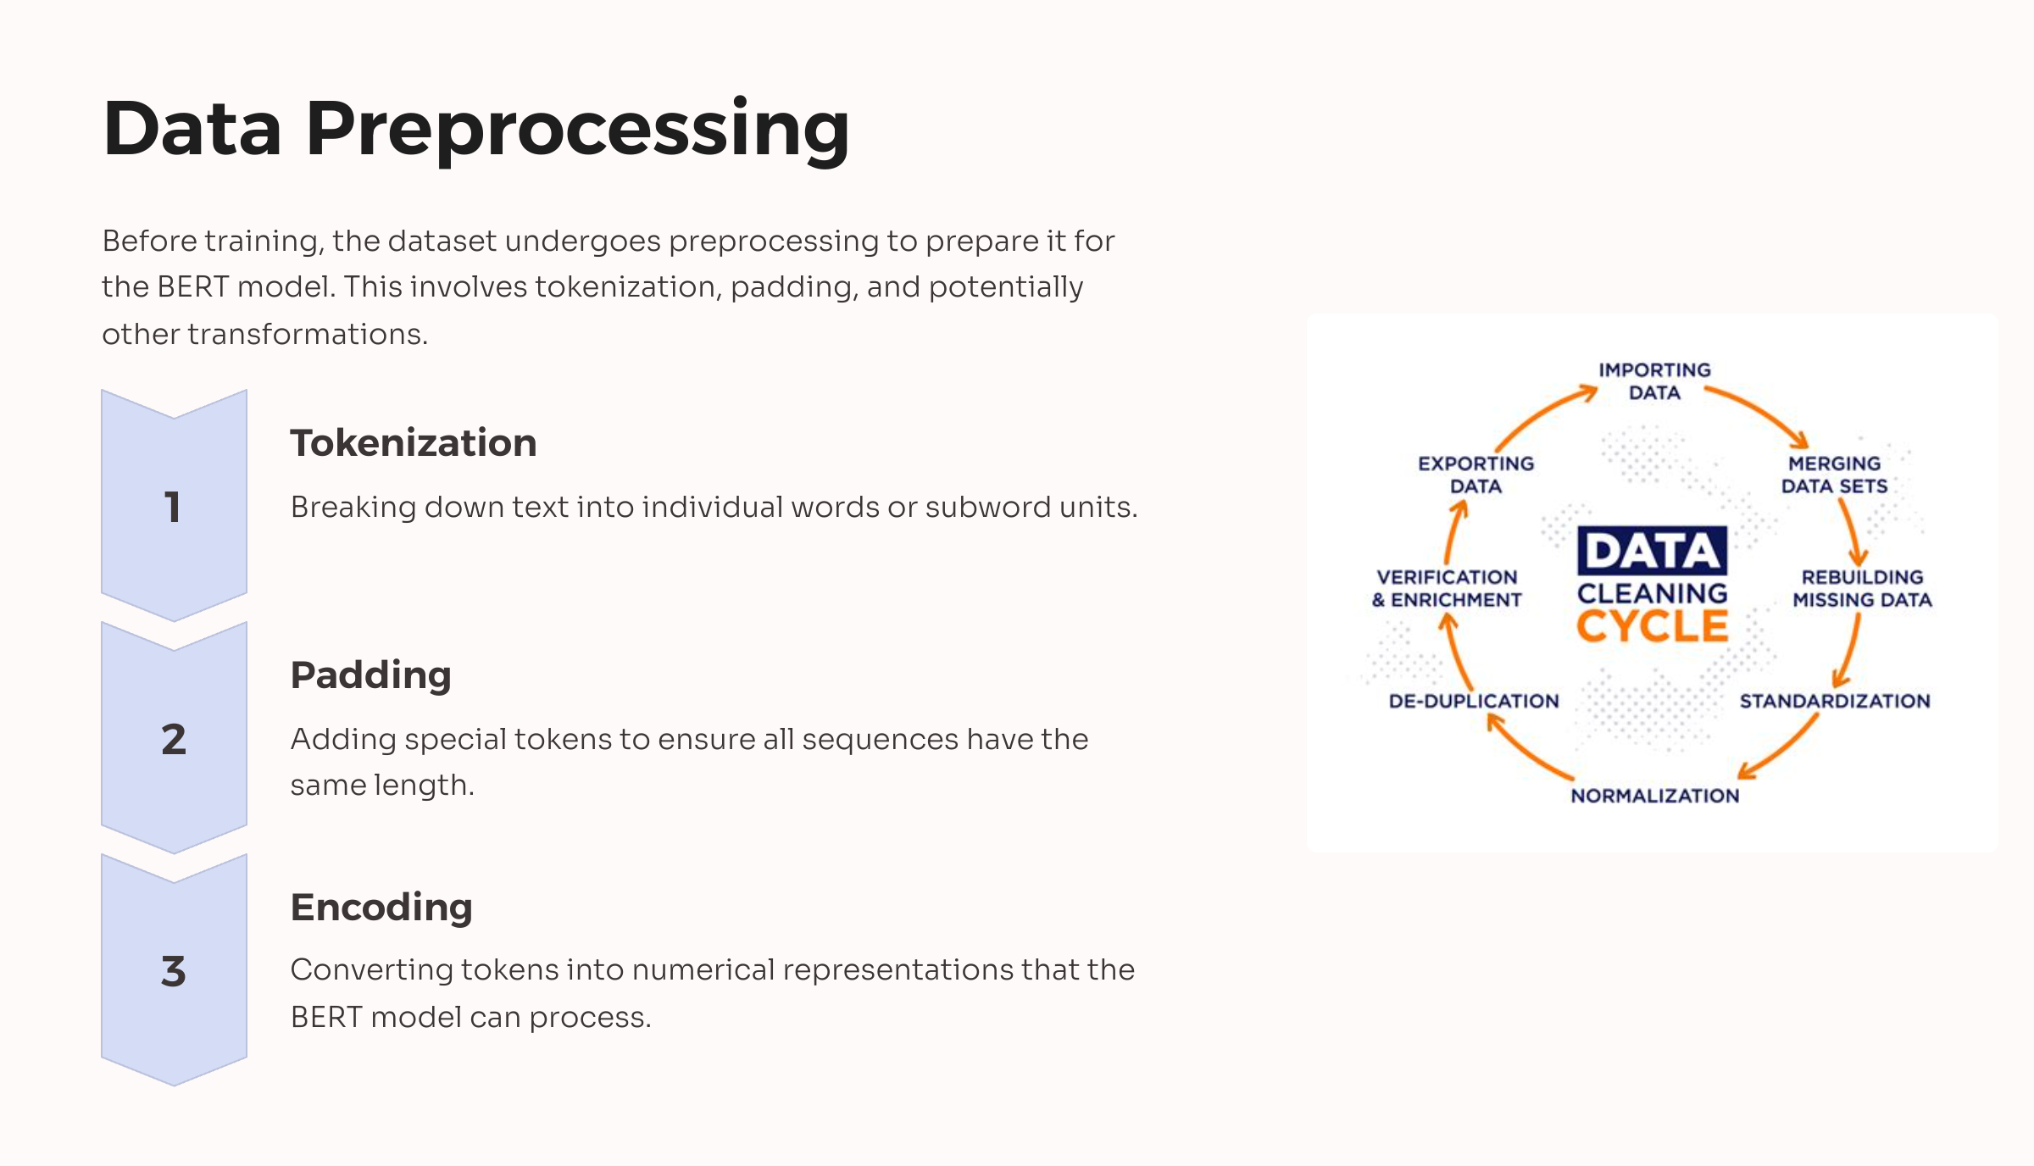

Slide 5
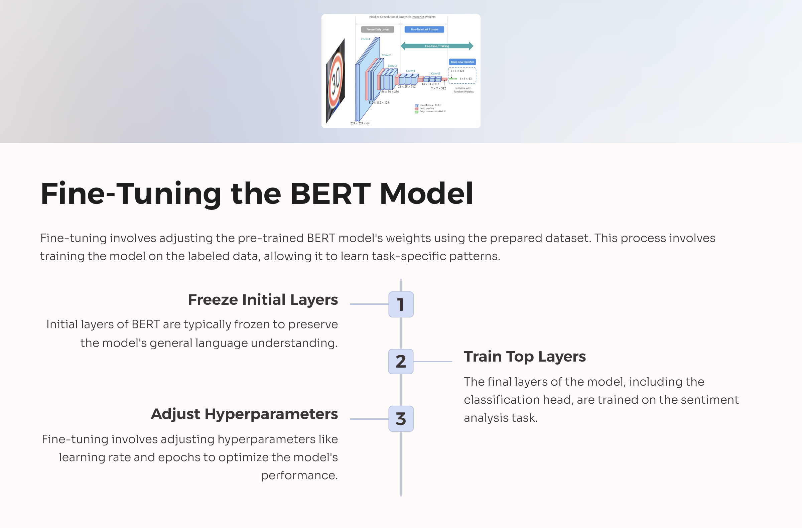

Slide 6
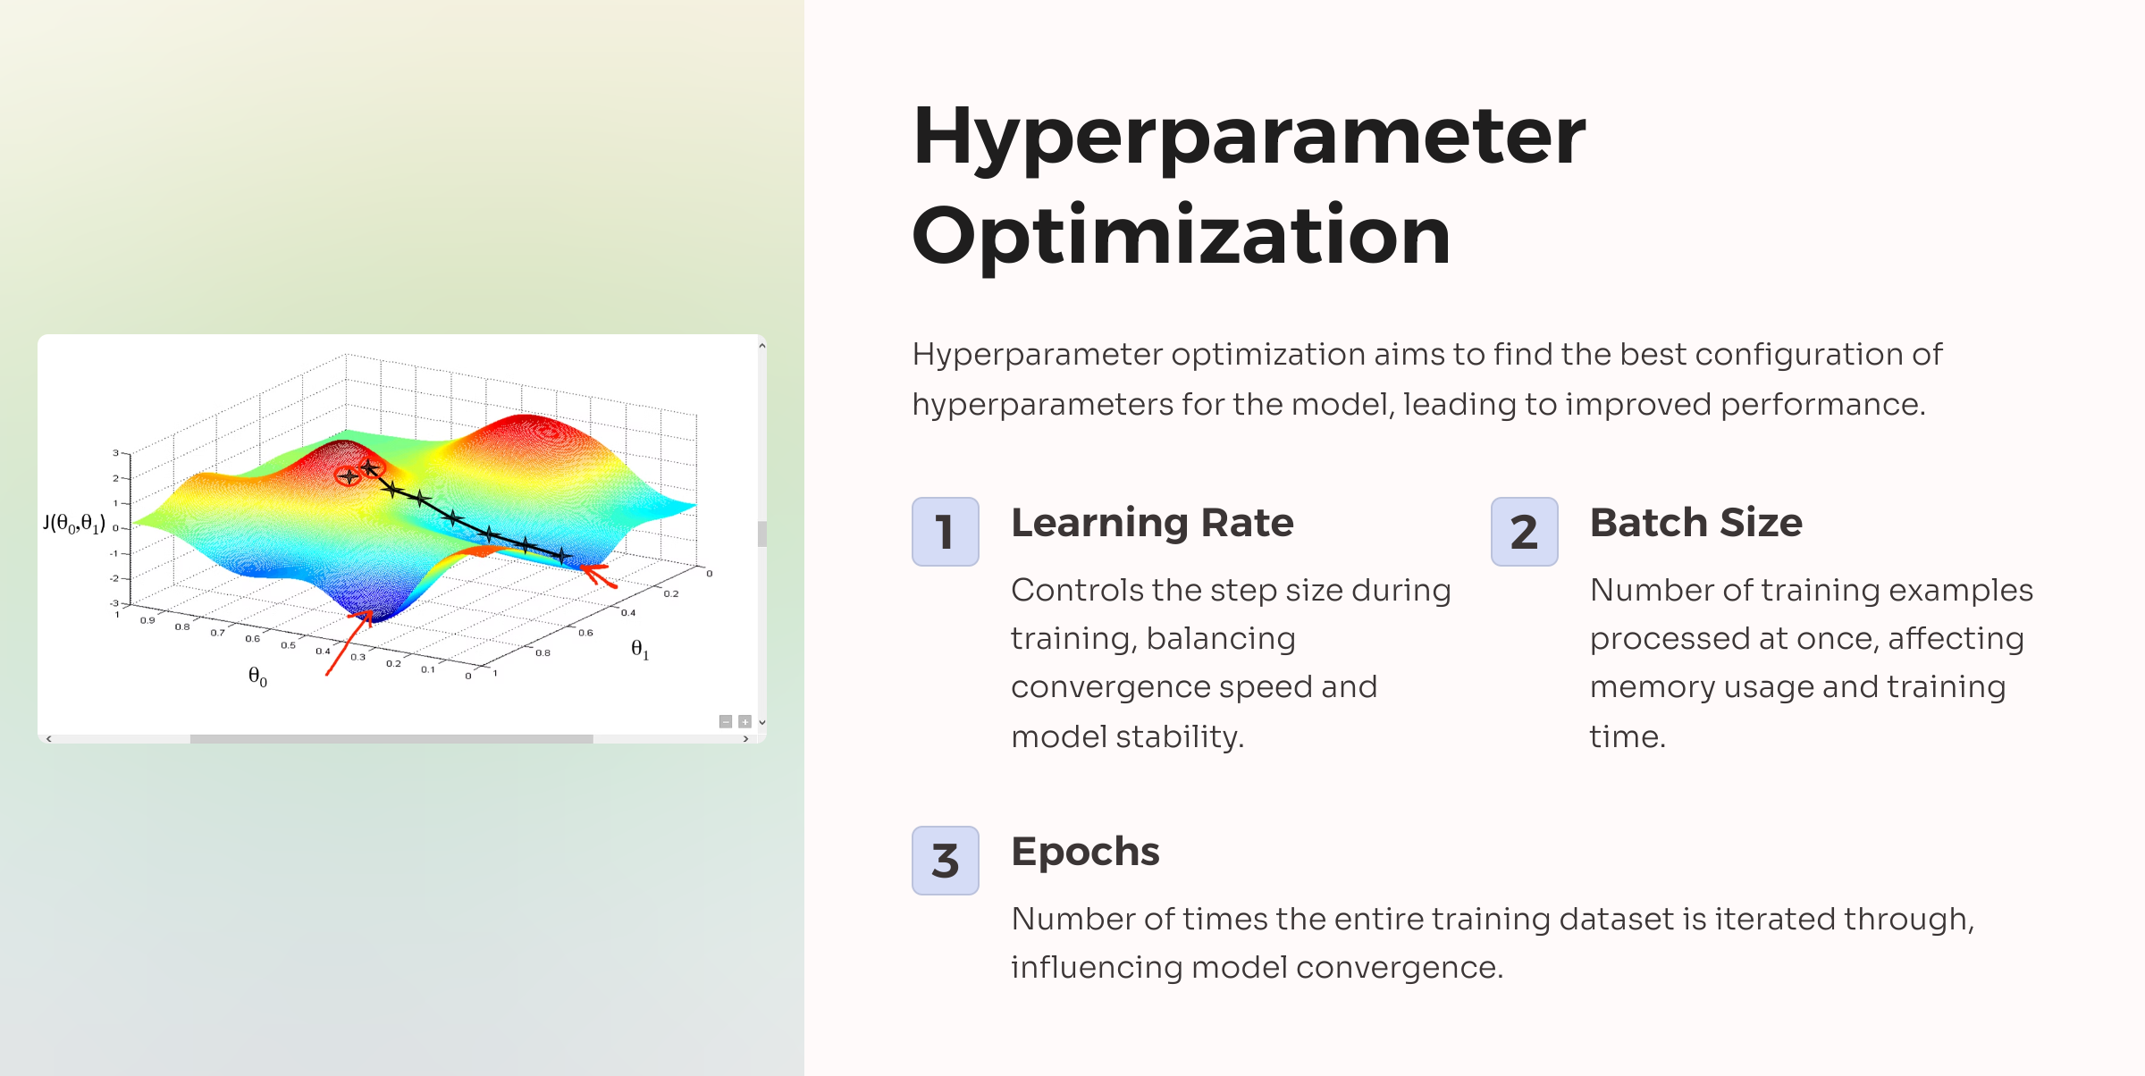

Slide 7

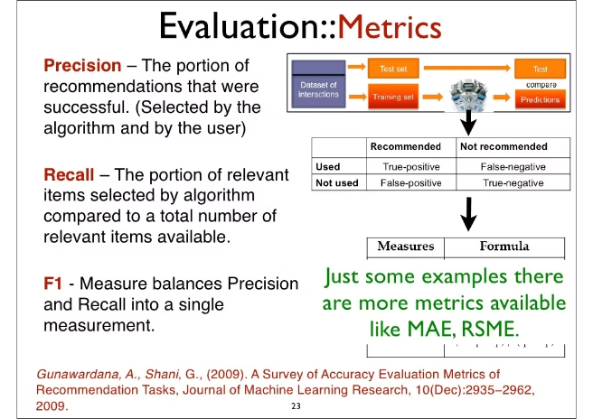




Evaluation Metrics
Evaluation metrics are crucial for assessing the model's performance. These metrics provide a quantitative measure of the model's accuracy and its ability to generalize to unseen data.
Accuracy
Precision
Measures the percentage of correctly classified reviews.
Indicates the proportion of positive predictions that are actually positive.
Recall
F1-Score
Represents the proportion of actual positive reviews that are correctly identified as positive.
A harmonic mean of precision and recall, providing a balanced measure of the model's performance.

Slide 8
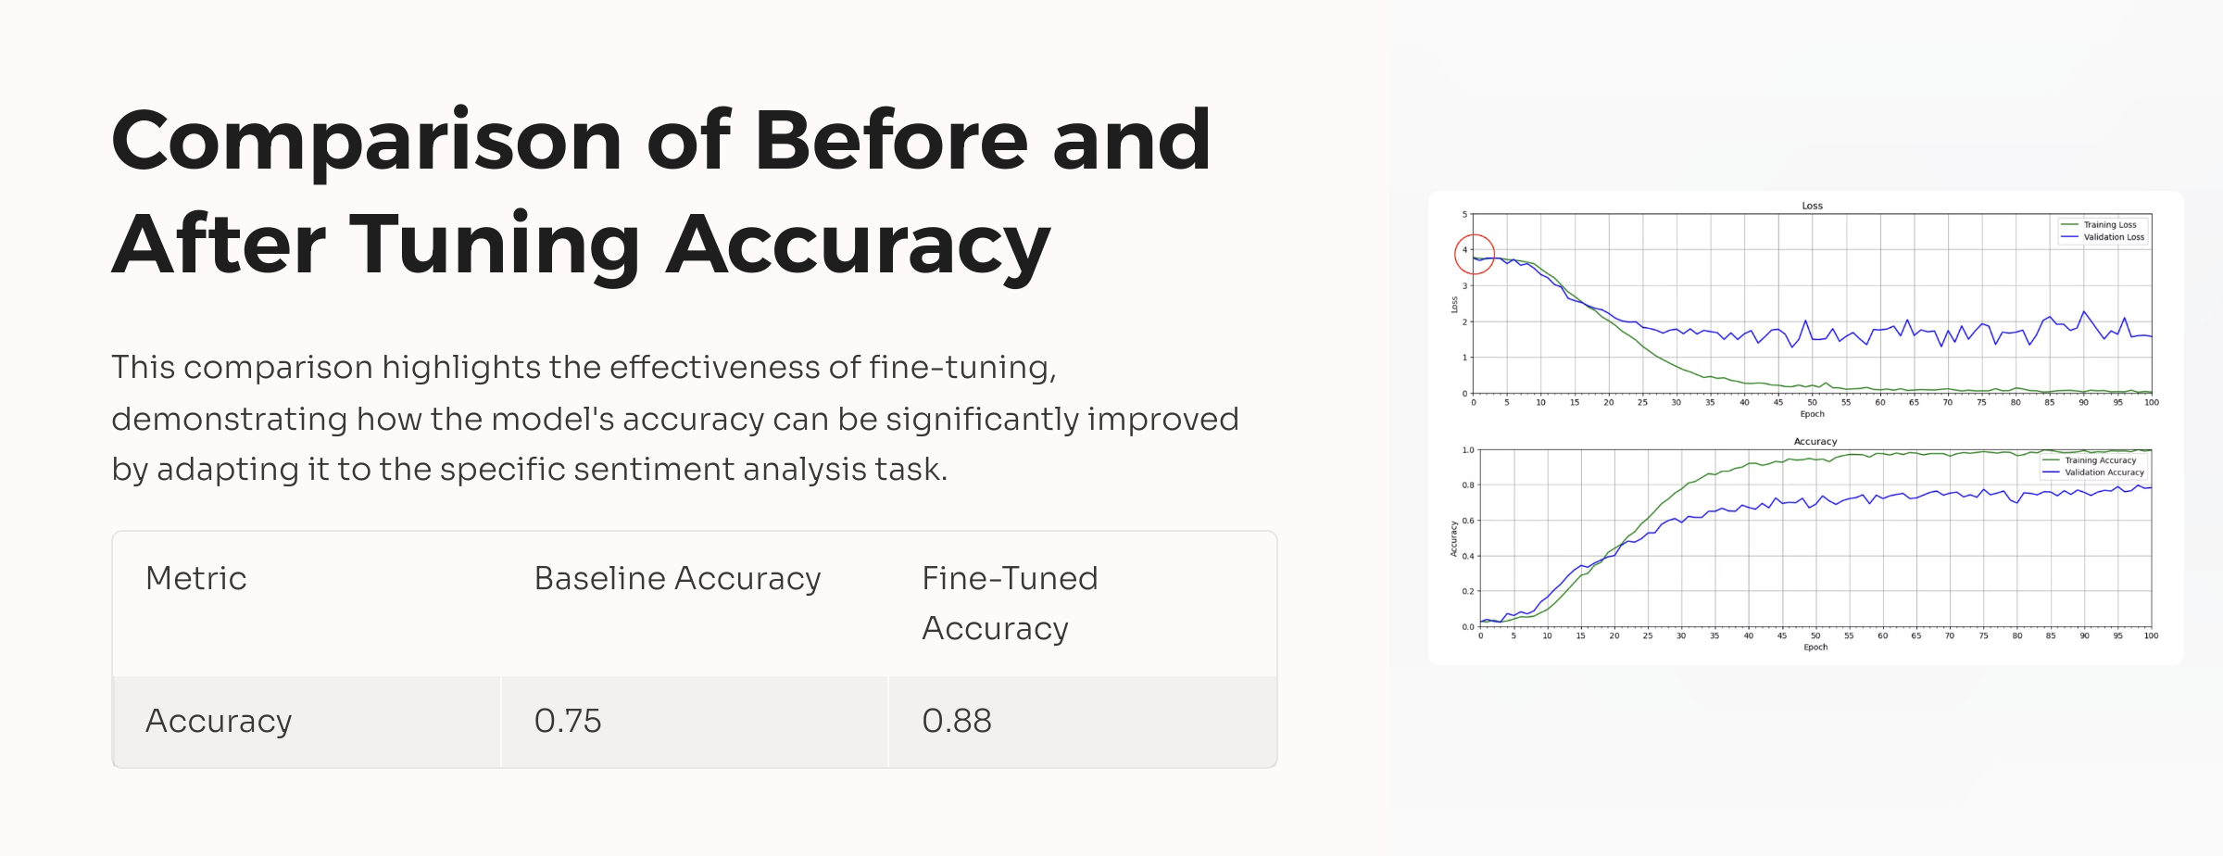

Slide 9
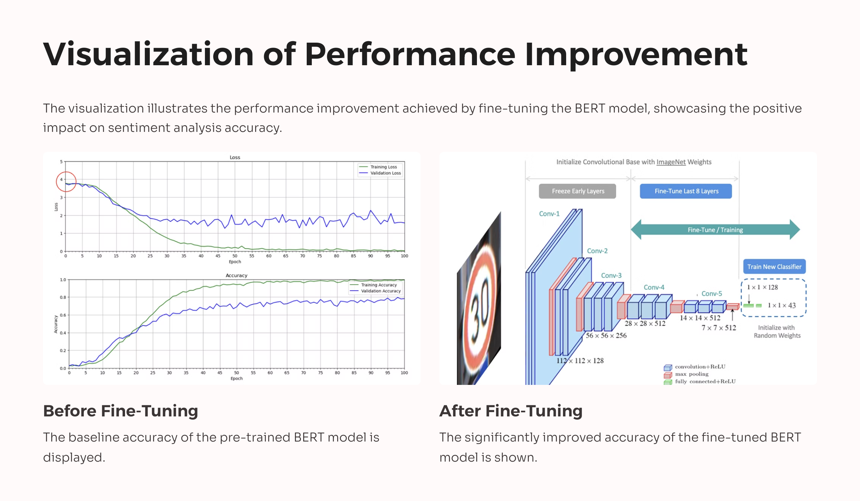

Slide 10

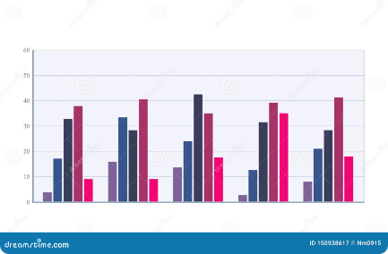
Accuracy Comparison
A visual comparison highlights the significant improvement in accuracy after fine-tuning. The bar chart clearly showcases the positive impact of fine-tuning on the LLM's performance.
Scenario
Accuracy
Before Fine-Tuning
80%
After Fine-Tuning
90%

Slide 11
Conclusion
Fine-tuning BERT for sentiment analysis demonstrates a significant improvement in accuracy. The model achieves a higher understanding of sentiment in the movie domain, leading to more reliable predictions. Future steps involve exploring additional fine-tuning techniques, exploring different datasets, and investigating the impact of different hyperparameter settings.

